Slide 1

International Mindedness and Intercultural Awareness in Pakistani College and University Teachers
Zehra Habib
Alliance for International Education World Conference
Doha, Qatar
October 20-22, 2012

Slide 2
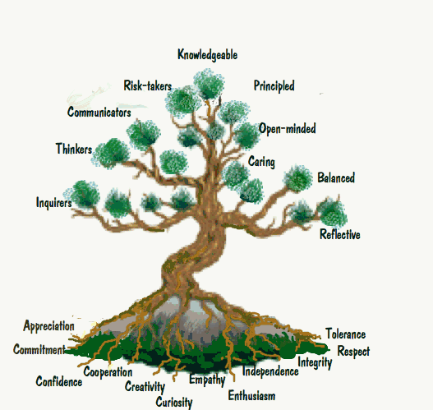
Characteristics of an Internationally minded person?

Slide 3
Theoretical Framework
Some components of international mindedness are:
- Interest in the world
- Open attitudes towards all
- Tolerance
- Acknowledgment of the earth’s environment for the
welfare of everyone (Haywood, 2007)
Internationally minded persons:
- Have an ecological world view
- Support universal human rights
- Believe in the interdependence of
humanity
- Have loyalties that extend beyond borders
(Hett, 1993)

Slide 4
Theoretical Framework
International mindedness is:
- Integral to achieving tolerance, peace, and
global cooperation (Skelton, Wigford, Harper,
& Reeves, 2002).
International mindedness and multicultural proficiency are complementary to each other. These frameworks prepare students to value diversity and respect all peoples of the world (Vooren & Lindsey, 2012).

Slide 5
Purpose of the Study (Phase One)
To examine college and university teachers’ and students awareness of and attitudes towards international mindedness and their willingness for incorporation of the concepts in education.

Slide 6
Research Questions
How aware and receptive are college and university teachers in Pakistan to ‘international mindedness’ and ‘intercultural competence?’
In what ways, (if at all), are they incorporating the concepts in their classrooms?
Are students aware of the concepts and do they find it relevant for teachers to incorporate international mindedness and intercultural awareness in their program of study?

Slide 7
Method and Participants
Open ended questionnaires were sent electronically to teachers and students of two universities and two colleges in November 2009.
22 college and university teachers from three institutions based in two cities of the province of Sindh participated. They taught Business Administration, Marketing, English Literature and Physics.
20 students belonging to the same institutions as the participating teachers were also participants in the study. Their ages ranged from 19-21 years.

Slide 8
Recurrent Themes from Teachers’ Responses
Majority of the teachers were familiar with the concepts, but expressed the view that these are not incorporated in their teaching practice and curriculum.
Measures recommended:
- Curricula reform.
- Building a mindset: teacher education should play a
role.
- Self-change.
- Emphasis on role of policy makers and management.
Very small percentage content with status quo.

Slide 9
Teachers’ Responses

Slide 10
Themes from Students’ Responses
Minimum awareness of concepts.
Curricula reform.
To some extent, multicultural perspectives are incorporated in business schools.
Few said they were content with status quo.

Slide 11
Findings: Students

Slide 12
Phase Two of the Project
A focus group interview was held in September 2012 with ten teachers who had participated in phase one of the project. Participants came from two universities and one college of a city in Sindh.
The aim was to explore changes in pedagogical practices, policy, and curriculum (if any) in the last two and a half years contributing toward international mindedness and intercultural awareness in students. Additionally, to explore participants’ perspectives regarding tools needed for developing international mindedness in students.

Slide 13
Findings
Awareness existed (in fact, it had increased) but was not practically implemented.
Tools: Change in curriculum.
Teacher education programs should focus on international mindedness and inspire change in the mindset of teachers.
Class room environment.
Exchange programs for teachers and students.
Additional factors:
- Ethnic and religious tolerance should first be established
within the country before moving on to wider horizons.
- Because the concepts are not developed as they should in
primary and elementary education in Pakistan, it poses
challenges for teachers at higher levels of education.

Slide 14
Implications for Teacher Education
There is a need for more focused efforts in developing teacher candidates’ understanding of international mindedness and global education (Holden & Hicks, 2007).
The aspiration of raising students awareness to international mindedness and cultural diversity can be fulfilled only if there is a change in teachers’ conceptions of themselves. “Other initiatives are doomed to fail if the primary agents of instruction are incapable of acting as generative agents of change..” (Ball, 2009, p.70).

Slide 15
Next Steps
Study teacher development programs in Pakistan.
Conduct a study of primary and secondary level education to examine if frameworks of international mindedness and intercultural education are being incorporated in the curricula and teaching practices.

Slide 16
More Questions Than Answers?
Is curriculum the most important tool for developing international mindedness in students?
Is change in syllabi more relevant or is self change in teachers more pertinent for incorporation of the framework international mindedness in classrooms?
How can teacher education programs bring about change in the mindset of teachers who are rigid in their beliefs?
Should there be an endeavor to change the mindset of the population within a country and then go beyond? Could it be possible to accomplish both goals simultaneously?

Slide 17
References
Ball, A.F. (2009). Toward a theory of generative change in culturally and linguistically complex classrooms. American Education Research Journal (46)45, 45-72.
Duckworth, R.L., Walker Levy, L., & Levy, J. (2005). Present and future teachers of the world’s children: How internationally-minded are they? Journal of Research in International Education (4), 279-305.
Haywood, T. (2007). A simple typology of international-mindedness and its implications for education. In M. Hayden, J. Levy, & J. Thompson, (Eds.), The Sage Handbook of Research in International Education (pp.79-89). The Cromwell Press.
Hett, E. (1993). The development of an instrument to measure global-mindedness (Doctoral dissertation). University of San Diego, San Diego, CA.

Slide 18
References
Holden, C., & Hicks, D. (2007). Making global connections: The knowledge, understanding and motivation of trainee teachers. Teacher and Teacher Education (23)1, 13-23.
Munro, J. (2007). Learning internationally in a future context. In M. .Hayden, J. Levy, & J. Thompson, (Eds.), The Sage Handbook of Research in International Education (pp.113-127). The Cromwell Press.
Skelton, M. , Wigford, A., Harper, P., & Reeves, G. (2002). Beyond, food, festivals, and flags. Educational Leadership
Vooren, C., & Lindsey, D.B. (2012). Leaders address inequity through a framework of international-mindedness. Journal of Transformative Studies Leadership and Policy Studies (2)1, 25-33.

Slide 19
Thank you
zhabib@masonlive.gmu.edu

