Slide 1
Transformation of cultural and linguistic capital: the struggle to be a ‘good’ student
Yvonne Slough-Kuss
AIE Conference, Mumbai, October 11, 2014
Intercultural Understanding: Reflection, Responsibility and Action

Slide 2
…there are large parts of the world where the ‘IB World School’ is a solitary one [where] an IB education has the possibility of becoming a status symbol and powerful ‘brand’… creating a route for elites to pursue individualistic advantage…
(Bunnell, 2011:173)

Slide 3
…the educational system and its modern nobility only contribute to disguise, and thus legitimize, in a more subtle way the arbitrariness of the distribution of powers and privileges…
(Bourdieu&Passeron, 1990:x)

Slide 4
Theory of Symbolic Capital
(Bourdieu, 1986)

Slide 5
Economic Capital
Transformed
Symbolic Capital
Cultural Capital
Social Capital
(Bourdieu, 1986)

Slide 6
Economic Capital
= Money
Cultural Capital
= Education
Social Capital
= Connections

Slide 7
Economic Capital
Cultural
Capital
Social
Capital

Slide 8
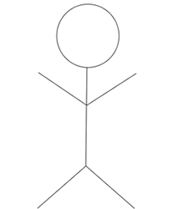
E
Habitus
C
E
C
S
S
E
C
E
E
S
C
C
E
E
S
E
C
S
S
S
C
E
C
S
C
S
E

Slide 9
Equality

Slide 10
Inequality

Slide 11
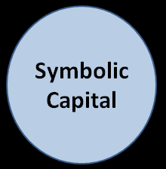
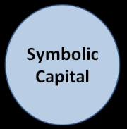
Symbolic Capital

Slide 12
Symbolic Capital
Positioning

Slide 13
Cultural Capital
= Education
?

Slide 14
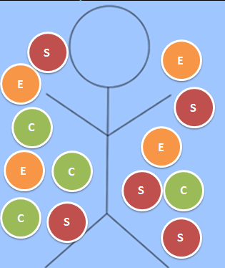
Symbolic Capital
in
= Education =
Network
Degree
Money
out

Slide 15
International schools?

Slide 16
local ‘elite’’
E
E
S
E
E
S
E
E
C
S
C
C
S
E
E

Slide 17
internationally mobile’
E
E
C
C
C
S
C
C
C
S
C
C
S
E
E

Slide 18
Cultural Capital

Slide 19
Cultural Capital
‘Rules of the game’
Linguistic Capital

Slide 20
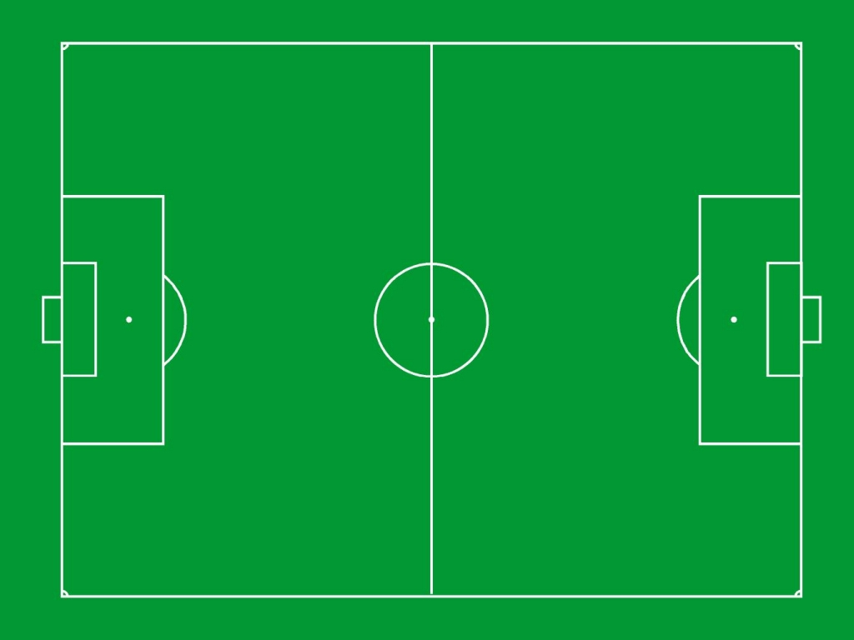
Rules of the game

Slide 21
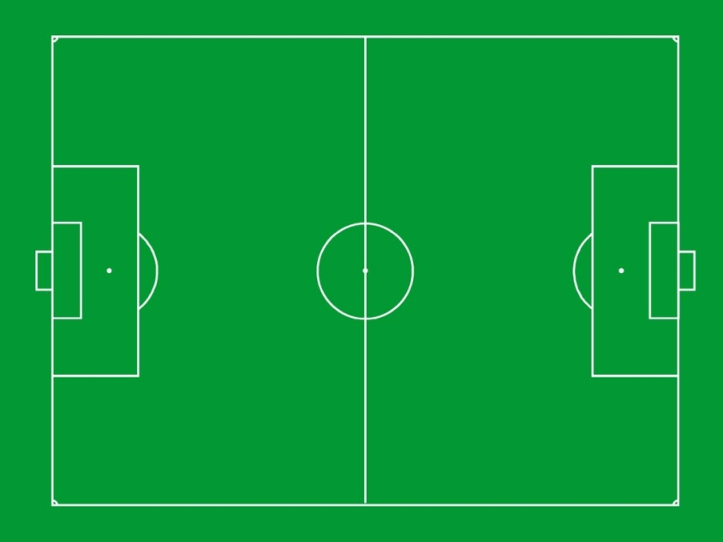
Rules
Rules
Rules
Rules

Slide 22
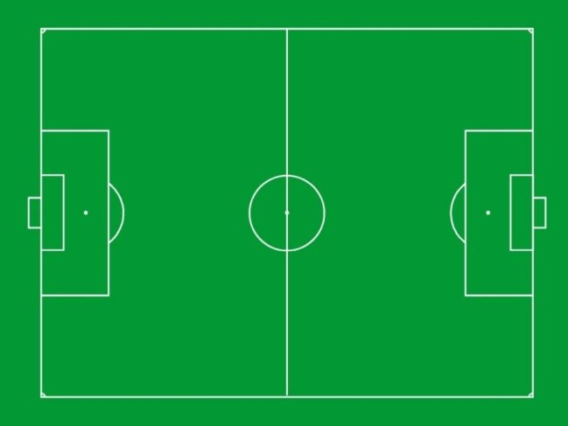
Rules
Rules
Rules

Slide 23
International Baccalaureate (IB)
Middle Years Programme (MYP)
Personal Project (PP):
Journal
Product/Process
Exhibition
Report
Field

Slide 24
Cultural Capital
Linguistic Capital
+
( )
=
Time
Pedagogic work
Scholastic Capital
(Bourdieu&Passeron, 1990)

Slide 25
<G
>G
Scholastic Capital

Slide 26
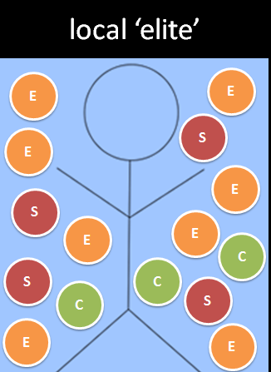
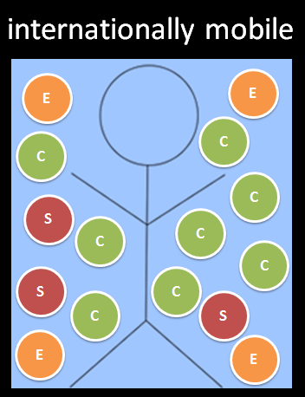
at?
= Education =

Slide 27
How and why do students use specific discursive strategies when positioning themselves as ‘good’ students?

Slide 28
Case Study
Critical Discourse Analysis (Fairclough, 2003)
Qualitative - Interpretive
IB MYP
International School of Eastern Europe
(pseudonym)
25 PP Reports

Slide 29
Phase 1 <Good and >Good ?
Rules: guidelines and rubric
Language: register and proficiency
Patterns?

Slide 30
‘mapping the field’ (Bourdieu&Wacquant, 1992)
 |  |  | 20 - register | 21,24
 |  |  | 5,7,8,18,19,23
 |  | 6,13 ‘had to play’ | 22 – dominant discourse
1 - proficiency | 3, 9,10,11,12,15,16 | 14, 17 ‘changed topics’
2,25 | 4 - guidelines
-C/-L +C/+L

Slide 31
I see what you did...
you picked a good one and a bad one.
Topic
Motivation
Help
<G R:12 >G R:24

Slide 32
habitus?
Phase 2: Interviews
R:12 – S:1
R:24 – S:2

Slide 33
Phase 3: Critical Discourse Analysis
(Fairclough, 2003)
Major types of text meaning | Data collection | Data Analysis
Action | Official Documents | Student workbook
Representation | Artifacts | Representation of social events-report
Identification | Interviews | Habitus

Slide 34
Action | Official Documents | Student workbook
Interpretation | <Good | >Good
Style | This is fun | This is a resource
‘Personal’ | More personal | More academic
‘Project’ | Not like other school assignments | Difficult school assignment
‘Report’ | Narrative | Narrative strategies within a report
‘Table of Contents’ | Verbatim | Rearticulated
‘Rubric’ | Some awareness | Primary focus
‘Achieve the goal’ | Have fun and be creative | Learn something

Slide 35
Representation | Artifacts | Representation of social events-reports
Strategies | <Good | >Good
Representation as recontextualization | Inclusion “What I made” ‘extra’ information Pronoun First Person Singular | Inclusion “What I learned” ‘relevant’ information Pronoun First and Second Person Plural
Representation of social actors | Activated student, family, friends, “experts”, professionals Passivated supervisor, school, community | Activated supervisor, those who offered assistance/support Passivated student
Representation of time and place | Time present Place local | Time past and future Place global

Slide 36
Conclusions <Good Students…
misinterpret ‘personal’
write a reflective statement (sequentially)
interested in what they ‘made’ – tactile/ ‘concrete’
see success as judged outside of school
claim their success based on their emotions
include irrelevant information (photos of themselves, etc.)
use a conversational register
overtly claim success and cite their product as ‘proof’

Slide 37
Conclusions >Good Students…
understand that the PP is an assignment
use an academic register; more ‘abstract’
hedge (do not claim outright success)
acknowledge difficulties
declare their PP as ‘interesting’ but demanding
use the past and future tense more often
acknowledge ‘help’

Slide 38
Further research…
Use of economic and social capital to compensate for a lack of scholastic capital (cultural and linguistic capital)
Value of allowing students to ‘publish’ work with language errors
The ‘Personal Project’ – the assignment
The role of supervisors

Slide 39
Discussion
‘Let me show you how to cheat!’
(Delpit, 2006:165)
Acts of ‘symbolic violence’?
(Bourdieu, 1990)
‘Conscious or unconscious’ ‘positioning’?
(Bourdieu quoted in Jenkins 2002)
There is need to define ‘student centered’.
(Neumann, 2013)

Slide 40
References
BOURDIEU, P., 1986. The Forms of Capital, in J. G. Richardson (ed.) Handbook of Theory and Research for the Sociology of Education. New York: Greenwood Press. Pp. 241-258.
BOURDIEU, P. and PASSERON, J.C., 1990. Reproduction in Education, Society and Culture, 2nd Ed. Sage Publications: London.
BOURDIEU, P. and WACQUANT, L., 1992. An Invitation to Reflexive Sociology. Cambridge: Polity Press.
BUNNELL, T., 2011. The International Baccalaureate and ‘growth skepticism’: a ‘social limits’ framework. International Studies in Sociology of Education, 21(2), pp.161-176.
DELPIT, L., 2006. Other people's children: cultural conflict in the classroom. New York: New Press.
FAIRCLOUGH, N., 2003. Analysing Discourse: Textual analysis for Social Research. New York: Routledge
JENKINS, R., 2002. Pierre Bourdieu: revised addition. New York: Routledge.
NEUMANN, J., 2013. Developing a new framework for conceptualizing “Student-Centered
Learning”. The Education Forum. 77 (2), pp. 161-175.

