Slide 2
“Education must include activities and processes that encourage an awareness of and commitment to the solution of global problems”
………..George Walker, former IB Director General

Slide 3


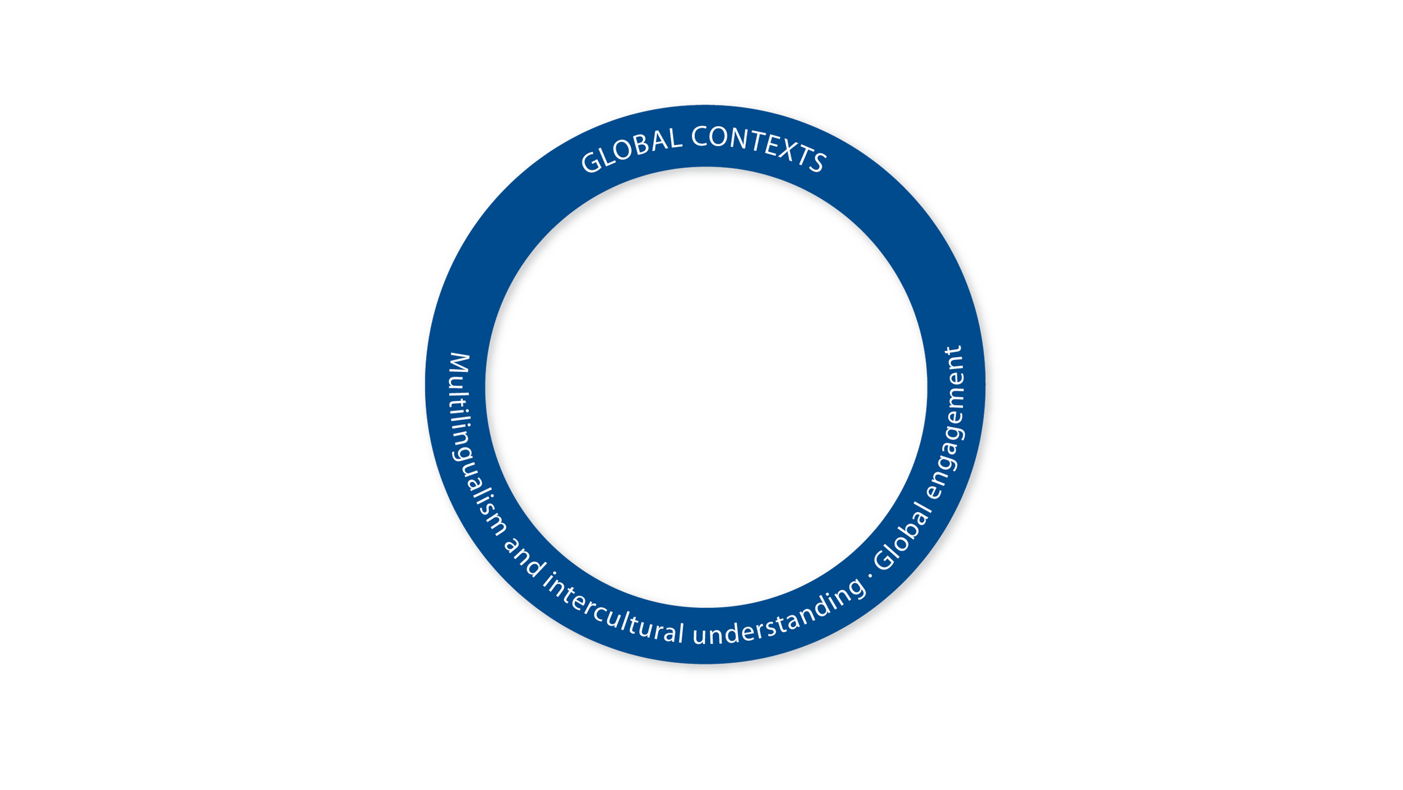
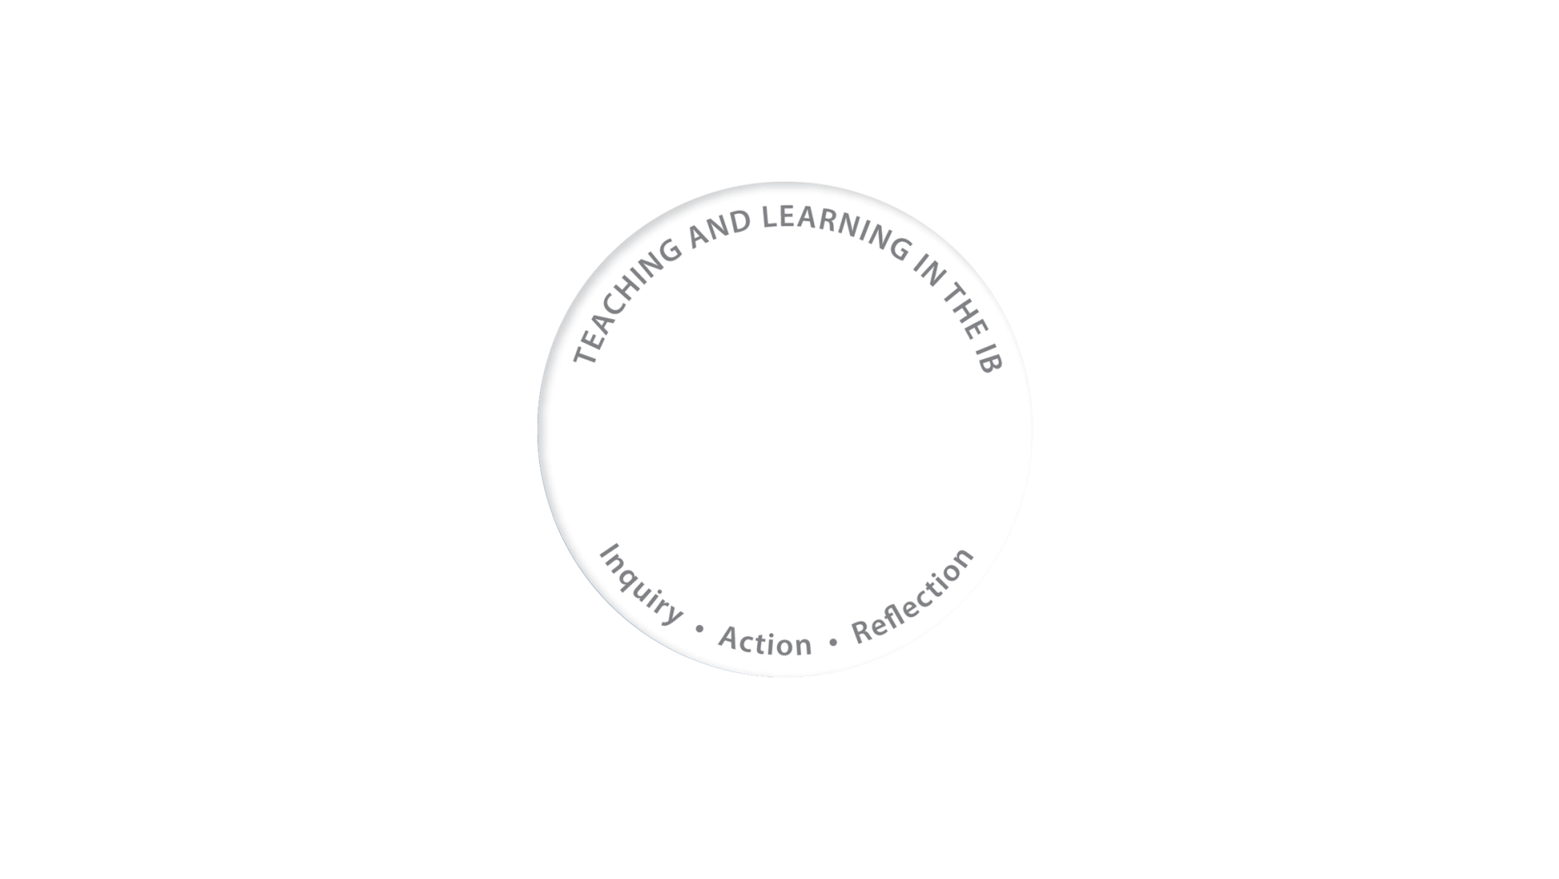

What is an IB education?
.
Notes:
An IB education:
centres on the learner
develops effective approaches to teaching and learning
works within global contexts
explores significant content
Working together, these four characteristics define an IB education.

Slide 4

Global contexts for education

Slide 5
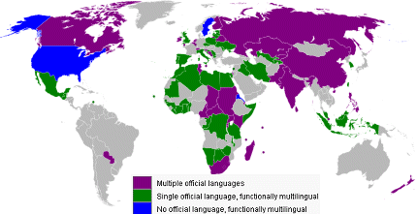
Internationally-minded people understand language and culture
An IB education creates learning communities in which students learn about the world from the curriculum and from their interactions with other people. Intercultural understanding involves
  recognizing and reflecting on one’s own perspective, as well as the perspective of others
  learning how to appreciate critically many beliefs, values, experiences and ways of knowing
  understanding the world’s rich cultural heritage
  exploring human commonality, diversity and interconnection
Multilingualism and
intercultural understanding

Slide 6
Internationally minded people are globally engaged
Global engagement represents a commitment to address humanity’s greatest 21st century challenges in the classroom and beyond.
IB World Schools :
  develop opportunities for sustained inquiry into a wide range of locally, nationally and globally-significant issues and ideas
  explore global concerns, including the environment, development, conflict, rights, and cooperation & governance across a variety of geographical and cultural dimensions
  critically consider power and privilege in their inquiry, action, and reflection
  recognize that the living hold the earth and its resources in trust for future generations.

Slide 7
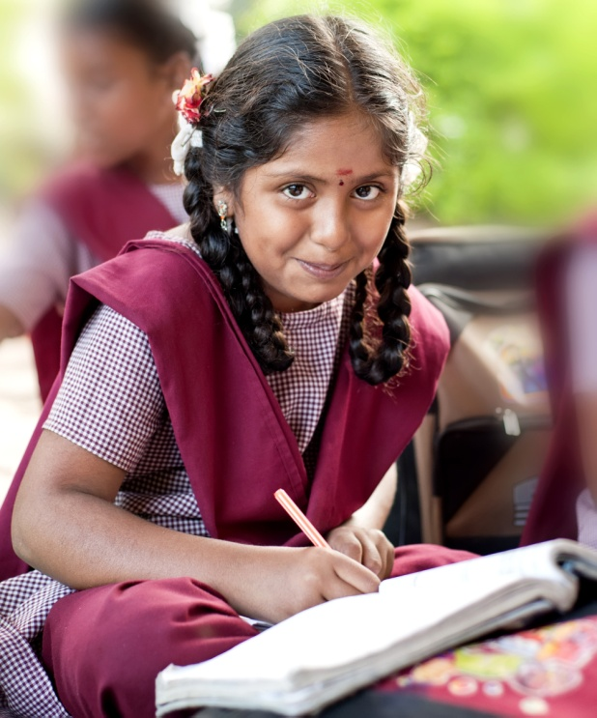
In order to understand difference, students need to examine their own assumptions and perspectives. Through this process of critical self-reflection, students increase their competencies for understanding human communities and cultures. Practicing open-mindedness, students grow in their abilities to learn, re-learn and unlearn what they know about the world.

Slide 8

In IB programmes, students learn to inquire into diverse perspectives which provide opportunities for them to extend their cultural horizons and enrich the resources they can bring to critically appreciate alternative world views. Intercultural understanding should lead toward action, as students develop their capacity for complex interaction with the many people and cultures living together in highly-globalized societies.

Slide 9

Inquiry in multilingualism
Affirmation of identity
Knowledge of mother tongue
Creating a culture of multilingualism in the school

Slide 10
Reflection in intercultural understanding
Constantly adapting behaviour in response to cultural diversity
Accepting and recognizing different cultures
Acknowledgment of contributions of different cultures to a group

Slide 11
Reflection in global engagement
Creating a safe and secure environment for expressing cultural diversity
Skilfully modifying behaviour to interact with other cultures
Engaging the school with the local community in a cultural dialogue whenever possible

Slide 12

“International mindedness is best defined as a ‘frame of mind’, perhaps though a philosophy for living would be more appropriate for it enables and empowers individuals with the ability to perceive the world in a manner that disregards the ‘self’ and its prejudices while embracing firmly a greater sense of the ‘other’. This takes the courage to be curious, to seek knowledge, to gain understanding, to encourage innovation and perhaps the most difficult of all, to develop a culture of acceptance. It is then that the responsible, considerate and informed global citizen emerges.”
Kahiro Maina, IB student,
The Aga Khan Acdemy, Nairobi

