Slide 1


Slide 2

1) Hello, my name is ____.​
2) I came here from ____.​
3) This morning, I had _____ for breakfast.​

Slide 3
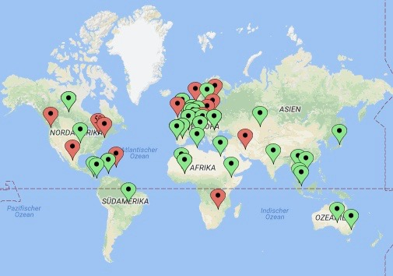
Melina
Knispel

Slide 4
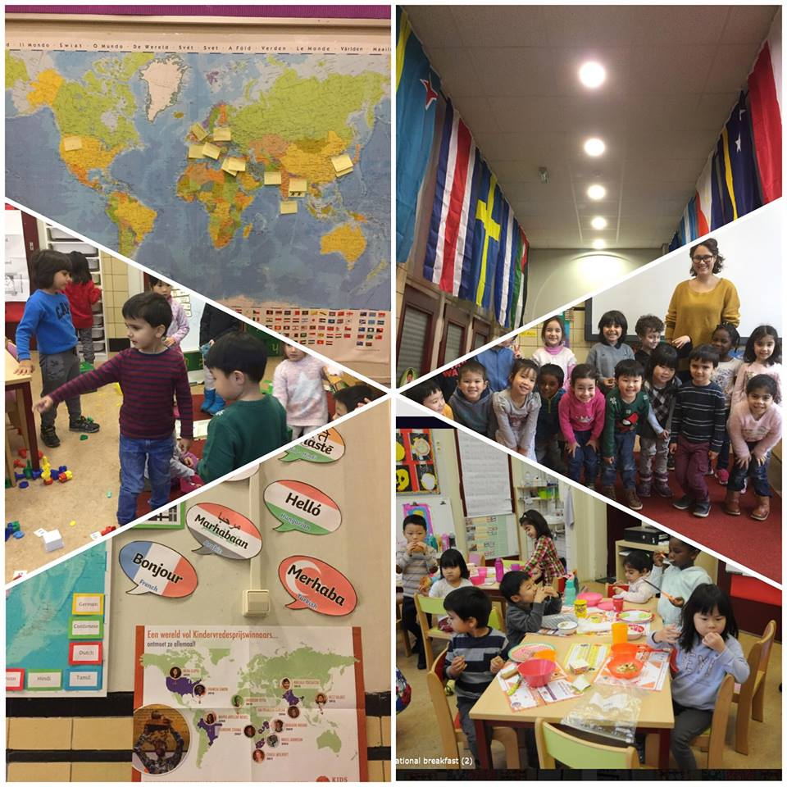
Chiara
Bernardi

Slide 5
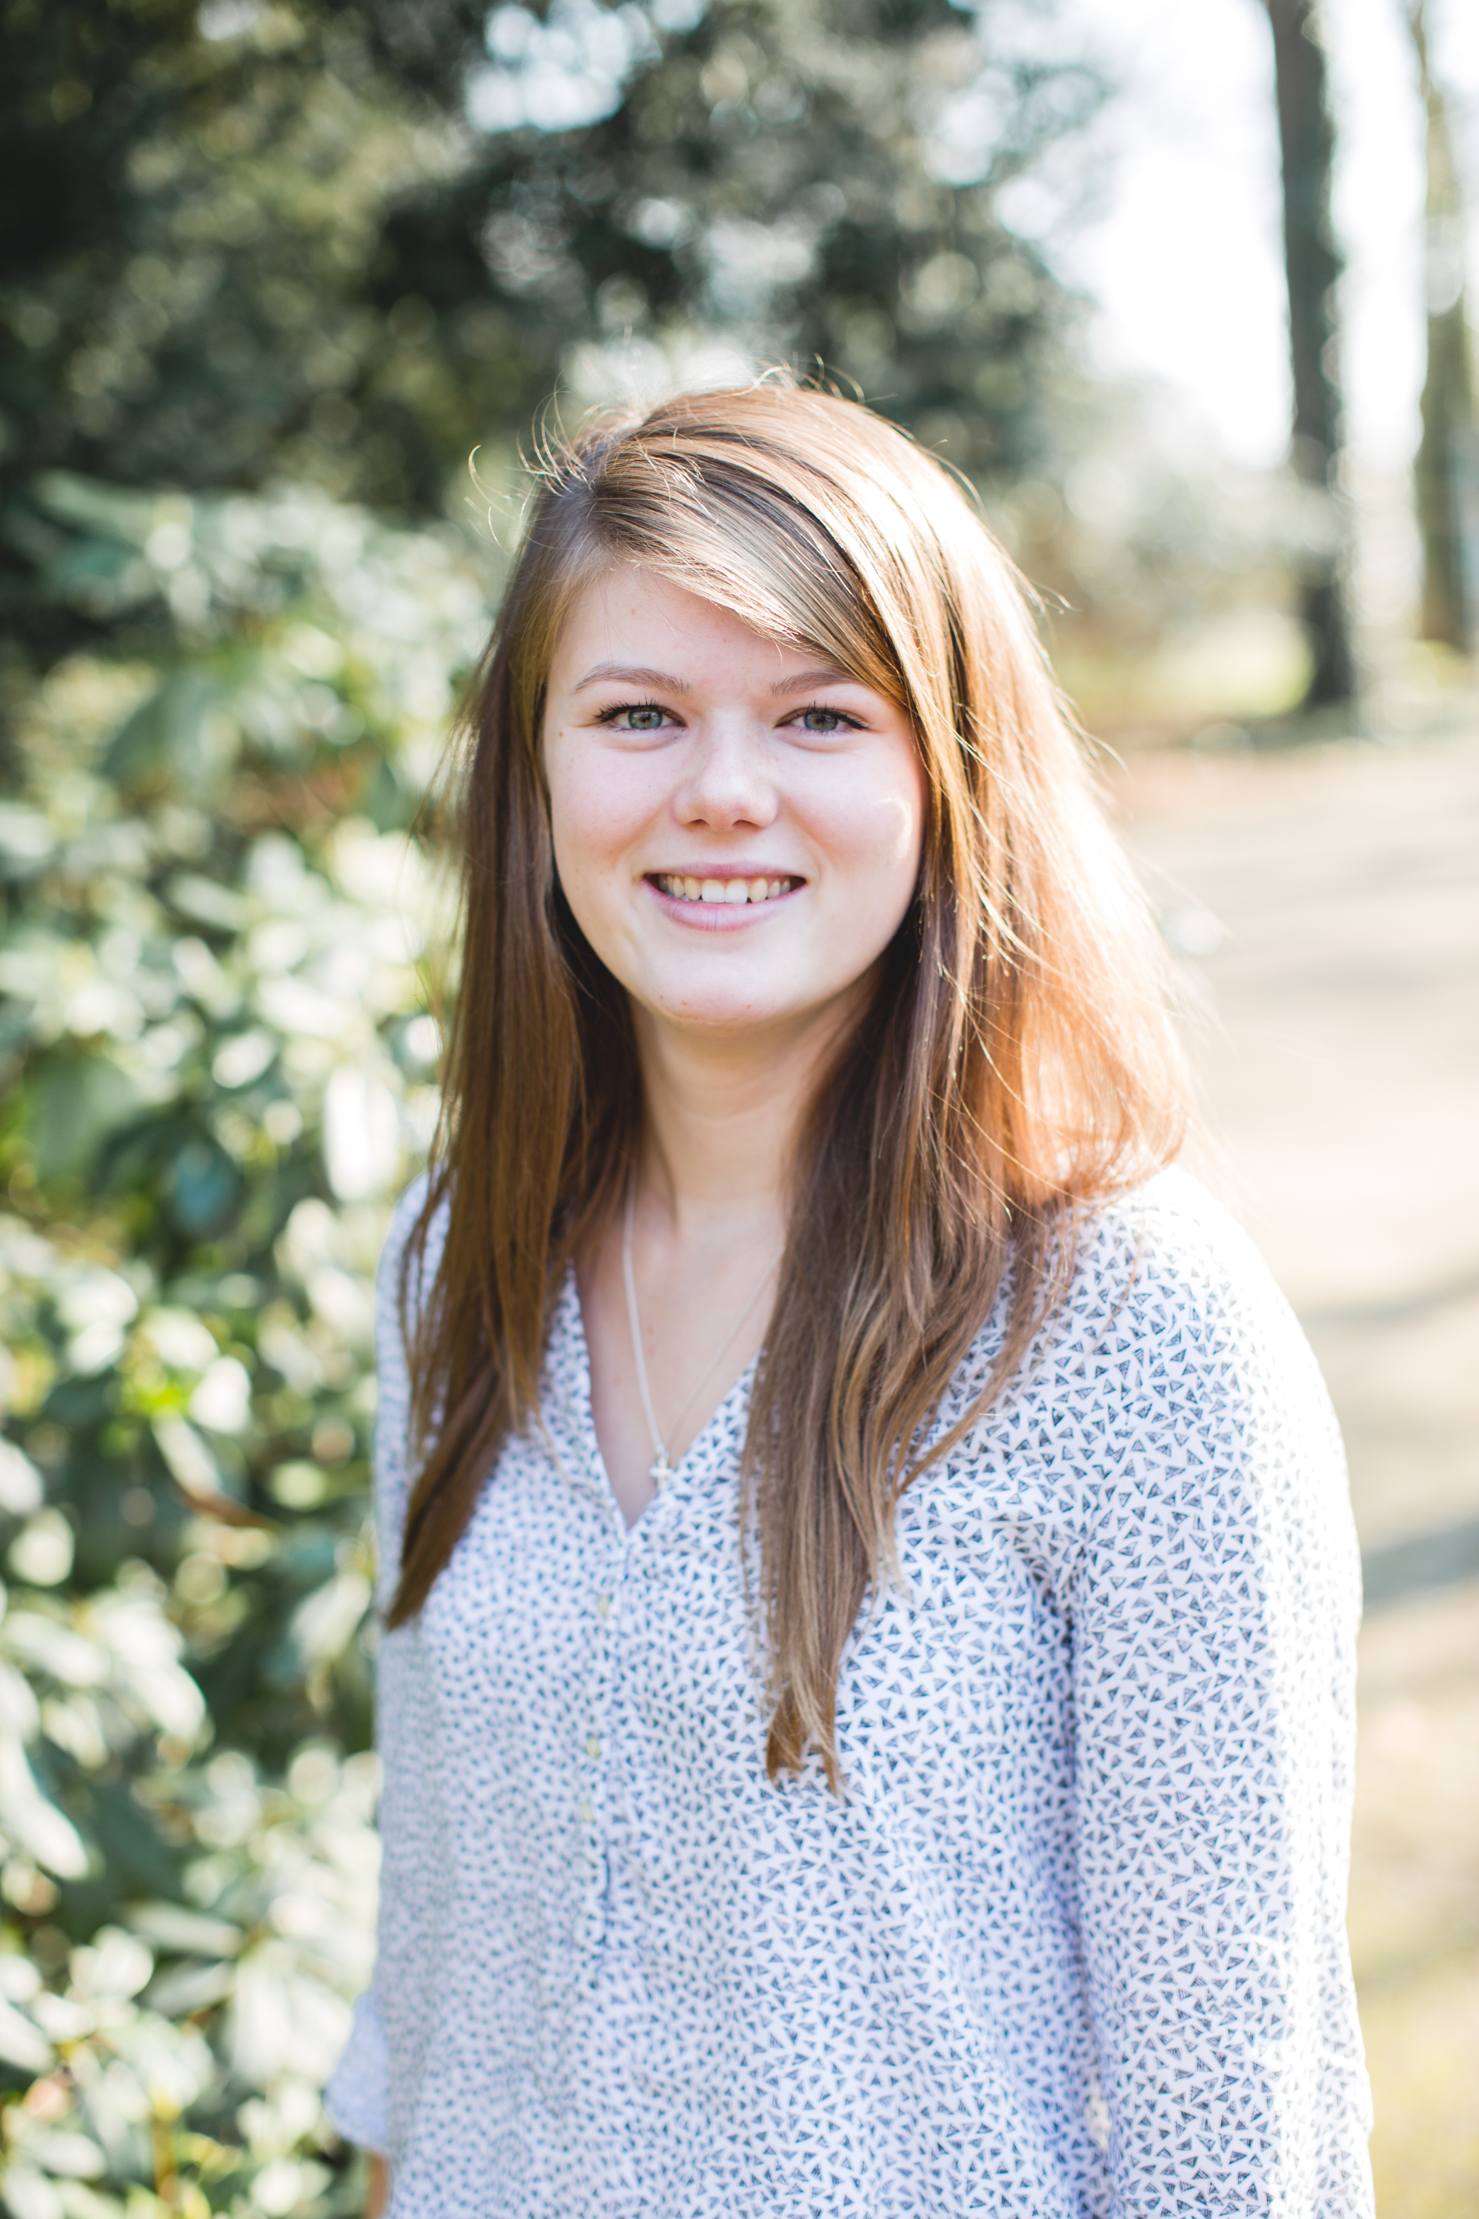
Jorijn Vuyk

Slide 6
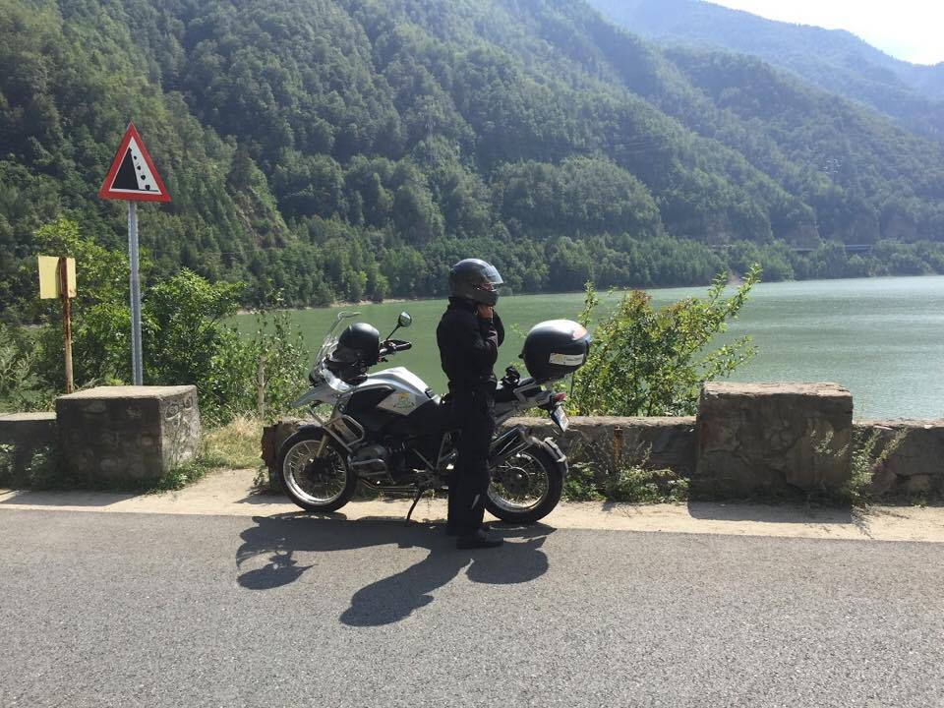
Vlad Coraci

Slide 7
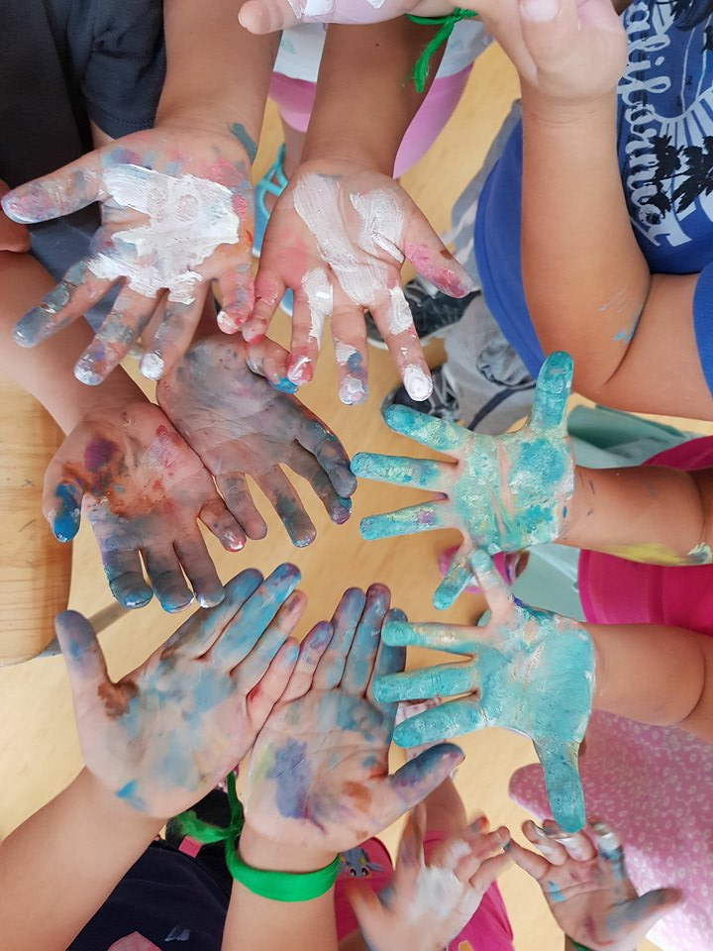
Emma Golles

Slide 8
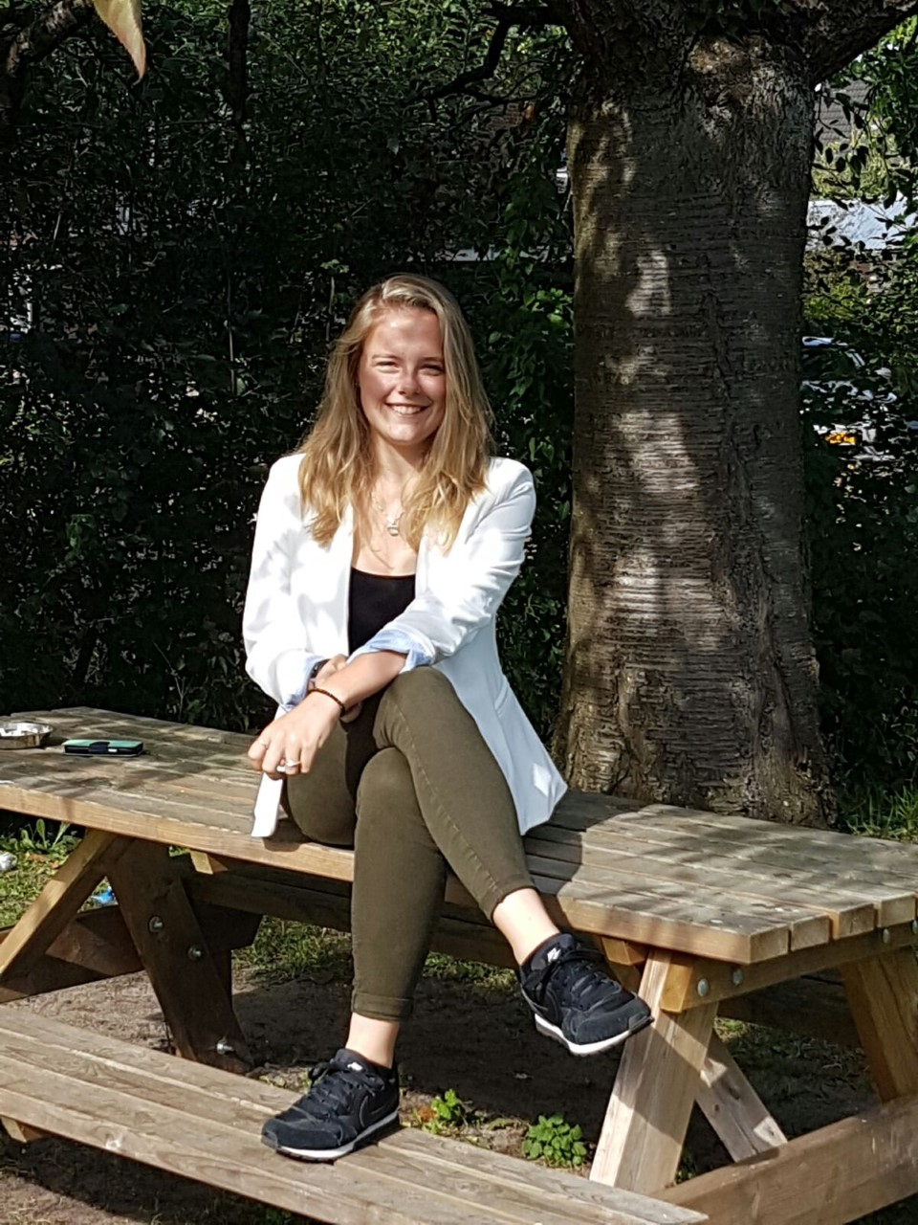
Noëlle van der Sligte​

Slide 9
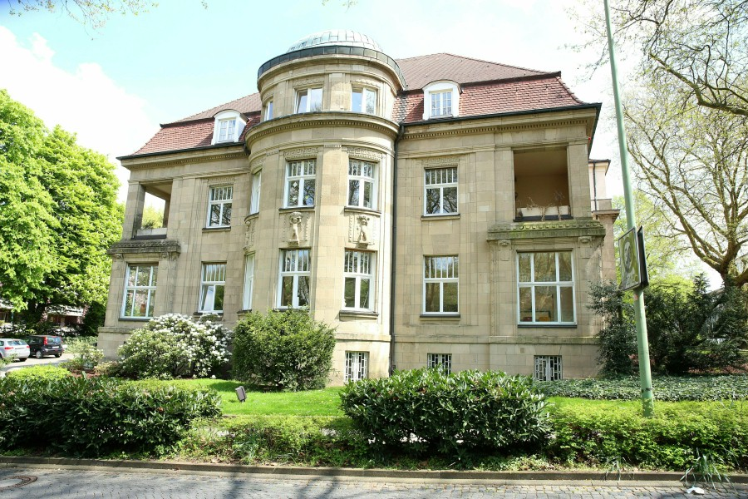
Christina
Jennifer
Kulle

Slide 10
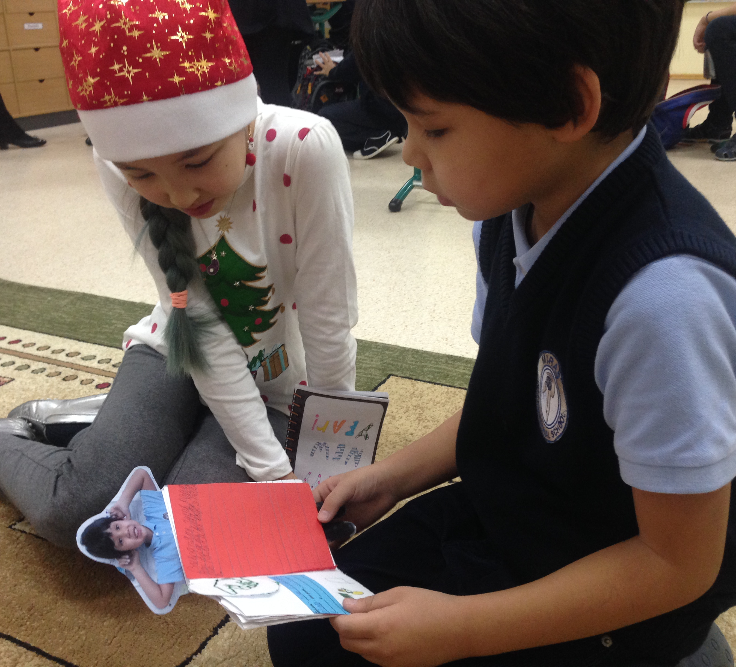
Lena Boßmann ​

Slide 11
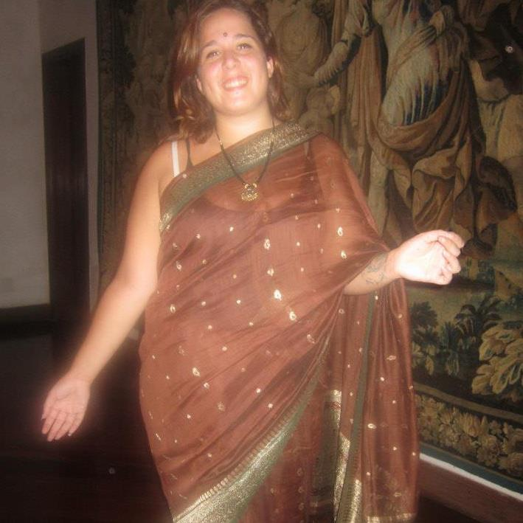
Melany
Mistrorigo

Slide 12
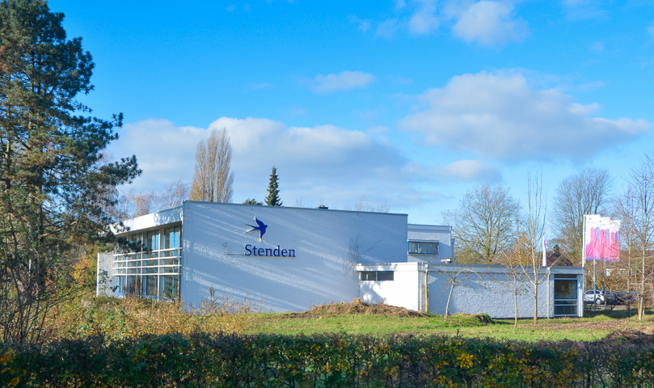
Marleen
Bosma

