Slide 1
AIE Qatar 2012 New language for Culture
New language for Culture, Identity and Values
- Richard Pearce

Slide 2
AIE Qatar 2012 New language for Culture
‘Whereof one cannot speak, thereof one must be silent’
- Wittgenstein (1921)

Slide 3
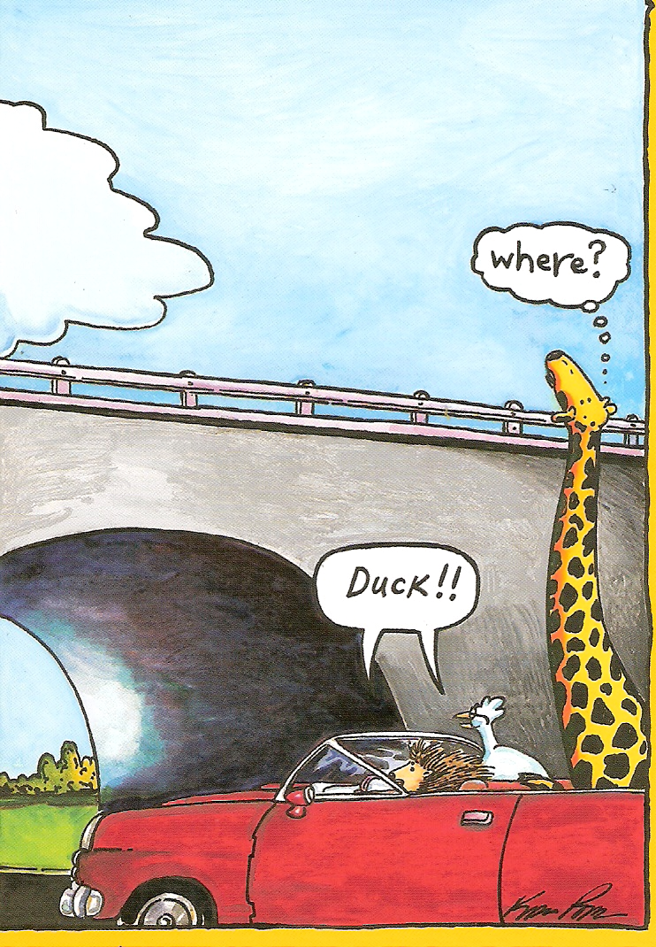
AIE Qatar 2012 New language for Culture

Slide 4
AIE Qatar 2012 New language for Culture
Current usage
Underlying process
Replacement words

Slide 5
AIE Qatar 2012 New language for Culture
Current usage
- values
- identity
- culture

Slide 6
AIE Qatar 2012 New language for Culture
Current usage
- values

Slide 7
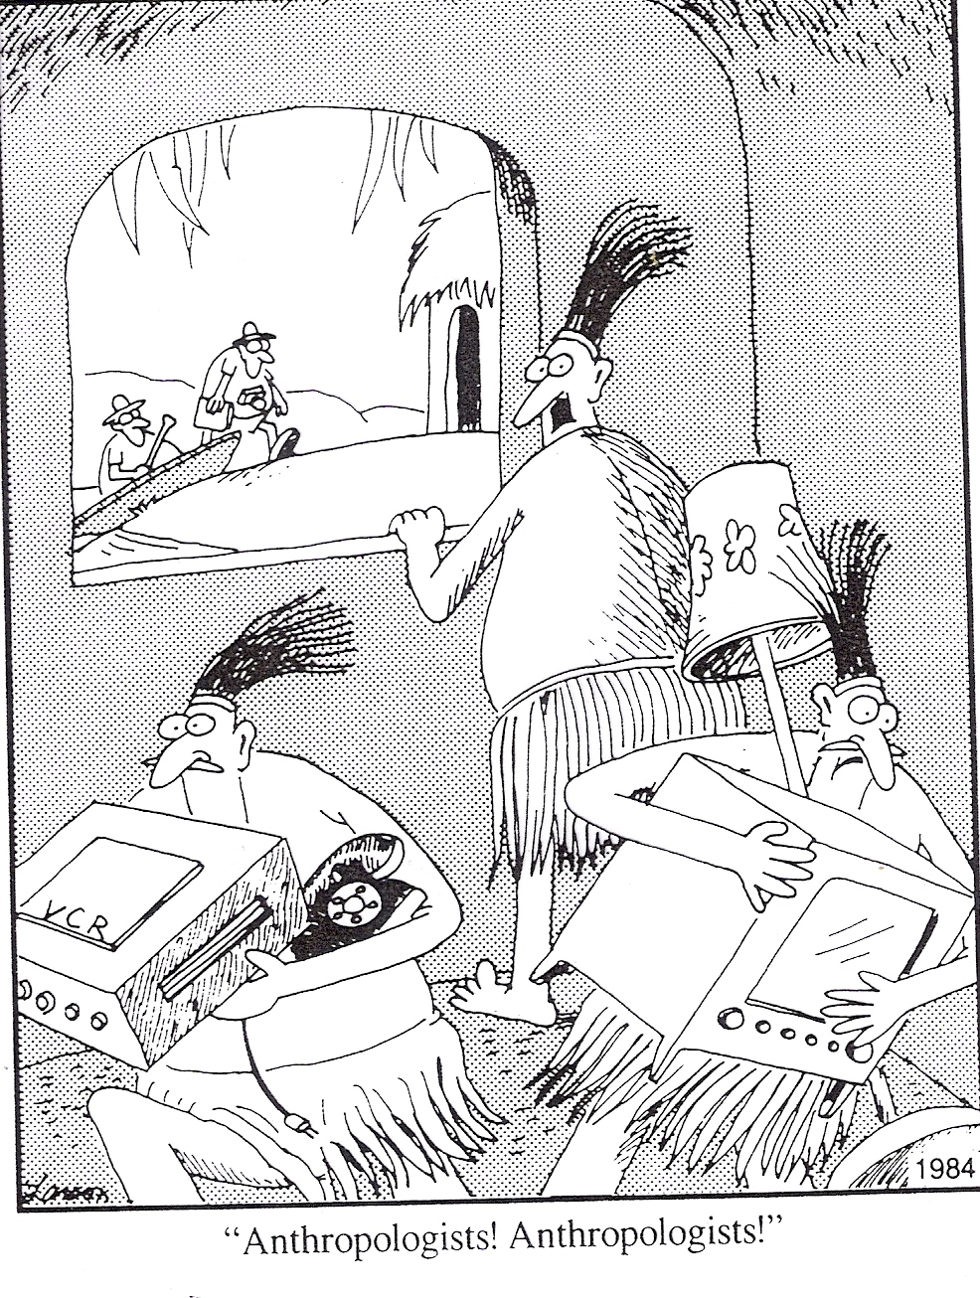
AIE Qatar 2012 New language for Culture

Slide 8
AIE Qatar 2012 New language for Culture
Current usage
- identity

Slide 9
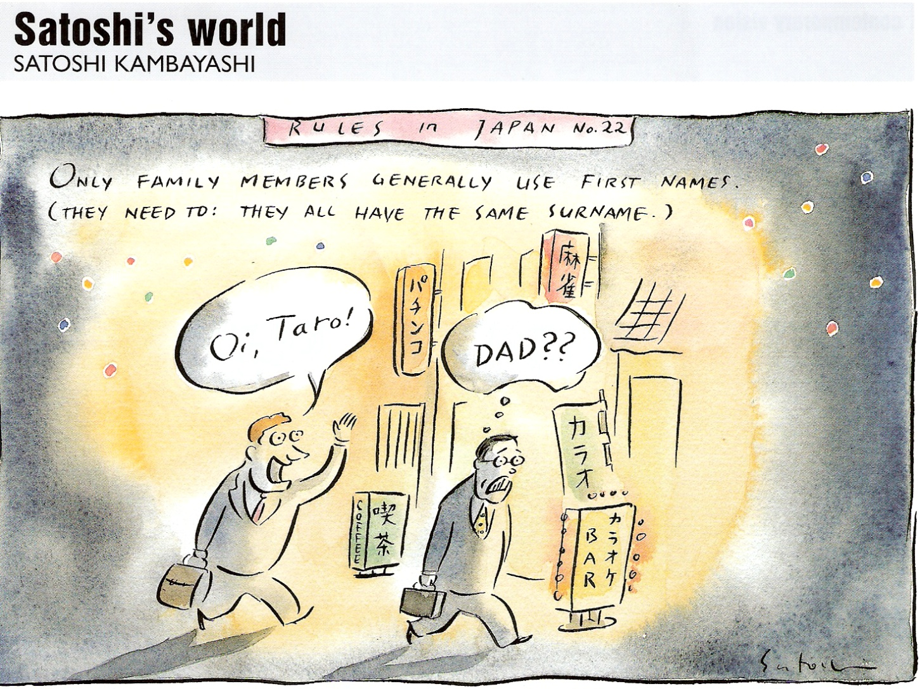

Slide 10
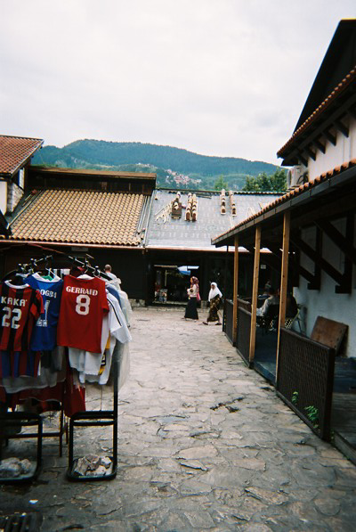
AIE Qatar 2012 New language for Culture

Slide 11
AIE Qatar 2012 New language for Culture
Current usage
- culture

Slide 12
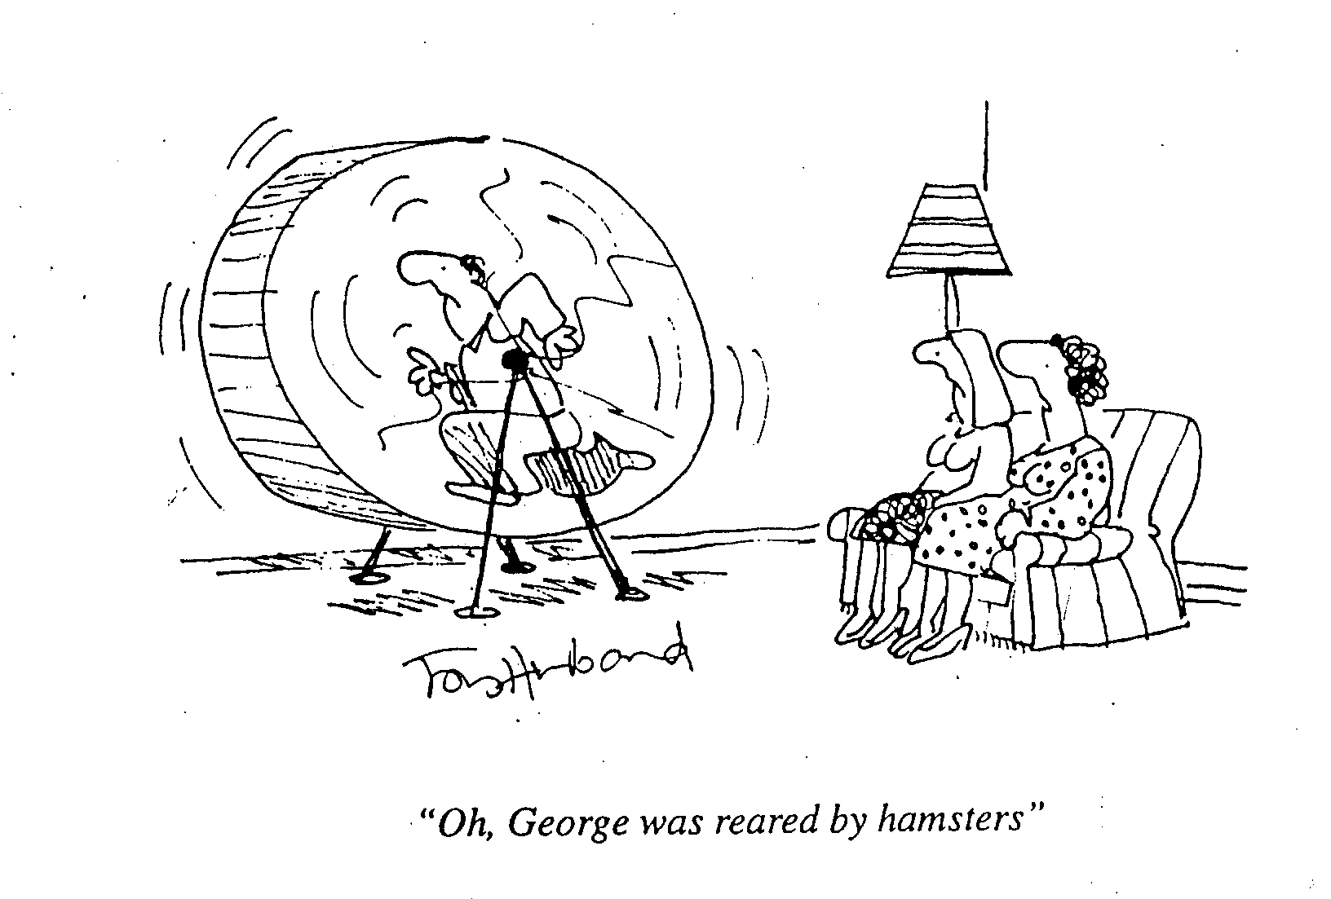
AIE Qatar 2012 New language for Culture

Slide 13

AIE Qatar 2012 New language for Culture

Slide 14
AIE Qatar 2012 New language for Culture
Underlying processes:
- what is actually happening

Slide 15
AIE Qatar 2012 New language for Culture
Three useful books:
        Descartes’ Error - Antonio Damasio
Moral Minds – Marc Hauser
The Righteous Mind – Jonathan Haidt

Slide 16
AIE Qatar 2012 New language for Culture
‘Values are conceptions of the desirable that influence the ways people select action and evaluate events,
. . . cognitive representations of three types of human requirements:
biologically based needs of the organism
social interactional requirements for interpersonal communication
social and institutional demands for group welfare and survival.’
  - Schwartz and Bilsky (1987)

Slide 17
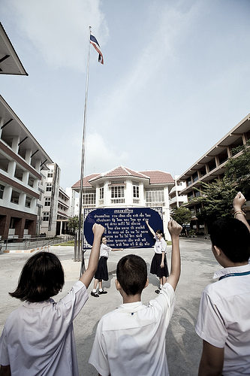
AIE Qatar 2012 New language for Culture

Slide 18
AIE Qatar 2012 New language for Culture
Goodenough (1957):
‘Culture is whatever one has to know or believe in order to operate in a manner acceptable to [a society’s] members.’

Slide 19
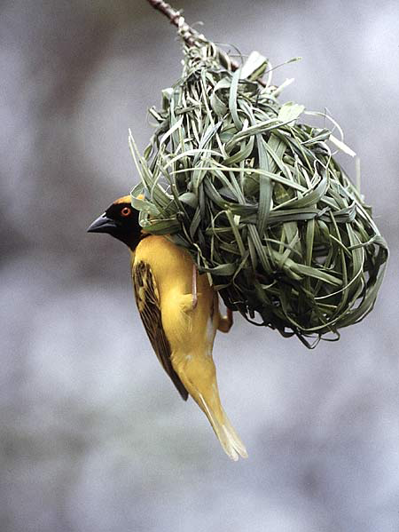
AIE Qatar 2012 New language for Culture

Slide 20
AIE Qatar 2012 New language for Culture
Replacement words:
How can we express these processes?

Slide 21
AIE Qatar 2012 New language for Culture
Replacement words:
Values:
‘doxomeres’
‘waybits’

Slide 22
AIE Qatar 2012 New language for Culture
Replacement words:
Culture:
‘demodoxa’
‘peopleways’

Slide 23
AIE Qatar 2012 New language for Culture
Replacement words:
Identity:
‘idiomorph’ ‘selfshape’
‘allomorph’ ‘othershape’
Identification:
‘idioparathesis’ ‘self-likening’

Slide 24
AIE Qatar 2012 New language for Culture
Values:
‘doxomeres’ ‘waybits’
Culture:
‘demodoxa’ ‘peopleways’
Identity:
‘idiomorph’ ‘selfshape’
‘allomorph’ ‘othershape’
Identification:
‘idioparathesis’ ‘self-likening’

