Slide 1
Peter Elting

Slide 2
ITEps
Why
Who / Advisory board and friends
Short History
ITEps programme
Staff and students
Concrete example preparing student teachers
Challenges / request and discussion

Slide 3
ITEps-Why
TE rooted in history and culture of the countries
Globalizing world, working abroad
ITEps ← → International education

Slide 4
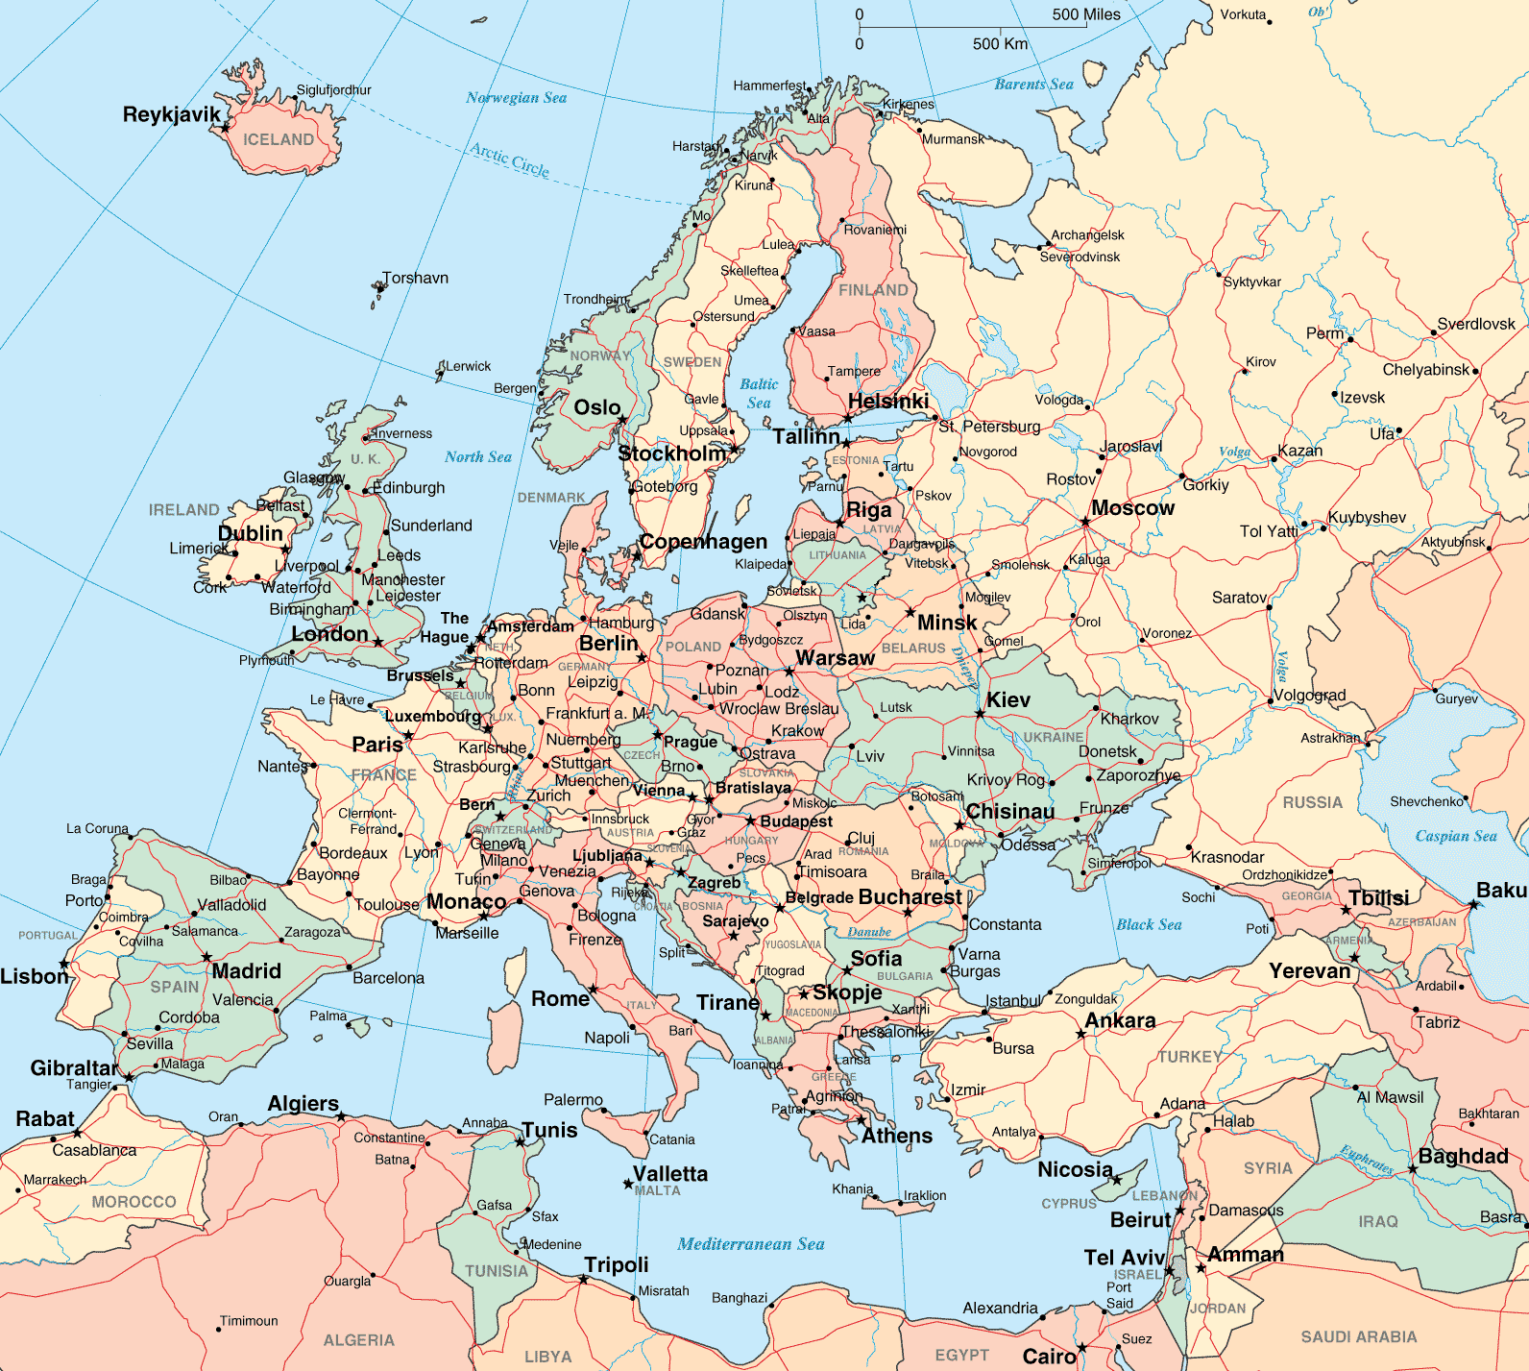
ITEps- Who
University College Zealand, Denmark
Buskerud University College, Norway
Stenden, The Netherlands
NHL, The Netherlands (per 1/1/2015)
In the coming years also: Universities from UK, Germany, South Europe, India and South Africa (associated partners / partners)
Unfortunately not:
Charles University, Czech Republic
Anadolu University, Turkey
Linnaeus University, Sweden (in 2015 associated partner)

Slide 5
ITEps- Avisory Board and Friends
Advisory Board
Prof. Jeff Thompson, Chairman
Mary Hayden, Bath University
Henk van Hout, Shell
Graham Reeves
Theresa Forbes
Hans Peter Jensen, Joint Research Centre EU
Per B. Christiansen, Culture Director Denmark
Probably Colin Bell director Cobis and Sjur Bergan (head education department EU)
Friends and supporters
- from the profession
- Bath University - Fieldwork
- Tic
ISCresearch - ECIS - SNOB
Cobis - IB-organization
- .............................. - ..............................

Slide 6
ITEps- Short History
2007-2009: Erasmus multilateral project 6 countries
2009-2012 Accreditation + implementation
1 September 2012 start in Denmark (pilot in 2011-2012) and the Netherlands
21 September 2012 Official opening

Slide 7
ITEps- competencies
Standard teacher competencies: interpersonal, pedagogical, subject knowledge and methodological, organisational, collaboration with colleagues and working environment, reflection and development
Intercultural competency - awareness of own cultural identity - knows about international and global issues - communicate with others - internationally minded - aware and act appropriate in response to diversity

Slide 8
ITEps- structure of the programme
Year 1 | Year 2 | Year 3 | Year 4
English as second language 30 ec | Subject A/B/C* 30 ec | Subject A/B/C * 30 ec | Subject A/B/C * 30 ec
Educ. Studies Educ.Studies 1 10 ec Elective (Teaching Practice/ Subject) 10 ec Democr. Citizenship 10 ec | Educ. Studies Educ.Studies 2 10 ec (Teaching) Practice 10 ec Research & Acad. Work. methods 10 ec | Educ. Studies Educ.Studies 3 10 ec (Teaching) Practice 10 ec Research & Acad. Work. methoss 10 ec | Educ. Studies Educ.Studies 4 5 ec (Teaching) Practice 10 ec Bachelor Thesis 15 ec
OPTIONAL Subjects
Physical Education & health
Intercultural understanding & religion
Natural Science, Life science & Technology
Mathematics*
Special Education
Art & Culture
History and Social Geography, International and global perspectives
Foreign language

Slide 9
ITEps- Curriculum Studies
Curricula in common use in International Schools
- PYP, IPC, British NC, …
Curriculum local schools
‘Comparative Curricula’ opportunities for research projects

Slide 10
ITEps- Staff
English C1-level (minimum), after 3 years C2-level + native speakers
(virtual) Guest lecturers
International mindedness
Experience in international schools
(virtual) Exchange
Study coach

Slide 11
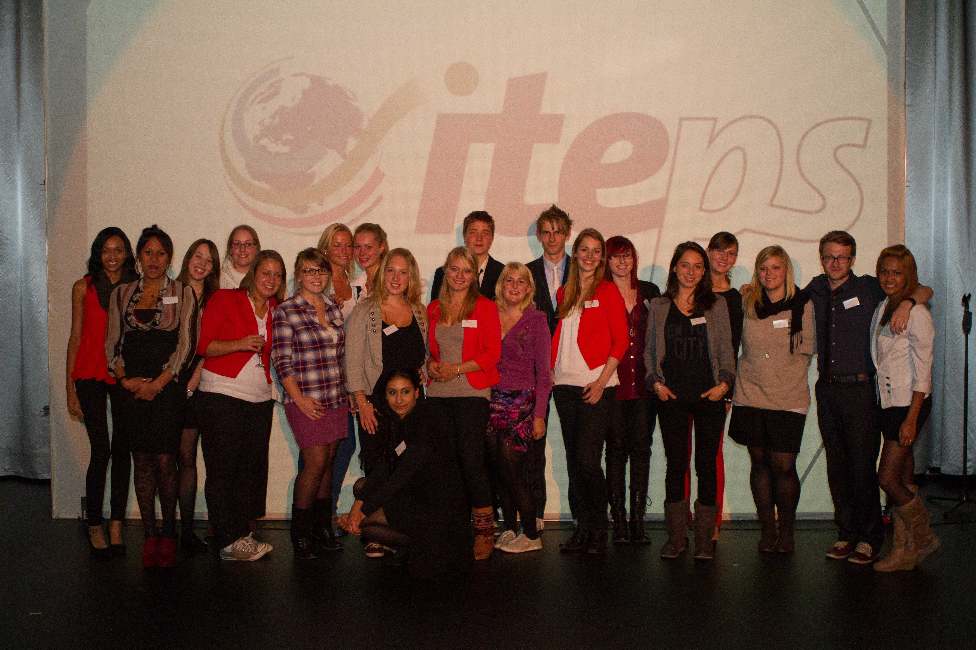
ITEps- students
Admission requirements: - minimum: advanced level = level 4 EQF - English B2
Excursions
Traineeship and subject abroad
English C1, after one year, before graduation C2-level

Slide 12
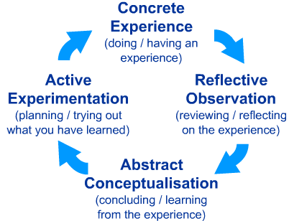
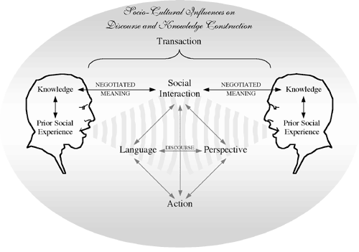
ITEps- concrete example preparing student teachers (1/2)
Subject: Democratic Citizenship, Year 1 students
- Three guest teachers from Moroccan schools invited
- One lecture about the Islam and especially class dilemmas
- Assignment about class dilemmas
- Teaching practice: Islamic art (Stanford materials), The Silk Road
- Feedback by the two teachers in a meeting
- Assignment about class dilemmas in a Chinese school
- Feedback by teachers from a Chinese school

Slide 13
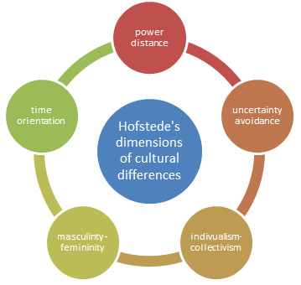
ITEps- concrete example preparing student teachers (2/2)
Year 3 student, teaching practice, Research and Academic working methods
Year 3 TP in International School Amman, Jordan
Assignment: research on the collection in the libraries of the school : How visible is the intercultural competence
+

Slide 14
ITEps- challenges / developments
1 programme <- -> national regulations
Changing laws
Deep or broad
Implication accreditation different countries
Intercultural competency, assessment (next conference of the consortium in May)
ITEls
Joint master

Slide 15
ITEps- requests
- Teaching practice and Classroom Experience - Guest Lecturers (virtual) - Students’ Project work
Acquisition of students for ITEps
To fill in the questionnaire about the competencies of the ‘ideal’ international teacher

Slide 16
Thank you/ Discussion / Questions / Questionnaire
www.iteps.eu
Info@iteps.eu
peter.elting@stenden.com

