Slide 1
Victoria Shanghai Academy

Slide 2
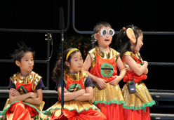
VSA Context

Slide 3
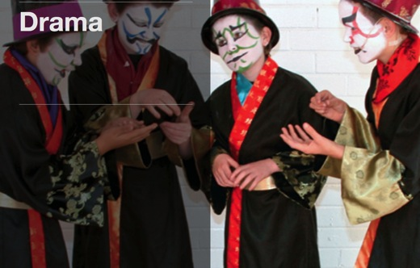
Eportfolio to Learner Portrait

Slide 4
A sociocultural approach

Slide 5
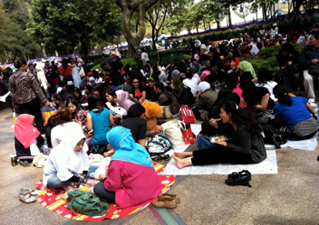
Hong Kong Context

Slide 6
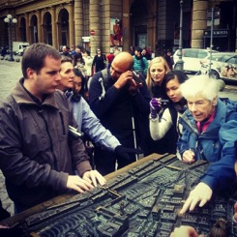
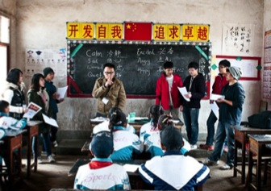
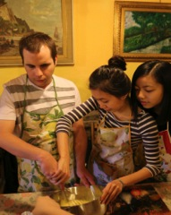
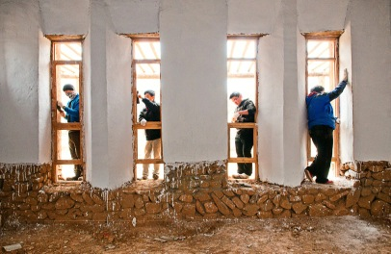
Legitimising the ‘Every Day’

Slide 7
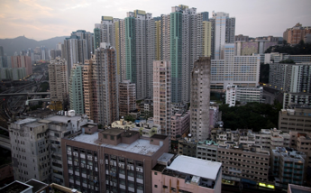
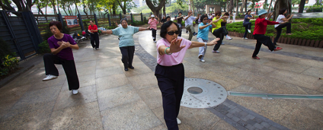
Pictures and Identity

Slide 8
Self Portraiture

Slide 9
Rethinking Assessment

Slide 10
E Portfolio as a Learner Portrait

