Slide 1
“I do not want my house to be walled in on all sides and my windows to be stuffed. I want the cultures of all the lands to be blown about my house as freely as possible. But I refuse to be blown off my feet by any.”
Mahatma Gandhi quotes

Slide 2

Nurturing multicultural understanding in the primary phase

Slide 3
What is culture?
My understanding
Making connections through the PYP
Challenges

Slide 4
What is culture?
Patterson (1975)
‘Culture is an identified complex of meanings, symbols, values and norms that are shared consciously or unconsciously by a group of people.’
Hofstede (1997) Pointed out
‘Culture is a fundamental phenomenon. It affects not only our daily practices: the way we live, are brought up, manage, are managed, and die; but also the theories we are able to develop to explain our practices. No part of our life is exempt from culture’s influence’.

Slide 5

My understanding of a culture after reading different definitions given by various scholars:
Culture is a kaleidoscope of a set of people who share values, symbols, tradition, and spiritual beliefs. It also encompasses art and literature, lifestyle, and ways of living together.

Slide 6
How it can be developed through education:
Gellar (2002, p.31) mentioned that a school can be truly international minded
If its curriculum focuses on the global perspectives rather than just local and
Gives equal importance to develop ‘universal values’ in the students.

Slide 7
The PYP curriculum
Themes based on human commonalities
Transdisciplinary skills
Globally transferable concepts
Attitudes for intercultural sensitivity (universal values)
Action to become responsible citizens

Slide 8
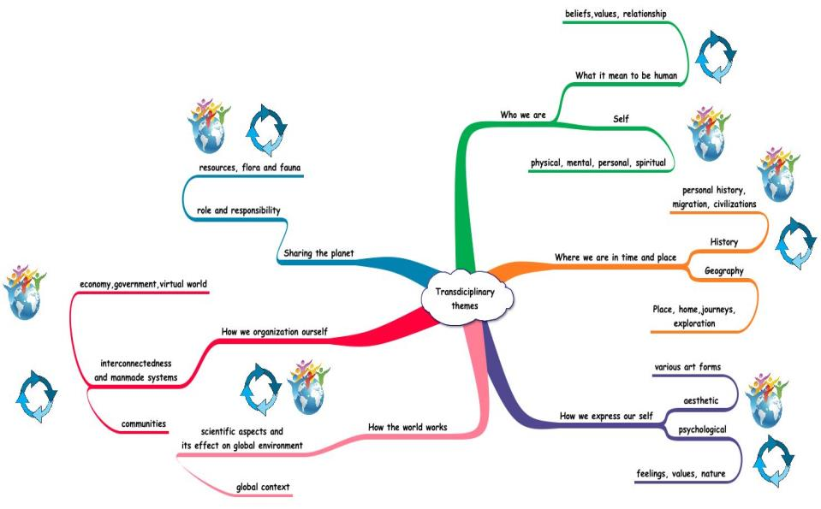
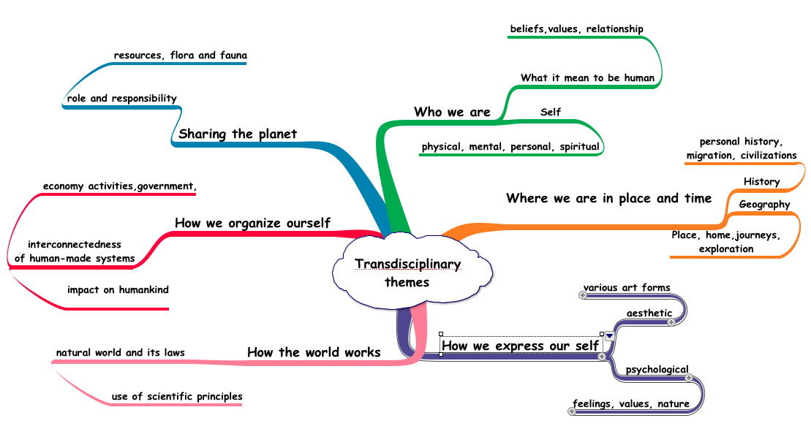
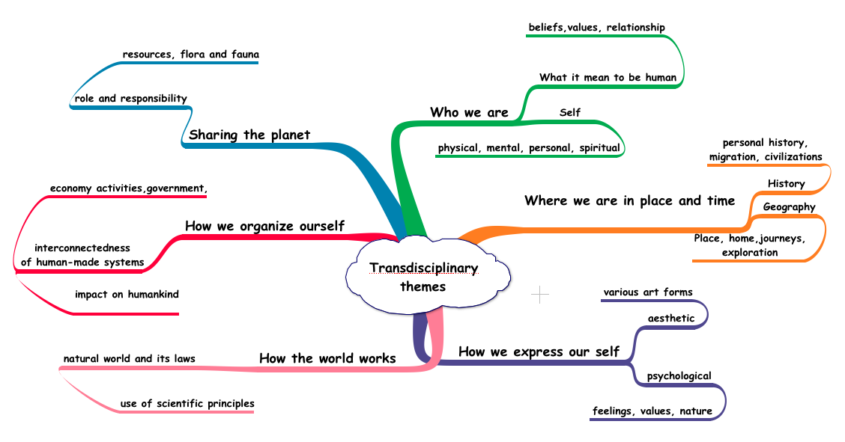

Slide 9
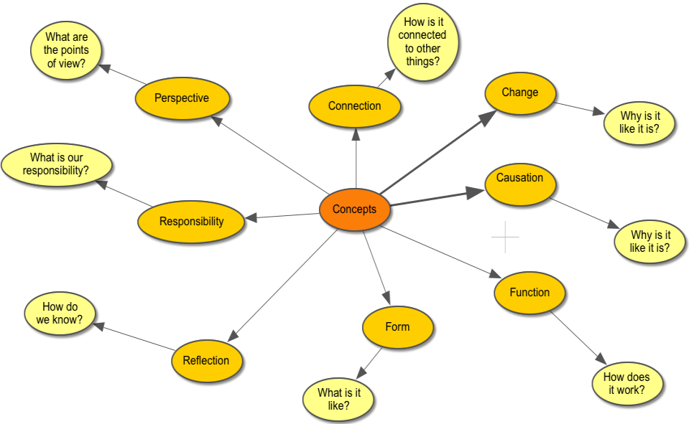

Slide 10
Approaches to learning
Skills:
Communication skill
Research Skill
Self-management skills
Social skills
Thinking skills

Slide 11
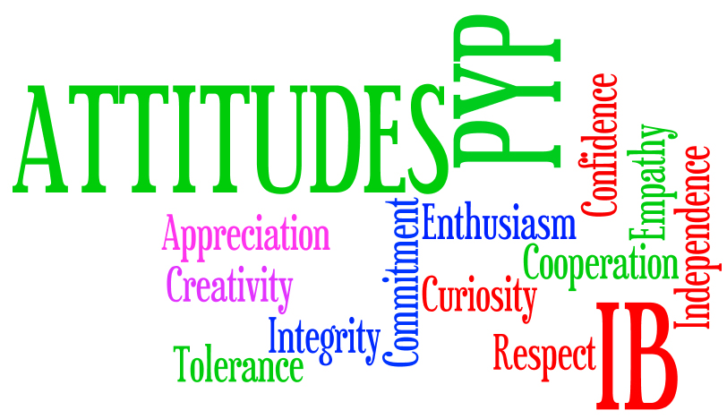
Attitudes

Slide 12
Action
‘In the PYP, it is believed that education must extend beyond the intellectual to include not only socially responsible attitudes but also thoughtful and appropriate action.’ Making the PYP Happen pg.25

Slide 13
Challenges
Teachers training and initiative approach in the collaborative planning meetings
Balancing it out in the Programme of Inquiry
Monoculture school
Parents workshop/ Parent information sessions

Slide 14
Dalai Lama (2009) The Moral Imperatives of Chance “Compassion will show the way” India Today, Vol XXXIV no. 12: for the week 17-23, K-9 Connaught Circus, New Delhi , pp. 32
Drennen, H (2002) Criteria for curriculum continuity in international education. In International education in practice eds by M Hayden, J Thompson and G Walker, New York, Routledge
Geller, A Ch (2002) International education: a commitment to universal values. In International education in practice eds by M Hayden, J Thompson and G Walker, New York, Routledge
Haywood, T (2007) A Simple Typology of International- Mindedness and its Implications for Education The SAGE Handbook of Research in International Education eds by M Hayden, J Levy and J Thompson, London, Sage Publication
International Classrooms, IB World magazine of the International Baccalaureate, Jan2008, Issue 52, Middlesex, Haymarket Network, Teddington Studios, Pg. 18,
Munro, J (2007) learning Internationally in a Future Context. The SAGE Handbook of Research in International Education eds by M Hayden, J Levy and J Thompson, London, Sage Publica

Slide 15
Ree, H (2004) To Educate the Nations. In To Educate the Nations 2 2nd ed, G Walker, Glasgow, Peridot Press
Sampatkumar, R (2007) Global Citizenship and the Role of Human Values. The SAGE Handbook of Research in International Education eds by M Hayden, J Levy and J Thompson, London, Sage Publication
Skelton, M (20 02) Defining ‘international’ in an international curriculum. In International education in practice eds by M Hayden, J Thompson and G Walker, New York, Routledge
Teaching without boards, IB World magazine of the International Baccalaureate, Jan2008, Issue 52, Middlesex, Haymarket Network, Teddington Studios, Pg. 12
Walker, G (2004) International education and National systems, 2nd ed, pg 90-91, Glasgow, Paridot press

Slide 16
Central Idea: Human migration is a response to challenges, risks and opportunities.
Lines of inquiries:
Concepts:
Skills:
IB Learner Profile:
Attitudes:

Slide 17
Going further:
George Walker added that the themes in the PYP helps to develop three characteristics:
Capacity to reason
Knowledge of self and others
A growing sense of global responsibility.
Notes:
How is the concept of global mindedness and intercultural awareness, sensitivity and competence viewed in international school? George walker, a former director general of the IB lists understanding cultures as one of the six skills needed in international education and as one of his five aims of international education.
Ian hill (2007) writes that DP programme should include intercultural understanding; learning more then one language, and values that promote wise choices for the good of humankind.

Slide 18
