Slide 1
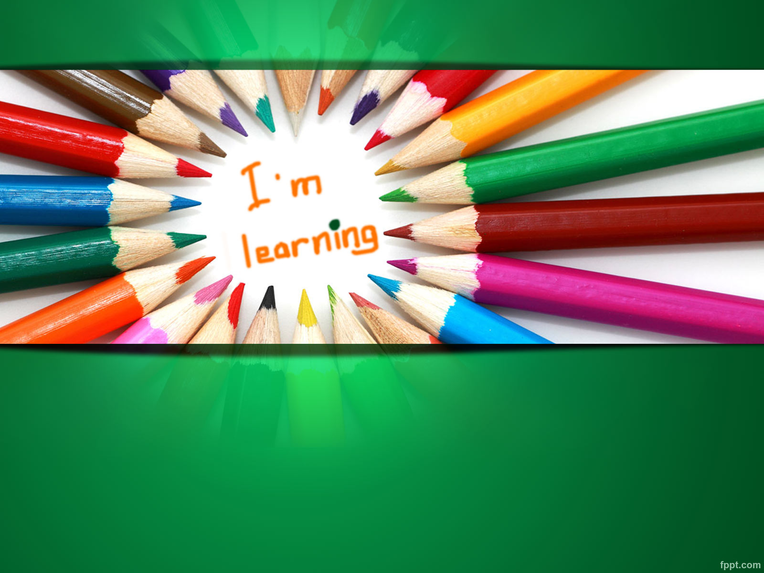
Cultural dissonance in cross-cultural interactions and issues faced in the Primary Year Programme (PYP) classroom:
Namrata Goel
11th Oct, 2014

Slide 2
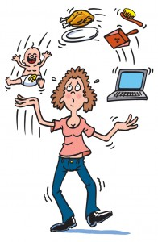

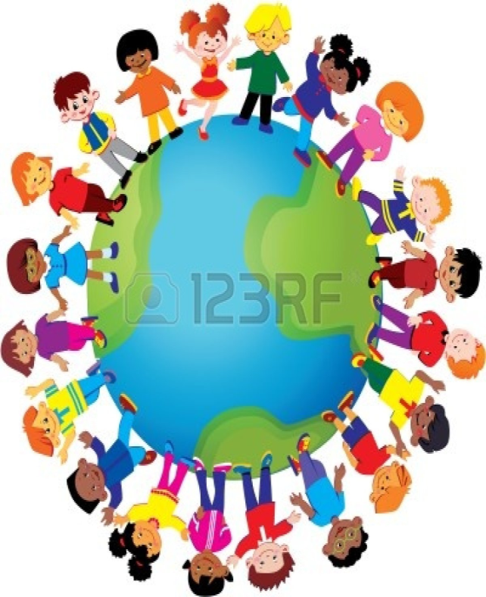


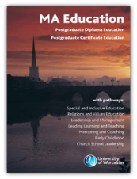
Who Am I
Me
Academic Context
Cultural Dissonance in cross-cultural interactions

Slide 3
Structure
What is culture?
  Concepts
  Distinctions
Cultural dissonance with 2 key features
Issues, responsibility & actions
Open Discussion

Slide 4
Definitions and concept of Culture
“the shared way of life of a group of people“ (Pearce, 1998)
“individuals from a given cultural group develop behaviour patterns and subjective cultures that are functional for their particular environment” (Albert and Triandis, 1994)

Slide 5
Definitions and concept of Culture
“software of the mind” (Hofstede G, 1994)
“the collective programming of the mind which distinguishes the members of one group or category from another” (Hofstede G, 1994)
…….. much of which has been acquired in early childhood

Slide 6
Manifestations of Culture
Symbols
Heroes
Rituals
Values
Rituals
Heroes
Onion Layered Approach
(Hofstede 1991)
Symbols

Slide 7
Iceberg Concept of Culture: (Larcher 1993)
Laws
Rules
Customs
Laws
Rules
Customs
CONSCIOUS
UNCONSCIOUS
Tradition
Tradition
Routine behaviour
Routine behaviour
Unconscious habits
Unconscious habits

Slide 8

MUMBAI
AMBULANCE: 108

Slide 9
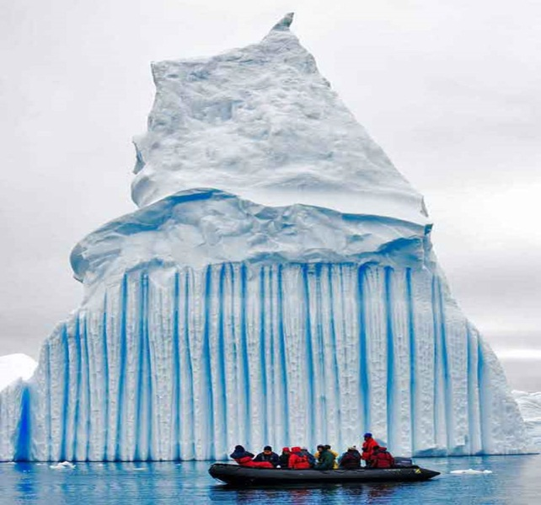
What is culture
"only a small part of it is visible. A large portion of what constitutes culture is beyond or below our conscious awareness. ...... We know how to act and behave according to it but we are not aware of it and subsequently cannot control it. We take culture as self-evident, like nature, and not as if it were a construction of our society" (Fennes H and Hapgood K: 1997 - Intercultural Learning in the Classroom, Cassell, London)

Slide 10
Iceberg Concept of Culture: Fennes and Hapgood, 1997
Primarily in awareness
Fine Arts
Literature Drama
Classical music Popular music
Folk-dancing Games Cooking Dress
Notions of modesty Conception of beauty
Ideals governing child-raising Rules of descent Cosmology
Relationship to animals Patterns of superior/subordinate relations
Definition of sin Courtship practices Conception of justice Incentives to work
Notions of leadership Tempo of work Patterns of group decision-making
Conception of cleanliness Attitudes to the dependent Theory of disease
Approaches to problem-solving Conception of status mobility Eye behaviour
Roles in relation to status by age, sex, class, occupation, kinship, etc.
Definition of insanity Nature of friendship Conception of ‘self’
Patterns of visual conception Body language Facial expressions
Notions about logic and validity Patterns of handling emotions
Conversational patterns in various social contexts
Conception of past and future Ordering of time
Preference for competition or co-operation Social interaction rate
Notions of adolescence Arrangement of physical space
etc.
Primarily
out of awareness

Slide 11
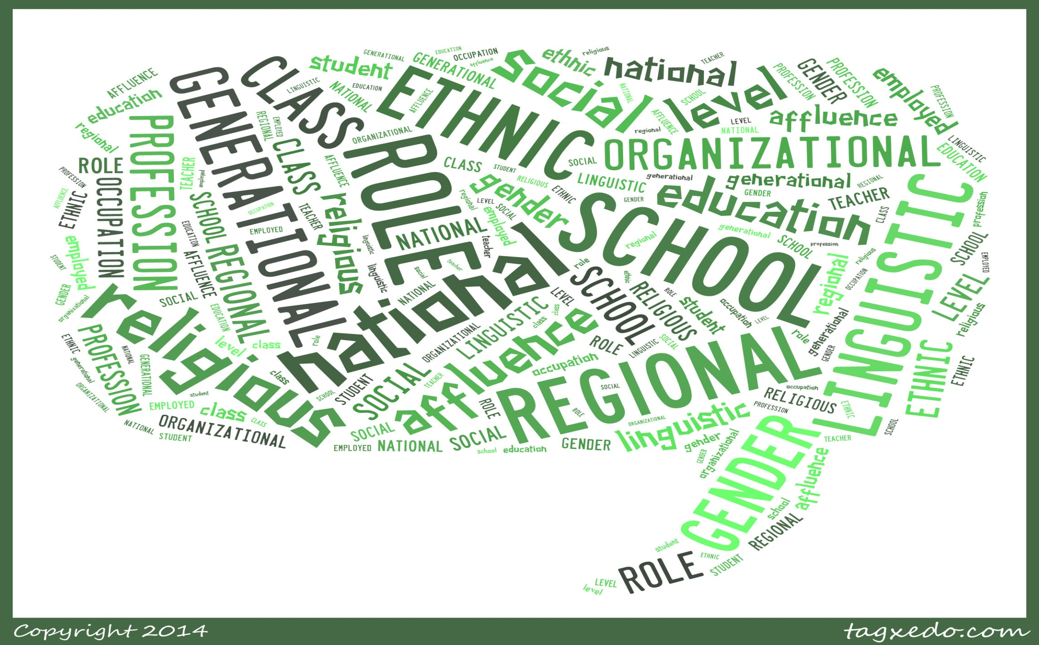
Possible Cultural Distinctions

Slide 12
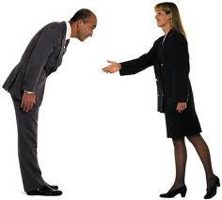
What is culture dissonance
is a sense of discomfort, confusion and a disconnect experienced by people when for a prolonged time they are in the thick of a changed cultural environment. These changes can be unexpected and are often not understood since they are below the water line.
mobility is a continuing feature in today’s world, with individuals voluntarily moving across borders for better prospects. For most of their young children, move involves changes in culture and language differences.

Slide 13
Key Features: Culture Shock
“The psychological events that occur to a person in the initial phases of his encounter with a different culture…culture shock is at the very heart of the cross-cultural learning experience. It is an experience in self understanding and change”(Adler, 1986)
It can be experienced when we realise that what we consider as natural or normal is not perceived similarly and is rejected by the other culture.

Slide 14
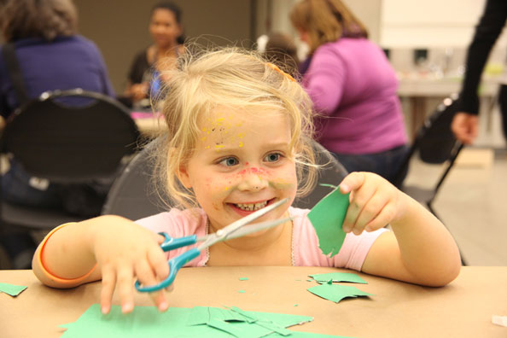
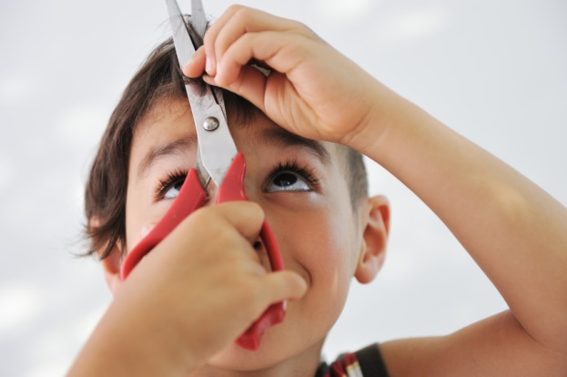
Culture Shock
Scissors
Scissors

Slide 15
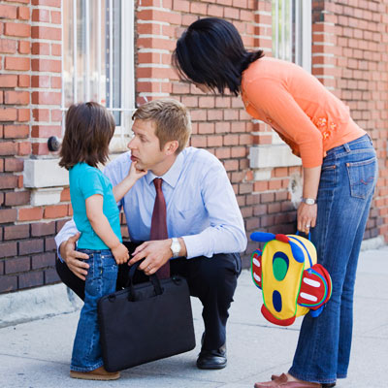
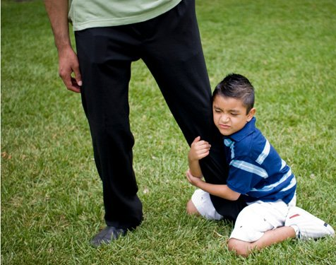
Culture Shock
Separation Anxiety
Separation Anxiety

Slide 16

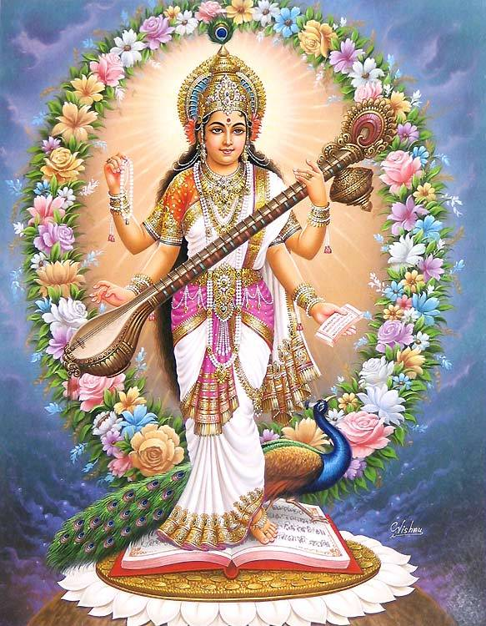
Culture Shock
Symbolism
Symbolism

Slide 17
Key Features: Culture Shock
“ A state of stress and anxiety that results from the disturbing impression we get and the loss of equilibrium we feel when we lose all our familiar signs and symbols of social intercourse and when we encounter environmental differences in an alien culture”
[Craig, 1984, p.36]
Acute homesickness is just one of the symptoms
Comparisons of new environment with the home environment

Slide 18
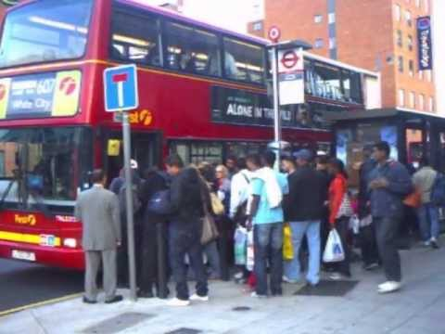
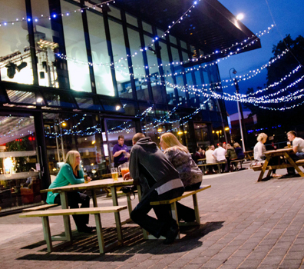
My experience on Culture Shock
Queuing
Campus

Slide 19

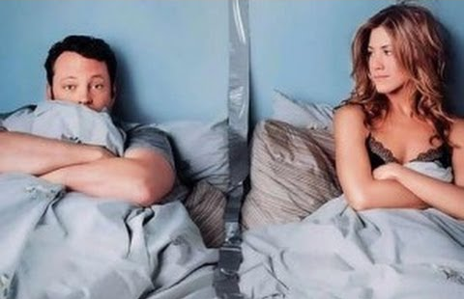

‘U curve’- Culture Shock (Lysgaard 1955, Sewell and Davidson 1956)
Initial Enthusiasm
Recovery (Adaptation)
Disenchantment

Slide 20
Loss of face, identity, self-esteem
“ We interpret the actions of others, and relate them to ourselves and react accordingly, within our own national cultures” (Triandis, 1990).
“When confronted with behaviour of people from other cultures,
our classification system gives us misleading or confusing interpretations” (Hoopes, 1979).
“This error in interpreting the behaviour of others and their reaction
to our behaviour leads to disorientation and
lack or loss of face ” (Allan, 2003)
“ the difference in language alone can be a significant source of anxiety, since language is closely linked to identity” (Burr,1995)

Slide 21

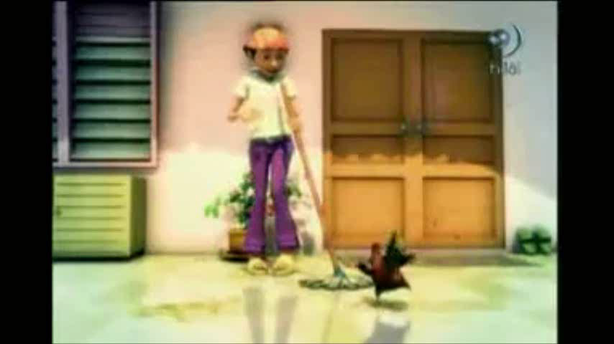
Loss of face, identity, self esteem
I was a very popular boy back home.
Here I have no friends, feel isolated.
Acute homesickness.

Slide 22
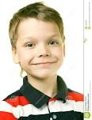
Loss of face, identity, self esteem
“Sad, low , I am different!
I don’t speak like they do!
I feel uncomfortable especially
when I am on the turf . When I go there
And see other students play , I feel unwelcomed
And feel they don’t care”
“face is a positive social value a person effectively Claims for himself by the line the others assume he has taken during a particular contact”
(Goffman,1967)

Slide 23
An intercultural learning
Cultural Dissonance can have positive effects: realisation of cultural differences is the first step towards intercultural learning
Cross- culture can only develop once individuals have mastered insights into their own values, which then allows them to possess greater understanding of other cultures.
Cultural awareness involves looking inward and reflection. It is the development of the personality of the student , where she learns to see different facets of behaviour in people of other cultures, is able to relate and adapt behaviour accordingly.

Slide 24
An intercultural learning
The widening and pluralization of the parameters of social
interactions leads to multiculturalism.
One who has learned the personal interaction skills to be able to communicate on various levels with people of other cultures not only with ones he has concrete experience with, but also eliminating confusion when confronted with new cultures attains multiculturalism.

Slide 25
An intercultural learning continuum
(Allan, 2003)
Awareness Ethnocentrism
Understanding Adaptation
Acceptance and Respect Assimilation
Appreciation and Valuing Multiculturalism

Slide 26
Multiculturalism
“The state in which one has mastered the knowledge and developed the skills necessary to feel comfortable and communicate effectively: with people of any culture encountered; and in any situation involving a group of diverse cultural backgrounds…..The multicultural person is one who has learned how to learn cultures.”(Hoopes, 1979:21)

Slide 27
Key Actions towards intercultural learning
Peer support
Teacher support
Effective ESL programme
Own language teaching
Cultural affirmation
Induction procedures
Social activities
Intercultural teacher training
Intercultural education in the curriculum

Slide 28

Your thoughts………

Slide 29
Allan, M.J. (2002) Cultural Borderlands: a case study of cultural dissonance in an international school. Journal of Research in International education 1(1): 63-90
Allan, M. J. (2003) Frontier crossings; Cultural Dissonance, Intercultural learning and the Multicultural Personality. Journal of Research in International Education 2 (1): 83-109
Berry J W, Poortinga Y H, Segall M H and Dasen P R (1992) Cross-cultural Psychology: Research and Applications, Cambridge University Press .
Burr, V. (1995) An Introduction to social Constructionism. London: Routledge.
DeCapua, A and Wintergerst, A. (2010) Crossing cultures in the language Classroom. The university of Michigan Press.
Fennes, H. and Hapgood, K. (1997) Intercultural learning in the classroom. London; Casselle.
Goffmann, E. (1967) Interaction Rituals: Essays on face-to-face behaviour. New York: Pantheon Books.
Hofstede G (1994) Cultures and Organisations, McGraw Hill
Pearce R (1998) Developing Cultural Identity in an International School Environment in Hayden and Thompson (eds) International Education: Principles and Practice, pp. 44-64. London: Kogan Page.

Slide 30
Thank you!
Contact: namrata@namratagoel.com

