Slide 1

Striving and struggling toward international-mindedness
Akın METLI
Bilkent Erzurum Laboratory School (BELS),
Bilkent University, Ankara, Turkey
06.10.2017
Photo 1

Slide 2
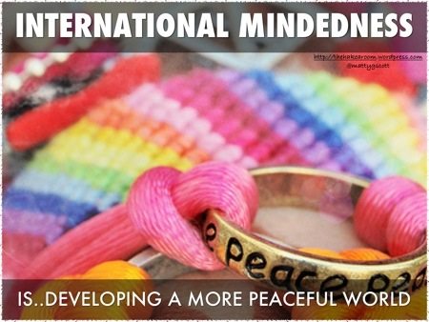
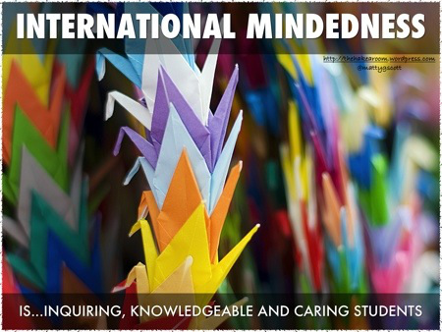
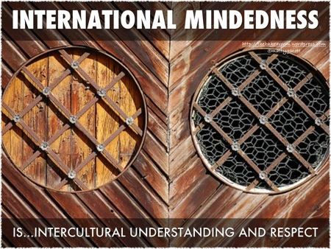
I’m IM.
Photo 2
Photo 3
Photo 4

Slide 3
Introduction
International-mindedness (IM) as a contested term
IB: IM through reducing ethnocentrism, increasing intercultural understanding and promoting global awareness
Prior research on the conceptualization, assessment and practices of IM
Conceptual Framework: Pillars of IM – Multilingualism (ML), Intercultural Understanding (IU) and Global Engagement (GE)
Research Aim: to investigate the practices and implementation of IM through student and teacher perspectives on supports, practices and challenges of IM and its pillars

Slide 4
Research Design
Multi-case study - mixed methods approach
IM conceptual framework: ML, IU, GE
Participants: Students, teachers and administrators from a NS and IS (IB continuum schools)
Instrumentation: Surveys (DS, IDI, GCS), interviews, focus groups, document review, classroom/school culture observations
Data Collection: Two-day visits to each case school three times in the 2016-2017 academic year
Data Analysis: Thematic content analysis of transcripts, descriptive statistics for IDI and GCS

Slide 5
General Findings on IM Pillars (ML, IU, GE)
ML shows the greatest differences among schools
IU easily discussed and understood
Struggled in defining, interpreting and giving examples on GE
Similar measures of IU (IDI - slightly stronger developmental score in the IS) and GE (GCS)

Slide 6
What are the assets of each school for supporting IM?
What do the two schools have in common?
school cultures demonstrating features fostering IM
How are the two schools different in terms of their IM supports?
IS: community-based supports, extracurricular activities
NS: a wide range of service activities, TOK supports, clubs, workshops, conferences

Slide 7
What are the unique challenges for IM?
What do the two schools have in common for IM challenges?
- Conceptualizing IM
Varied perspectives on assessment
Intercultural understanding: not well addressed
How are the two schools different in terms of their IM challenges?
IM as developmental (NS) vs IM as a fixed trait (IS)
IS: lack of explicit teaching/learning strategies, taking IM for granted
NS: Socio-political environment, bureaucracy, MoNE, budget and time, university examinations

Slide 8

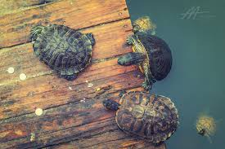
Striving and Struggling for IM
What features tell the story of the “struggling/striving” contrasts?
What counter evidence shows how sometimes the struggling school was also striving, and vice versa?
Photo 5
Photo 6

Slide 9
Conclusion
Not intended to be generalizable to the entire international education contexts
Utilizing the research findings for reflection on the perception of supports, practices and challenges of IM
Using the IM framework for self-evaluation on the pillars of IM and developing an action plan

Slide 10
The End…
Thank you for listening to me.
Questions?
Contact Information:
Email: metli@bels.bilkent.edu.tr

Slide 11
References
Braun, V., and Clarke, V. 2006. “Using thematic analysis in psychology”. Qualitative Research Psychology. 3 (2), 77-101.
Brinkman, S., and Kvale, S. (2015). Interviews: learning the craft of qualitative research interviewing. USA: SAGE Publications.
Hacking, E, Blackmore, C, Bullock, K, Bunnell, T, Donnelly, M., and Martin, S. 2017. The international mindedness journey: School practices for developing and assessing international-mindedness across the IB continuum. Bethesda, MD, USA. International Baccalaureate Organization.
Hammer, M. 2017. “Education Group Profile Report”, Intercultural Development Inventory v.3 (IDI), USA.
International Baccalaureate Organization. (2008). Towards a continuum of international education. Cardiff, Wales: Author
Marshall, H. 2007. “The Global Education Terminology Debate: Exploring Some of the Issues” in The SAGE Handbook of Research in International Education, M. Hayden, J. Levy and J. Thompson, eds, 38-50. London: SAGE Publications
Morais, D., Ogden, A. 2010. “Initial development and validation of the global citizenship scale” Journal of Studies in International Education, 15 (5), 445-466.
Singh, M., and Qi, J. 2013. 21st century international-mindedness: An exploratory study of its conceptualization and assessment. The Hague: International Baccalaureate Organization.
Sriprakash, A., Singh, M., and Jing, Q. 2014. A comparative study of international mindedness in the IB Diploma Programme in Australia, China and India. Bethesda, MD, USA: International Baccalaureate Organization.
Yin, R. K. 2003. Case study research: Design and methods. Thousand Oaks, Calif: Sage Publications.

Slide 12
References
Pictures retrieved from the following websites (accessed on 03.10.2017);
Photo 1: https://www.google.com.tr/search?q=international+mindedness&source=lnms&tbm=isch&sa=X&ved=0ahUKEwjVyN-d4dbWAhXSh7QKHQ_uApkQ_AUICigB&biw=1366&bih=620#imgrc=KHmrE5ct3RTIUM:&spf=1507112944029
Photo 2, 3 and 4:
https://thehakearoom.wordpress.com/2013/08/19/international-mindedness-2/
Photo 5: https://www.google.com.tr/search?biw=1366&bih=620&tbm=isch&sa=1&q=striving&oq=striving&gs_l=psy-ab.3..0j0i30k1l3.68310.69352.0.69541.8.8.0.0.0.0.182.616.0j4.4.0....0...1.1.64.psy-ab..4.4.611....0.klmq5w8SnbU#imgrc=Ru1yHj71KM4jyM:&spf=1507113016863
Photo 6: https://www.google.com.tr/search?biw=1366&bih=620&tbm=isch&sa=1&q=struggling&oq=struggling&gs_l=psy-ab.3..0l4.46916.53778.0.53981.24.17.3.0.0.0.645.1985.0j6j2j5-1.9.0....0...1.1.64.psy-ab..13.11.1411...0i67k1j0i13k1j0i13i30k1.0._25weWpw10w#imgrc=iaeeTFDxj0fJXM:&spf=1507113072885

