Slide 1
Internationalizing students:
International perspectives from localized experiences

Slide 2
The Impact of Creativity, Activity, Service (CAS) on students and communities (2017)
Professor Mary Hayden,
Anthony Hemmens,
Dr. Shona McIntosh,
Dr. Andrés Sandoval-Hernández,
Professor Jeff Thompson

Slide 3
Creativity, Activity, Service (CAS)
International Baccalaureate Diploma Programme (IBDP)
CAS: experience-based learning
Potential to personally experience international issues?

Slide 4
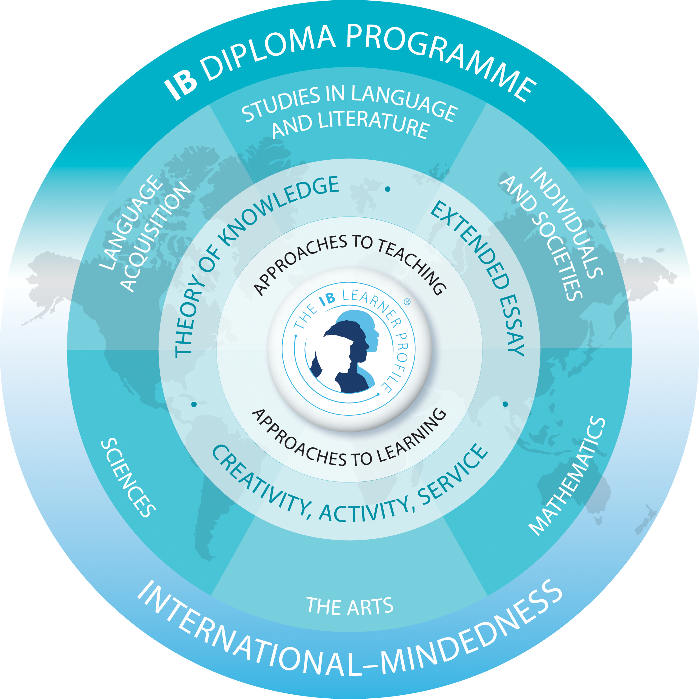

Slide 5
CAS and internationalisation?
“a range of enjoyable and significant experiences, as well as a CAS project...”
[p3, current, 2015, CAS Guide published by the IB]

Slide 6
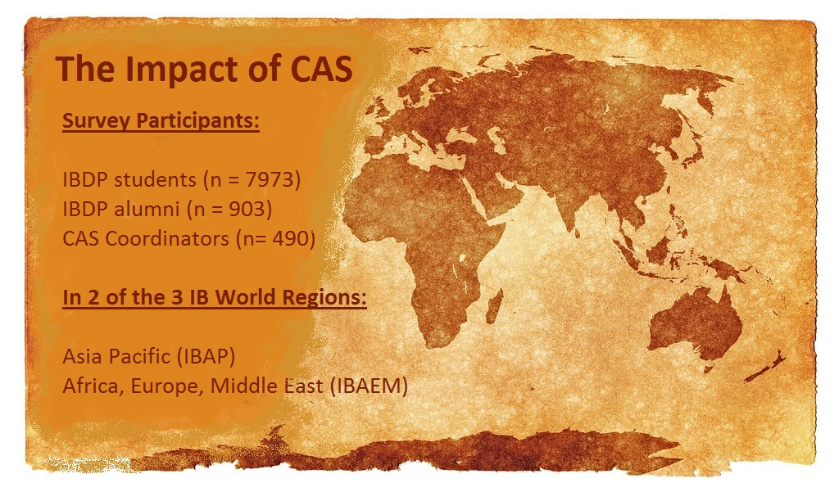

http://ibo.org/contentassets/d1c0accb5b804676ae9e782b78c8bc1c/cas-summary-2017-en.pdf

Slide 7
CAS
Activities
by
theme
Creativity Themes | Action Themes | Service Themes Volunteering/helping… | Project Themes
Performing | Sport | At school | Charity
Making | Exercise | With/for charity | School
Organising | Other | In the wider community | Educational
Communicating |  | Other | Other
Giving
Other

Slide 8
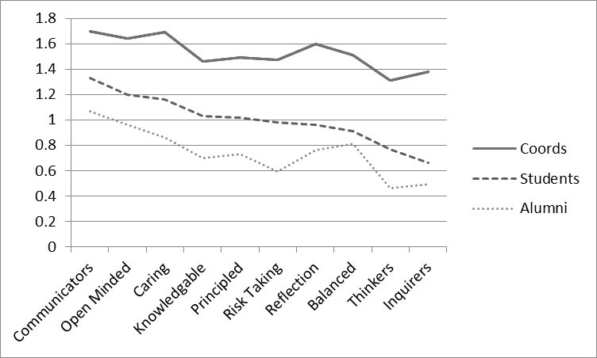
Impact of CAS on students’ attributes
Learner
Profile
Attributes

Slide 9

Emergent benefits of CAS
Well-being:
feeling fitter
involvement with people
“stress-buster”
Having fun
Balance

Slide 10

Developing an international perspective
Through creativity

Slide 11
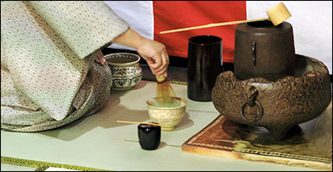
…through Creativity

Slide 12
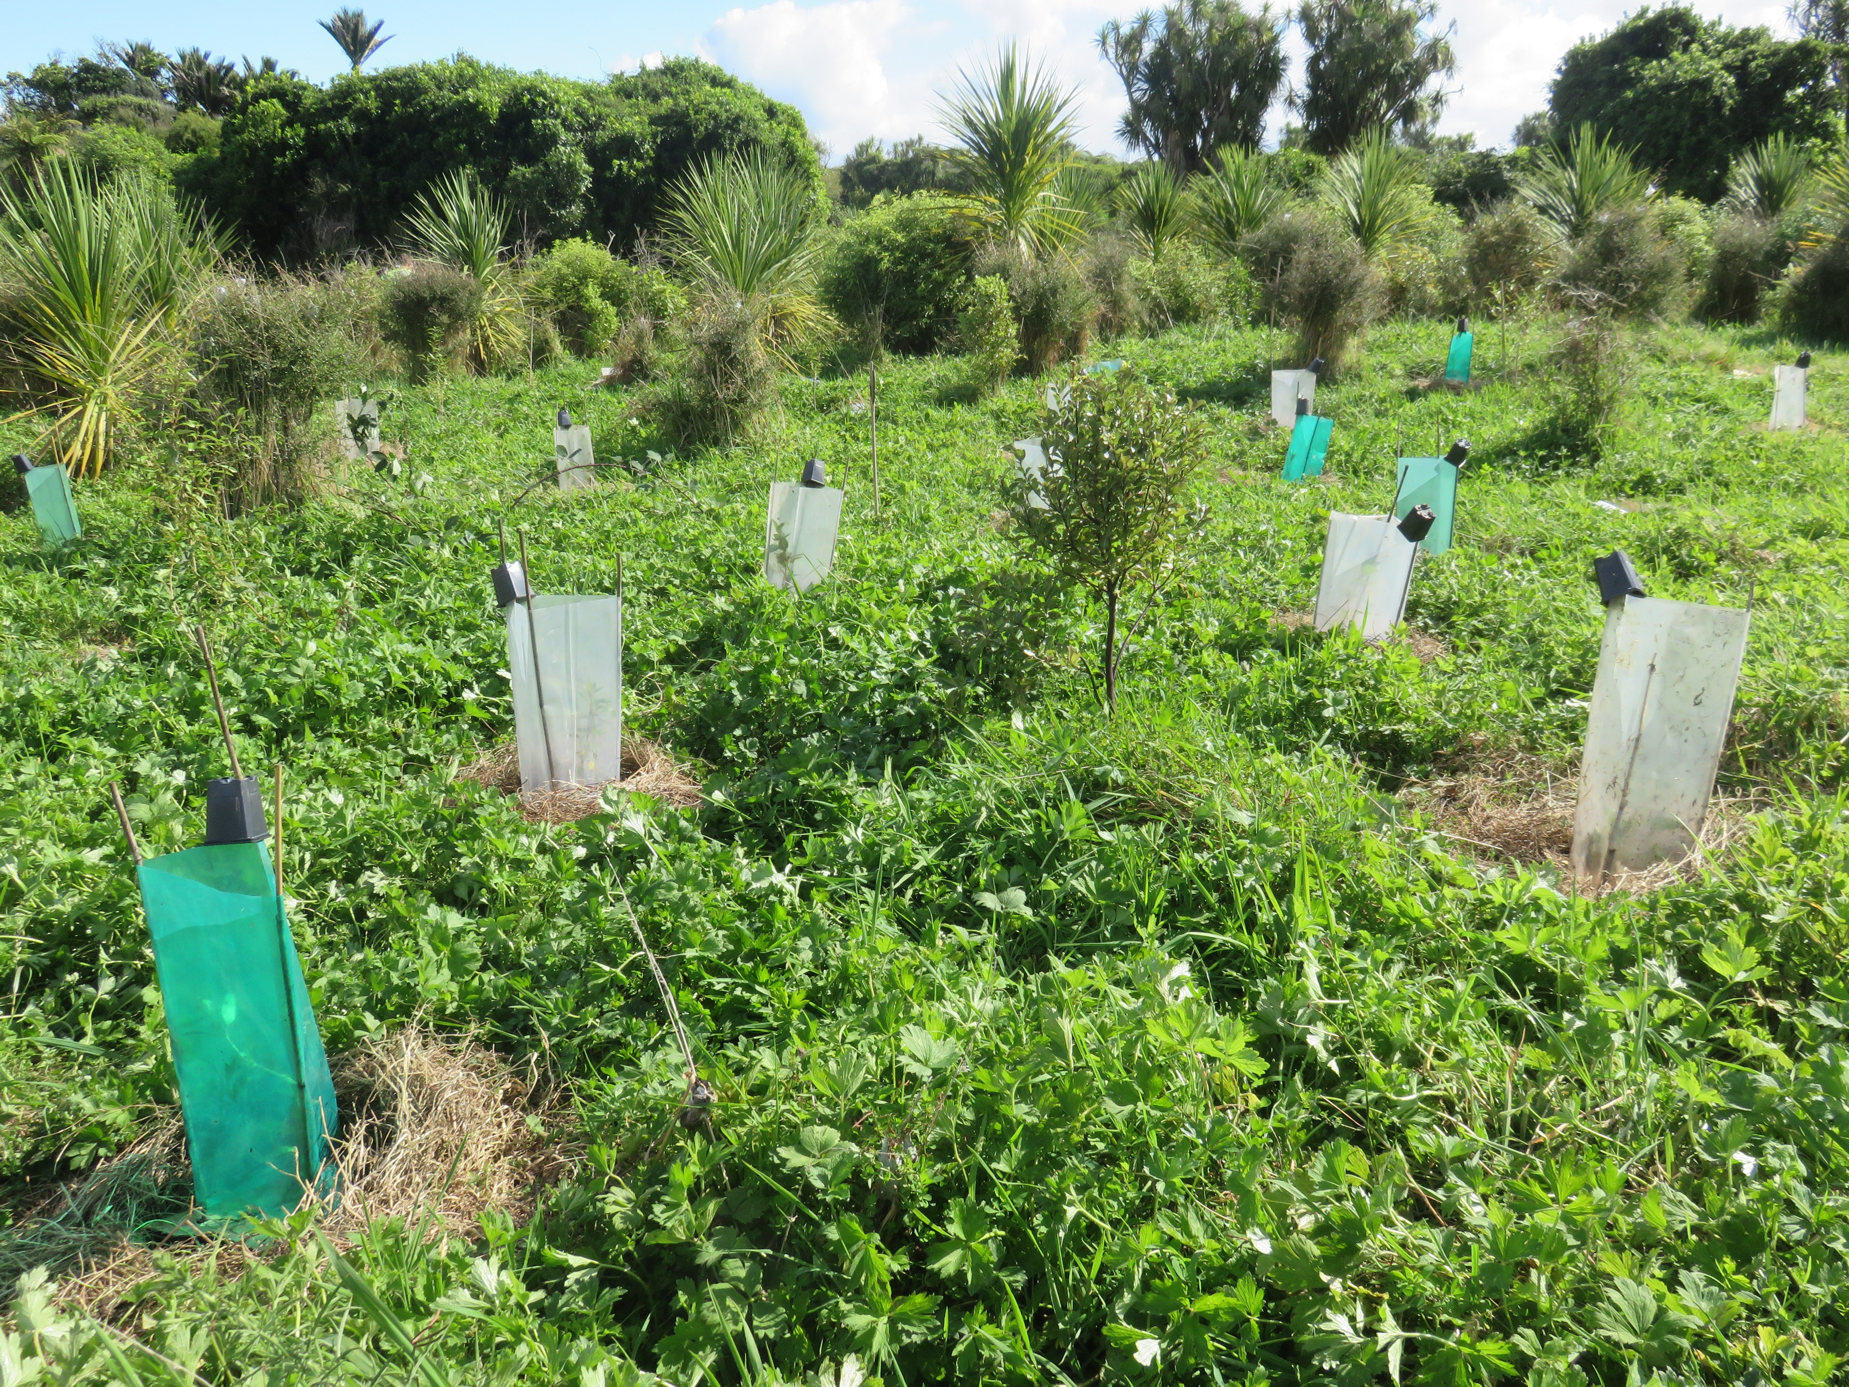

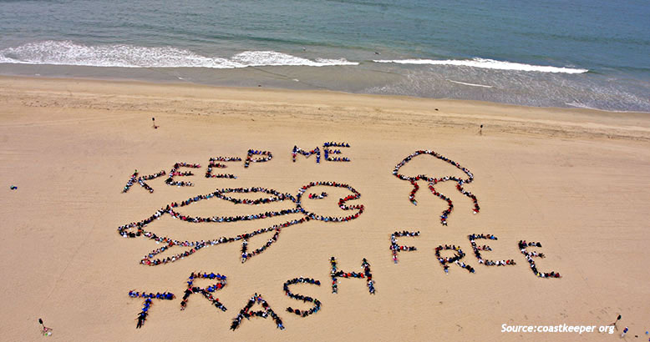
Developing an international perspective
Through activity

Slide 13
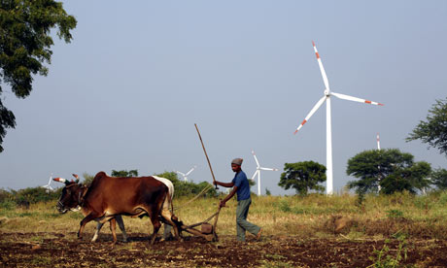

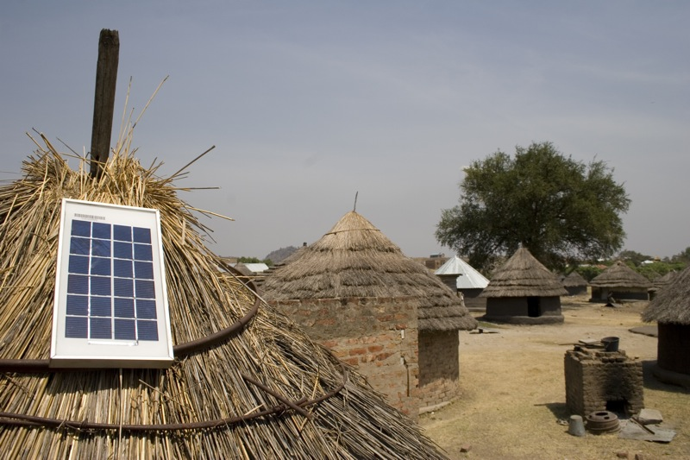
  Through Activity

Slide 14

Developing an international perspective
through service

Slide 15
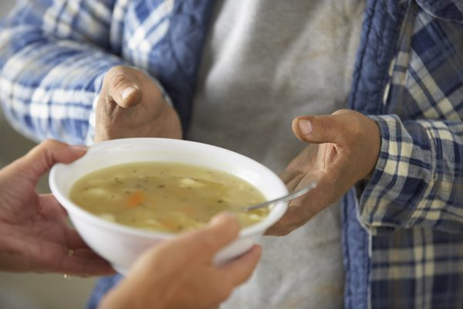

Through Service

Slide 16
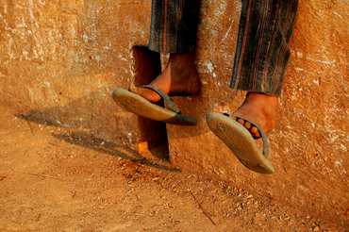
Developing an international perspective
through CAS projects

Slide 17
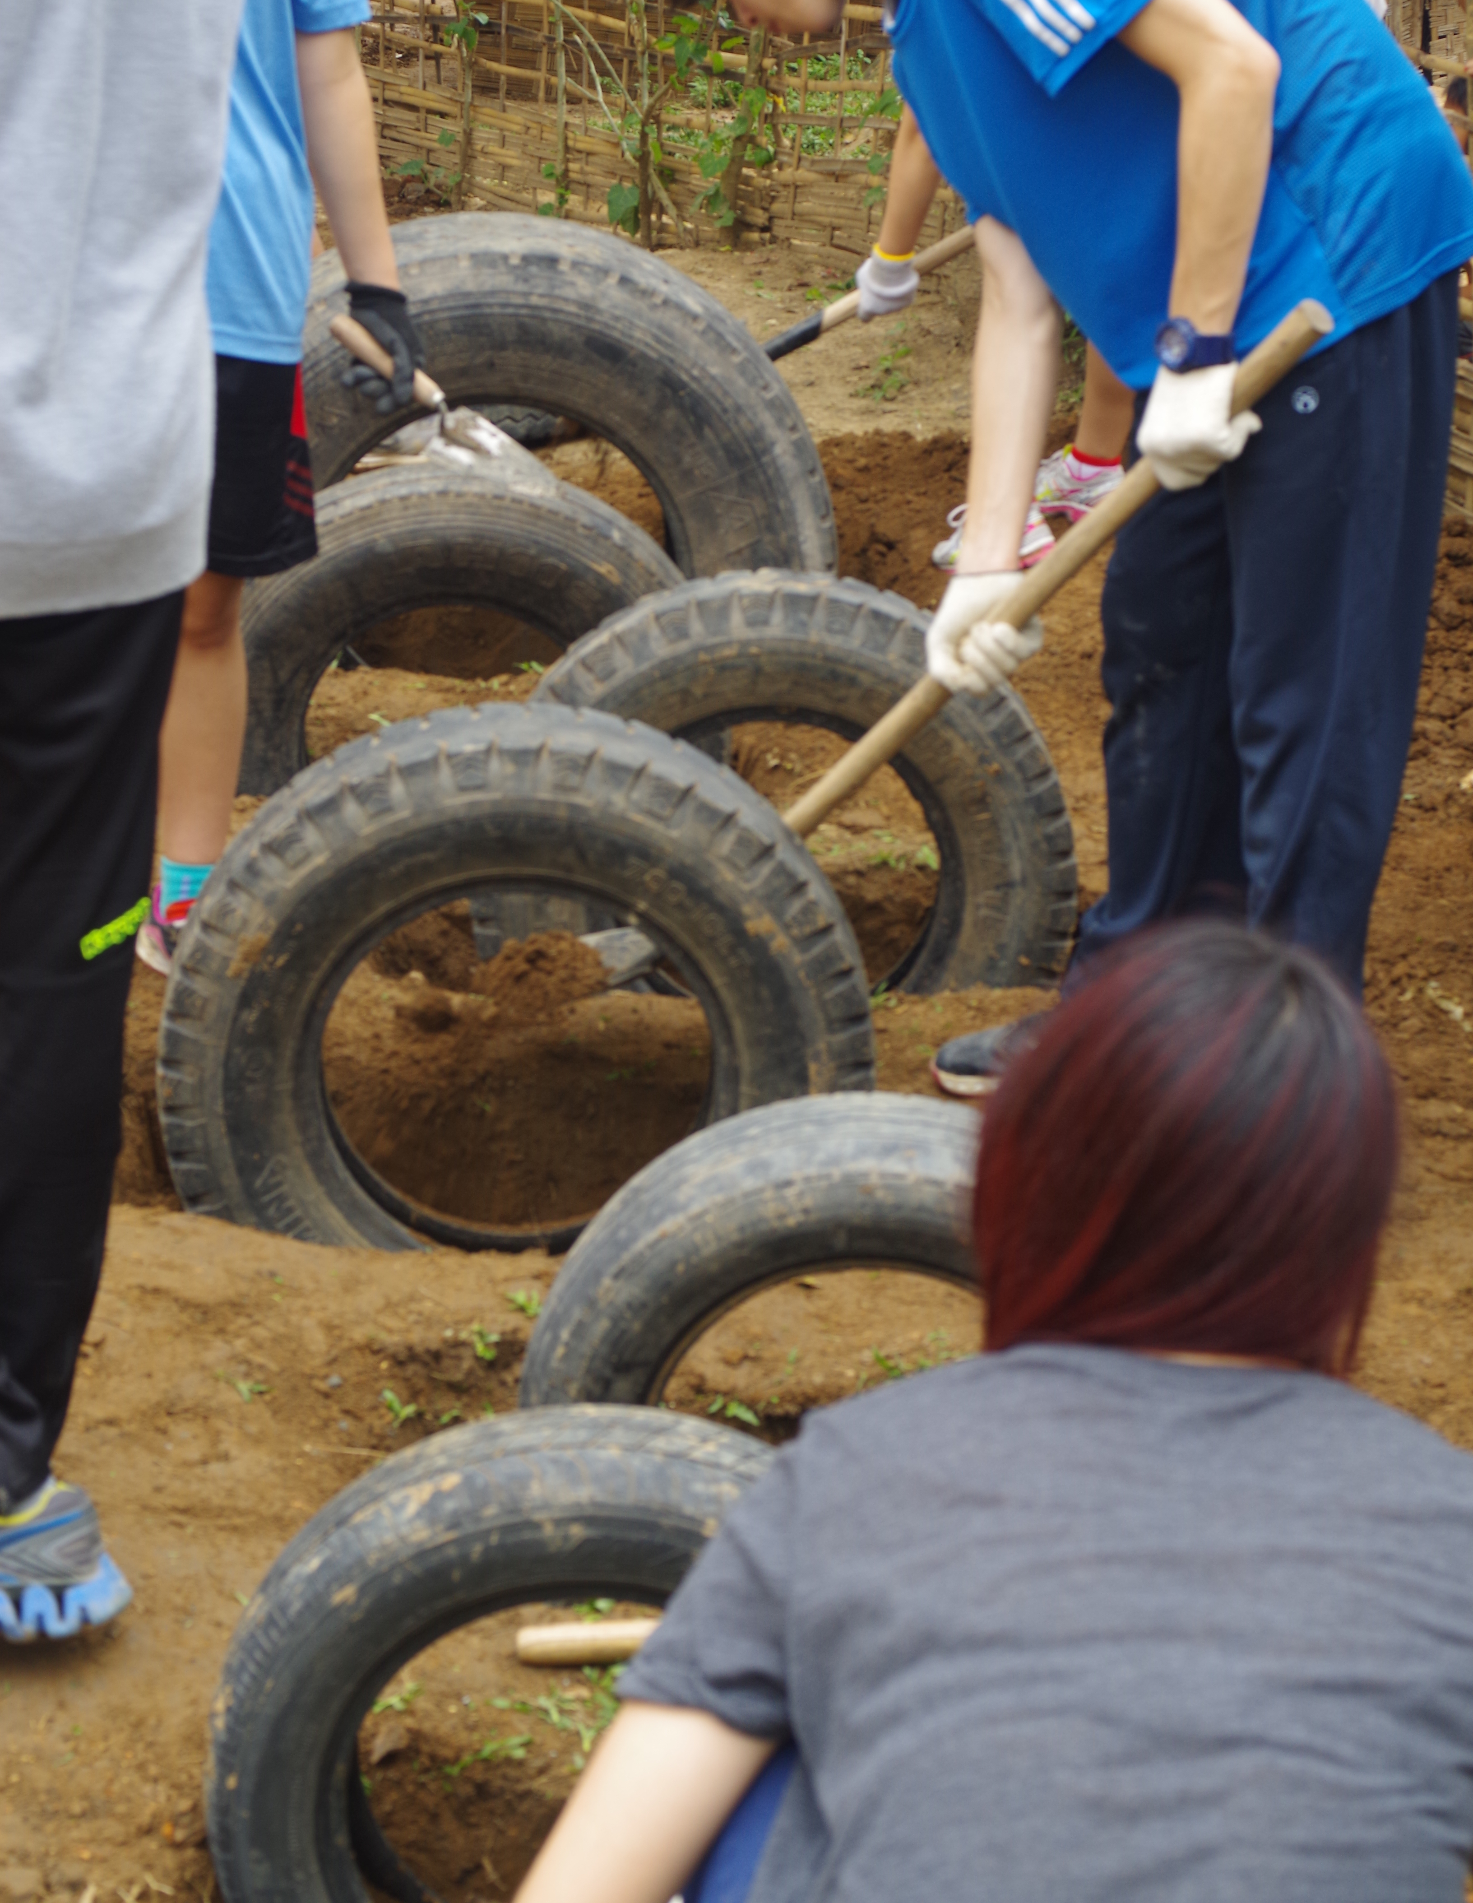
Can internationalising begin at home?
Just a memorable experience?

Slide 19
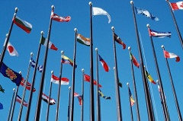
Internationalising intentionally
Dr. Shona McIntosh
Department of Education
University of Bath
s.p.mcintosh@bath.ac.uk

Slide 20
Thankyou for listening!
Barratt Hacking E, Blackmore C, Bullock K, et al. (2016) The international mindedness journey: School practices for developing and assessing international mindedness across the IB continuum. International Baccalaureate Organization.
Hayden M, Hemmens A, McIntosh S, et al. (2017) The Impact of Creativity, Activity, Service (CAS) on Students and Communities. http://ibo.org/contentassets/d1c0accb5b804676ae9e782b78c8bc1c/cas-finalreport-2017-en.pdf: University of Bath, Department of Education.
https://quyenscasblog.wordpress.com/2015/05/23/cas-project-his-playground-project-dien-bien-phu/amp/

