Slide 1
Intercultural Understanding Beyond the Classroom
Melanie Hilton
AIE 2014 Conference - École Mondiale World School

Slide 2
The World is Changing ….
The world is evolving rapidly.
Increased transnational migration is making communities more heterogeneous or “glocalised”.
According to the OECD, today, most goods and a growing share of services are “made in the world” (Interconnected Economies, 2013)

Slide 3
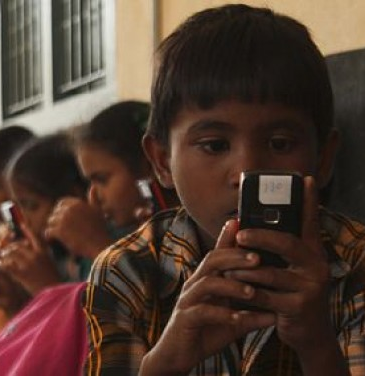
… And we Communicate Differently
In 2006, the US postal service delivered 250 million pieces of mail. By 2012, it had dropped to 50 million (USPS)
The number of mobile phones in the world is now more than the number of people and Hans Vestberg, CEO of Ericsson, has predicted that by 2020, 50 billion devices will be connected to the internet.
It therefore falls to us as educators to prepare young people for tomorrow’s challenges.

Slide 4
“The only certainty is that nothing is certain”
"I think there is a world market for maybe five computers” (Attributed to Thomas J Watson, CEO of IBM, 1943).
So, first and foremost, we must prepare our young people to be flexible, adaptable and tolerant.
They must have skills that enable them to utilise technology to maximum advantage and address challenges and solve problems using all of the resources at their disposal – particularly each other.

Slide 5
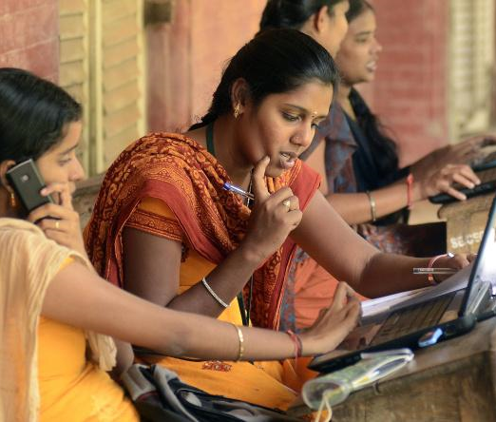
CIE Global Perspectives
Cambridge International’s Global Perspectives prepares learners for positive engagement with our rapidly changing world.
Learners broaden their outlook through the critical analysis of - and reflection on - issues of global significance.
The syllabus is based on skills: Learners develop research, thinking, reasoning and communication skills by following an approach to analysing and evaluating arguments and perspectives called the Critical Path.
The skills gained enable students to meet the demands of twenty first century learning.

Slide 6
AP Capstone (AP Seminar/AP Research)
AP Seminar strengthens analytic and inquiry skills.
Students learn to consider an issue from multiple perspectives, evaluate the strength of an argument, and make logical, fact-based decisions.
AP Research allows students to design, plan, and conduct a year-long research-based investigation on a topic of individual interest.
Through this inquiry and investigation, students demonstrate the ability to apply scholarly understanding to real-world problems and issues.
It cultivates “curious, independent, and collaborative scholars and prepares them to make logical, evidence-based decisions.”

Slide 7
UNESCO - Citizenship
A module to embed within existing curriculum models to encourage and develop sustainable, international citizenship:
To develop an understanding of the nature and scope of educating for active citizenship;
To provide examples of some school initiatives in active citizenship; and
To develop skills for planning across-the-curriculum learning experiences in citizenship education in school, community and settings.
“It is necessary to introduce, at all levels, true education for citizenship which includes an international dimension.”
UNESCO Declaration and Integrated Framework of Action on Education for Peace, Human Rights and Democracy, 1995.

Slide 8
Programme for International Student Assessment (PISA) 2015
Collaborative problem solving competency is the capacity of an individual to effectively engage in a process whereby two or more agents attempt to solve a problem by sharing the understanding and effort required to come to a solution.
(www.pisa.oecd.org)

Slide 9
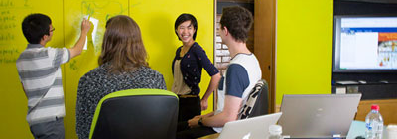
Assessment & Teaching of 21st Century SkillsTM (ATC21S)
The project team believed that curricula must go further to include skills such as collaboration and digital literacy that will prepare students for 21st-century employment.
ATC21S has devised a developmental learning approach to assessment and instruction of 21st-century curricula, with an emphasis on:
digital fluency,
problem-solving,
citizenship, and
communication and collaboration.

Slide 10
Beyond the Classroom …
Future Leaders, Cambridge, 2014:
New to working together, and with teachers who were themselves new.
They were unfamiliar with the learning platform used to record their progress on the programme.
The curriculum content was new.
The style of assessment, leading to a qualification of the Institute of Leadership and Management, was being experienced by them for the first time.

Slide 11
Global Study Pass
We provide international learning experiences for students, equipping them with skills that stand out in the eyes of universities and employers.
We believe that capabilities such as entrepreneurialism, creativity, leadership, and collaborative problem-solving will become increasingly important in a global economy.
We have designed a range of accredited programmes, delivered in collaboration with schools across the globe, that enhance and enrich existing curricula and areas of education and develop ‘global citizens’

Slide 12
Our Programmes …
Our Short Programmes run for 2-3 weeks at a range of exciting locations across the world and focus on important aspects of 21st Century Skills.
They operate a model of blended learning, combining face-to-face teaching and real life experiences with online delivery.
Future Leaders explores the key hallmarks of effective leadership in the 21st Century, and core leadership behaviours endorsed by UNESCO and others.
The Living Leadership model (Ashridge Business School) underpins the programme, giving students early insight into leading with integrity and situational awareness.

Slide 13
… Our Programmes
The Enterprise Programme is designed to develop the broad range of skills key to success in employment, education or as an entrepreneur in the 21st Century.
Students complete project-based activities, group work, challenges, presentations and quizzes, improving creativity, collaborative problem-solving and critical thinking.
We also offer the opportunity for young people to study abroad for extended periods, from four weeks to two years in a host school in a wide range of locations around the world.

Slide 14
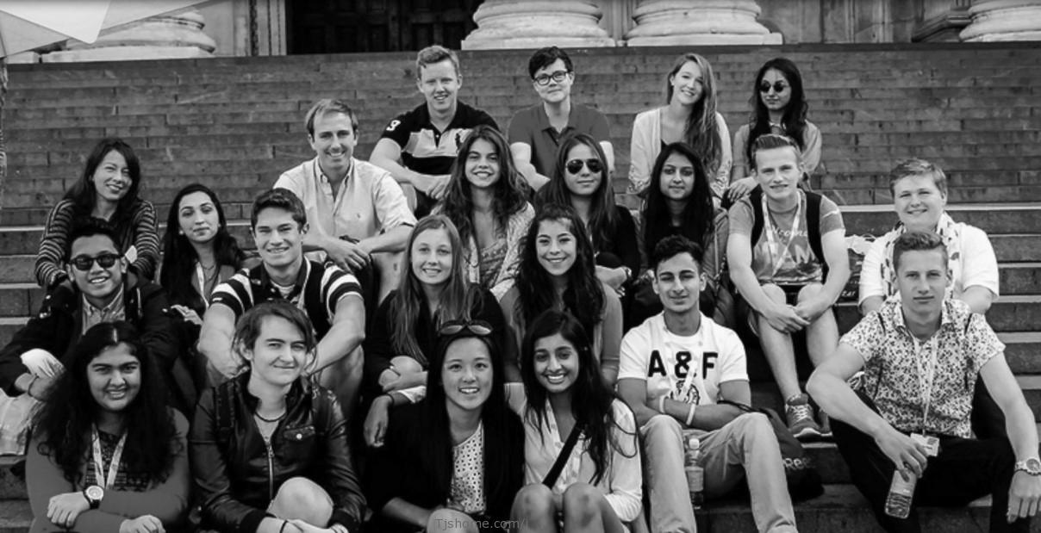
Future Leaders, Cambridge, 2014

Slide 15
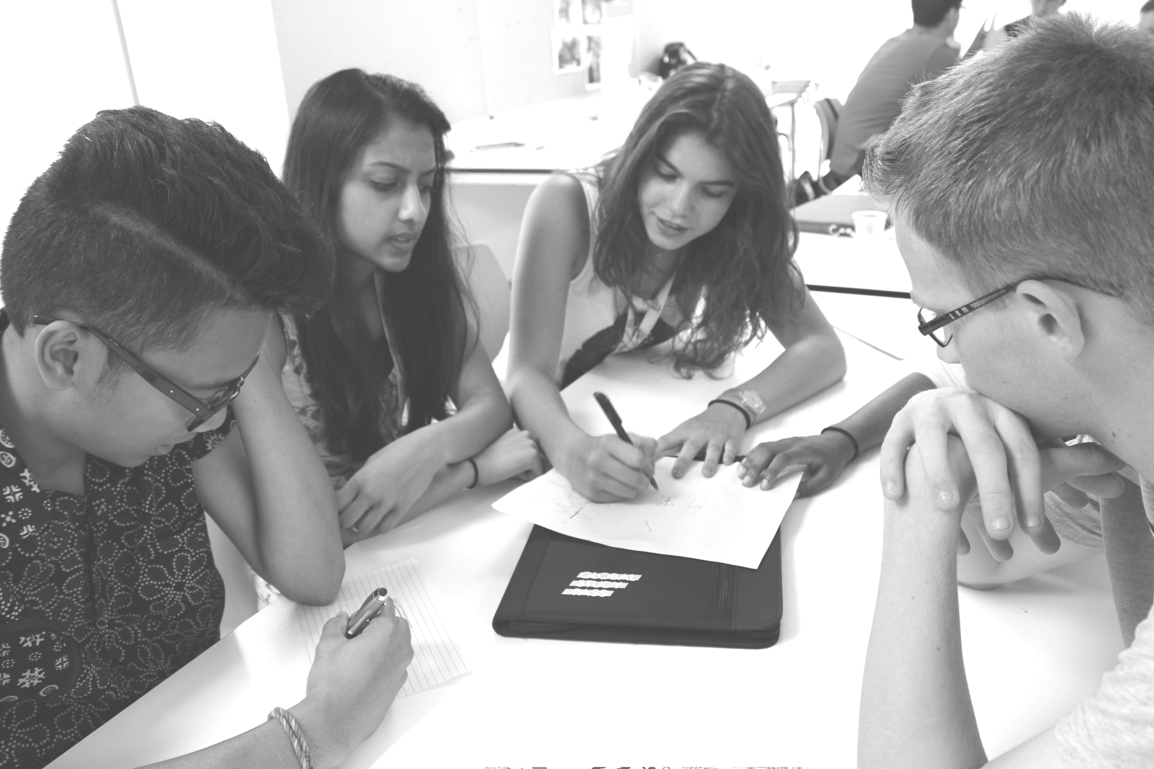
Future Leaders, Cambridge, 2014
Twenty young people from nine countries.
Two week residential programme.
140 Guided Learning Hours - Accredited by the Institute of Leadership and Management (ILM).
Mix of discussion, debate, project-based activities, group work, challenges, presentations and quizzes.
Comprised of ten units.
Included cultural activities.
Developed creativity, collaborative problem-solving
and critical thinking.

Slide 16
Intercultural Understanding
The programme immersed participants in a multicultural environment;
It provided them with tools to understand life’s complexities;
The programme developed self-awareness and social skills; and
It demonstrated to participants, the inherent values within human rights, democracy, intercultural understanding, respect for others.

Slide 17
What went well?
Authenticity of programme;
Qualification framework;
Enthusiasm and energy of students;
Sharing of perceptions, expectations and ideas.

Slide 18
What were the risks?
There is a need for reflective time in a busy programme; and
Careful design of the social programme is crucial.

Slide 19
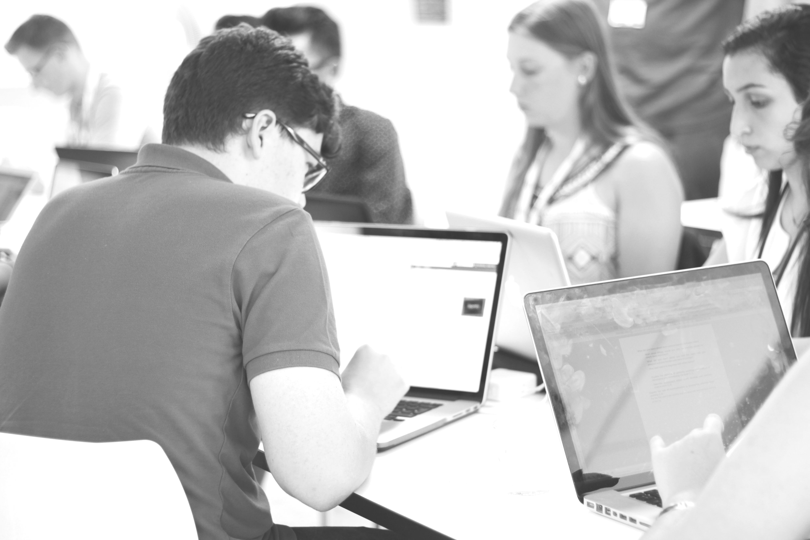
Student Feedback
“This was one of the greatest trips of my life. I have met so many interesting people that I hope to stay friends with forever. I have learned important skills I will use for the rest of my life. It was an overall great experience!”
“This experience was wonderful. It opened my eyes and I have learnt a lot about the world and leadership. However, the teachers and my peers deserve the most credit as it was the people who made the experience so enjoyable.”

Slide 20
www.globalstudypass.com

