Slide 1

Cultural Humility in Higher Education Contexts –
The Essence of Ethical, Principled Leadership
AIE 2017
Amsterdam
Dr. Colleen Kawalilak
Associate Dean International
Werklund School of Education
Calgary, CANADA

Slide 2
UofC International Strategy
UofC International Strategy
Goal 1: Increase diversity of our campus communities
Goal 2: To improve global and cross cultural competencies within our campus communities
Goal 3: Enhance opportunities for international collaborations and partnerships in research and education
Goal 4: Leverage our unique areas of expertise to engage in international development
Notes:
Build on strengths

Slide 3
Goal 2
*Internationalization Task Force on Cross/Intercultural Competencies
Created to address Goal 2: To improve global and cross cultural competencies within our campus communities
The Task Force positions itself at the intersection of a number of initiatives on campus that focus on deepening and enhancing cross/intercultural competencies.

Slide 4
Mandate – Internationalization Task Force
Determine cross-cultural competencies required for the University of Calgary
Determine internal standards for international competencies (cross-cultural or intercultural competencies and international research competencies)
Perform an audit of existing cross-cultural competencies (students, staff, faculty, and graduates) to establish a baseline and perform a gap analysis
Target deficiencies and operationalize expected outcomes
Notes:
COLLEEN will speak to this slide

Slide 5
Cross-Cultural Competencies I, II, III
Understanding Global Connections and Cultural Differences
Interdependency of worldwide systems (natural and built)
Power structures across time and space
Cultural differences in local and global contexts
Human impact on worldwide systems
Inequities and injustices related to gender, race, nationhood, religion, age, class
Communicating Across Cultures
Relation between language and social context
Linkage between language and non-verbal behaviours
Bridge cultural differences to reach common goals
Understanding language as shaping values and beliefs
Traverse cultural boundaries
Appropriate intercultural communication
Analyzing Cultures and Valuing Diversity
Compare hierarchies and inequalities embedded in culture
Respect multiple cultural perspectives
Understanding cultures as existing in contexts
Historical legacies shape knowledge, individuals, and values
Critical self reflection regarding one’s own culture
Understanding cultures as constantly changing

Slide 6
Traditional Focus
Regardless of how one shifts the lens, the focus remains:
Recruitment of international students
Study abroad/travel study programs
Agreements (joint degrees/cotutelle agreements)
Advancing the “Pause” and “Reflective Practice”—
Creating spaces for dialogue – leaning into difficult conversations (what are some difficult conversations?)
Principles that guide our work

Slide 7
Moving Forward with Intention –
Guiding Principles
Cultural Humility
“[the] ability to maintain an interpersonal stance that is other-oriented (or open to the other) in relation to aspects of cultural identity that are most important to the [person]” (Hook, Davis, Owen, Worthington, & Utsey, 2013, p. 2).
… focuses on an interactive, process-oriented approach to competency (seeks to “understand” versus “inform”)
Factors—
Lifelong commitment to self-evaluation and self-critique (requires openness and ongoing flexibility a responsiveness – we are never “done”—never “competent)
Desire to fix power imbalances (we each bring something of value—collaborating and learning from one another)
Develop partnerships with people/groups who advocate for others—includes advocating within larger organizations in which we participate as cultural humility is larger than ourselves – we must advocate for it systemically

Slide 8
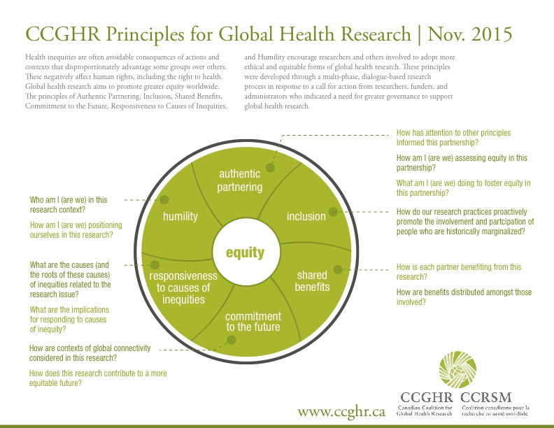
Global Health Research

Slide 9
Leading with Intention
Moving forward by stepping back
Identifying and making transparent Guiding Principles
An ongoing, fluid process
Revisiting Guiding Principles (adjust as needed)
Creating spaces to deepen cultural humility opportunities and practices
Reflective practice is a legitimate “Action Item”
Advancing Internationalization at Home (IaH)
A sub-set of Internationalization of the Curriculum (IoC)
Examples …

Slide 10
References
Hook, J. N., Davis, D. E., Owen, J., Worthington Jr., E. L., & Utsey, S. O. (2013). Cultural humility: Measuring openness to culturally diverse clients. Journal of Counseling Psychology. doi:10.1037/a0032595
Tervalon, M., & Murray-Garcia, J. (1998). Cultural humility versus cultural competence: A critical distinction in defining physician training outcomes in multicultural education. Journal of Health Care for the Poor and Undeserved, 9, 117-125.
University of Calgary International Strategy (2013). Retrieved from http://www.ucalgary.ca/uci/files/uci/ucalgary-international-strategy.pdf

