Slide 1
Creative leadership and intercultural understanding

Slide 2
Intercultural education
Culture
Leadership
Relationships
Notes:
Leading for:
Creative teaching
Creative learning
Teaching creativity

Slide 3
Global citizenship
Notes:
Our youngest students will start work in 2030
Predictions for that year include a macbook with the computational ability of the human brain.
The old will outnumber the young
What will the world of work require for out students to be successful

Slide 4
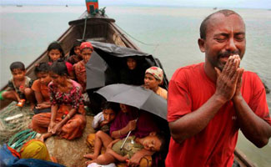
Excluded from global citizenship
Notes:
Global citizenship is almost a given isn’t it?
Or are there layers:
Rohingya in Myanmar

Slide 5
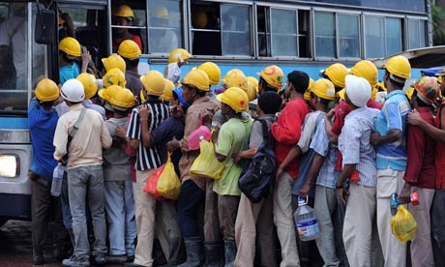
Tentative global citizenship
Notes:
Migrant Burmese workers in Thailand

Slide 6
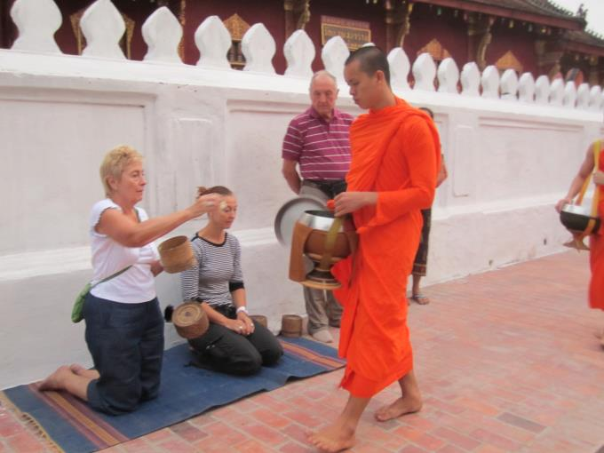
Secure global citizenship
Notes:
Tourist or expat executives in Myanmar

Slide 7
With whom do our students
have most in common?
What kind of global citizens are our students?
Notes:
Tourist or expat executives in Myanmar

Slide 8
Student demographics
50 nationalities represented
Notes:
A typical international school?

Slide 9
Teacher demographics
26 nationalities represented
Other Nationalities
Chinese
French
Spanish
German
Japanese
Paraguan
Argentinian
Belgian
Colombian
Costa Rican
Finnish
Korean
Malaysian
Phillipino
Salvador
Swedish
Taiwanese
Notes:
Faculties are becoming more divers

Slide 10
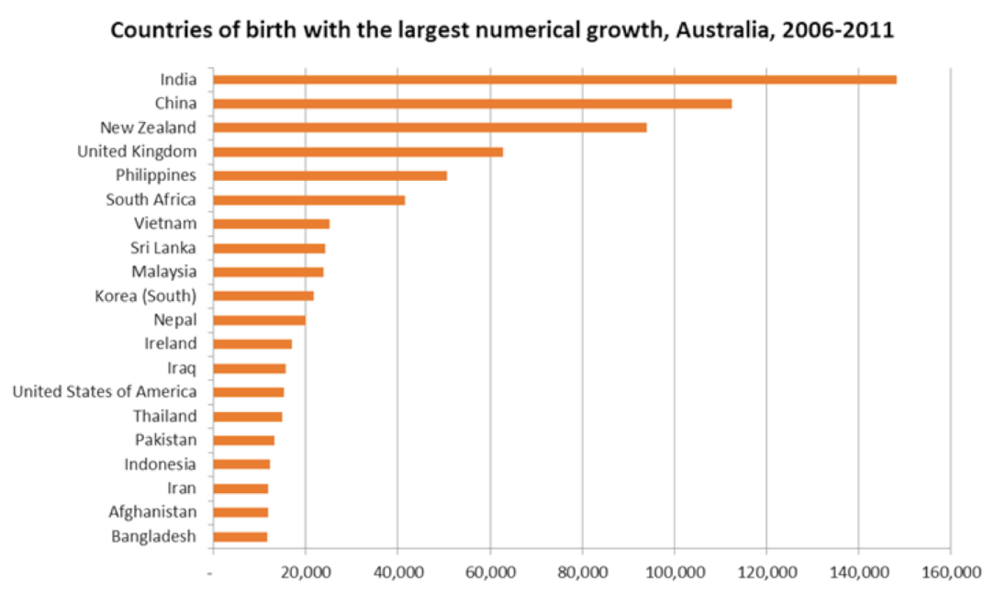
Australian countries of origin increase 2004-11
Notes:
As are nations

Slide 11
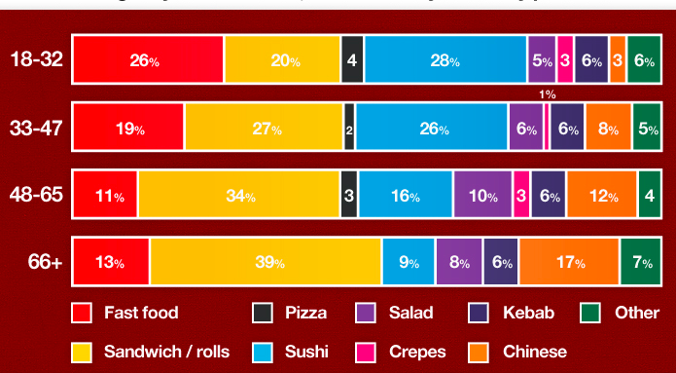
Australian food court preferences
Notes:
And national tastes

Slide 12
A shifting focus in education
Notes:
No two countries with amcDinalks have gone to war.
Increasingly intranational conflict as international

Slide 13
Academic learning
Notes:
Used to be either experiential or academic
Academic curriculum was about learning as much as possible about what had already been written
Assessment was based on acquiring knowledge and skills then giving the right answers which were already known
Ken Robinson: An alien visiting earth might assume the purpose of some educational systems is to produce university professors

Slide 14
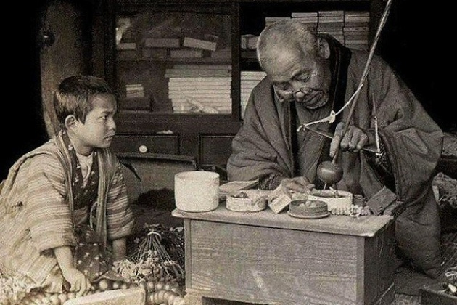
Apprenticeship learning
Notes:
The curriculum for apprenticeship was based on learning what is was known would be effective in real life.
Assessment was based on the ability to apply what had been learned to solve real life problems or needs.

Slide 15
Breakpoint and beyond 2000
Notes:
But what does our current system do to create people who can create a different more preferred future?

Slide 16
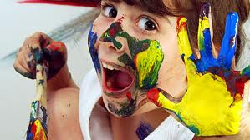
98%
3-5 year olds geniuses

Slide 17
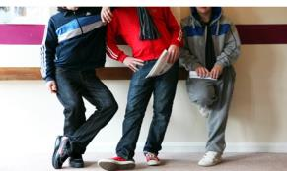
32%
8-10 year olds geniuses

Slide 18
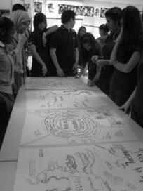
10%
13-15 year olds still geniuses

Slide 19
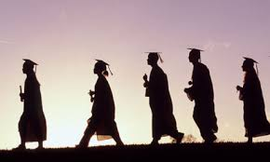
2%
Over 25 year olds geniuses

Slide 20
Schools seem to be educating children out of creativity yet the correlation between childhood CQ with adult achievement is three times greater than IQ
Michael F. Shaughnessy

Slide 21
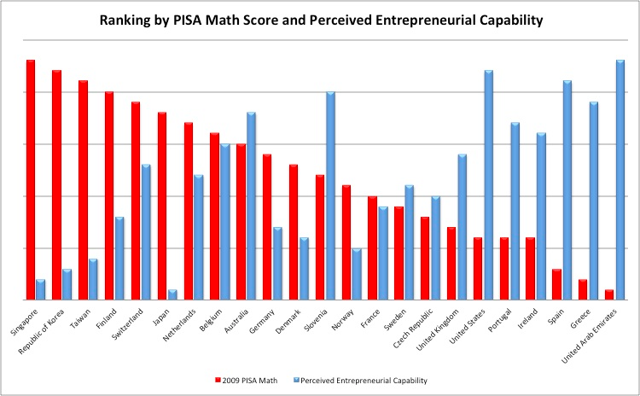
Ranking by PISA score and perceived entrepreneurial ability
Yong Zhao
Notes:
Academics aloen don’t guarantee the qualities which will create a future. In fact they almost seem opposed.

Slide 22
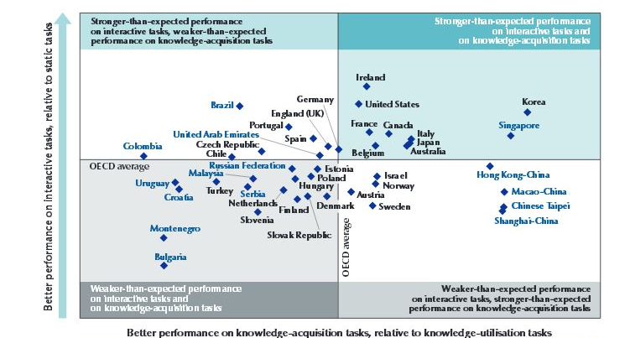
Transcultural education

Slide 23
Curriculum is a framework for the kind of learning you want to happen
What is a curriculum?

Slide 24
Standards and Content
Assessment and Matriculation
Competencies
Concepts
Character
Pedagogy and Methods
Curriculum options

Slide 25
Focus on action
Teaching affective skills
Global contexts a default
Problem based and product–oriented learning
Social entrepreneurship
Transcultural curriculum

Slide 26
7017
1,270
2,945
1,220
1,582
46% claim an “internationally oriented” learning approach
International schools worldwide
Notes:
The latest figures published by The International School Consultancy Group (ISC) indicate that there are now 7,017 international schools around the world meeting the learning needs of over 3.5 million students, all using English as the language for learning.

Slide 27
3,870
IB World Schools
680,000
students
147
countries
If the IB authorization rate continues, the IBO expects a worldwide tally of “10,000 schools and 2.5 million students enrolled in IB programmes by the year 2020”.
Growth of the IB

Slide 28
766,000
Students in for-profit schools in 2001
2,400,000
Students in for-profit schools in 2010
225%
Increase between 1998-2008
Growth of for-profit international schools

Slide 29
+250,000
international educators will be needed within the next 10 years
A growing need for educators

Slide 30
The educational domain
Creative system-Czsiksentmihalyi
Notes:
Domain- system of symbols and pratices regarding body of knowledge
Field- connection of individuals and institutions that evaluate products

Slide 31
The field of education
Creative system-Czsiksentmihalyi
Notes:
Domain- system of symbols and pratices regarding body of knowledge
Field- connection of individuals and institutions that evaluate products

Slide 32
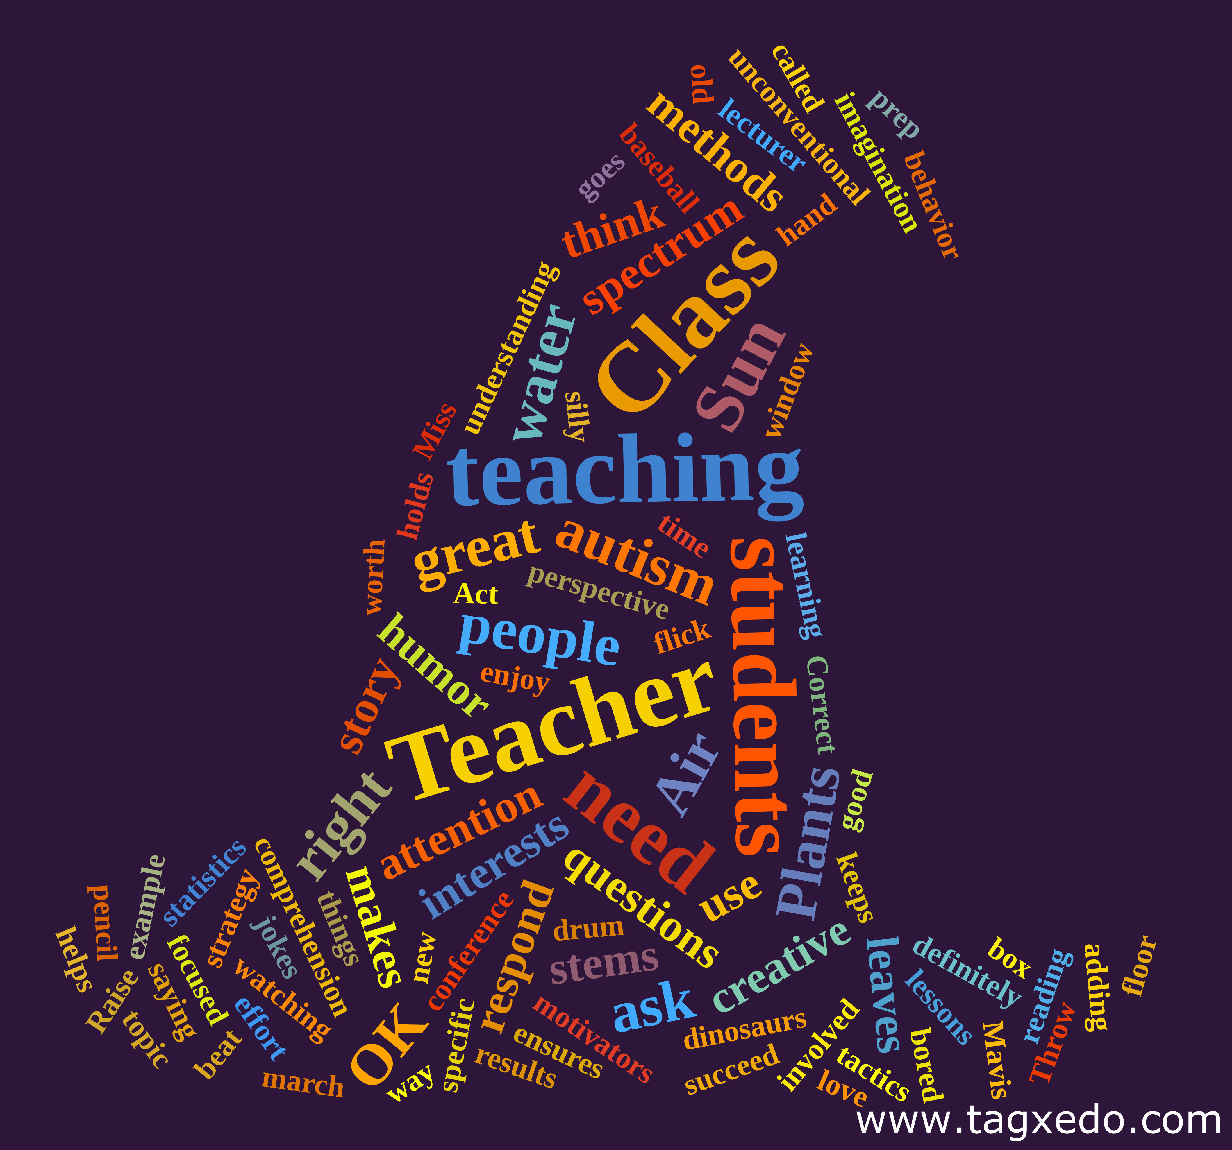
The educator
Creative system-Czsiksentmihalyi
Notes:
Domain- system of symbols and pratices regarding body of knowledge
Field- connection of individuals and institutions tht evauate products

Slide 33
Bilingualism and first/second generation immigrants
(Nemeth and Swan, Simonton)
Culture and creativity

Slide 34
Deep immersion in a novel culture
(Leung, Maddux, Galinsky and Chiu)
Culture and creativity

Slide 35
Deep immersion in a novel culture
New ideas and concepts
Same form has different functions
De-stabilize routine responses
May seek out diverse ideas on return
Incongruent concepts lead to new perspectives
Cross cultural experiences (Weisberg)

Slide 36
Cultural norms relating to ‘world views :
Individualism-collectivism
Masculinity-femininity
Power distance
Uncertainty avoidance
Willingness to make sacrifices
Culture and creativity (Hofstede)

Slide 37
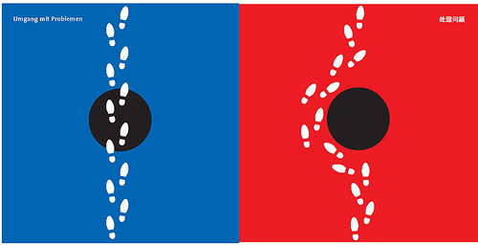
Confront or elaborate on a problem

Slide 38
Processing conflict

Slide 39
Leadership status

Slide 40
Relationships

Slide 41
Sense of self

Slide 42
Cultural and stylistic norms?

Slide 43
Cultural intelligence and agility
Collaborative norms
Clarity on the role of innovation
Norms for creativity

Slide 44
‘My mum was very different to most parents in China, because she always encouraged me to take risks. Especially she always told me, "You are great." It's not like some parents say, "Stay humble. Don't recognize you are great." My mum always said, "You're great; you can do it.”
An international educator

Slide 45
Kaleidoscope thinking Ambience Negative affective reactions More time for complex tasks Need managing
Diverse multicultural teams
Notes:
Kanter 1968

Slide 46
The status quo is a very compelling state. So what might help promote the creativity needed for schools to be successful and children to achieve?
School leaders need to be able to unlock creativity in their staff in order to enhance learning. And to lead a creative school, you need creative leadership.
Stoll and Temperley

Slide 47
What really triggers creativity?

Slide 48
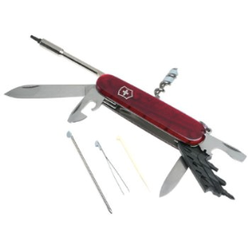
Domain relevant skills
Amabile componential model of creativity

Slide 49
Creativity-relevant processes
Amabile componential model of creativity

Slide 50
Task motivation
Amabile componential model of creativity

Slide 51
Surrounding social environment
Amabile componential model of creativity

Slide 52
Preparation
Incubation
Insight
Evaluation
Elaboration
Czikszentmihalyi 1997

Slide 53
Model creativity and risk taking
Stoll and Temperley

Slide 54
Stimulate a sense of urgency
Stoll and Temperley
Notes:
if necessary, generate a crisis

Slide 55
Expose colleagues to
new thinking
and experiences
Stoll and Temperley

Slide 56
Self consciously
relinquish control
Stoll and Temperley
Notes:
avoid a surveillance culture

Slide 57
Provide time and space
Stoll and Temperley
Notes:
Facilitate the practicalities

Slide 58
Promote individual and group
creative thinking and design
Stoll and Temperley

Slide 59
Set high expectations about the nature and degree of creativity
Stoll and Temperley

Slide 60
Use failure as a
learning opportunity
Stoll and Temperley

Slide 61
Keep referring back to
core values
Stoll and Temperley

Slide 62
Missions, expeditions and diverse opportunities

