Slide 1
Evaluating international-mindedness
in a school context
Katharine Bailey
Towards a definition of ‘international-mindedness’
[‘global consciousness’]
How can it be communicated?
How does it manifest itself and develop as students mature?
How can it be nurtured and assessed?
1

Slide 2
Evaluating international-mindedness
in a school context
International Learning ...
... How does it occur ?
In school? In class? Outside of schools?
In international schools?
In other schools? As adult learners?
Through structured teaching?
Through curriculum design?
Through informal interactions and
role- modelling?
iS magazine - volume 12, 2009 - UK State schools
Alliance for International Education – 52 questions

Slide 3
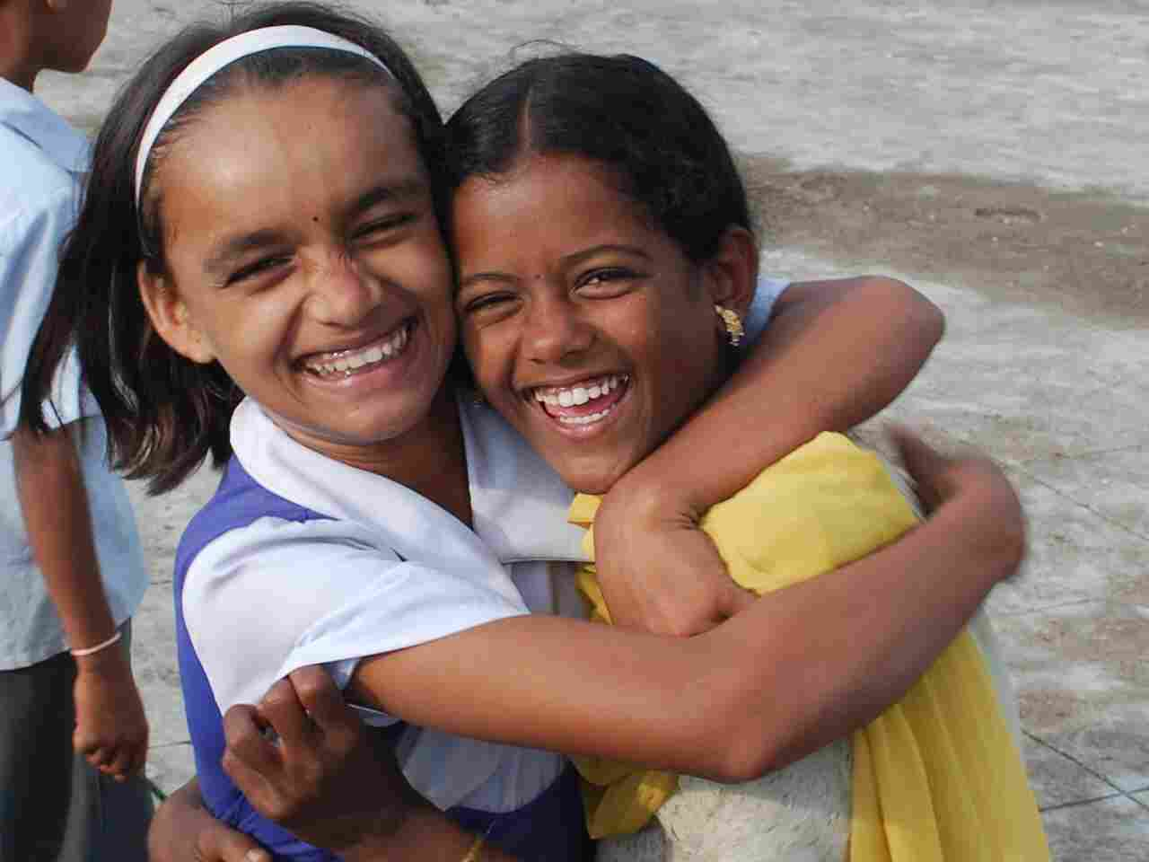
Evaluating international-mindedness
in a school context
International Learning ...
... How can it be described ?
Is there a Knowledge Base?
Is there a Skills Set?
Is it a portfolio of Personal Attitudes and Mindsets?
*What does it mean for an 8 year old?
* What does it mean for a 17 year old?
* Is it fully formed or still evolving when a young
person graduates from school?
If we can’t describe it, how can we teach it?
If we can’t describe it, how can we evaluate it?
Should we evaluate it?

Slide 4
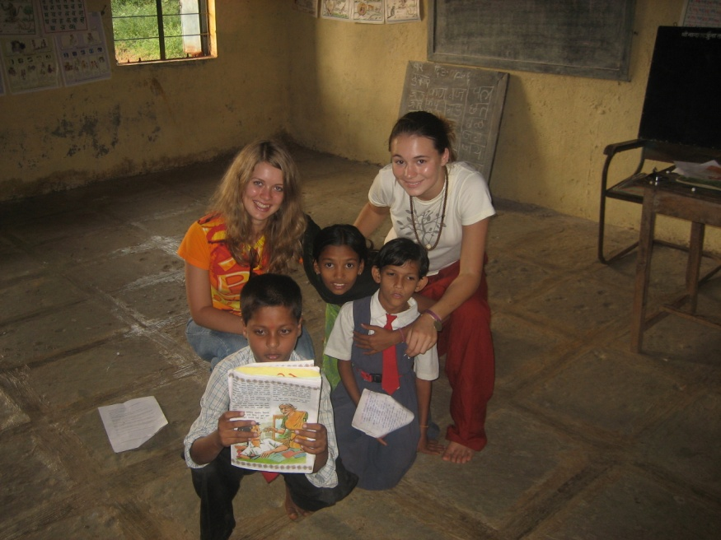
Evaluating international-mindedness
in a school context
International Learning ...
... Is it context dependent?
If I define it in my context, will this be
universally applicable?
Is it the same for bilinguals as monolinguals?
Is it harder for a monolingual than for a
bilingual?
Does it depend on learning styles?
Does it depend on the community I live in?
Does it depend on the religion I believe in?
iS magazine, volume 13, 2010 ‘Promoting
international-mindedness through language
acquisition’

Slide 5
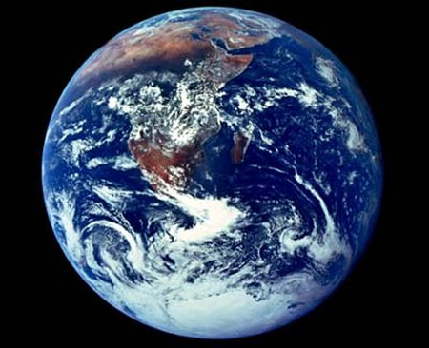
Evaluating international-mindedness
in a school context
International Learning ...
... What drives it ?
Is it driven by humanistic values?
Is it driven by global demand for jobs & services?
Is it driven by my school’s mission statement?
Does my school’s mission help me understand what
international learning is in my context?
Is it driven by migration and population shifts?
Is it driven by technology?
Is it driven by environmental science?

Slide 6
Evaluating international-mindedness
in a school context
Three Driving Ideas to Remember – CIS, 8th edn.
Mission-driven
Vision-led
Internationalism
Student Learning
and
Well- being

Slide 7
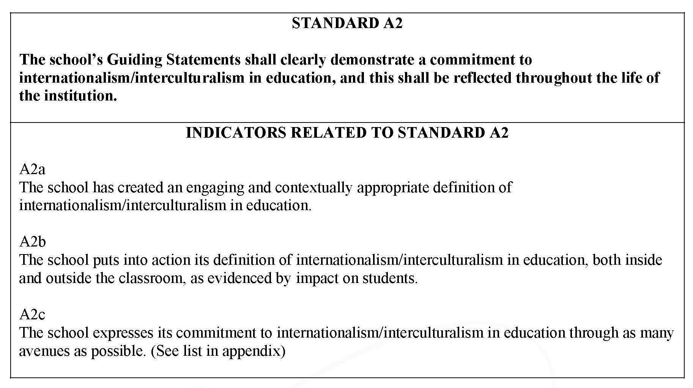
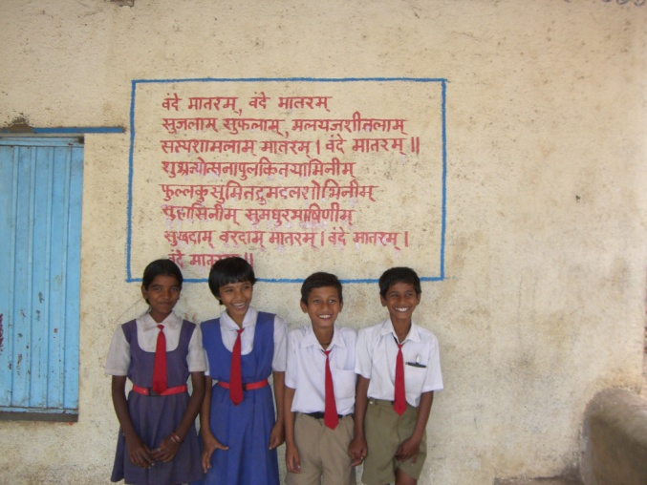
Evaluating international-mindedness
in a school context

Slide 8
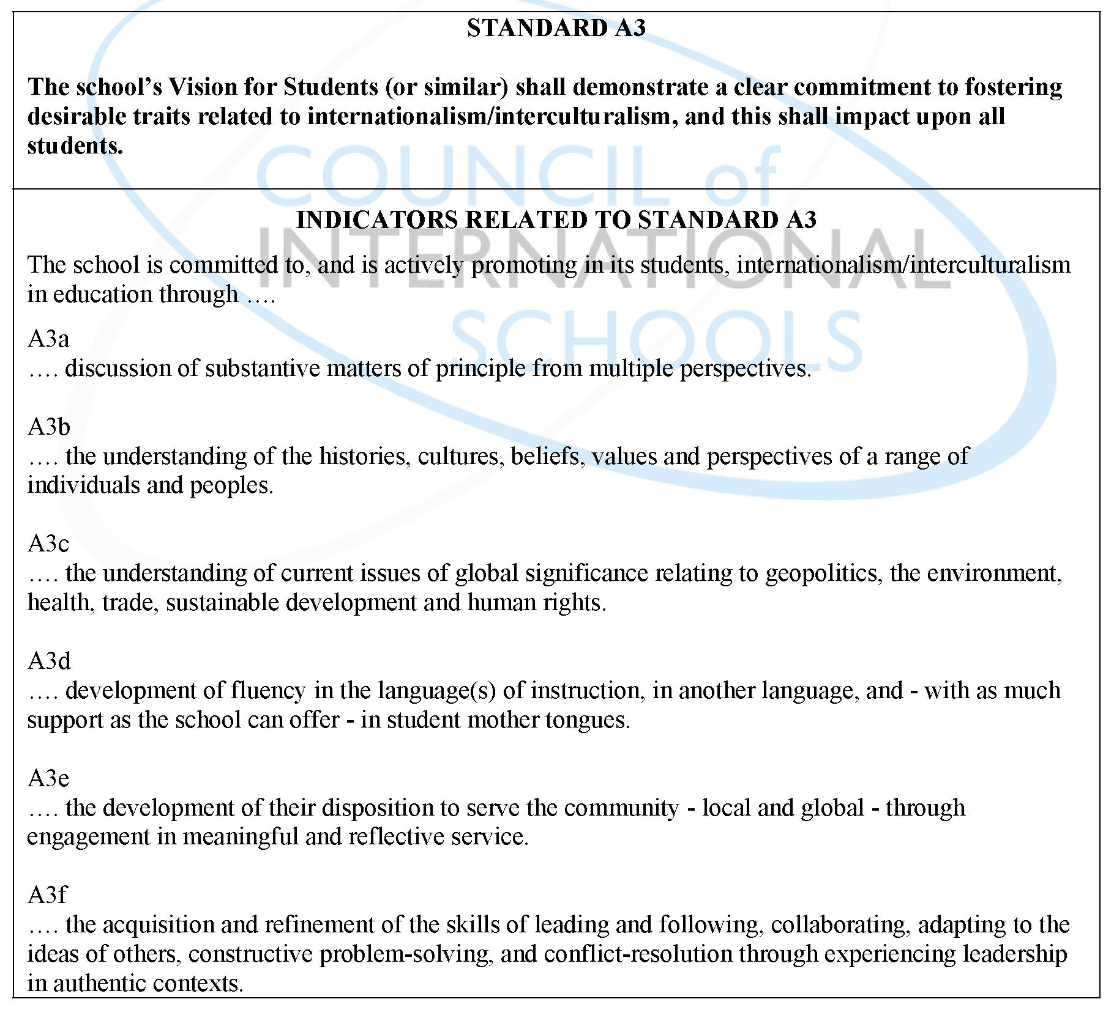
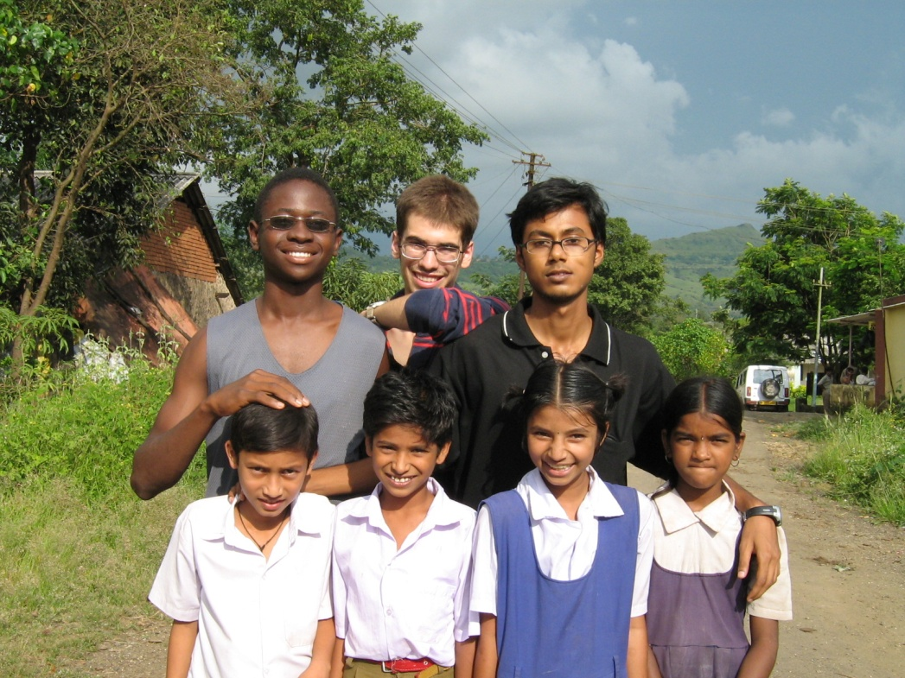
Evaluating international-mindedness
in a school context

Slide 9
Evaluating international-mindedness
in a school context
CIS / NEASC makes statement re awareness of UN declaration of human rights – UNICEF:
UNITED NATIONS CONVENTION ON THE RIGHTS OF THE CHILD – www,rrsa.org.uk

Slide 10
Evaluating international-mindedness
in a school context
ISA – International School Award
British Council – Comenius programme –
http://schoolsonline.britishcouncil.org/accreditation-and-awards/International-School-Award
10,000 schools in the UK – working to open it to overseas schools

Slide 11
Evaluating international-mindedness
in a school context
INTERNATIONAL SCHOOL AWARD
Three levels:
Foundation - Intermediate - Full
Involving progressive development of international connections
and projects and the embedding of their influence on school life

Slide 12
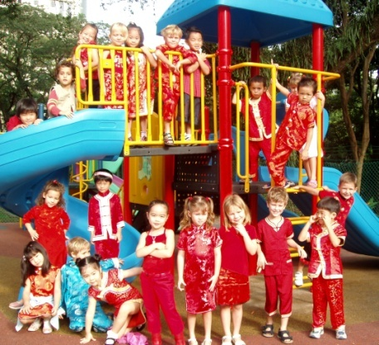
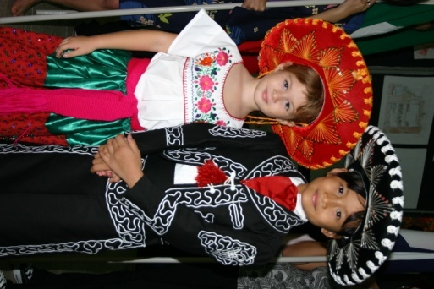
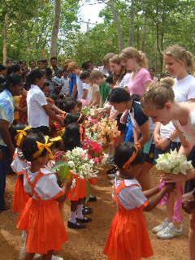
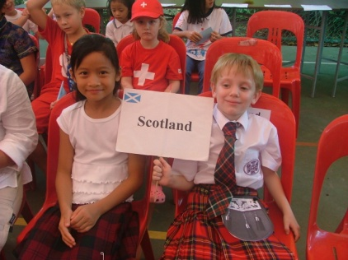
Evaluating international-mindedness
in a school context
Moving Beyond the ‘Five Fs’
Fashion
Festivals
Fieldtrips
Flags
Food

Slide 13
Evaluating international-mindedness
in a school context
iS Journal
Vol. XXX, No. 1
Nov. 2010
Looking beneath the tip of the iceberg: cultural
intelligence in international education

Slide 14
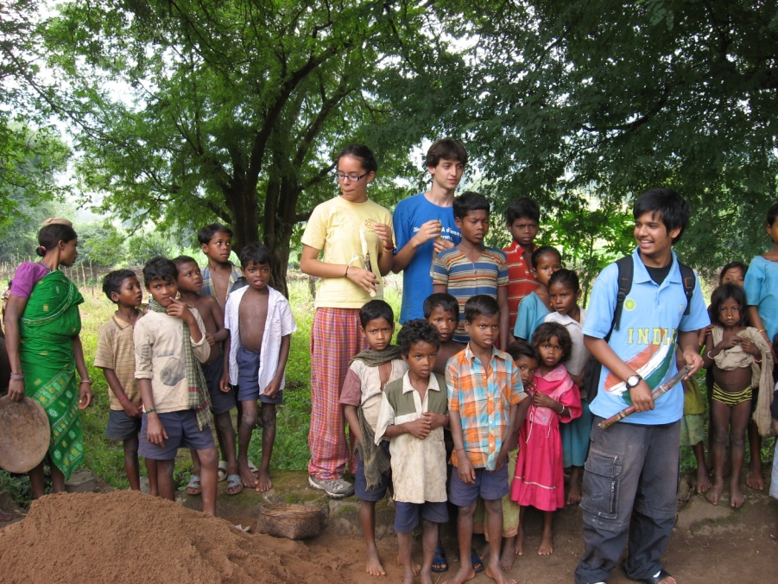
Evaluating international-mindedness
in a school context
Explore the notion of what it means to be a ‘good national and international citizen’ – origins – danger of ‘cultural colonialism’
Need to consider a broader and deeper definition of culture than traditional/conventional views of culture defined by nationality, geography and history.
Distinction between ‘awareness’ and ‘attitude’ – awareness can function entirely at a cognitive level, whereas attitude conveys a sense of action that stems from the affective domain and includes commitment.

Slide 15
Evaluating international-mindedness
in a school context
Chapter on the ‘Art
of Failure’
‘Choking’ and
‘Panicking’
intrinsic and
extrinsic learning

Slide 16
Evaluating international-mindedness
in a school context
Awareness we don’t always do what we know to be right
Attitude
Behaviour

Slide 17
Evaluating international-mindedness
in a school context
A possible definition:
International-mindedness (global consciousness)
is a person’s capacity to transcend the limits of
a worldview informed by a single experience of
nationality, creed, culture or philosophy and
recognise in the richness of diversity a
multiplicity of ways of engaging with the world.

Slide 18
Evaluating international-mindedness
in a school context
The framework, given the working title
of ‘Me and My World’, covers the
five areas (or strands) represented
in diagrammatic form as shown:
Profiling ‘international-mindedness’

Slide 19
Evaluating international-mindedness
in a school context
Within each of the areas, the student experience is monitored
at four different levels of involvement – ‘me, my school, my country,
the world’.
This two-dimensional view will extend the
reach of international-mindedness from
being about individual experiences to cover
the appreciation of global issues that affect
everyone.
Thus the framework progresses outwards
From the individual student through
their interaction with their school, their
locality and country to the broader world.

Slide 20
Evaluating international-mindedness
in a school context
World Views
This strand explores the way students think of (and interact
with) their peers, the local community, their host country and
the wider world. It encourages awareness of cultural and ethnic
diversity, tolerance and acceptance.
Awareness of different religions worldviews and their impact on society
Consideration of different political ideals and systems
Multiculturalism, cosmopolitanism, citizenship and nationality
Migration and political asylum – impact on home communities
‘First nationals’ and ethnicity

Slide 21
Evaluating international-mindedness
in a school context
Global Issues
An awareness of global concerns will encourage students to
take responsibility and engender an interest in the future of our
world and resources.
Tension between national interest and globalisation
Availability and transfer of resources, natural and man-made
Economic aid and trade
International efforts on global environmental concerns and conflict
Sustainability, endangered species and world action

Slide 22
Evaluating international-mindedness
in a school context
Language
Although second languages are not a pre-requisite for
international-mindedness, awareness and interest in the
diversity and importance of languages is needed.
Development of spoken language skills in English and other languages
Development of written language skills in English and other languages
Maintenance of mother tongue competence and interest
Appreciation of languages of host country and ethnic groups within host country
Appreciation of importance of language to thinking and communication
History and future of world prevalence of certain languages

Slide 23
Evaluating international-mindedness
in a school context
Culture
This strand collects evidence that students are aware of the
heritage of their host country and show an interest in different
aspects of the culture. It is important, too, that they maintain
an interest in the culture of their own country.
Appreciation of cultural aspects of own and host country – drama, art, music and literature
Study of the architectural heritage of own and host country
Comparative awareness of cultural background of different groups in own and host country
Participation in cultural activities as appropriate
Participation in cultural visits of a variety of types

Slide 24
Evaluating international-mindedness
in a school context
Human Society
This area deals with how people interact with each other and
the extent to which there is an interdependence between
people, communities and countries. It also addresses economic,
social and industrial infrastructures.
Historical and geographical background to development of own and host country
Awareness of social structures within own and host country
Socio-economic development of country – sources and distribution of wealth
Impact of resources, wealth and culture on education, women’s rights, child labour and child poverty
Impact of human society on natural world – sustainability, diversity and endangered species.

Slide 25
Evaluating international-mindedness
in a school context
Types/levels of evidence

Slide 26
Evaluating international-mindedness
in a school context
Given the different strands and levels
we had identified we drew up a matrix of
the types of evidence that could contribute
to the evaluation and help draw up the
‘surveys’.
Looked at non-school examples from business and university worlds:
Thunderbird School of Global Management ‘Global Mindset Inventory’ HBR
Warwick University – language students on exchange

Slide 27
Evaluating international-mindedness
in a school context
Personal –
student
development,
tutoring
School –
philosophy,
delivery,
accreditation
Staff
Exam/curriculum body
Curriculum –
exemplars
used

Slide 28
Evaluating international-mindedness
in a school context
The overall aim is to provide ‘surveys’ to be completed by
students and the school that will serve to help schools
evaluate and monitor their progress and development
in this area
at a school level; for self-evaluation, for school improvement
and accreditation, and
at the level of the individual student for tutorial and personal
social development and progression.

Slide 29
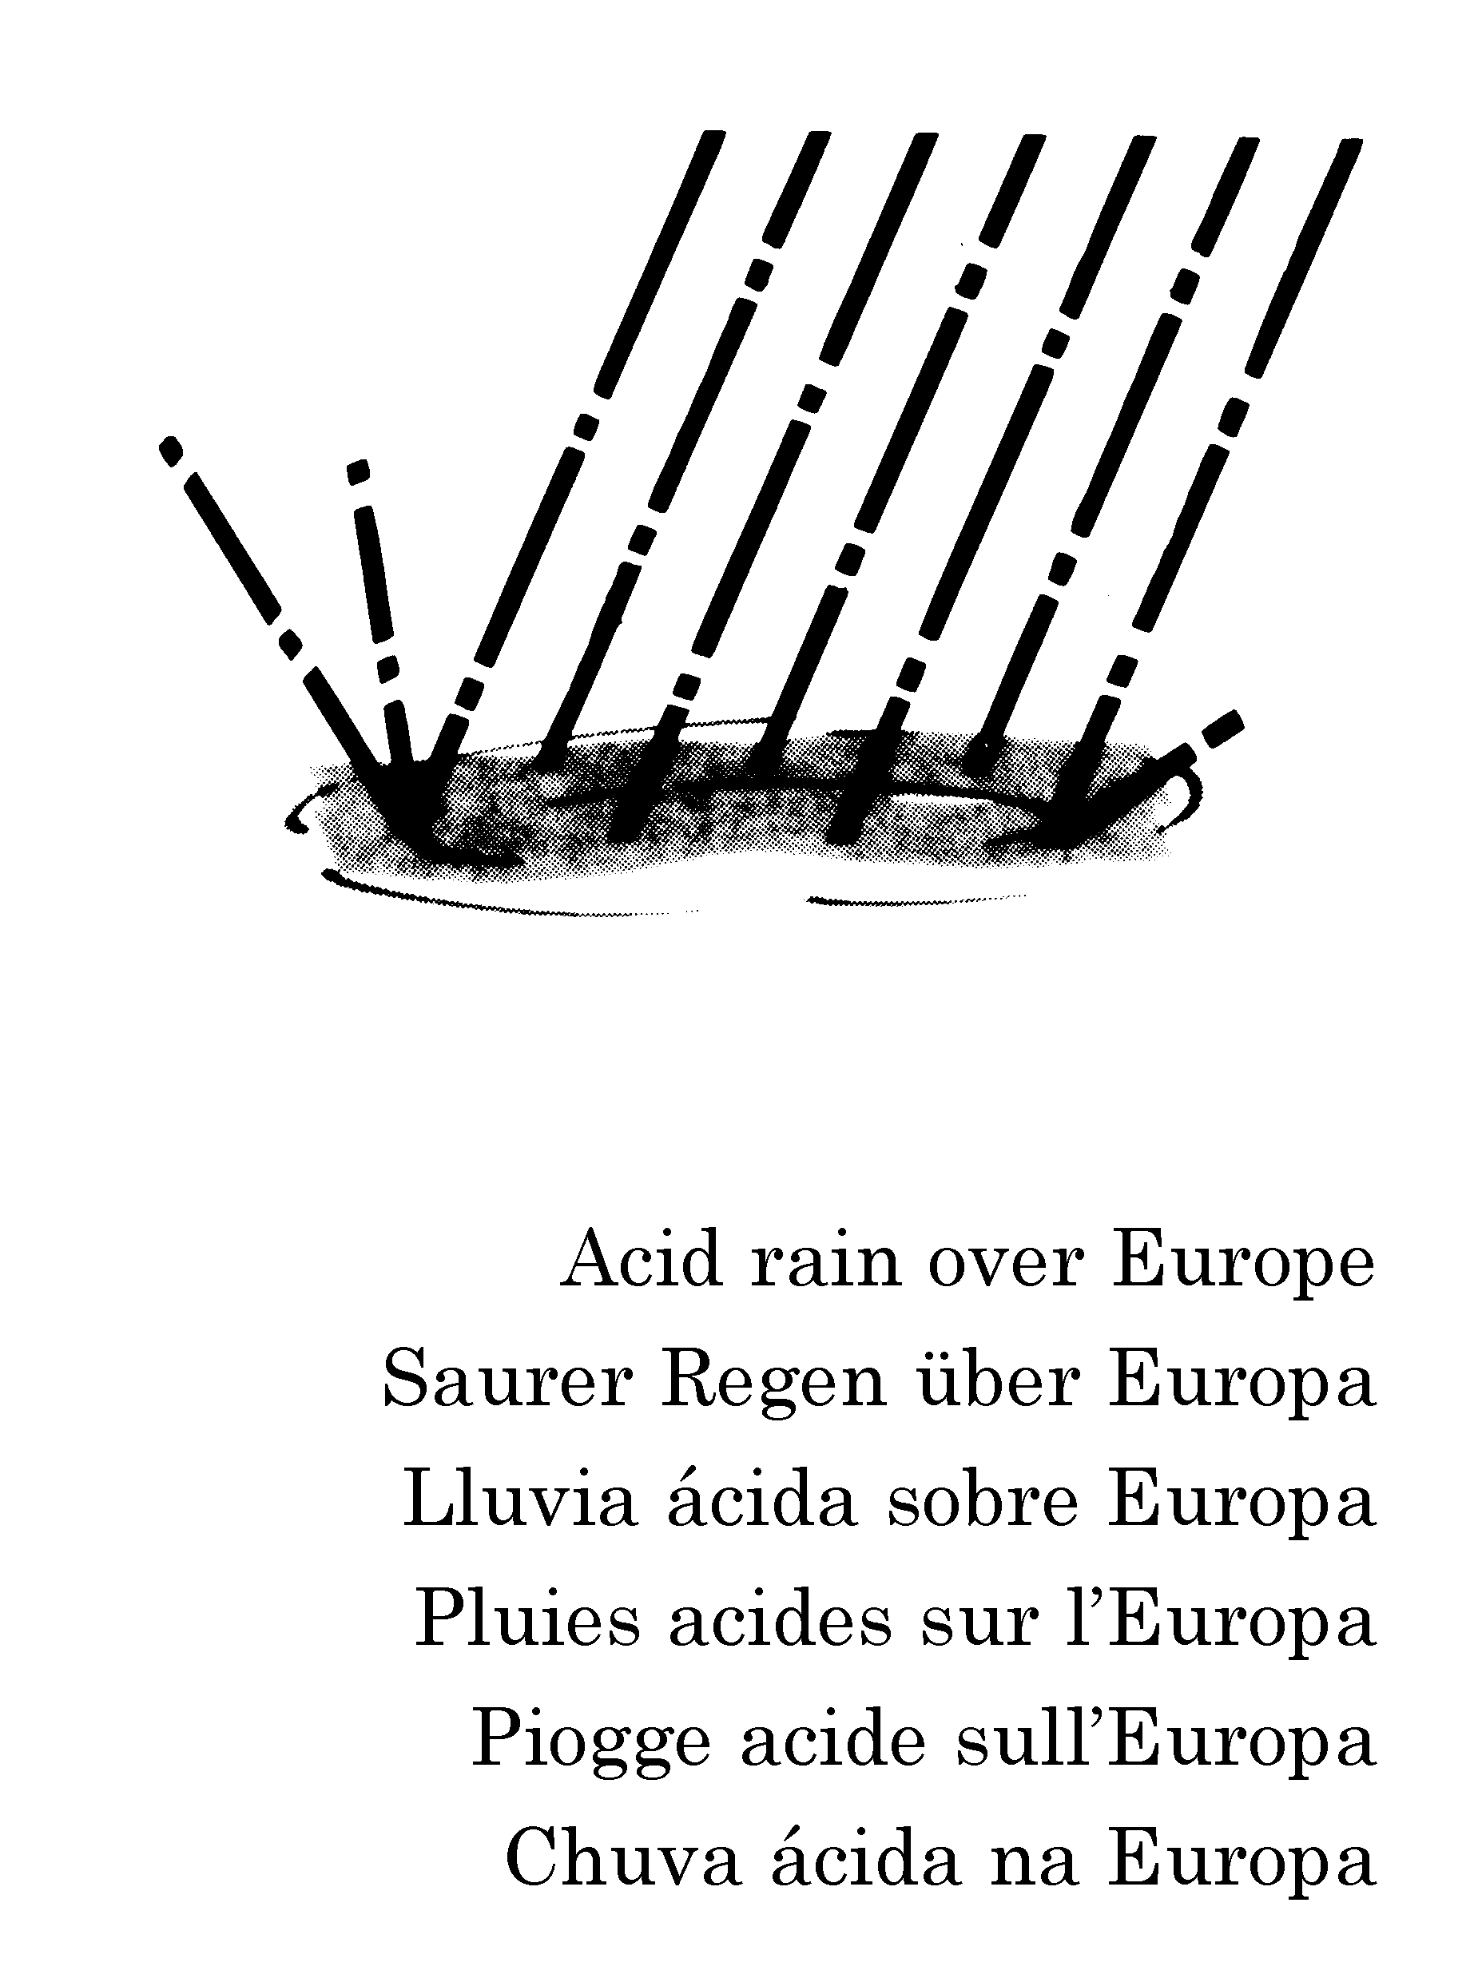
Evaluating international-mindedness
in a school context
These surveys would be linked to opportunities for self-reflection
and tutorial discussion that could include the assembly of
portfolios of student work and experience to illustrate student
development.
Students would be encouraged to collect a range of
evidence in support of their understanding of the
different areas. This might include video and audio
recordings, letters and e-mails, essays, photographs,
plays, poems, personal statements and evidence of
participation in school, local & broader activities.

Slide 30
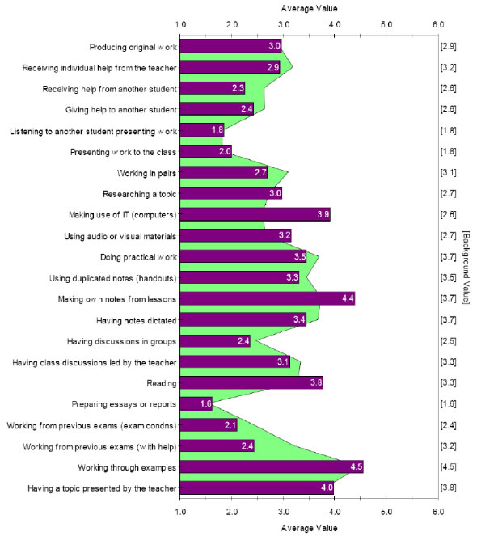
CEM has many years of
experience in the evaluation and monitoring of student progress, computer-adaptive testing and the assessment of ‘value-added’ at all age levels. This experience has involved ‘attitudinal testing’ and the current project is a development from that.
http://www.cemcentre.org/

Slide 31
Evaluating international-mindedness
in a school context
References
Hayden, M. et al. (eds.) ‘The Sage Handbook of research in International Education’, London, Sage Publications
Darla Deardorff (ed.) ‘The Sage Handbook of Inter-Cultural Competence’ London. Sage Publications
Harwood & Bailey, ISJ, April 2012
Dr. Richard Harwood,
International Consultant CEM,
rickharwood@btinternet.com

