Slide 1
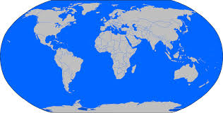
Developing Intercultural Understanding through Multicultural Education in Schools: Challenges and Promises in the Global South and Global North
Dr. Eirini Gouleta
George Mason University
Fairfax, Virginia
U.S.A.

Slide 2
The Presentation Will:
Discuss multicultural education notions, principles, practices, and policies in the Global North and Global South
Examine the implications for literacy, development, peaceful co-existence and quality learning for all
Raise critical questions to enrich the dialogue and help move the multicultural research agenda forward

Slide 3
Multicultural Approaches in the Global North

Slide 4
What is Multicultural Education?
NAME (2003) embraced a more global perspective according to which MCE is a “philosophical concept built on the ideals of freedom, justice, equality, equity, and human dignity”
Multicultural education:
Enhances democracy
Affirms pluralism (students, communities, etc.)
Promotes social justice
Goes beyond race and gender
(-linguicism, ableism, ageism, heterosexism, religious intolerance, and xenophobia)

Slide 5
Gorski (2010)
“Multicultural education is a progressive approach for transforming education that holistically critiques and responds to discriminatory policies and practices in education”
Grounded in theories of:
Social Justice
Critical Pedagogy
Education Equity
Education experiences in which all students reach their full potential as learners and are socially aware and active beings locally, nationally, and globally.
Schools are essential to laying the foundation for the transformation of society and the elimination of injustice

Slide 6
Does my teacher understand?

Slide 7
MCE in an Non-Western Context
Multicultural education can be viewed differently depending on the context as seen in developing, transforming, and industrialized world countries (Ball, 2013; Bennett, 2001; Gouleta 2011; 2010; 2004)
A global view on MCE goes beyond our "home lens” and supports sociocultural dimensions and equity for all students
(Cochran-Smith 2004, 2008; Gay & Kirkland; 2003; King, 2008; Ladson-Billing, 1995; Lee, 2011; Nieto, 2000; Nieto & McDonough, 2011; Sleeter, 2009; Tatum, 2007)

Slide 8
MCE in an Non-Western Context
MCE must embrace not only cultural diversity but linguistic diversity as well to promote mother tongue based education and multilingual education environments
(Ball, 2013; Gouleta , 2011, 2010, 2004)

Slide 9
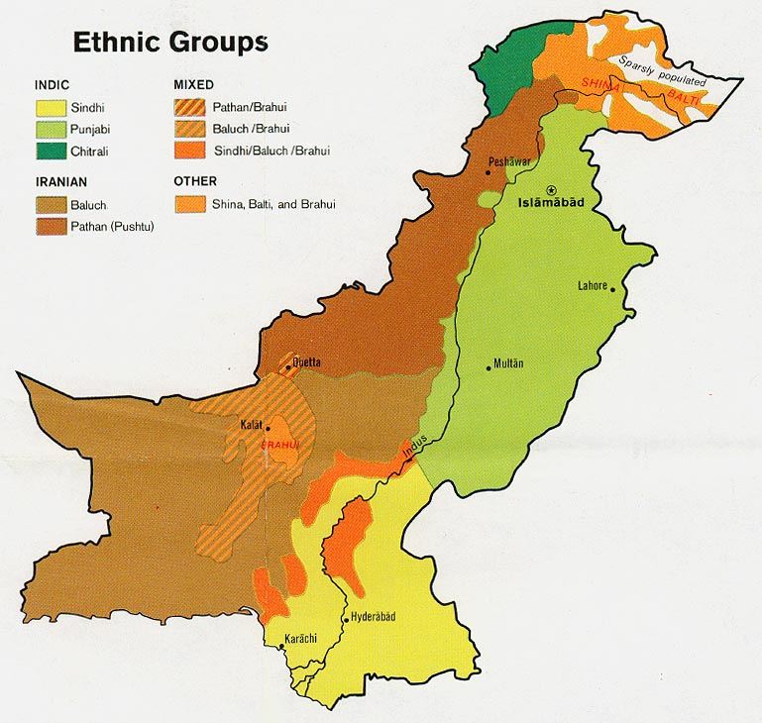
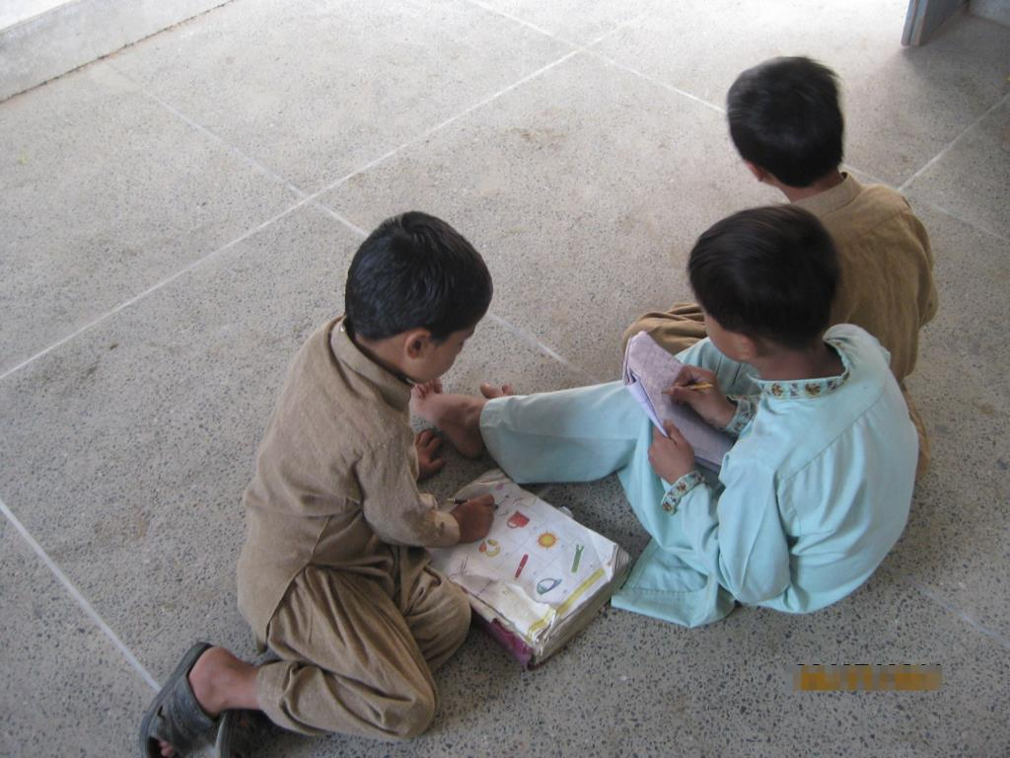
Pakistan
Various ethnic groups in conflict- 80 languages
Religious diversity and the law
Girls education
6 m out of school children
ELI in Punjab and MTE in KP
The subject of Ethics
Teacher education
Public –Private Partnerships and Low-Income Private Schooling and the Madaris (Madrassas)

Slide 10
MT and LOI in Pakistan
1 in 10 out of Primary School Children in the World live in Pakistan:
-91-95% children have no access to education in MT
-By providing LOI in 7 of the major languages 85% would receive instruction in MT

Slide 11
Teacher’s Lesson Plan

Slide 12
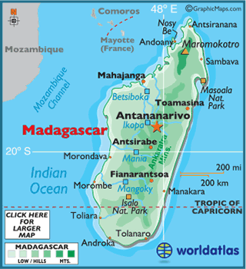
Linguistic Policy and Practice in Education: Policy Implications for Madagascar
School Materials in Madagascar

Slide 13
Linguistic Profile
0.57% use mainly French
15.82%use French occasionally and Malagasy at all other times
83.61% use only Malagasy
18 tribes
Same language with variations
Same writing system

Slide 14
School enrollment, attendance and completion
Nearly universal enrolment to date
About 70% school attendance
High repetition and drop out rates
Only about 30% mainly boys complete primary school
About 49% population illiteracy
Low acceptance and completion university rates

Slide 15
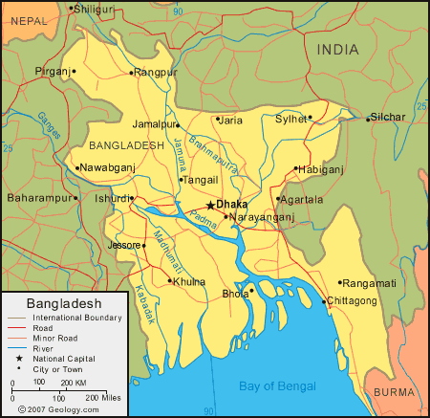
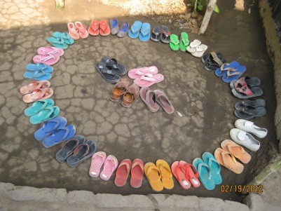
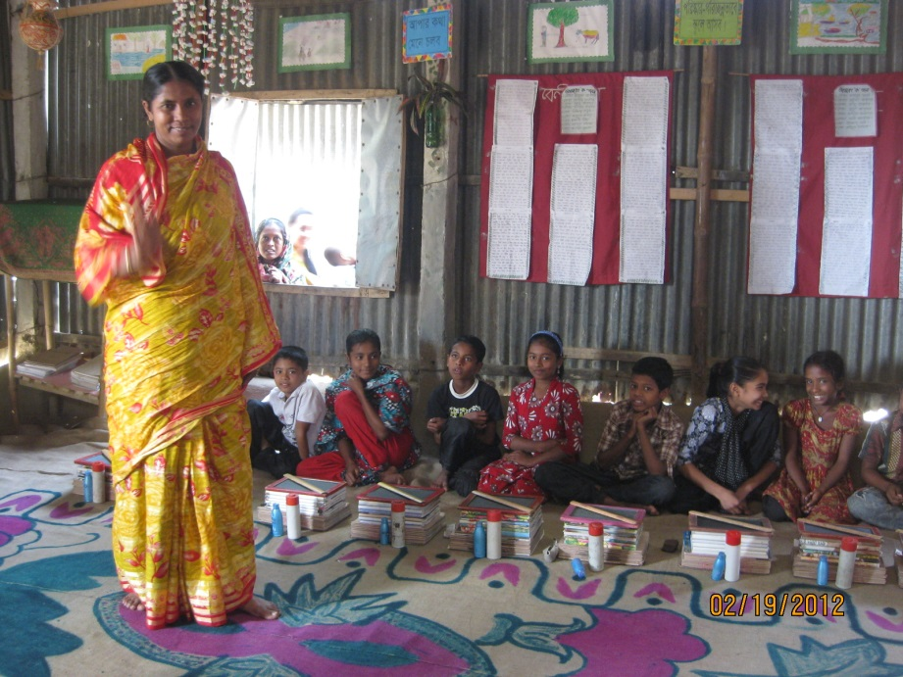
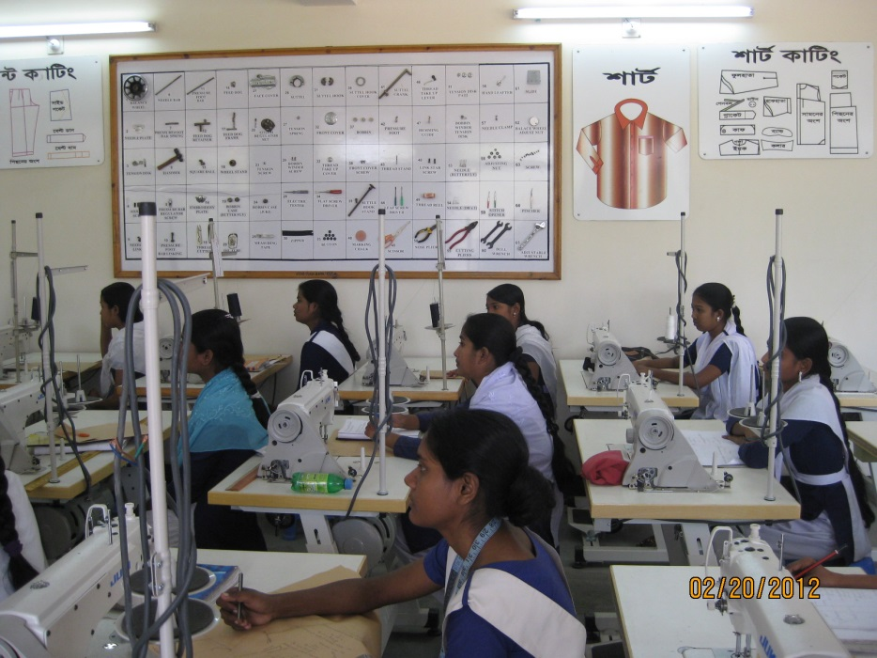
Bangladesh
MTB Education
About 40 languages
The law and the practice
BRAC Schools
The garment industry and slum children
Technology and vocational learning

Slide 16
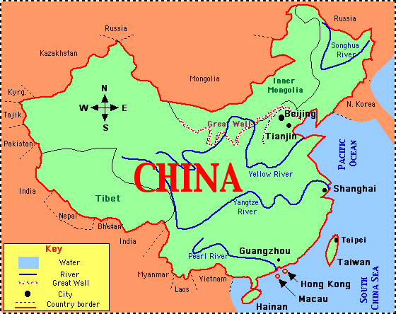
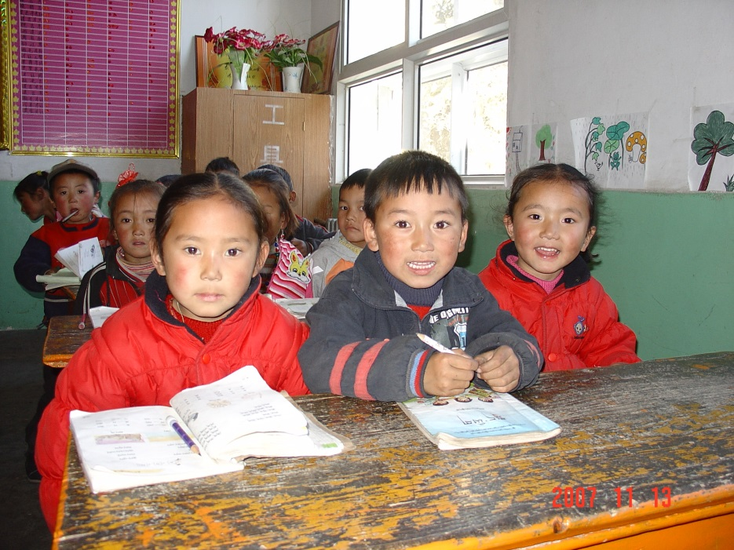
China
* 55 ethnic minorities * 80 languages
* bilingual policies in place
* normal schools and minority areas
* normal schools and the big cities
* the examination system
* the inevitable inequity

Slide 17
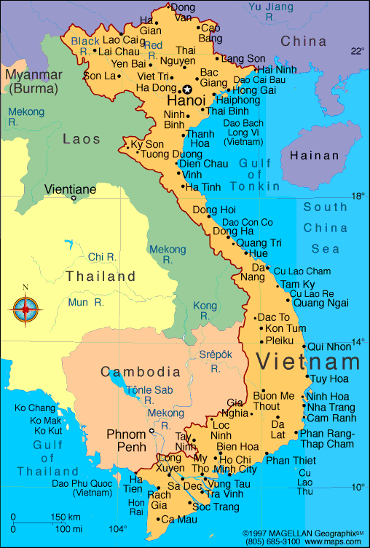
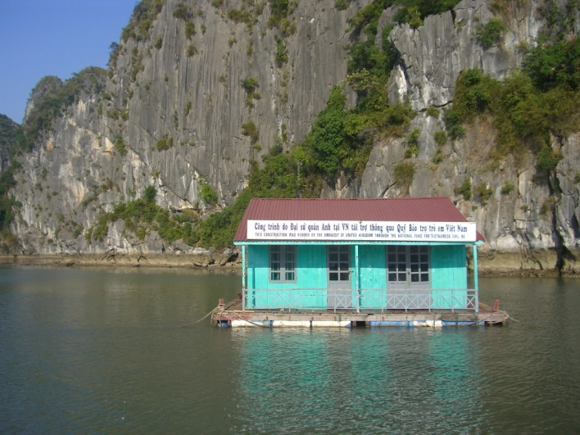
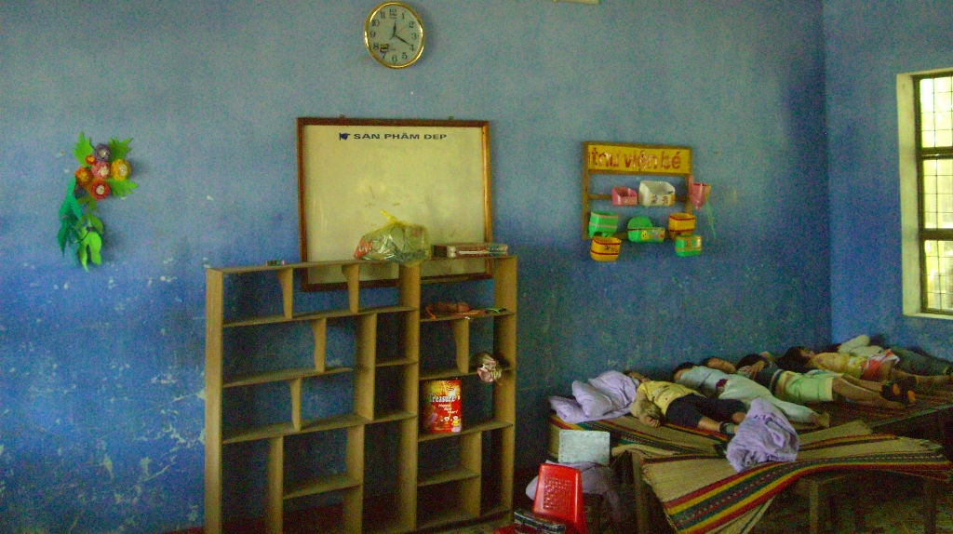
Vietnam
56 ethnic groups and the Kinh people
Multilingual communities in the highlands
Bilingual policies and the law
Teacher education
Key mothers and other initiatives

Slide 18
MCE Implementation: Things to Consider
Each Country’s geographical, ethnical, linguistic, and cultural diversity and needs:
Not “one size fits all” approach
Build on the strengths and capitalize on the resources of communities:
Empowerment, leadership, incentives, support

Slide 19
MCE Implementation: Things to Consider
Follow a gradual approach:
Set targets at different levels and focus on results
Develop multicultural curricula based on equity, democracy, peace, intercultural understanding, tolerance, and social justice:
Curriculum, syllabus, textbooks, instruction and assessment must be linked together
Develop culturally appropriate assessment process:
Design, implementation, assessment, feedback cycles
Share lessons learned
With stakeholders and development partners

Slide 20
Discussion Questions
What can we learn from these examples about how MCE can evolve to be globally informed and inclusive?
What can teacher educators and educator preparation programs do to better prepare future teachers to understand and practice multicultural education through both a non-western and a western view?
How can we elevate and move the research agenda to appreciate a more inclusive concept of multicultural education that expands from the Global North to the Global South?
Notes:
Get ideas from Ball (2013)

Slide 21
“Ny taranaka no vanona dia tao ireo mpanabe nitaiza sy nanolokolo,tsy nitandro hasasarana” (A better and intelligent generation would be the result of a good education and an efficient management) Malagasy Proverb
MCE and intercultural understanding
Learning for All
Mother Tongue Ed

Slide 22
Thank you!
Dr. Eirini Gouleta
George Mason University
egouleta@gmu.edu
703-993-4015

