Slide 1
A study of the comparison of international mindedness and intercultural understanding in IBDP and non-IBDP in Turkey
AIE Conference- 10-12 October 2014, Mumbai, India
Presentation by Dr. Jale Onur
Notes:
Presentation slide for courses, classes, lectures et al.

Slide 2
A research for IBO by Bilkent Univ.
Alignment between the International Baccalaureate Diploma Program (IBDP) and the Ministry of National Education Diploma Program (MoNEP) in Turkey and their effect on the later achievement and development of university students.
The team that worked on the research were: Dr. Jale Onur, Dr. Armagan Ates, Dr. Sencer Corlu, Sila Sagun and Dr. Margareth Sands
Notes:
Objectives for instruction and expected results and/or skills developed from learning.

Slide 3
Scholastic and Non-scholastic aspects
Both scholastic and non-scholastic aspects of the two programs were examined in this study.
The two programs were designed for different clientele as indicated by the word international in IBDP and national in MoNEP.
However, the swift globalization of our times has forced both to change and take other needs into consideration.
Notes:
Objectives for instruction and expected results and/or skills developed from learning.

Slide 4
Scholastic and Non-scholastic aspects (cont.)
Gathier (1996), ex-president of the IBO, expresses this as, “internationality has become a normal characteristic of our contemporary society”.
That’s the reason for investigating the development of international mindedness as one of the non-scholastic attributes specifically studied in this research.
Notes:
Objectives for instruction and expected results and/or skills developed from learning.

Slide 5
IBDP
The IBDP, specifically designed for international schools in the second half of the 20th century, states this as “The Diploma Program prepares students for effective participation in a rapidly evolving and increasingly global society” (IBO, 2014).
Notes:
Objectives for instruction and expected results and/or skills developed from learning.

Slide 6
MoNEP
MoNEP, on the other hand, designed for the children of a new nation state early in the 20th century, has also developed and evolved, showing awareness of the same global interdependence in the mission statement, “constructing a happy society partner of contemporary civilization” (MoNE, 1973 amendment to educ. law).
Notes:
Objectives for instruction and expected results and/or skills developed from learning.

Slide 7
Comparative Background
Notes:
Objectives for instruction and expected results and/or skills developed from learning.

Slide 8
Comparative Background (cont.)
Notes:
Objectives for instruction and expected results and/or skills developed from learning.

Slide 9
Referrals to international mindedness in policy statements
The IB mission statement:
The International Baccalaureate aims to develop inquiring, knowledgeable and caring young people who help to create a better and more peaceful world through intercultural understanding and respect.
To this end the organization works with schools, governments and international organizations to develop challenging programmes of international education and rigorous assessment.
These programmes encourage students across the world to become active, compassionate and life-long learners who understand that other people, with their differences, can also be right (IBO, 2014).
Notes:
Objectives for instruction and expected results and/or skills developed from learning.

Slide 10
Basic principles of Turkish National Education
1- General goals:
  article 2 - the general goal of the Turkish national education is to bring up all members of the Turkish people as:
1.(amended:16/6/1983- art. 2842/1) citizens, who are committed to the principles and reforms of Atatürk, and to the nationalistic ideals of Atatürk as expressed in the constitution, as people who have internalized the national, moral, human, spiritual and cultural values of the Turkish people, and who love their family and country and always try to direct them, who are aware of and fulfil their duties and responsibilities towards the Turkish Republic, which is a democratic, secular and social state governed by laws that are founded on human rights and on the tenets in the preamble to the constitution;
Notes:
Objectives for instruction and expected results and/or skills developed from learning.

Slide 11
Basic principles of Turkish National Education (cont.)
2- constructive, creative and productive individuals, who are physically, mentally, morally, spiritually and emotionally balanced, have a sound personality and character, with the ability to think freely and scientifically and have a broad world-view and respect for human rights, value personality and enterprise, and feel responsibility towards society;
3. happy people, by preparing them for life developing their interests, talents and capabilities, and providing them with the necessary knowledge, skills, attitudes and team-work habits that will help them acquire a career and contribute to the happiness of the society; thus, while increasing the welfare and happiness of Turkish citizens and Turkish society, support and accelerate economic, social and cultural development with national cohesion and unity, and finally make the Turkish nation a constructive, creative and distinguished partner of contemporary civilization (MoNE, 1973).
Notes:
Objectives for instruction and expected results and/or skills developed from learning.

Slide 12
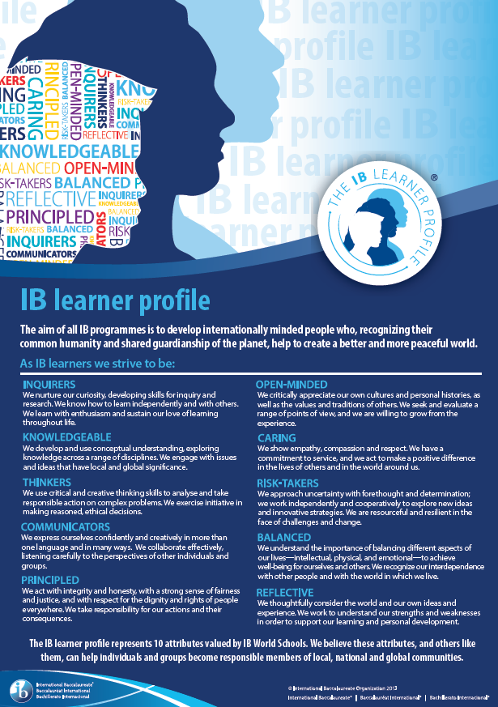
Notes:
Objectives for instruction and expected results and/or skills developed from learning.

Slide 13
Notes:
Objectives for instruction and expected results and/or skills developed from learning.

Slide 14
Non-scholastic attributes in other documents
in (IB)
  “All IB students learn a second language and the skills to live and work with others internationally - essential for life in the 21st century” (IBO, 2014).
in (MONE)
  “The goal is to provide a foreign language education at a level that will enable students to follow the developments and changes in the world” (MONE, 2013).
Notes:
Objectives for instruction and expected results and/or skills developed from learning.

Slide 15
Others (IB)
“We encourage international-mindedness in IB students. To do this, we believe that students must first develop an understanding of their own cultural and national identity” (IBO, 2014).
“We promote intercultural understanding and respect, not as an alternative to a sense of cultural and national identity, but as an essential part of life in the 21st Century” (IBO, 2014).
“These programmes (IB) encourage students across the world to become active, compassionate and life-long learners” (IBO,2014).
Notes:
Objectives for instruction and expected results and/or skills developed from learning.

Slide 16
IB Core Component
In IB, the unique way of activating these goals and how to put all the skills they have learned into practice, is in the core component. The intentional design of the core components EE, TOK and CAS “broadens students’ educational experience and challenges them to apply their knowledge and skills.” (IBO,2014).
Notes:
Objectives for instruction and expected results and/or skills developed from learning.

Slide 17
Six facets of understanding
Another tool used was a rubric for evaluating student outcomes for every unit of the IBDP/MoNE program adapted from Understanding by Design by Wiggins and McTighe (2005). It has six facets: Explained, Meaningful, Effective, In-Perspective, Emphatic and Reflective. Discerning the student outcomes related to intercultural understanding and international-mindedness was possible especially in the last three facets: In-Perspective, Emphatic and Reflective.
Notes:
Objectives for instruction and expected results and/or skills developed from learning.

Slide 18
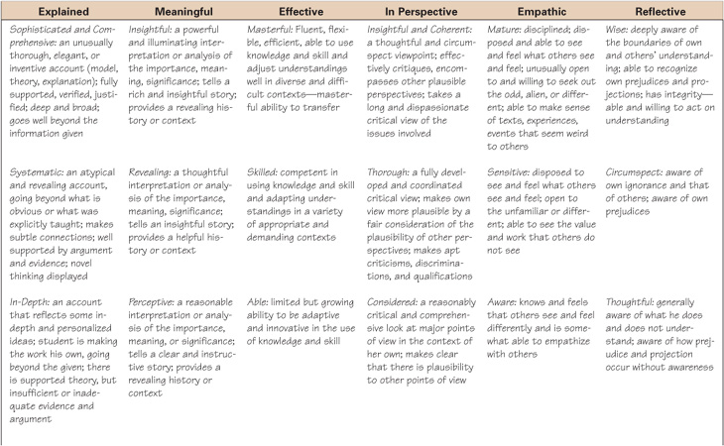
Six facets of understanding (cont.)
Notes:
Objectives for instruction and expected results and/or skills developed from learning.

Slide 19
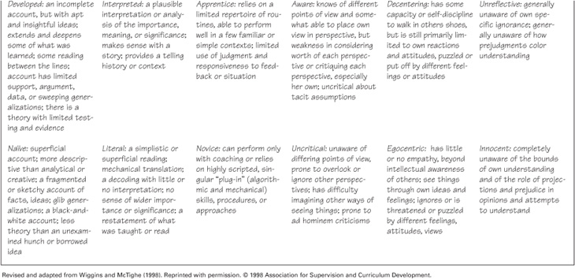
Six facets of understanding (cont.)
Notes:
Objectives for instruction and expected results and/or skills developed from learning.

Slide 20
Parental Choice
The pragmatic concerns of the parents for the future of their children is a motivation for them to demand internationally recognized diplomas. As a result, more and more schools are taking on the IBDP as an-add on program to MoNEP because they cannot take it as stand alone for the national policy requires all students to go through the 12 years obligatory national program. Along with the pragmatic concerns, “the idealistic outcomes of bringing up internationally minded people is a source of both pride and relief for the parents, in that both pragmatic and ideological education of their children is addressed by the school curriculum” (Onur, 2011) in the Turkish IBDP schools.
Notes:
Objectives for instruction and expected results and/or skills developed from learning.

Slide 21
References
Gathier, J. (1996). In: J. Delors ed. Learning: the treasure within. International Commission on Education for the 21st Century, Paris: UNESCO
IBO-International Baccalaureate Organization. (2014). IB Learner Profile. Retrieved from http://www.ibo.org/myib/digitaltoolkit/files/brochures/LearnerProfile-EN.pdf
IBO-International Baccalaureate Organization. (2014). Mission and strategy. Retrieved from http://www.ibo.org/mission/
MoNE-Ministry of National Education. (1973). Fundamental principles T.C. Resmi Gazete, 14574, 24 June 1974. Retrieved from
Notes:
Objectives for instruction and expected results and/or skills developed from learning.

Slide 22
References (cont.)
http://mevzuat.meb.gov.tr/html/temkanun_1/temelkanun_1.html
MoNE-Ministry of National Education. (2013). Regulations for secondary schools. T.C. Resmi Gazete, 28758, 7 September 2013. Retrieved from
http://www.resmigazete.gov.tr/eskiler/2013/09/20130907-4.htm
Onur, J. (2011). The IB diploma in a national education system: a case study of the IB diploma programme forward (p. 80). John Catt Educational.
Notes:
Objectives for instruction and expected results and/or skills developed from learning.

Slide 23
References (cont.)
Wiggins, G., & McTighe, J. (1998). Understanding by design (1st ed.). Alexendria, VA: ASCD.
Notes:
Objectives for instruction and expected results and/or skills developed from learning.

