Slide 1
Organisational culture and leadership
EMWS Mumbai
Darlene Fisher
September 2014

Slide 2
Outline
What is leadership
Culture and leadership
Organisational culture and leadership
Where to from here?

Slide 3
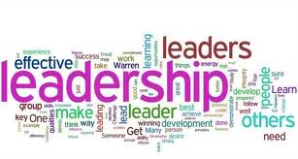
Effective … leadership
What 7 – 10 characteristics do you associate with effective leadership?
Notes:
Combined list for poster…. For on the wall comparisions later ☺
Q where to the similarities/differences come from… what is the problem if all in IB are similar? If all are different ?

Slide 4
What characteristics do you believe are required for effective school leadership in an international school?

Slide 5
Cultures, geography and leadership

Slide 6
Nisbett’s Geography of Thought

Slide 7
Geography of thought

Slide 8
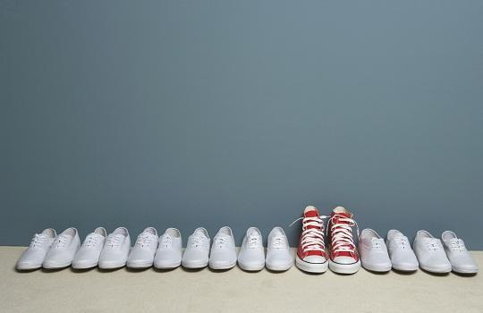
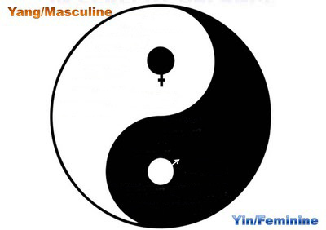
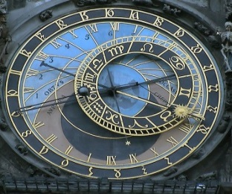
Hofstede’s cultural dimensions
Power distance « PDI »
Individualism/ Collectivism « IDV »
Masculinity / Femininity « MAS »
Uncertainty avoidance « UAI »
Long term orientation « LTO »

Slide 9
Geography of leadership
What does this image present as a difference in leadership styles in different cultures?

Slide 10
How do expectations of good leadership differ between cultures?

Slide 11
Questions
What leadership styles do we associate with western schools in general?
What leadership styles do we associate with eastern schools in general?
What leadership styles do we expect in international curriculum schools?
What issues might arise out of the differences between your answers to Q1-3?

Slide 12
Challenges in international schools?

Slide 13
Universal leadership attributes? Is there such a thing?

Slide 14
Day et al ‘10 strong claims’
Headteachers are the main source of leadership in their schools.
There are eight key dimensions of successful leadership.*
Head teachers’ values are key components in their success.
Successful heads use the same basic leadership practices, but there is no single model for achieving success.
Differences in context affect the nature, direction and pace of leadership actions.

Slide 15
Day et al cont…
Heads contribute to student learning and achievement through a combination and accumulation of strategies and actions
There are three broad phases of leadership success – staffing, focus on curriculum & curriculum change.
Heads grow and secure success by layering leadership strategies and actions.
Successful heads distribute leadership progressively
The successful distribution of leadership depends on the establishment of trust.

Slide 16
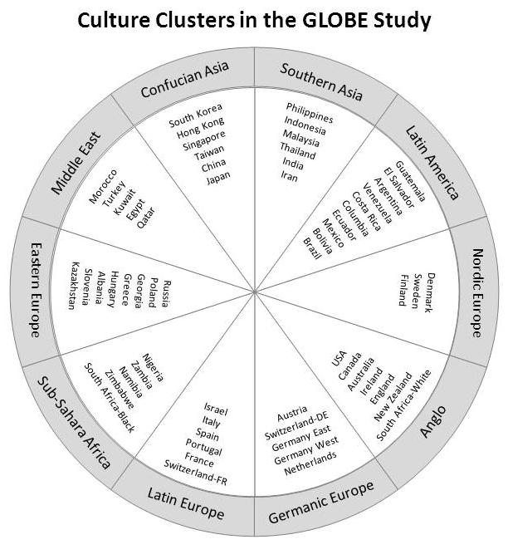
GLOBE universals
GLOBE decided on 9 Dimensions across different cultural clusters

Slide 17
GLOBE’s 9 Dimensions
Power distance
Uncertainty avoidance
Humane Orientation
Collectivism (institutional)
Collectivism (in group)
Assertiveness
Gender Egalitarianism
Future Orientation
Performance Orientation

Slide 18
What did they study?
an outstanding leader is a person in an organization or industry who is "exceptionally skilled at motivating, influencing, or enabling you, others, or groups to contribute to the success of the organization or task.”
112 traits were studied with reference to how they might enable or hinder a leader from being this person

Slide 19
21 leadership scales
Integrity (6.07) Inspirational (6.07) Visionary (6.02)
Performance-oriented (6.02)
Team-integrator (5.88) Decisive (5.80) Administratively competent (5.76)
Diplomatic (5.49)
Collaborative team orientation (5.46)
Self-sacrificial (5.0)

Slide 20
21 characteristics cont…
Modesty (4.98)
Humane (4.78) Status conscious (4.34)
Conflict inducer (3.97)
Procedural (3.87)
Autonomous (3.85)
Face saver (2.92)
Non-participative (2.66)
Autocratic (2.65)
Self-centered (2.17)
Malevolent (1.80).

Slide 21
6 leadership styles
The charismatic/value based style (4.5 – 6.5)
The team-oriented style (4.7 – 6.2)
The participative style (4.5 – 6.1)
The humane style (3.8 – 5.6)
The self-protective (2.5 – 4.6)
The autonomous style (2.3 – 4.7)

Slide 22
Culturally contingent leadership characteristics
A more detailed analysis identified that leader characteristics such as [being] ambitious, enthusiastic, formal, logical, or risk taker are valued very differently around the world.
For example, on GLOBE's 7-point scale to measure a society's view of these leader traits, the culture means for “risk taker” range from 2 to 6. This is in line with the extent to which countries tolerate uncertainty …

Slide 23
Leadership…?
Q What might be recommended and what might ‘depend on the context’?

Slide 24
Layers of culture

Slide 25
Organisational culture
http://www.managementparadise.com/article_print.php?article_id=1061

Slide 26
How does the leader lead the culture with his/her behaviours?
How does SLT lead the culture with their behaviour?
How does the behaviour
of teachers, students
and all in the community
exemplify the culture?
What are the org. practices which
exemplify the culture?
What are the assumptions
values and beliefs
that need to be
shared by the community?
What actions ‘show’
‘the way we do things
here’ on a daily basis?
How do we make sure our ‘culture’ reflects our mission and vision and is visible and clear to all who visit?

Slide 27
Communication
-through
Culture
-through
Culture
http://phprimer.afmc.ca/Part3-PracticeImprovingHealth/Chapter10IdentifyingHazardsAndCommunicatingRisks/RiskCommunication

Slide 28
Reflection

Slide 29
Bibliography
Aslan, M., Beycioglu, K., & Konan, N., (2008) Principals’ Openness to Change in Malatya, Turkey. International Electronic Journal For Leadership in Learning. 12, Number 8
Chen, C., Chen, X., & Meindl, J., (1998) How can Cooperation be Fostered? The cultural effects of individuals and Collectivism. Academy of Management Review. Vol. 23, No. 2, 285-304.
Cheng, Kai-ming(1998) Can education values be borrowed? Looking into cultural differences', Peabody Journal of Education, 73: 2, 11 — 30
Hofstede, G., ‘Cultural Dimensions’ accessed June to December 2009 from http://www.geert-hofstede.com
Hofstede, G., and Hofstede, G.J., (2005), Cultures and Organizations - Software of the Mind.
London: Mc Graw Hill, UK.
James, C & Connolly, M., (2009) An analysis of the relationship between the organizational culture and the performance of staff work groups in schools and the development of an explanatory model. International Journal of Leadership in Education, 12: 4, 389 — 407.
Joy, S., & Kolb, D.A., (2009), Are there cultural differences in learning style? International Journal of Intercultural Relations , 33, 69–85.

Slide 30
Leithwood, K., (1994) Leadership for School Restructuring. Educational Administration Quarterly 30; 498.
Leithwood, K., & Duke, D. L. (1998) Mapping the conceptual terrain of leadership: A critical point of departure for cross-cultural studies, Peabody Journal of Education, 73: 2, 31- 50
Lorwatanapongsa P., (2003) Cross-cultural communication in international schools. (Unpublished Doctoral dissertation) Katholieke Universiteit Leuven (Belgium);. Publication Number: AAT C818941
Nemetz, P., & Christensen, S., (1996),The Challenge of Cultural Diversity; A Harnessing a Diversity of Views to Understand Multiculturalism. Academy of Management Review21, No. 2. 434-462
Portin, Bradley S.(2009) 'Cross-national professional learning for school leaders', International Journal of Leadership in Education, 12: 3, 239 — 252
Schlichting-Artur, S., (2009), Learning to Listen: Pursuing Leadership Strategies for Achieving Multiculturalism in Educational Administrative Work Environments. (Unpublished Dissertation for Doctorate) University of Pennsylvania.
Weigl, R., (2009) Intercultural competence through cultural self-study: A strategy for adult learners. International Journal of Intercultural Relations 33, 346–360
Xie, Rau, Tseng, Su and Zhao (2009) Cross-cultural influence on communication effectiveness and user interface design. International Journal of Intercultural Relations. 33. 11–20.

