Slide 1
Teachers Perceptions’ of Mother Tongue & Bilingual Education in a Rural Guatemalan School
Presenter: Kelly Dalton
Co-Researchers: Sarah Hinshaw & Jack Knipe
George Mason University ~ Fairfax, VA, USA

Slide 2
Ixil Population
Guatemala
Mother Tongue Education

Slide 3
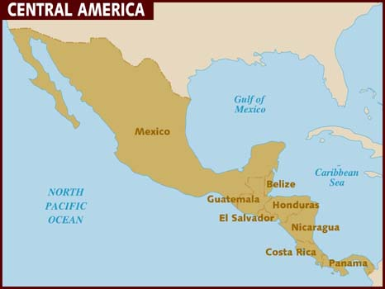
Guatemala
Civil War
Current State of Education
Indigenous Peoples

Slide 4
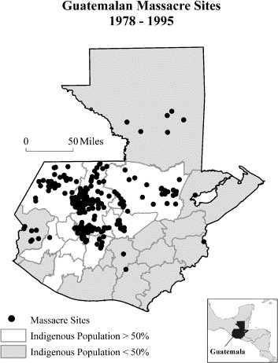
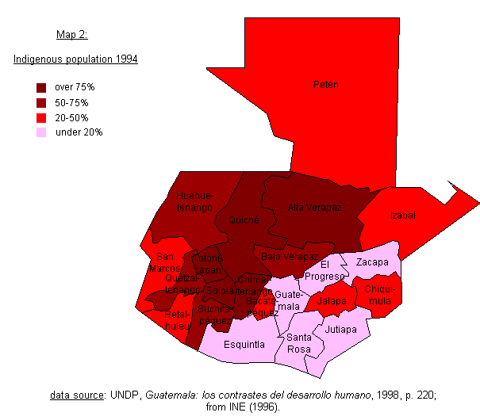

Slide 5
Guatemala

Slide 6
Guatemala

Slide 7
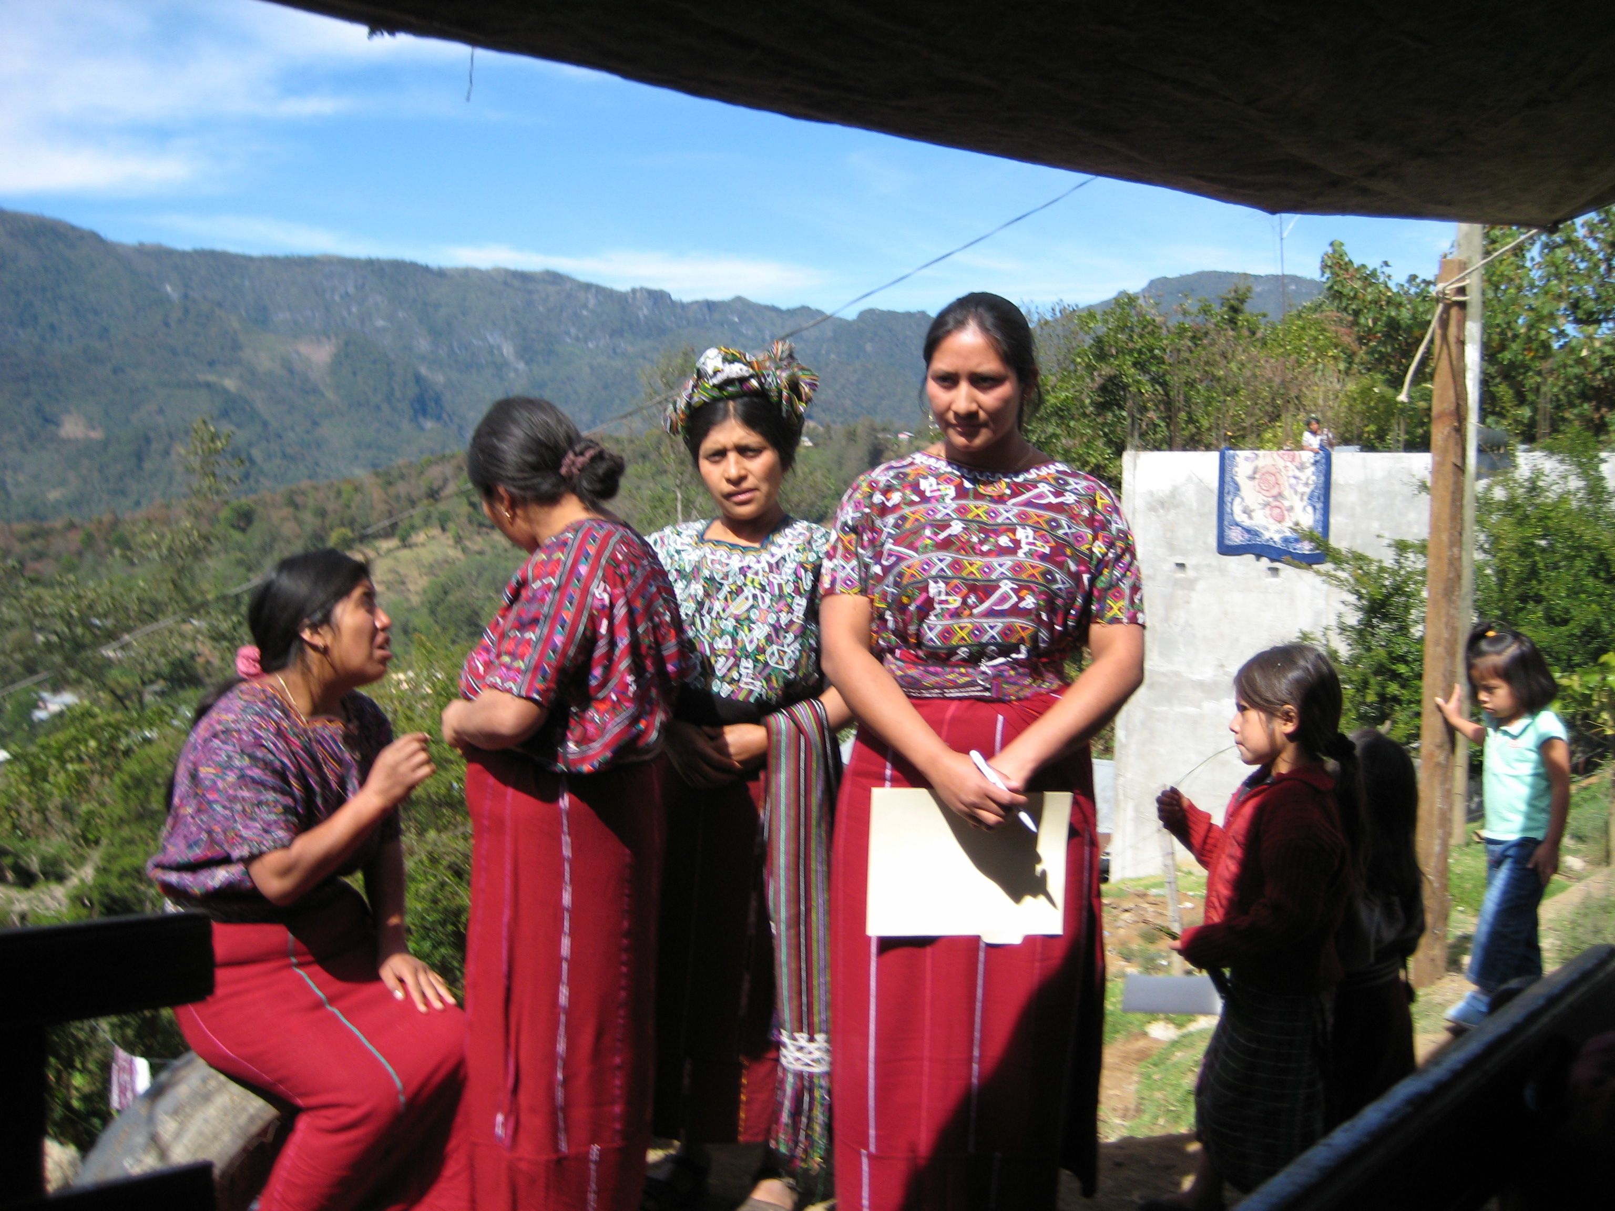
Ixil Population
70,000
Mayan Language (3 dialects)
Ixil Language
Literacy rate L1: 10-30%
L2: 15-25%
Lieberman, A. (2008). Ixil Mayan Women at Center Inauguration [Online image]. Retrieved September 29, 2014 from https://www.globalgiving.org/projects/support-technology-centers-guatemala/updates/
Lewis, M. Paul, Gary F. Simons, and Charles D. Fennig (eds.). 2014. Ethnologue: Languages of the World, Seventeenth edition. Dallas, Texas: SIL International. Retrieved from http://www.ethnologue.com/language/ixl

Slide 8
Language Map
by the Comisión de Oficialización de los Idiomas Indígenas de Guatemala

Slide 9
Mother Tongue Education
Additive Bilingualism
“Funds of Knowledge”
Why it matters . . .
Ixil Books

Slide 10
Research Project
Case Study
Summer 2014
Data collection: Interviews, Observations, Survey, Essays
Data Analysis

Slide 11
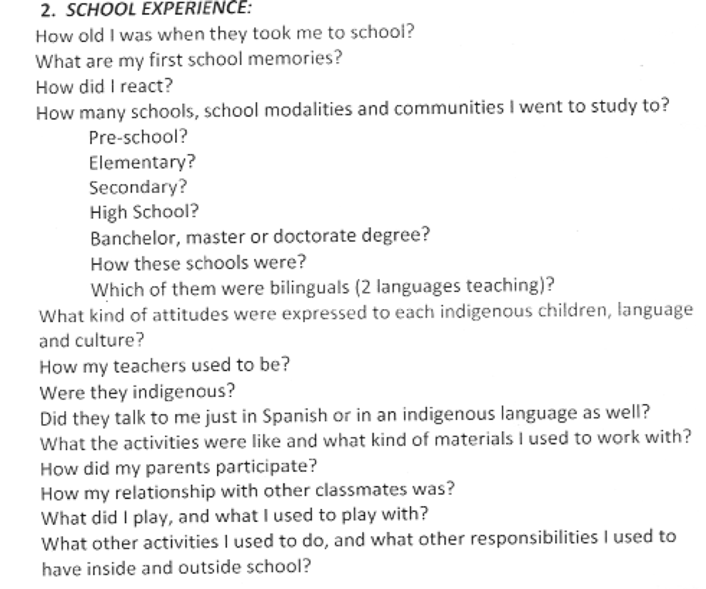
Teachers’ Idiomatic Biography
With permission from Lois M Meyer, University of New Mexico, 2013

Slide 12
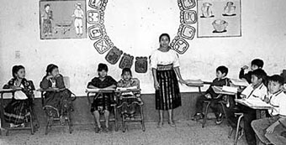
Excerpts
[Untitled illustration of Mayan teacher]. Retrieved September 30, 2014 from http://www.proartemaya.org/pro-arte-maya-project/
“The schools I attended were bilingual and the attitudes that they expressed was that they didn’t discriminate against the cultures of any town”
“My teachers were friendly and were indigenous. They spoke to me in the indigenous language and in Spanish”
“I met made many friends as they came from other communities. I was very close and unified with my classmates”
“I also met other friends from different cultures and different costumes [traditional suites worm by women]. There where I learned to share with them, we talked about our different typical dresses, foods, and other things”
“When I started to study, I wasn’t motivated. Quite the opposite – I was in despair, worried, and sad. Why? Because at that age, the class was too advanced…”
“It was hard enough as it was and on top of that, the classes were completely in Spanish. There wasn’t bilingual schooling.”
“There was no solidarity between us [in primary school]”
“Indigenous children need to see good attitudes in order to want to be in the classroom”

Slide 13
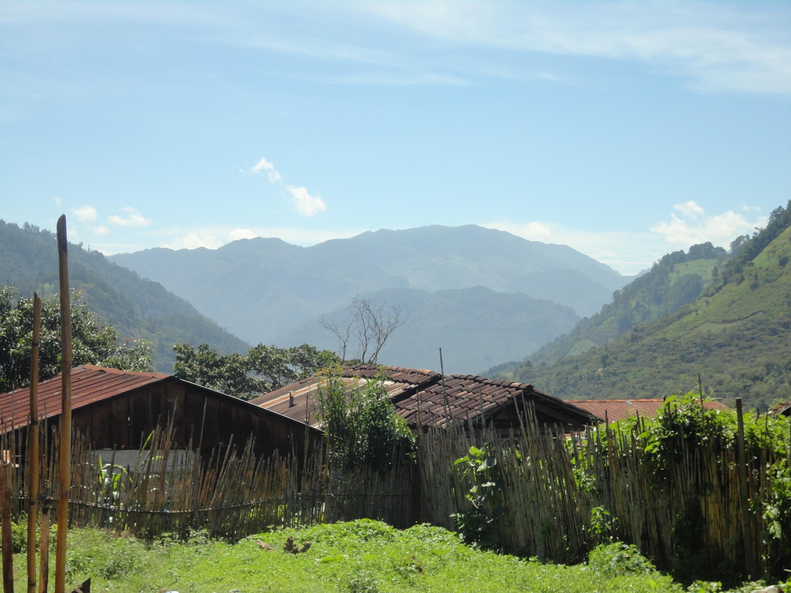
Implications?

