Slide 1
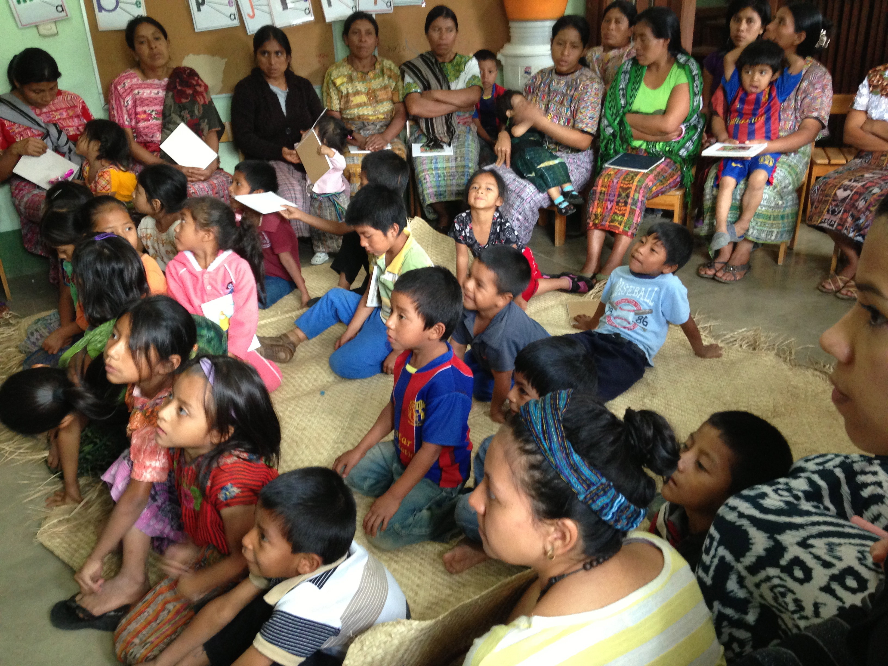
Immersion as a Vehicle for Meaning Making:
Examining the role of community-engaged learning and teacher professional development
Kelly Dalton, PhD, RDN
George Mason University
Fairfax, VA, USA
kmcgrat7@gmu.edu

Slide 2
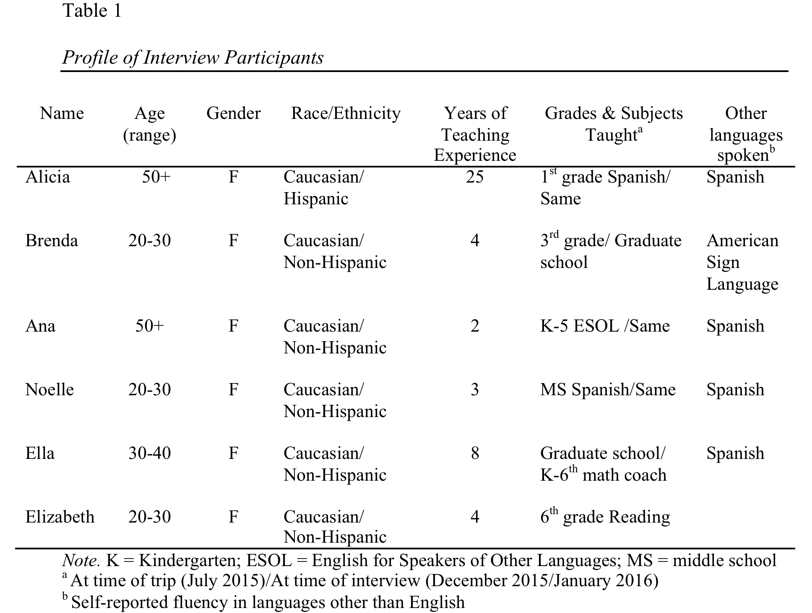

Slide 3
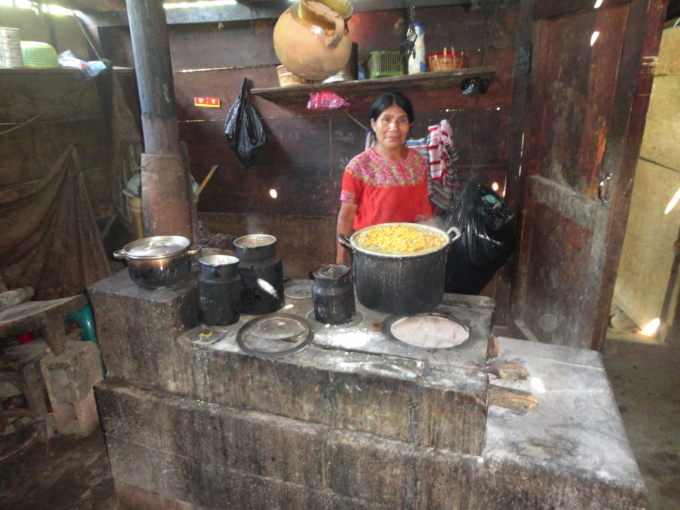
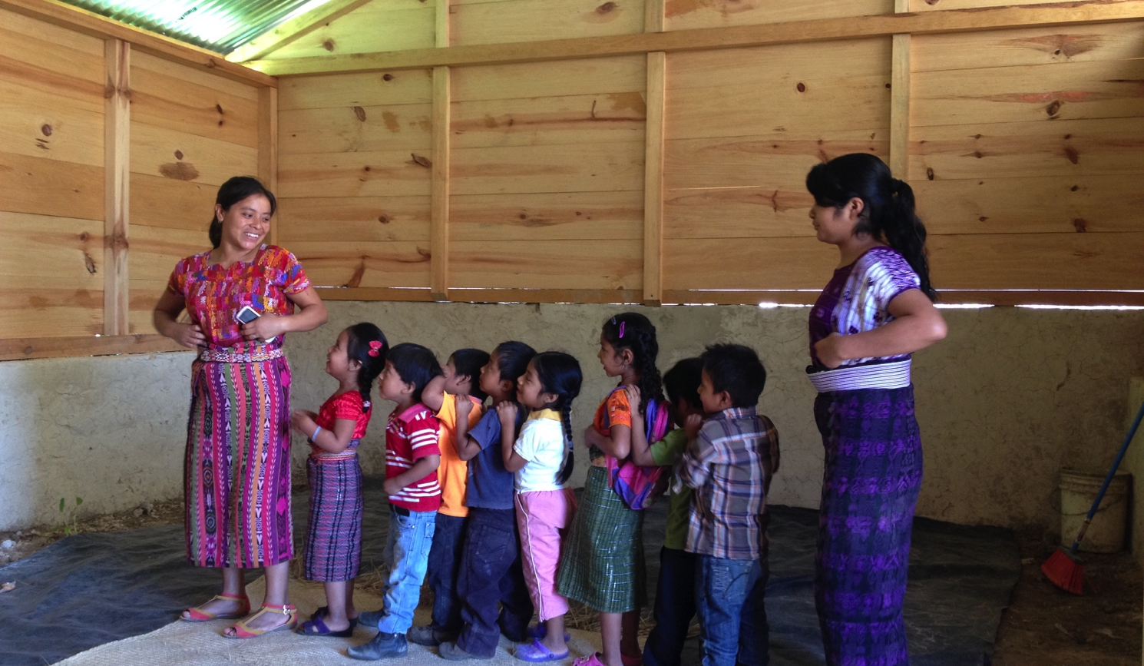
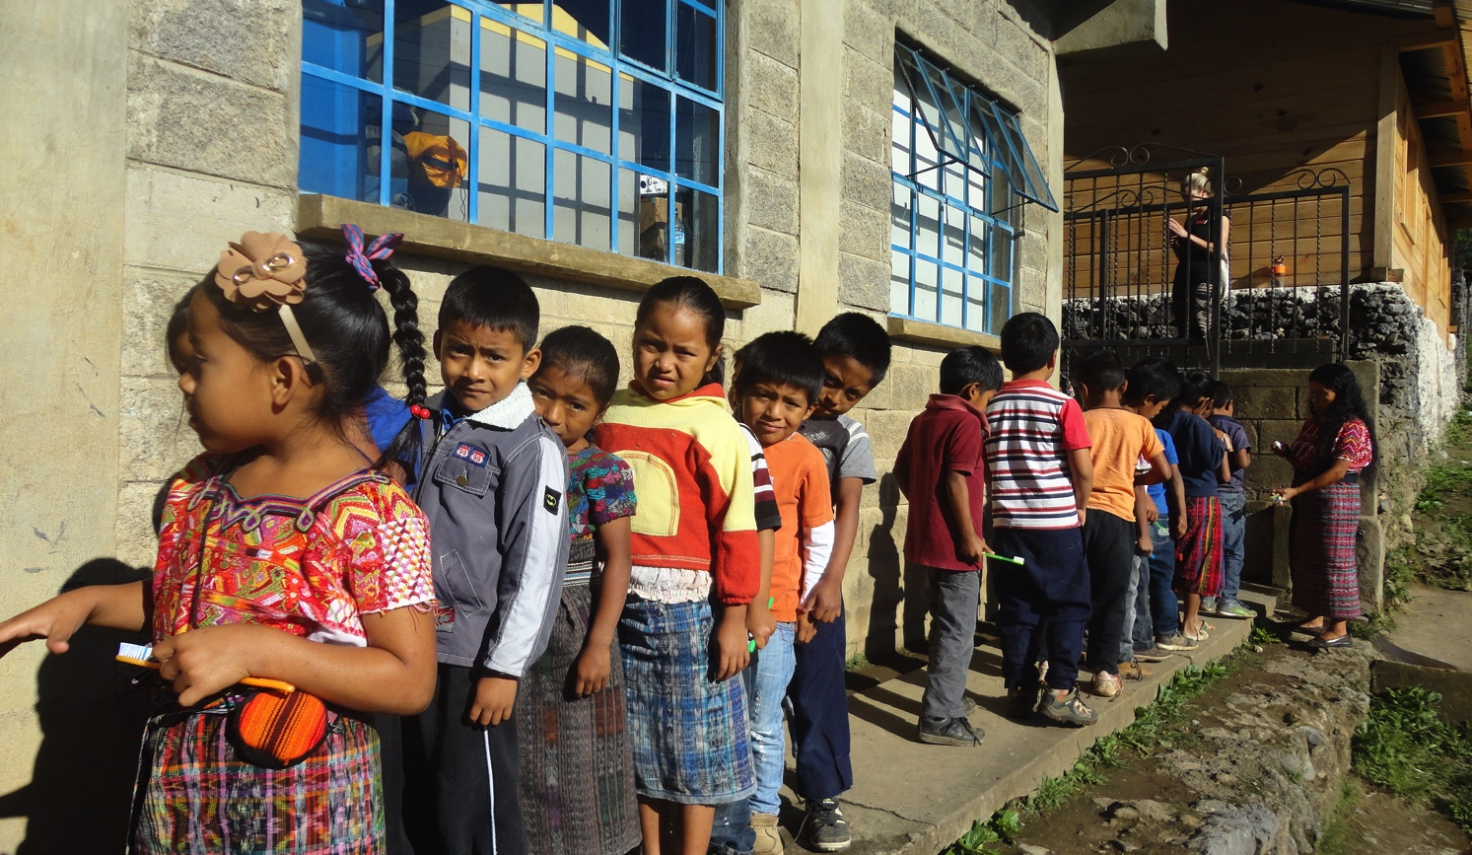
“There are just differences in the way people see the world and it seems so obvious but then when you go and you work there, you live that experience, and its so different.”

Slide 4
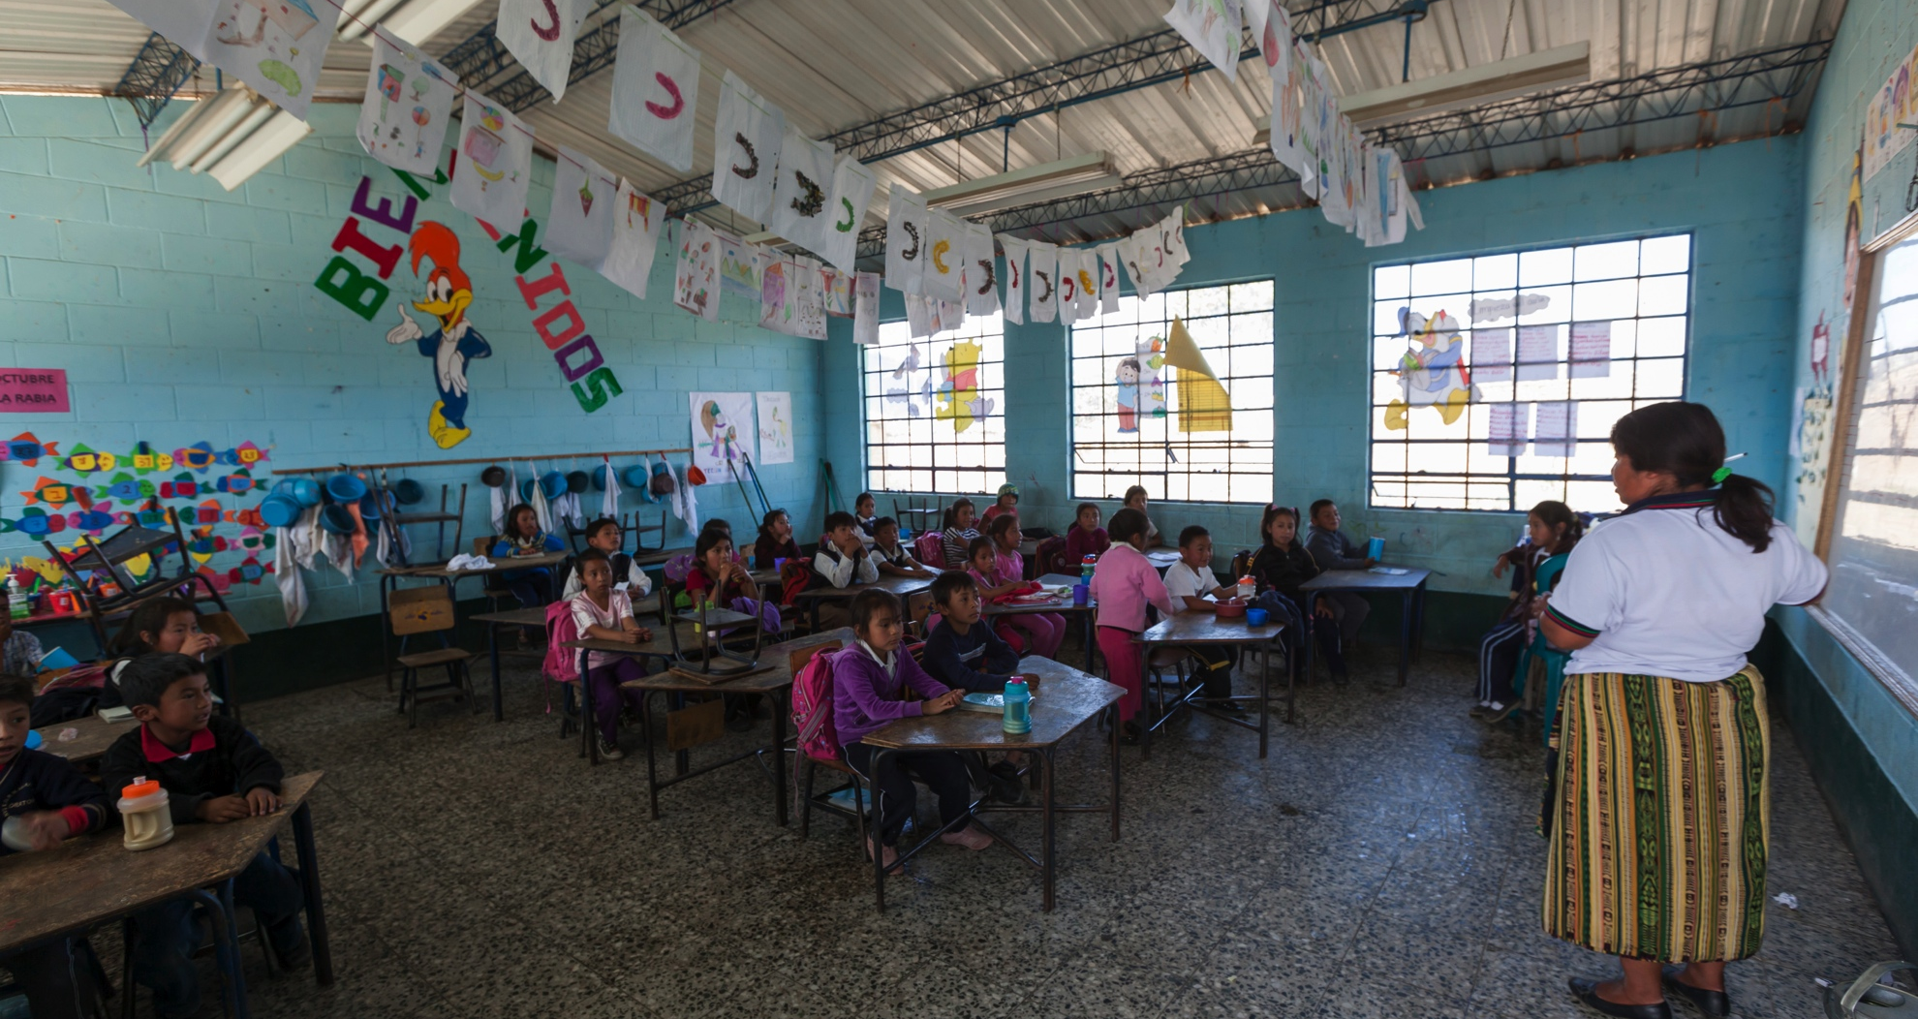
Expanded Perspectives of Teaching and Learning
Reaffirming
Questioning
New Understandings

Slide 5
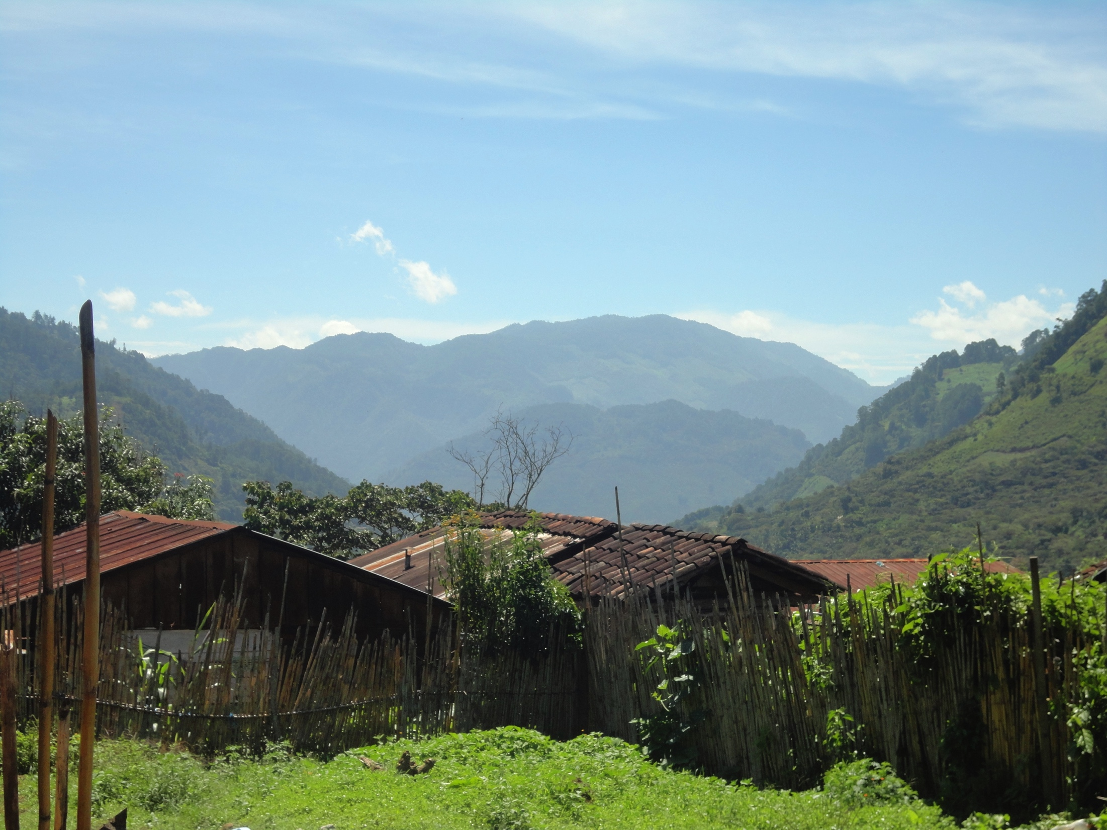
Empathy
  “I explained it as a life changing experience and I think that all teachers should be able to do that if you’re teaching such a diverse population…you can read about it in books and watch videos and movies but going there is different, it’s [a] completely different experience.”

Slide 6
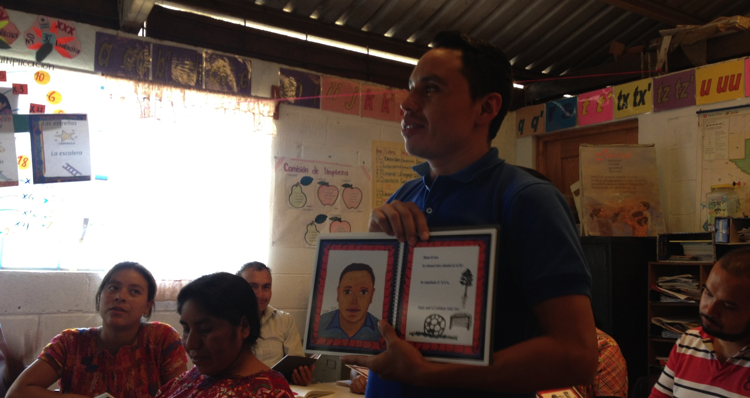
Challenging Inequities
Power of Language
Breaking Down Stereotypes
“Being more sensitive to the inequities [they were] was putting in the classroom”

Slide 7
Implications
“I made the typical mistake that ESOL teachers make all the time, that they hear the kids say a few phrases in English and they think – oh they speak English – but they really don’t. Because you tend to pick up a lot of the language that’s repeated daily, language you need for social interaction, very quickly and very well but it's the academic language that takes so much longer...I thought oh my goodness with all my years in second language acquisition how did I fall into that same trap?

Slide 8
Reflective Relationships for Change
Relationship to self – social location
Relationship to others – privilege and power
Relationship to community – participation
Relationship to world – social responsibility
*Adapted from the work of Carrie Hutnick

