Slide 1


Slide 2
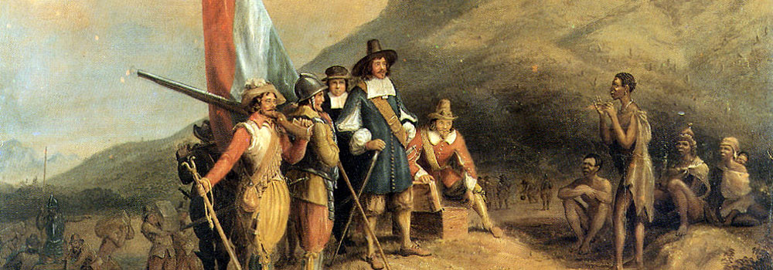
http://www.thejournalist.org.za/spotlight/the-eight-years-of-jan-van-riebeeck

Slide 3
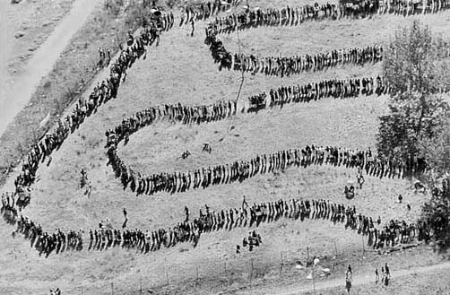
http://nonsenseatwork.com/2012/11/

Slide 4
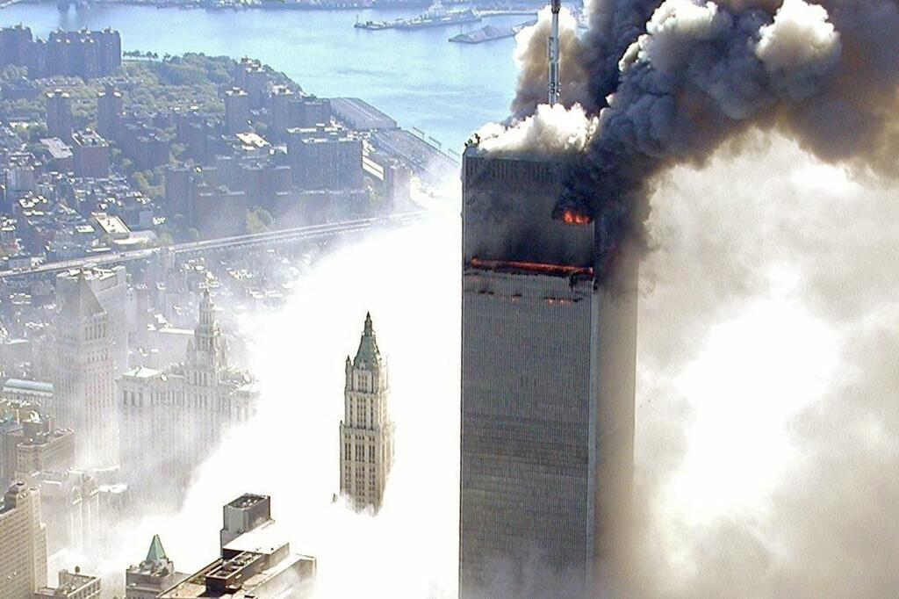
http://web.de/magazine/politik/terror/911-15-jahre-terroranschlag-11-september-2001-31873918

Slide 5
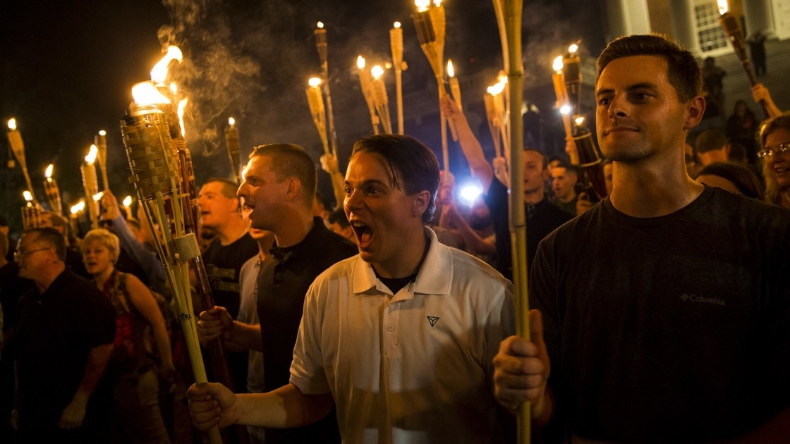
https://www.newyorker.com/news/daily-comment/the-battle-of-charlottesville

Slide 6
WHAT IS PREJUDICE?

Slide 7
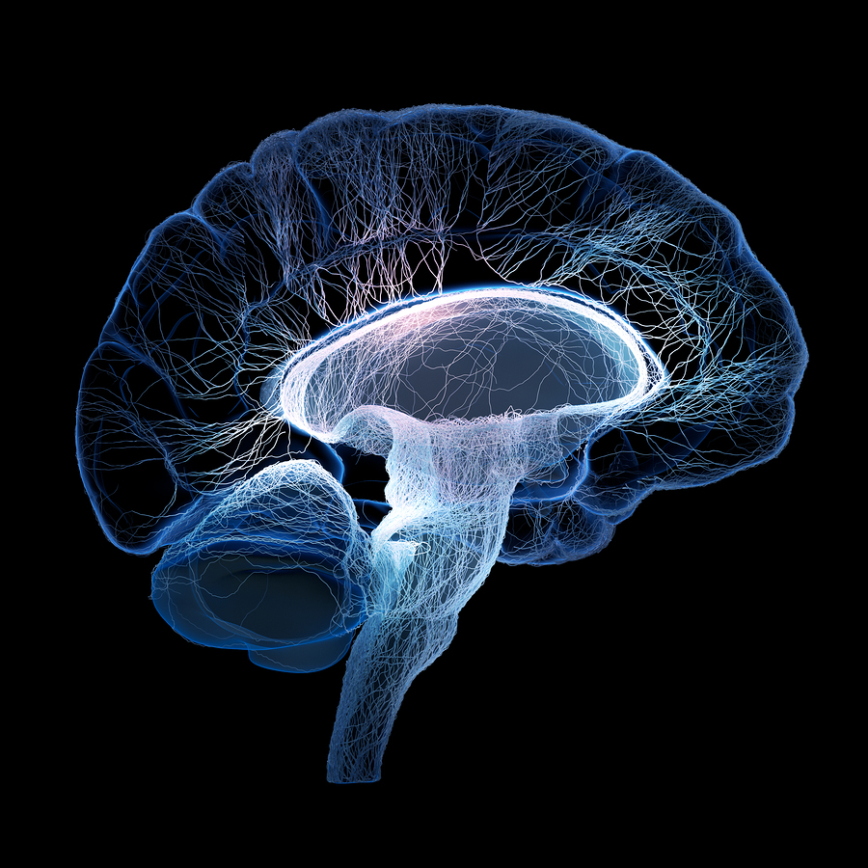
http://jonlieffmd.com/category/blog/neuronal-plasticity-blog

Slide 8
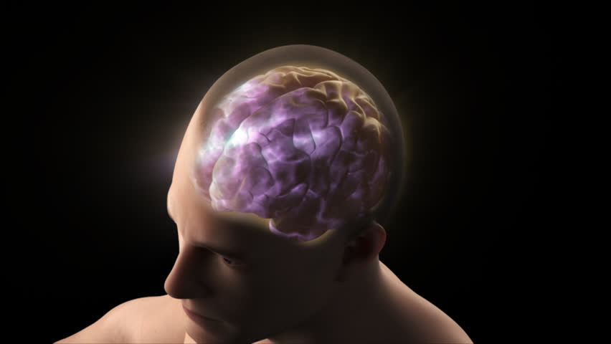
https://www.shutterstock.com/video/search/cerebral-cortex/

Slide 9
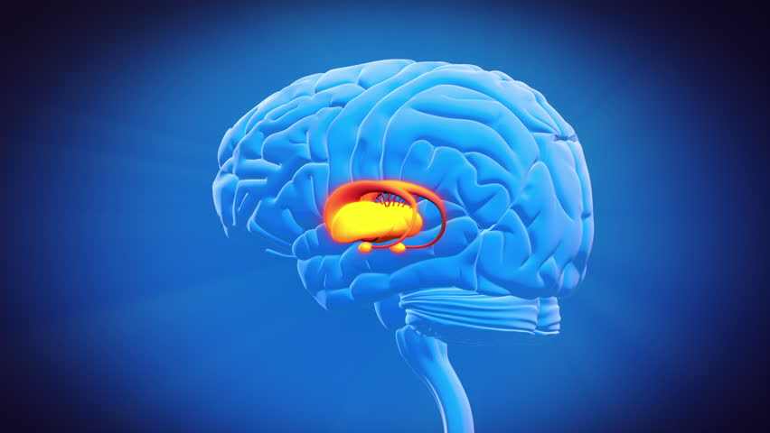
https://www.shutterstock.com/fr/video/clip-3283064-stock-footage-brain-part-limbic-system.html

Slide 10
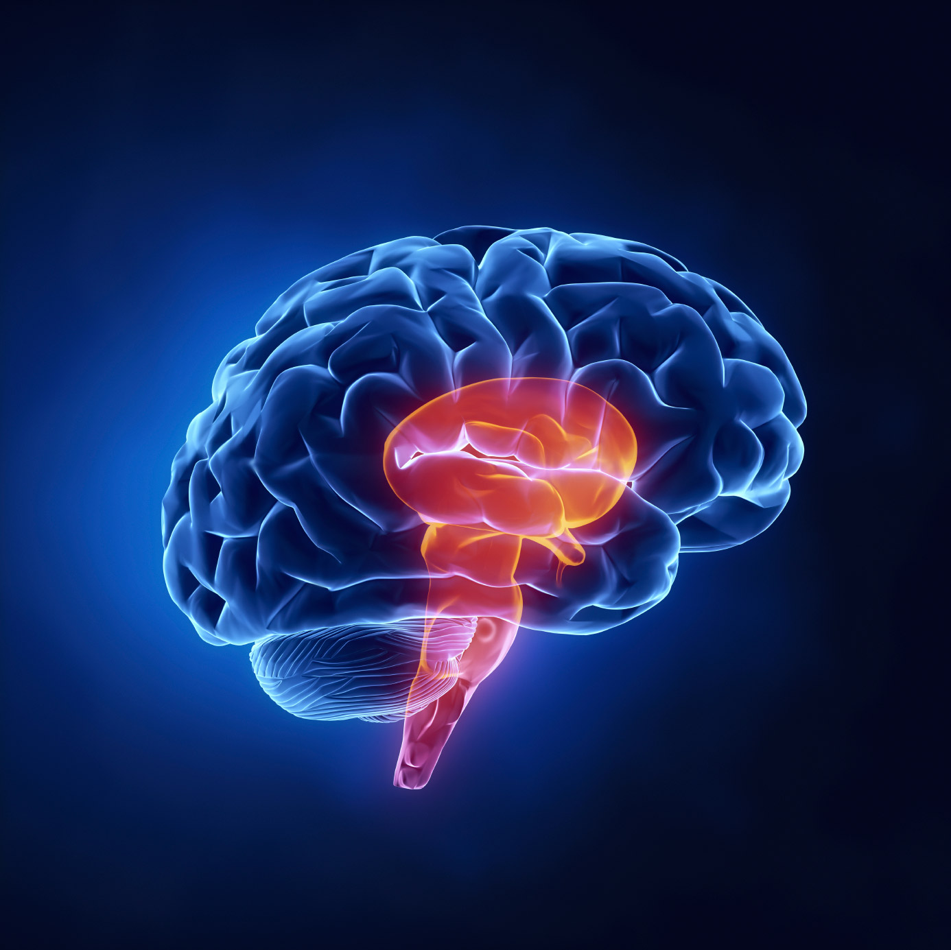
http://www.salesbrain.com/neuromap-overview/3-brains/

Slide 11
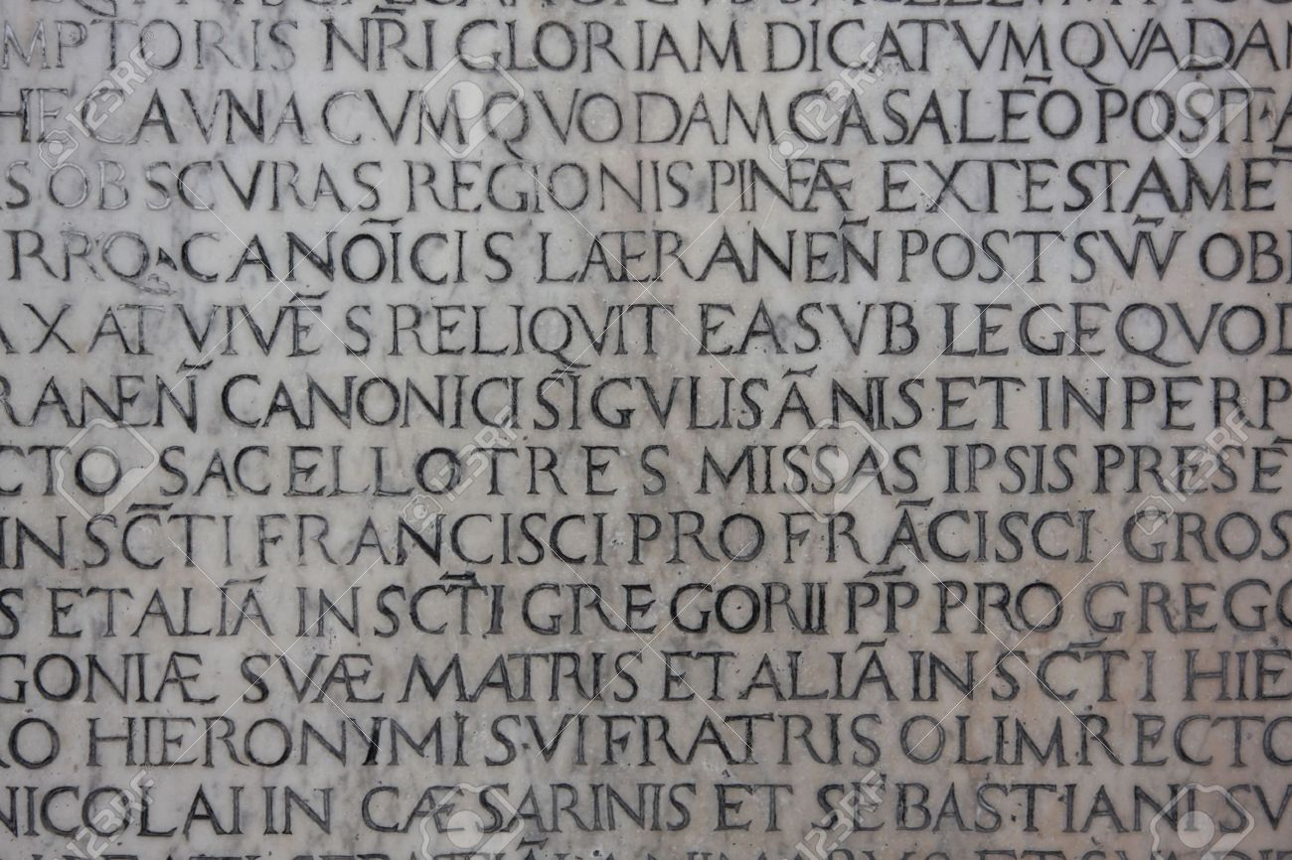
http://www.123rf.com/photo_4953368_old-medieval-latin-catholic-inscription.html

Slide 12
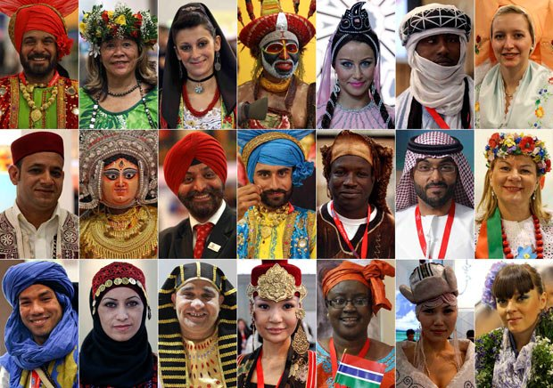
http://cloudmind.info/photography-beauty-of-different-cultures-around-the-world/

Slide 13

http://blueprint.ucla.edu/feature/police-racism-search-for-answers/

Slide 14
WOULD YOU LIKE TO BE A MINORITY IN YOUR NEIGHBOURHOOD?
Thomas Schelling
DYNAMIC MODELS OF Segregation

Slide 15
Assume that all "reds" are quite "tolerant" of greens. They are willing to live in "mixed neighborhoods" in which both groups are proportionally represented. Assume that "greens" feel the same way.
Thomas Schelling
DYNAMIC MODELS OF Segregation
http://faculty.ucr.edu/~hanneman/spatial/schelling/schelling.html

Slide 16
However, let's also assume that, while members of each group are tolerant of the other, that no one wants to be a "minority" in their neighborhood. That is, greens are happy to live in a neighborhood with up to 50% reds -- but not more than that; reds feel the same way about the presence of greens.
Thomas Schelling
DYNAMIC MODELS OF Segregation
http://faculty.ucr.edu/~hanneman/spatial/schelling/schelling.html

Slide 17
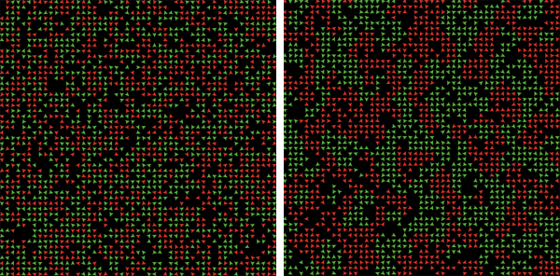
http://www.businessinsider.com.au/how-to-see-the-world-like-a-fox-not-like-a-hedgehog-2012-3

Slide 18
http://www.businessinsider.com.au/how-to-see-the-world-like-a-fox-not-like-a-hedgehog-2012-3

Slide 19
A fundamental goal of a good education is to reduce prejudice
DISCUSS

Slide 20
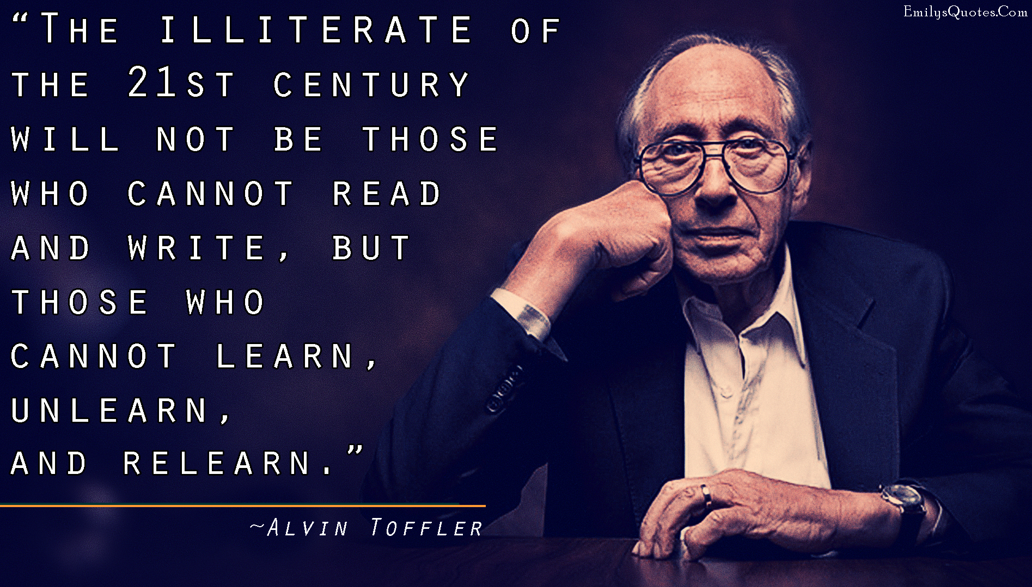
https://www.pinterest.ch/pin/497999671267557351/

Slide 21
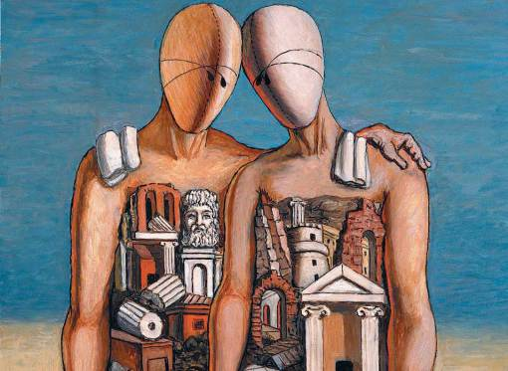
The Archaeologists (1927) Giorgio de Chirico

Slide 22
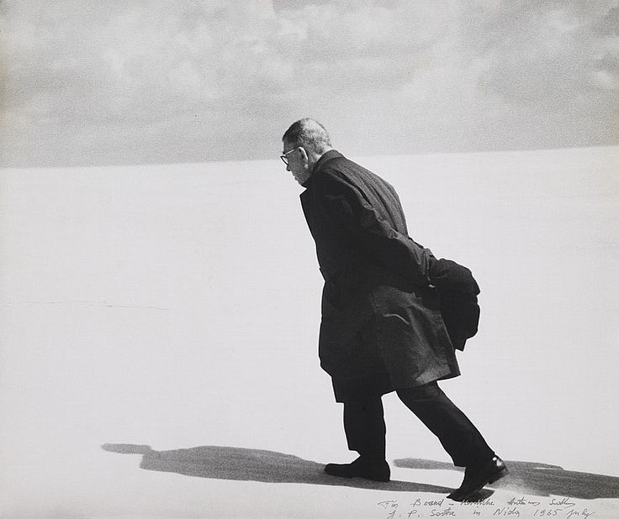
https://www.pinterest.com/pin/423056958722674504/

Slide 23
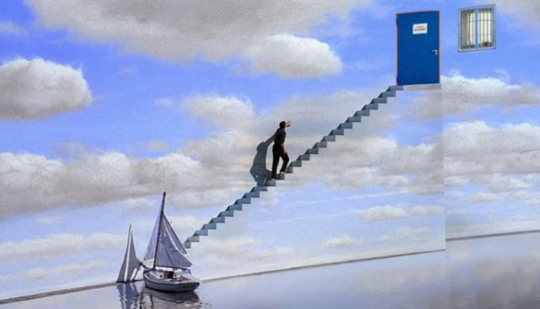
http://sites.psu.edu/weaverpassion/2016/09/27/movie-3-the-truman-show/

Slide 24
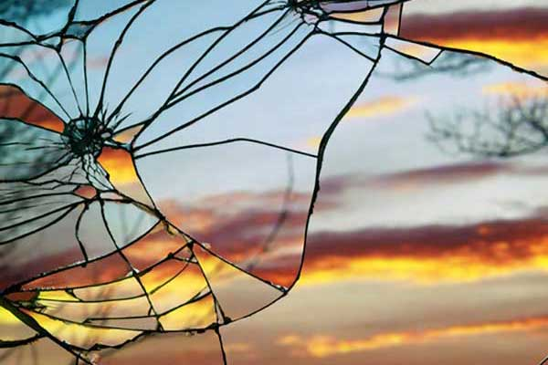
http://www.photographytuts.com/impressive-sunset-photos-captured-broken-mirrors/

Slide 25
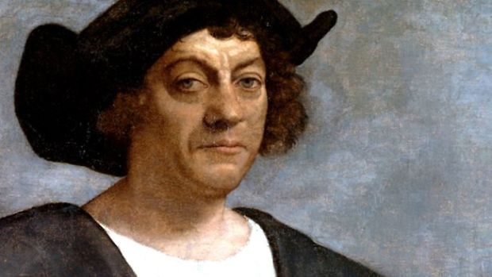
http://www.biography.com/news/christopher-columbus-day-facts

Slide 26
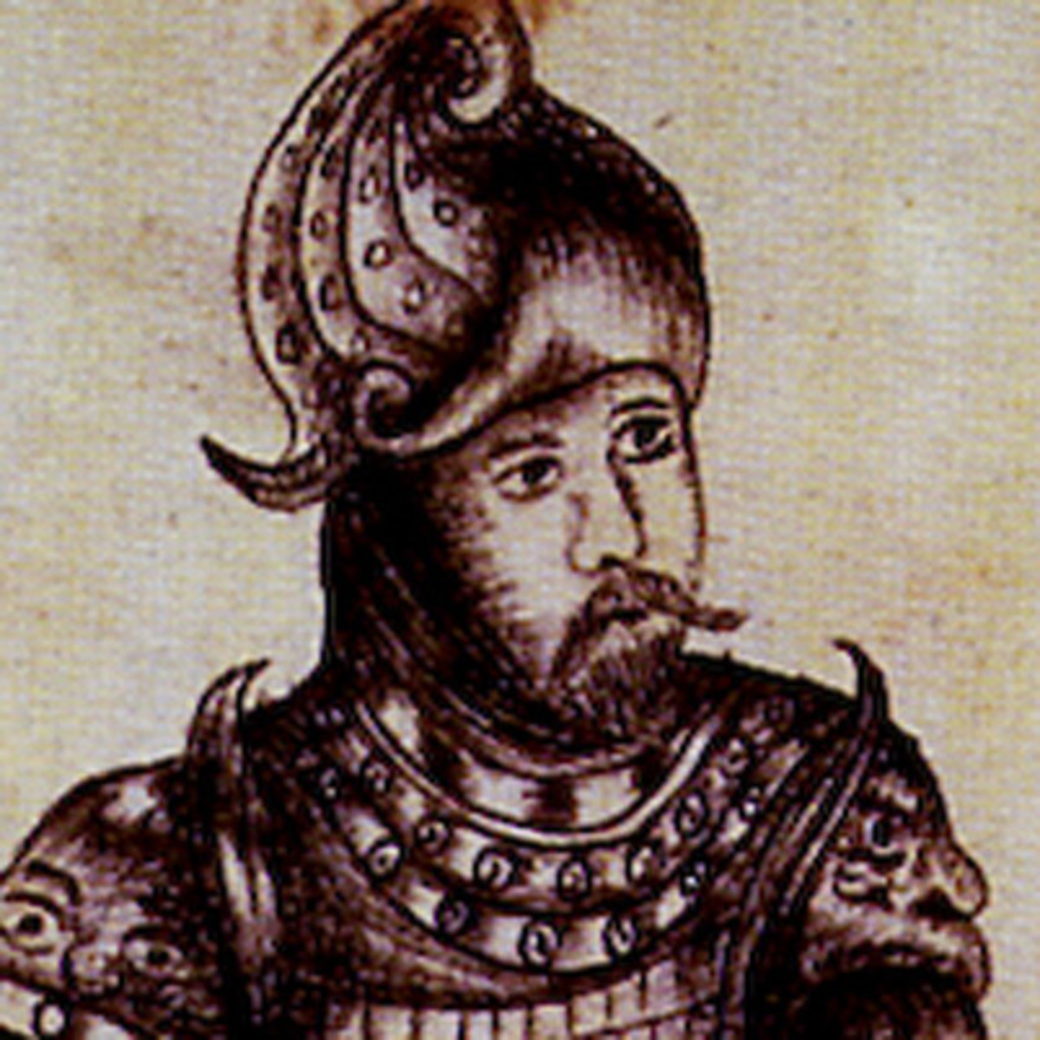
https://www.biography.com/people/erik-the-red-9288270

Slide 27
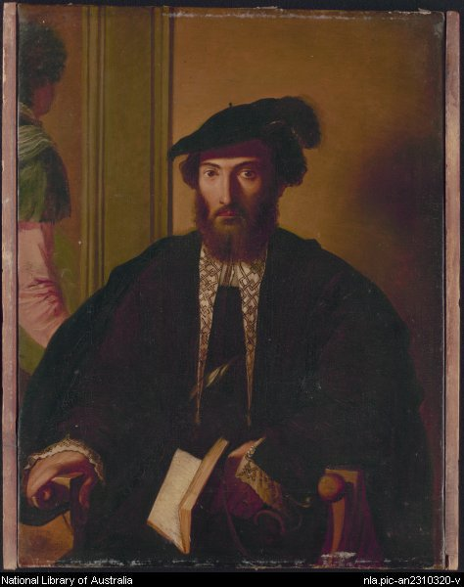

Slide 28
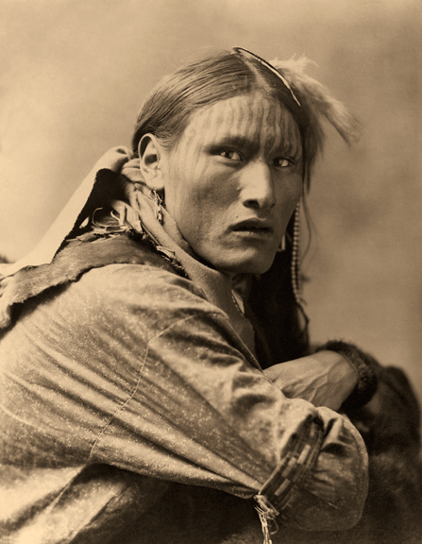
http://www.human-highway.org/tag/crazy-horse

Slide 29
PREJUDICE IN THE WORLD

Slide 30
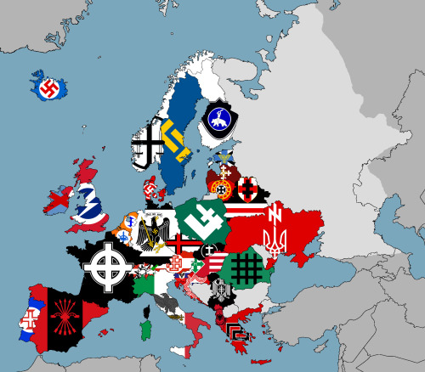
http://geographica.net/2014/05/cachez-cette-europe-que-nous-ne-saurions-voir/

Slide 31
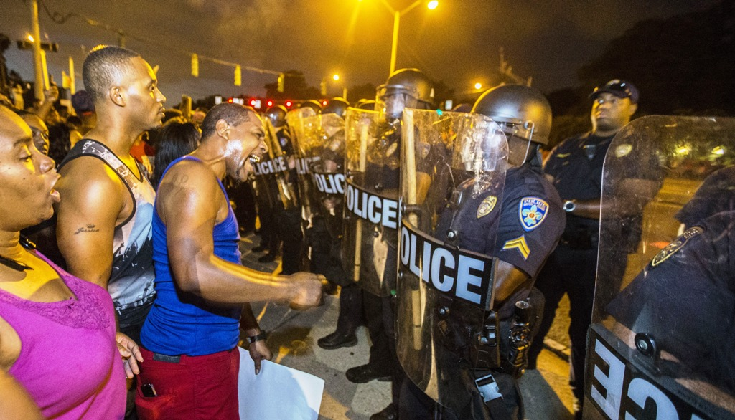
http://www.ibtimes.com/what-does-black-lives-matter-want-amid-dallas-police-killings-movement-seeks-end-2391185

Slide 32
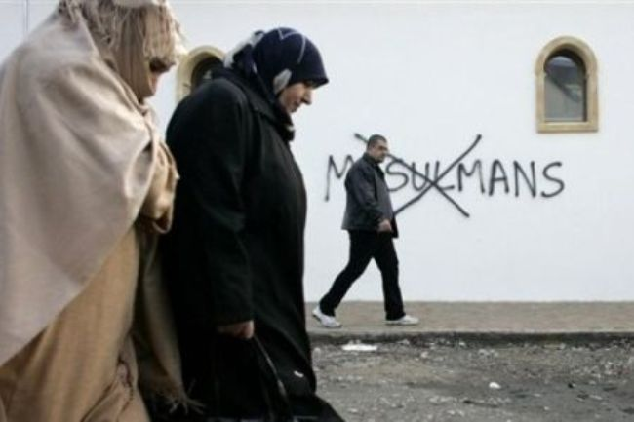
http://www.saphirnews.com/La-CNCDH-appuie-la-lutte-contre-l-islamophobie-en-France_a18649.html

Slide 33
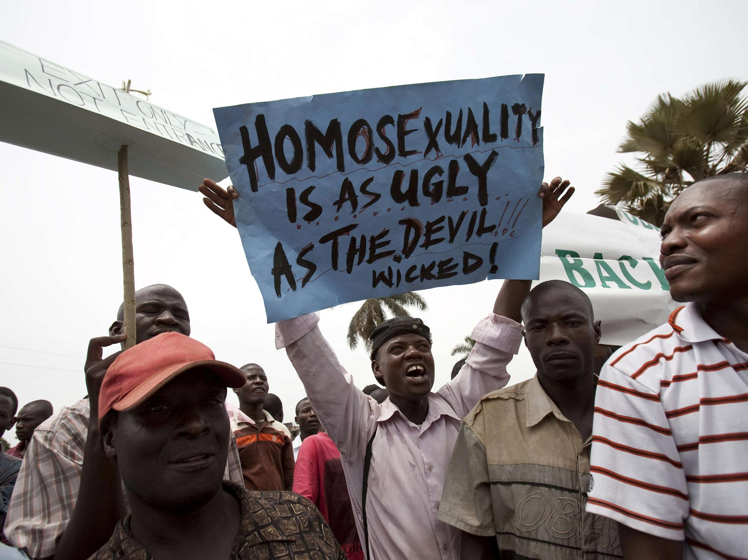
http://www.independent.co.uk/news/world/africa/how-uganda-was-seduced-by-anti-gay-conservative-evangelicals-9193593.html

Slide 34

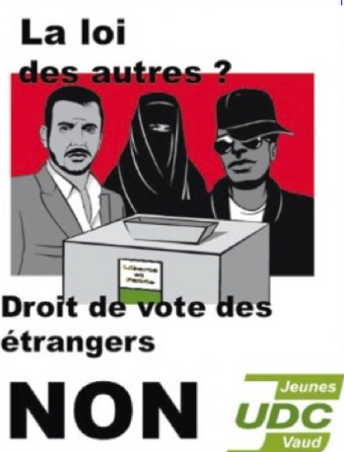
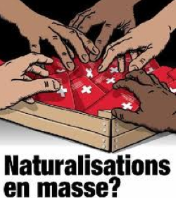

http://crimesofthetimes.blogspot.nl/2011/12/xenophobic-campaign-posters-from.html

Slide 35
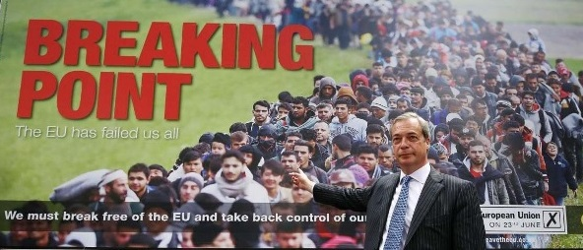
http://threeworlds.campaignstrategy.org/?p=1104

Slide 36
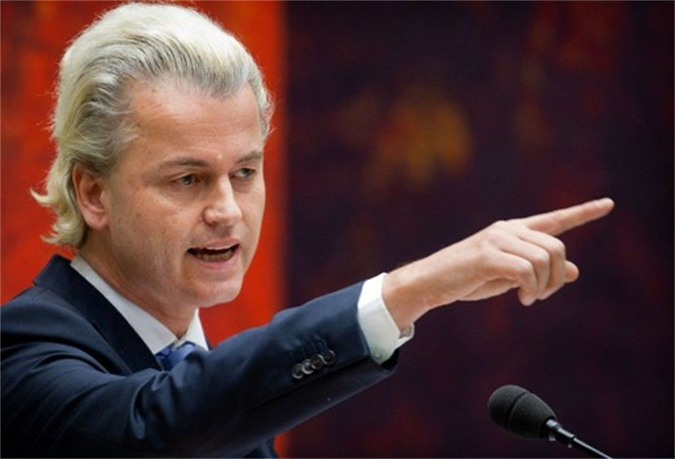
https://thisisafrica.me/dutch-right-wing-politician-leads-anti-moroccan-chant/

Slide 37
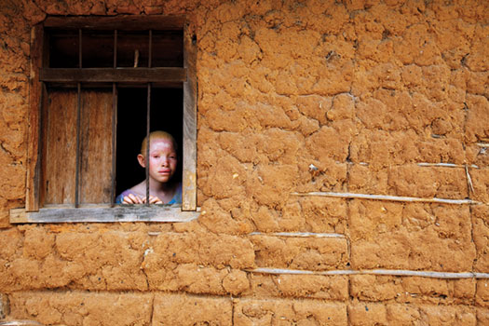
http://onwisconsin.uwalumni.com/features/pigment-prejudice/

Slide 38
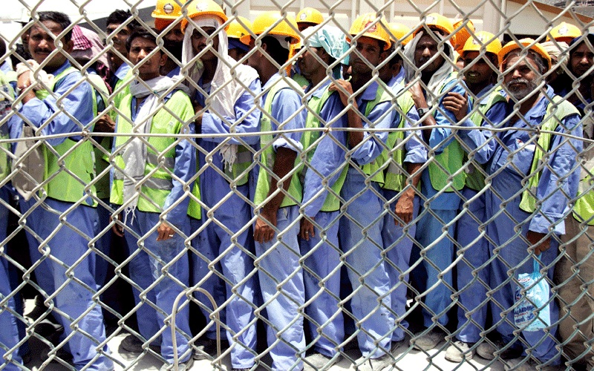
https://bkpk.me/why-i-left-dubai-and-wont-come-back-part-12/

Slide 39
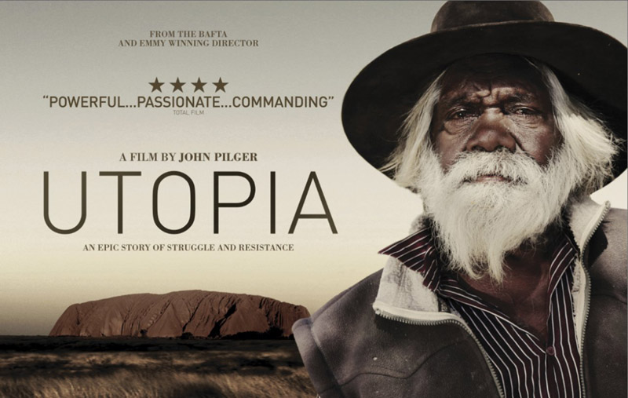
http://www.solidarity.net.au/aboriginal/aboriginal-soldiers-rewarded-with-racism-and-discrimination/

Slide 40
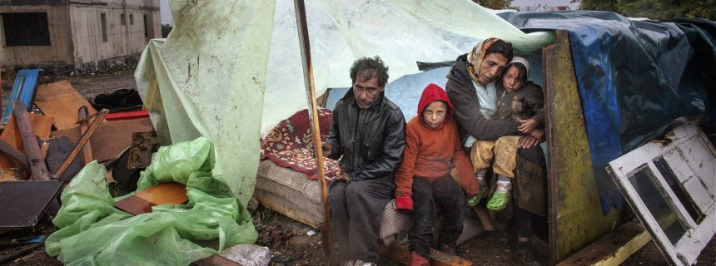
http://www.spiegel.de/international/europe/europe-failing-to-protect-roma-from-discrimination-and-poverty-a-942057.html

Slide 41

https://www.pinterest.com/mmkhartney/womens-rights/

Slide 42

HATE CRIME
Over 1000 hate crimes in US after,
First month of Trump presidency
(southern poverty law center)
Increase of 28% in LA; 46% in phoenix arizona
(california state study)
250 000 hate crimes per anum between 2004 & 2015

Slide 43

HATE CRIME
The number of hate crimes recorded by regional police forces rose by 100% following the Brexit vote (National Police Council)

Slide 44

Republished in 2016
4000 copies printed
Subscriptions:
15 000

Slide 45
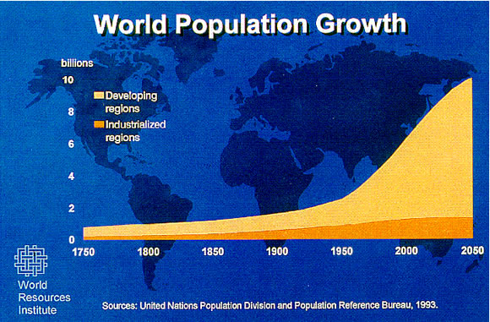
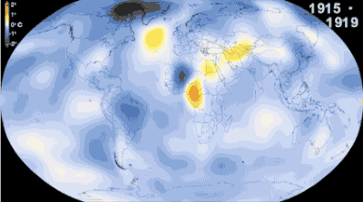
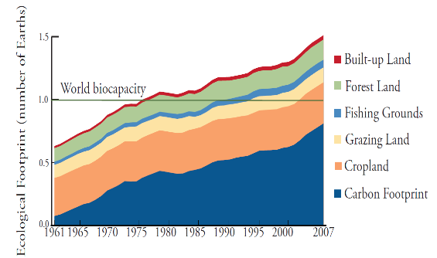
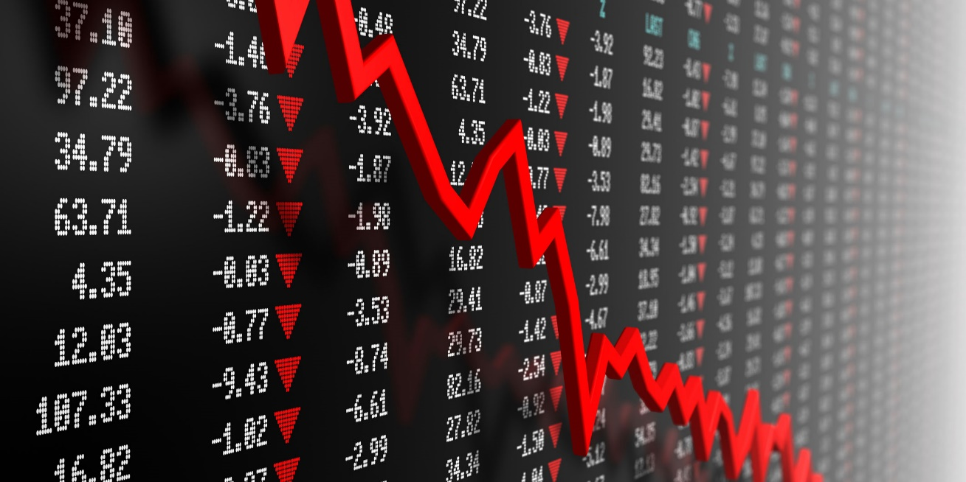
https://fxandgeopolitix.com/2016/01/12/the-financial-crisis-of-2016-rolls-on-china-oil-copper-and-junk-bonds-all-continue-to-crash/

Slide 46
REALISTIC CONFLICT THEORY

Slide 47
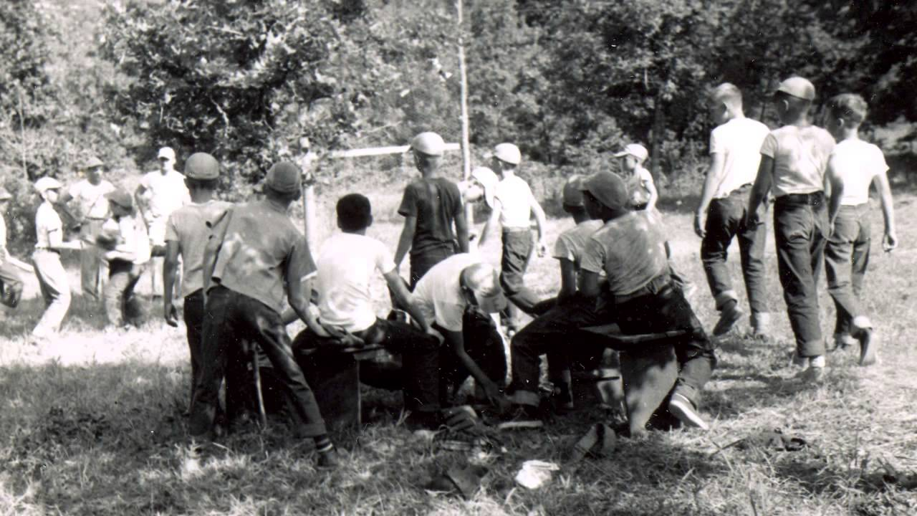
théorie du conflit
https://www.youtube.com/watch?v=8PRuxMprSDQ

Slide 48
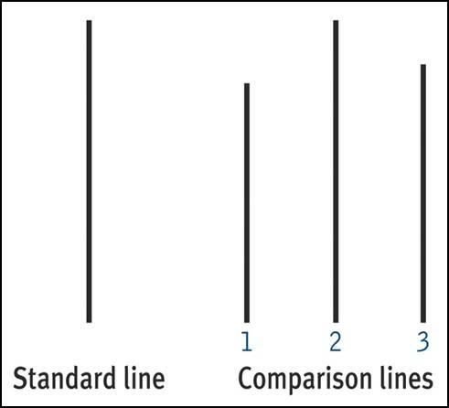
COMPLIANCE

Slide 49
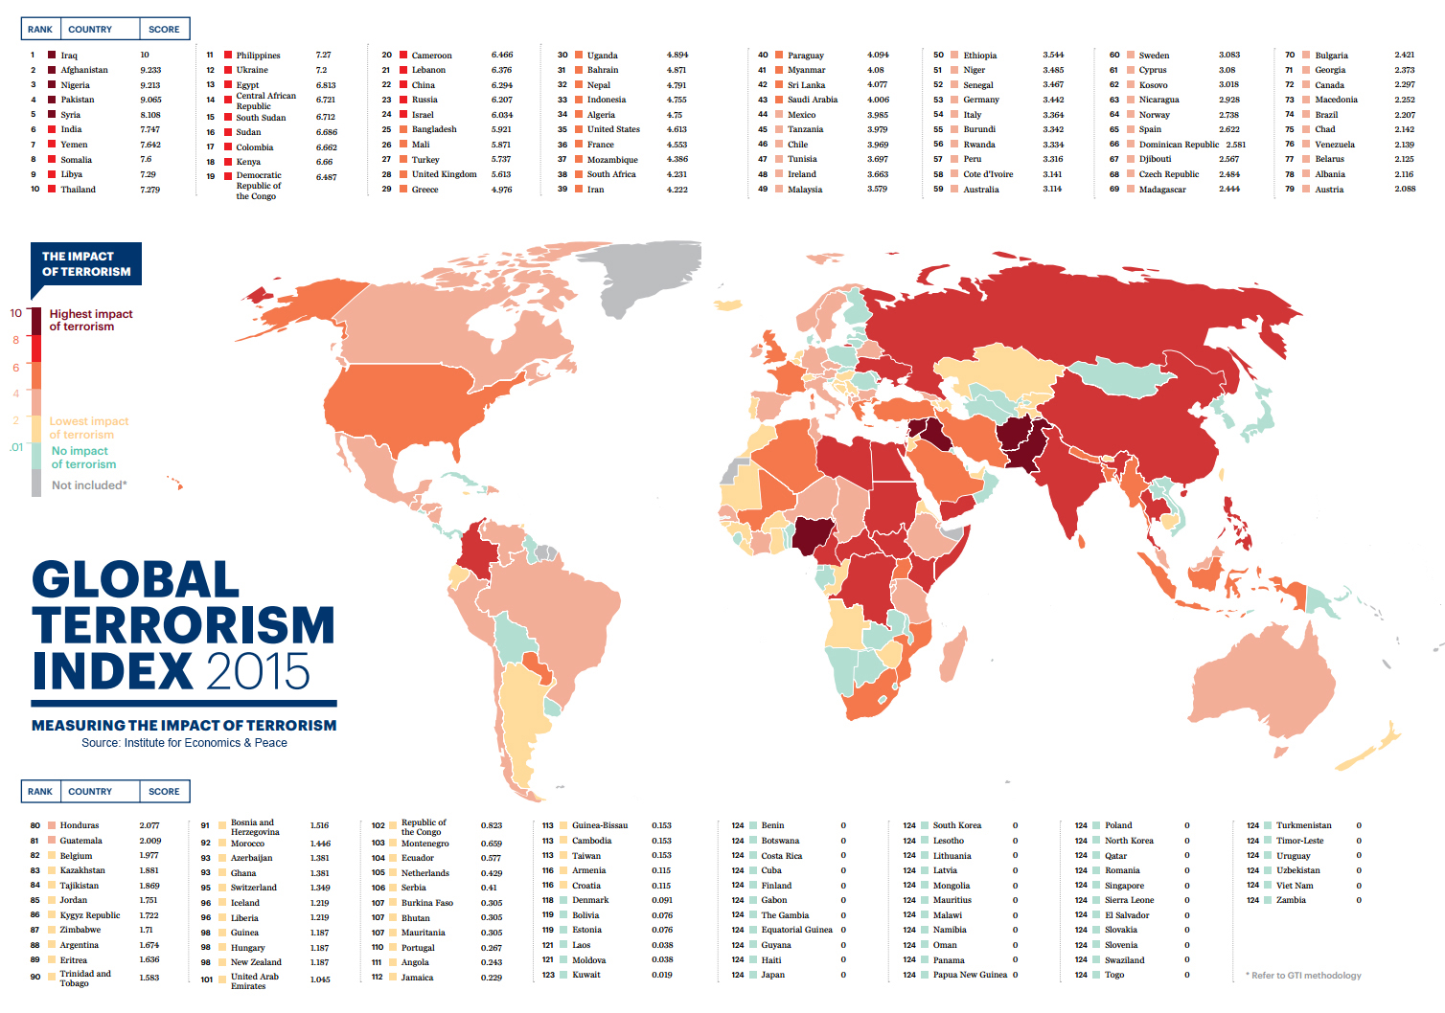
http://www.astrosurf.com/luxorion/terrorisme2.htm

Slide 50
EDUCATIONAL RESPONSES

Slide 51
INDIVIDUAL
UNDERSTANDING BEYOND THE OTHER
CRITICAL THINKING
METACOGNITIVE AWARENESS
EMPATHY

Slide 52
INDIVIDUAL
UNDERSTANDING BEYOND THE OTHER
CRITICAL THINKING
METACOGNITIVE AWARENESS
EMPATHY
PRINCIPLES OF INTERNATIONAL EDUCATION
INSTITUTION
CONTACT HYPOTHESIS

Slide 53
Understanding beyond the other

Slide 54
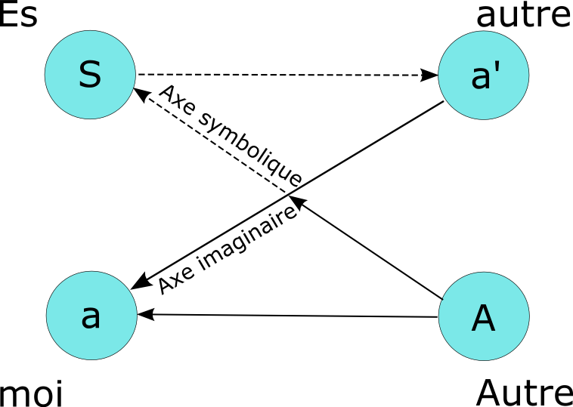
Lacan, Schéma L

Slide 55
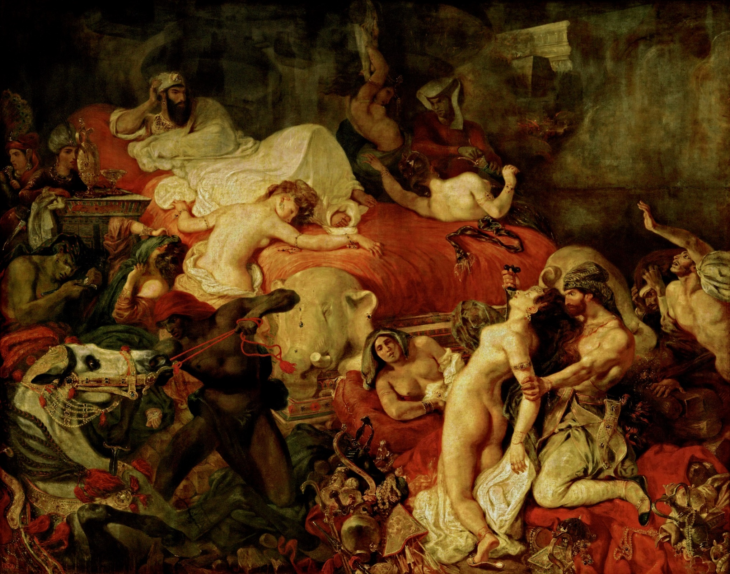
Comprendre et déconstruire l’Autre
https://commons.wikimedia.org/wiki/File:Delacroix_-_La_Mort_de_Sardanapale_(1827).jpg
La Mort de Sardanapale (1827), Delacroix

Slide 56
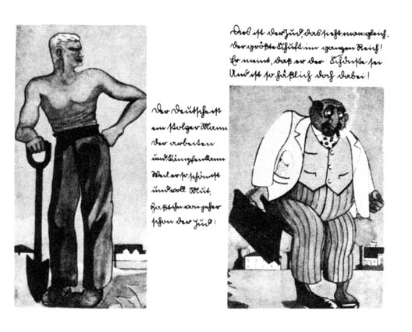

Slide 57
CRITICAL THINKING

Slide 58
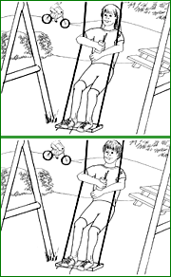
http://www.understandingprejudice.org/apa/english/page4.htm

Slide 59
Morrongiello, Midgett, and Stanton (2000)
children 6-10 years of age
http://www.understandingprejudice.org/apa/english/page15.htm

Slide 60
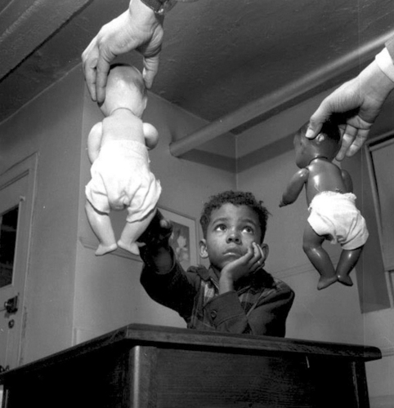
The doll test
Clark & Clark (1954)
http://www.naacpldf.org/brown-at-60-the-doll-test

Slide 61
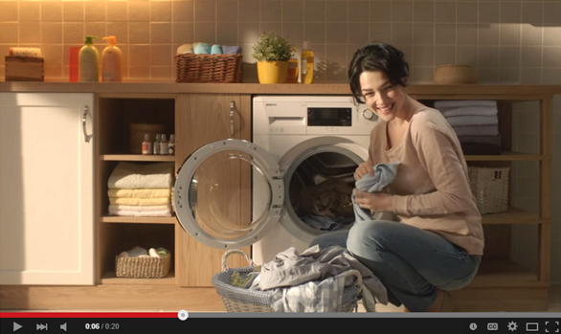
https://tylerperks.wordpress.com/2015/04/16/gender-stereotypes-in-advertising/

Slide 62
mEtacognition

Slide 63

Describe the shapes in the middle of the line

Slide 64
"rotated square"
"off-centered diamond“
assimilated to one of the preexisting categories
Human
multiple
identities
The human mind must think with the aid of categories....Once formed, categories are the basis for normal prejudgment. We cannot possibly avoid this process. Orderly living depends upon it. (Allport, 1954 p. 20)
http://www.understandingprejudice.org/apa/english/page4.htm

Slide 65
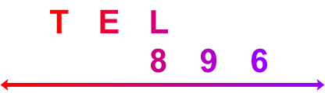
Which is more red, the L or the 8?

Slide 66
In a study on colour perception, Robert Goldstone (1995) found that the "L" above was perceived as more red than the "8," even though the "L" and "8" were actually identical in hue. Figure reprinted with permission of Blackwell Publishing, Ltd.
differences within groups will tend to be minimized and differences between groups will tend to be exaggerated
http://www.understandingprejudice.org/apa/english/page5.htm

Slide 67

Implicit Association Test
Greenwald, Banaji, Nosek(1998, 2003, 2009)
https://www.radcliffe.harvard.edu/news/in-news/peering-our-blind-spots

Slide 68
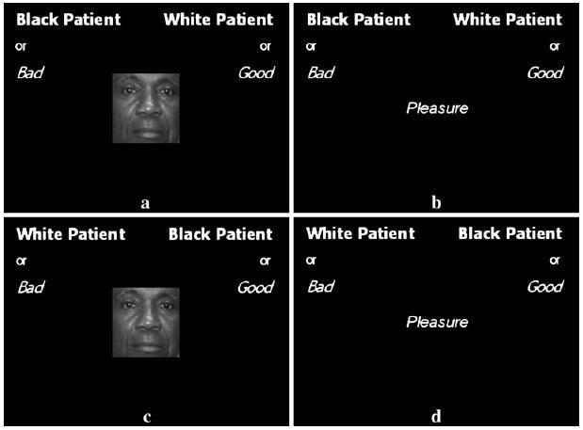
Implicit Association Test
Greenwald, Banaji, Nosek(1998, 2003, 2009)
https://medium.com/psyc-406-2015/implicit-association-and-racism-a5b84bc934a6

Slide 69
EMPATHY

Slide 70

http://www.plkdenoetique.com/developpons-notre-cerveau-droit-pour-etre-empathique/

Slide 71
A | 7 | 8 | 9 | 10 | 11 | 12 | 13 | 14 | 15 | 16 | 17 | 18 | 19
B | 1 | 3 | 5 | 7 | 9 | 11 | 13 | 15 | 17 | 19 | 21 | 23 | 25
Sample Reward Matrix Used in Minimal Group Research
Allen and Wilder (1975)
SHARING
http://www.understandingprejudice.org/apa/english/page4.htm

Slide 72
A | 7 | 8 | 9 | 10 | 11 | 12 | 13 | 14 | 15 | 16 | 17 | 18 | 19
B | 1 | 3 | 5 | 7 | 9 | 11 | 13 | 15 | 17 | 19 | 21 | 23 | 25
Sample Reward Matrix Used in Minimal Group Research
Allen and Wilder (1975)
SHARING
http://www.understandingprejudice.org/apa/english/page4.htm

Slide 73
how can education strengthen empathy?
DISCUSS

Slide 75
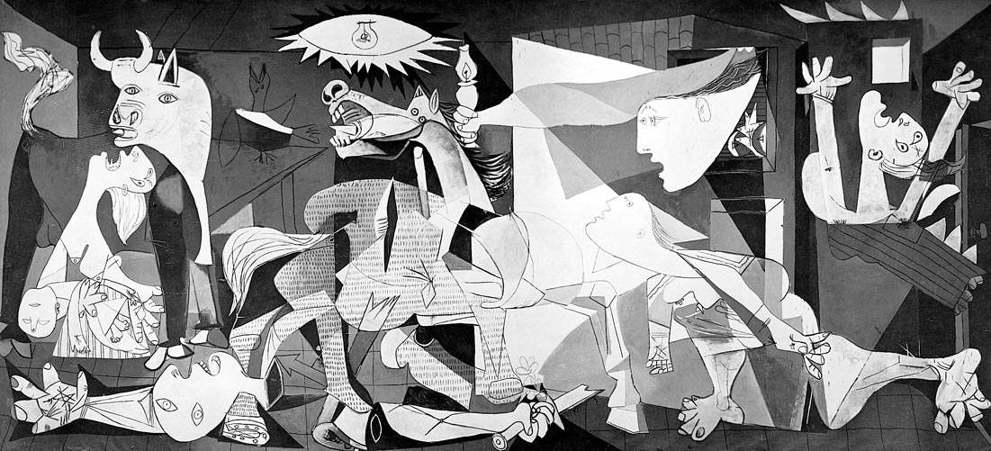
LEVEL 1 EMPATHY
Picasso
Guernica (1937)
http://www.markwk.com/teaching/lessons/quino-picasso-%20guernica/quino-esl-lesson.html

Slide 76
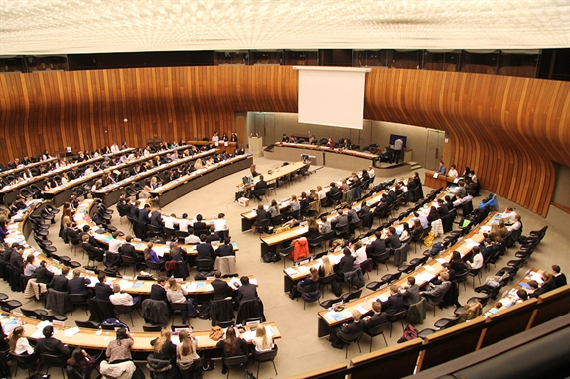
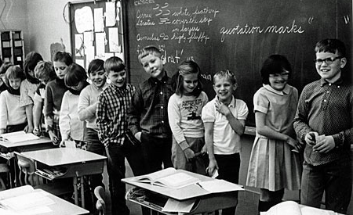
LEVEL 2 EMPATHY
Student league of nations (1953 -) blue eyes brown eyes experiment (1968 -)
http://www.ecolint.ch/beyond-classroom/students-league-nations
https://abagond.wordpress.com/2009/05/28/the-blue-eyedbrown-eyed-exercise/

Slide 77

LEVEL 3 EMPATHY
https://twitter.com/aravainstitute

Slide 78

Red bird
https://fr.wikipedia.org/wiki/Sioux#/media/File:Portrait_of_Red_Bird.jpg

Slide 79
INDIVIDUAL
UNDERSTANDING BEYOND THE OTHER
CRITICAL THINKING
METACOGNITIVE AWARENESS
EMPATHY

Slide 80
INSTITUTIONAL conditions

Slide 81
THE CONTACT HYPOTHESIS

Slide 82

Gordon Allport
1897-1967
http://psychology.fas.harvard.edu/people/gordon-w-allport

Slide 83
THE CONTACT HYPOTHESIS
Contact should be group oriented
with a superordinate goal
in a climate of respect
Under strong instutional values

Slide 84

http://undersatndingarabamericans.weebly.com/solution-contact-hypothesis.html

Slide 85
PRINCIPLES OF INTERNATIONAL EDUCATION

Slide 86
Service Learning
The learning of an additional language
World Literature
International Humanities
Inquiry
Reflection
Concepts-Focussed Learning
Theory of Knowledge

Slide 87
INTERNATIONAL HUMANITIES

Slide 88
 | History | Literature | Philosophy
Concepts | Language, Writing, Agriculture, belief systems
Africa | Ancient Egypt & Phoenicia | Cultural Atlas of Ancient Egypt (Baines & Malek) | The Book of the Dead
Asia | Ancient & Imperial China & India | Ancient India: In Historical Outline (Jha) | The Upanishads
Oceania | Aboriginal culture | Papunya School Book of Country and History (8-14 year olds) | Ancient and Modern: Time, Culture and Indigenous Philosophy (Muecke)
Middle East | Sumeria & Persia | Gilgamesh, The Histories (Herodotus), The Shahnameh (Ferdowsi) | Teachings of Zoroaster and the Philosophy of the Parsi Religion (Kapadia)
Europe | Greece & Rome | The Illiad & Odyssey (Homer), Parallel Lives (Plutarch) | The Republic (Plato), The Meditations (Marcus Aurelius)
Americas | Native Americans | An Indigenous Peoples' History of the United States (Dunbar-Ortiz) | The Wisdom of the Native Americans (Nerburn)
Concepts | Empires
Africa | Kingdoms of Africa (Nok, Awkar, Fulani, Hausa, Zulu) | Chaka (Mofolo) | The Desert Shore: Literatures of the Sahel, Volume 3 (Wise)
Asia | Han dynasty & Mughals | The Baburnama (Babur) | The Analects (Confucius)
Oceania | Peoples of Polynesia and Micronesia | A History of the Pacific Islands (Campbell) | Hawaiian Mythology (Beckwith)
Middle East | Early Islam and the Ottoman Empire | Osman’s Dream (Finkel) | Seyahâtnâme (Celebi), On the Perfect State ( Al-Farabi)
Europe | Middle Ages & Renaissance | The Bible, The Inferno (Dante), The Great Tragedies (Shakespeare), Poetry of John Donne | The Confessions (St Augustine), Discourse on Method (Descartes), The Prince (Machiavelli)
Americas | Inca, Mayan & Aztec Kingdoms; the conquistadors | Conquistador (Levy) | The Popol Vuh (translated by Tedlock)
Concepts | Power and territory
Africa | The scramble for Africa & Colonisation | The Lion and The Jewel (Soyinka), Things Fall Apart (Achebe), Heart of Darkness (Conrad), King Leopold’s Ghost (Hochschild) | Imperialism: The Highest Stage of Capitalism (Lenin), Writings on Empire and Slavery (Tocqueville)
Asia | The East India company and colonisation of India | The Honourable Company (Keay) | Autobiography (Gandhi), The Jail Notebook and Other Writings (Bhagat Singh), Dream of the Red Chamber (Cao Xueqin)
Oceania | Cooke, Tasmania & the colonisation of Australia | Blue Latitudes: Boldly Going Where Captain Cook Has Gone Before (Horwitz), The Fatal Shore (Hughes) | Two Treatises of Government (Locke)
Middle East | The Sykes-Picot agreement & Balfour Declaration | Seven Pillars of Wisdom (Lawrence), The Arab Awakening (Antonius) | The State of the Jews (Herzl), The Prophet (Gibran)
Europe | Enlightenment & Industrial revolution | Hard Times (Dickens), Pride & Prejudice (Austen), The Brothers Karamazov (Dostoevsky), Madame Bovary (Flaubert), Industry and Empire: The Birth of the Industrial Revolution (Hobsbowm) | The Communist Manifesto (Marx & Engels), The Twilight of the Idols (Nietzsche), The Origin of Species (Darwin)
Americas | American colonisation, independence & Civil War | Moby Dick (Melville), The Metaphysical Club (Menand) | Walden (Thoreau)
Concepts | War and independence
Africa | Post-colonisation | Long Walk to Freedom (Mandela), Season of Migration to the North (Salih), The Cairo Trilogies (Mahfouz) | African Philosophy: An Anthology (Eze)
Asia | Independence and Communism | Midnight’s Children (Rushdie), The God of Small Things (Roy), | The Little Red Book (Mao), Orientalism (Said), The Master of Go (Kawabata)
Oceania | The plight of modern Aborigines and Maoris | A Secret Country (Pilger), The Bone People (Hulme), The Whale Rider (Ihimaera) | Tikanga Whakaaro: Key Concepts in Maori Culture (Barlow)
Middle East | Afghanistan, Arab Spring, Palestine and Israel, Iraq war | Woman at Point Zero (Nawal El Saadawi), The Shapoing of the Modern Middle East (Lewis) | Murderous Identities (Maalouf)
Europe | WW1, WW2, Cold War | War poets (Owen, Sassoon), 1984 (Orwell), Death in Venice (Mann) | Nausea (Sartre)
Americas | WW1, WW2, Cold War | The Great Gatsby (Fitzgerald), Who Rules the World (Chomsky), Beloved (Morrison), One Hundred Years of Solitude (Marquez) | Labyrinths (Borges)

Slide 89



Slide 90
SERVICE LEARNING

Slide 91


Slide 92
INDIVIDUAL
UNDERSTANDING BEYOND THE OTHER
CRITICAL THINKING
METACOGNITIVE AWARENESS
EMPATHY
PRINCIPLES OF INTERNATIONAL EDUCATION
INSTITUTION
CONTACT HYPOTHESIS

Slide 93


Slide 94
conclusion

Slide 95

https://www.reddit.com/r/HistoryPorn/comments/1s7b5p/nelson_mandela_triumphant_february_11th_1992_3296/

