Slide 1
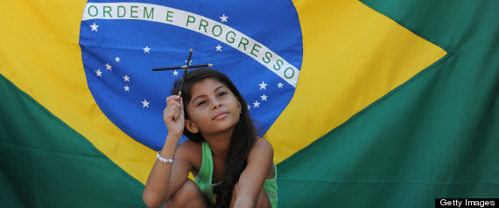
Educational Policies in Brazil
Set against the global context,
their impact on raising standards
and addressing the needs of an intercultural Brazilian society
Notes:
Educational policies in Brazil set against the global context, their impact on raising standards, and addressing the needs of an intercultural Brazilian society.
Brazil’s economy has strengthened over the past decades placing the country in a prominent position within the global market. However, for most of its recorded history, Brazil’s educational policies have been inconsistent with its aspirations, thereby generating a fragmented system of inequity and inequality. Over the past two decades, a new set of educational policies at a federal level have been emerging. These policies advocate in favour of access to basic education for all citizens, the monitoring of educational achievements, equitable distribution of funds and the urgent need to promote intercultural understanding and awareness amongst all end-users.
An additional challenge to this process is access to constitutionally guaranteed educational provision which meets the needs of mixed cultural backgrounds, ethnic heterogeneity, the rural/urban divide and low income elements of Brazilian society. Through links with international non-governmental institutions such as the United Nations Develop Programme (UNDP), United Nations Educational, Scientific and Cultural Organization (UNESCO), The World Bank, and the Programme for International Student Assessment (PISA), the Brazilian government is striving to raise the country’s achievements and intercultural awareness, whilst simultaneously reaching out to many disparate areas of the country.
The aim of my presentation is to reflect on the two-way process between Brazil’s educational history and its current educational policies. I will also consider the growing need to bring policies in line with the international circuit of education and, from an intercultural perspective, will assess how effective these current policies are proving to be in order to prepare all Brazilian citizens to be more inter-culturally aware, globally alert and valued members of their society.

Slide 2
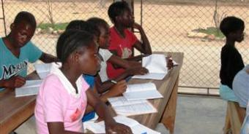
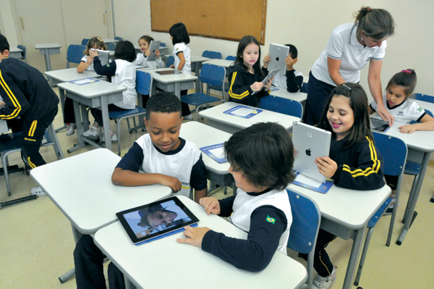
See, THINK, Wonder…
Notes:
What do you see? Avoid personal opinion or questions to begin with…
Think? Contrast in place,/rich and poor different regions, all in school
I wonder
Same country? Good school? Has enough resources.
Same level of education?
Children in a learning situation
In a country of contrasts as big as Brazil, how can we ensure that all students are given equal opportunities to succeed?

Slide 3
In a country of contrasts as big as Brazil, how can we ensure that students from different cultural backgrounds are being given equal opportunities to succeed?

Slide 4
For most of its recorded history, Brazil’s educational policies have been inconsistent with its aspirations.
Notes:
This has thereby generating a fragmented system of inequity and inequality to its vast population. Regardless of this, Brazil’s economy has strengthened over the past decades and placed the country in a prominent position within the global market.

Slide 5
Alarming inequalities in Brazil’s educational scenario is confirmed by the on-going data produced by the Brazilian Institute of Geography and Statistics (IBGE, 2010).
Guzzo and Euzébios Filho (2005)
The cause of such disparities is a product of the country’s economical, social and political history.
Ansell (2010)
Factors such as clientilism, the power of the church, ethnic heterogeneity, poverty and the shift between democracies and dictatorship have contributed to the creation of such disparities.

Slide 6
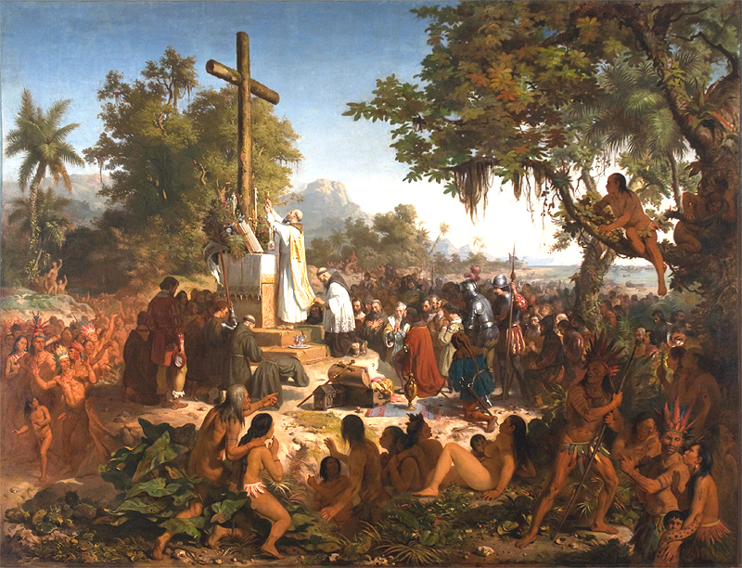
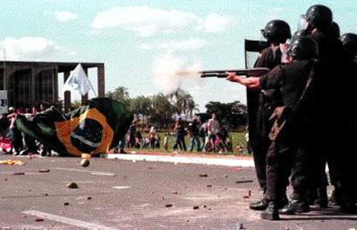
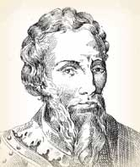
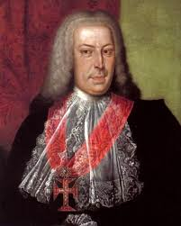
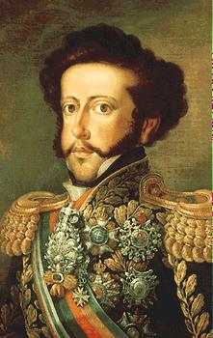
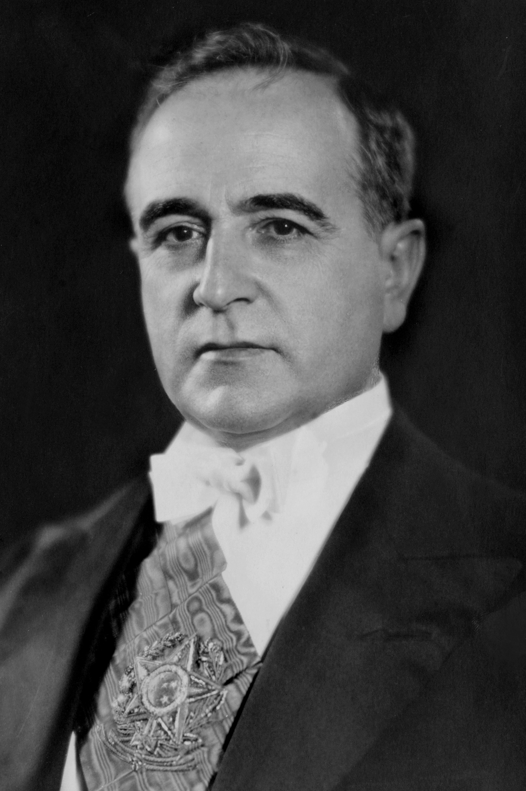
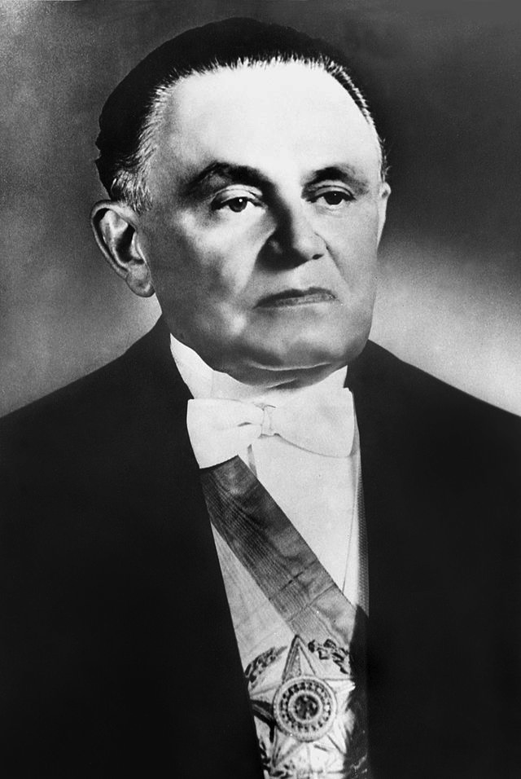
A Brief History of Brazilian Education

Slide 7
From colonial times to the end of the military dictatorship in 1985, Brazil dwelled on a hierarchical top-down approach towards policymaking and implementation. Governments have repeatedly failed to perceive education as a national priority and have generally responded to immediate economic needs rather than to long-term prospects. Educational policies were prescriptive and funds for education were substandard and misdirected; hence, rationalised decision-making generally failed to lead to its intended outcomes.

Slide 8
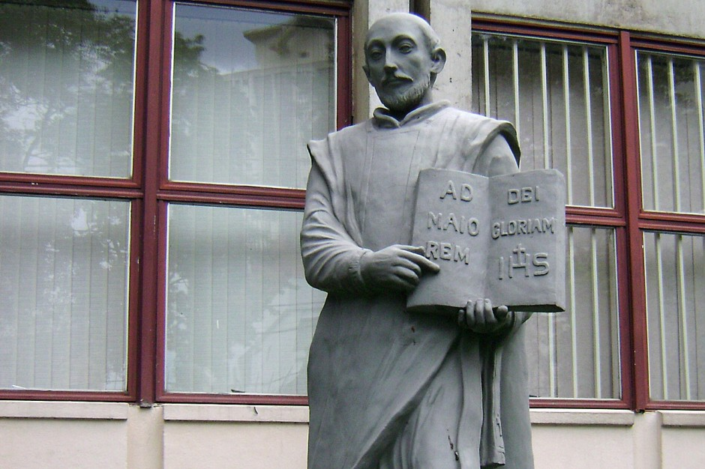
The Jesuits
In the 1500s, The Jesuits set up the first schools of formalized education Their role was to catechize and instruct the
native Indians following the missionary objectives, as well as those of the Portuguese crown In 1759 (210 years later), Portugal shut down all Jesuit schools and expelled the Jesuits from Brazil. Primarily, the political strategy was to populate and defend its colony’s national boundaries.
Notes:
Qualified teachers did not replace the empty positions previously occupied by the Jesuits. This was, therefore, a period of stagnation for Brazilian education, which strengthened the power of the state rather than served the needs of individual citizens

Slide 9
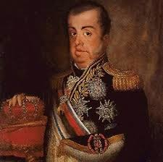
Some advances in education were made through King Dom João VI.
Education was predominantly focused on the upper class, diffusing inequity and inequality across the colony, which remained for many years.
King Dom João VI
Notes:
upon his arrival in Brazil in 1808 due to the Napoleonic Wars. Higher educational institutes were established, although of a technical, military oriented, and elitist demeanour.

Slide 10
President Vargas
In the 1930s, President Vargas envisioned education as a means to integrate the fragmented cultural and political society of the time.
Notes:
He implemented a centralized education system as a matter of national priority. Autocratic decisions were made, such as the closure of immigrant schools. On the other hand, some access policies which were implemented remain prevalent until today: provision of scholarships, distribution of funds to rural and urban areas, benefits such as free pedagogical material, health care, and sustenance.

Slide 11
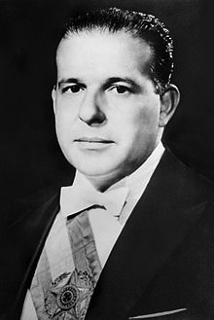
Military Dictatorship
During the military dictatorship (1964-1985), the educational context was adjusted to a regime where democratic rights of the society were lost. A decentralized system was favoured.

Slide 12
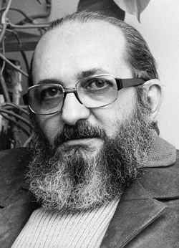
Paulo Freire
Freire states that, as an important tool for awakening political awareness, education was being manipulated at this time.
Notes:
At this time, one of the foremost Brazilian educational philosophers, Paulo Freire, whilst exiled in Chile for his revolutionary ideologies, wrote “Education as the Practice of Freedom” (1967) and “Pedagogy of the Oppressed” (1970). His work tries to convince teachers to engage learners in dialogue, to pinpoint oppressive experiences and generate ‘problem posing’ and ‘conscientization’, to understand how education has been influenced by ruling societal forces (Freire, 1970).

Slide 13
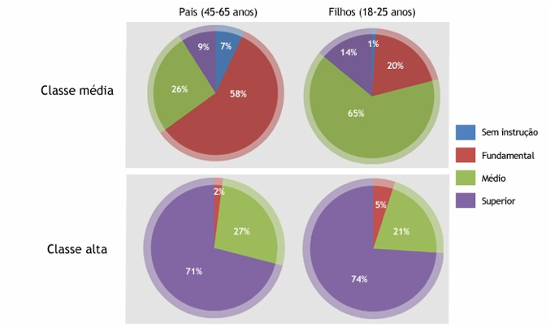
Schooling distribution
Parents
(45-65 year old)
Children
(18-25 year old)
Middle Class
Educational levels
None
Basic
Secondary
Higher
Upper Class
(Oliveira, 2011)
Notes:
What conclusions do you reach?
There has been an improvement in the level of education

Slide 14
What Policies have led to this?

Slide 15
Changes in Brazilian Education
The 1990s was probably the most important time in history for Brazilian education. (Castro, 2005)
The neo-liberal economic era, led by the Social Democratic Party against a long period of recession, debts, inflation and loss of civil rights, brought forth the social participation and social rights ideology.
In 1996, the third Lei de Diretrizes e Bases da Educação (The National Educational Guidelines and Framework Law – LDB 9394/96) was passed in Brazil.
It developed along three lines: education as a right, education as a tool of economic and social development, and education as a factor of social inclusion.

Slide 16
The National Education Plan (PNE) set out several long-term goals with effect from 2001-2010.
I – to eradicate illiteracy; guaranteeing compulsory primary and lower secondary education to those who did not have access to it at the proper age or to those who did not complete it;
II – to universalise school attendance; ensuring access and completion of compulsory primary and secondary education;
III – to overcome educational inequalities; expanding schooling at all levels;
IV – to improve the quality of education; developing an information and evaluation system at all levels of instruction;
V – to achieve appropriate credentials for work;
VI – to promote environmental sustainability;
VII – to promote human, scientific and technical research throughout the country;
VIII – to set goals for the application of public funds as a proportion of gross domestic product;
IX – to value professionals in the field of education; elevating their professional status;
X – to disseminate the principles of fairness, respect for diversity and democratic management in education.
(PNE 10172/01, 2010)

Slide 17
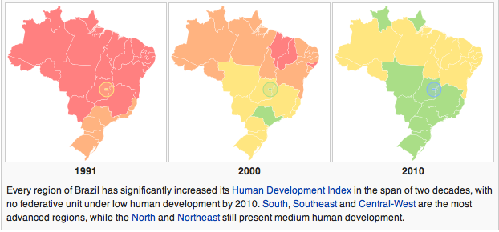
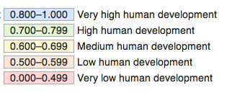
funding
Equalizing redistribution of funds across regions, states and municipalities (OECD, 2010) preventing embezzlement of public money, albeit to a certain extent (Ioschpe, 2012).
Atlas do Desenvolvimento Humano no Brasil, 2013
Notes:
IDH – Indice de Desenvovimento Humana –
the Human Development Index (HDI) is a composite statistic of education, income and longevity indices, calculated in order to measure social and economic development within countries.
The improvement see in this picture may be a result of access policies implemented these past 20 years.

Slide 18
Would you agree with Cordiolli’s argument?
Education plays a vital role in improving the lives of the population even if its quality is below the standards of other countries. (Cordiolli, 2011)
Atlas do Desenvolvimento Humano no Brasil, 2013

Slide 19
In a country of contrasts as big as Brazil, how can we ensure that all students of different cultural backgrounds are being given equal opportunities to succeed?

Slide 20
ASSESSMENT
National Benchmarking
Revamping the structure of Brazil’s educational assessment system has become part of the package to improve the quality of its education: building the context; defining the all-encompassing policy framework; creating the best fitting organisation to lead such programs; maximising capacity; and safeguarding sufficient funding.
Notes:
To monitor equal opportunities within the country there is a positive impact not only when comparing education within the country but also to that of other countries in order to allow equal opportunities to Brazil’s entire population.
Several factors have allowed for these reforms to be built upon: stable political leaderships; the monitoring of educational quality as a national urgency;

Slide 21
ASSESSMENT
International Benchmarking
Support and partnership with international non-governmental institutions such as the United Nations Develop Programme (UNDP), United Nations Educational, Scientific and Cultural Organization (UNESCO), The World Bank, and the Programme for International Student Assessment (PISA)
(Castro, 2012)

Slide 22
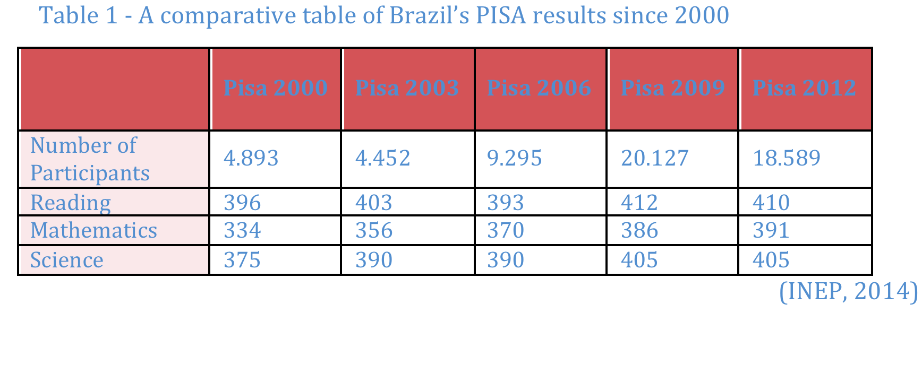
PISA RESULTS
Notes:
Why is it important to have international benchmarking to ensure equal opportunities are being given?
National Benchmarking can be restricted to ranking assessment whilst having the country set against other nations will demand action in order to tackle/improve the underperforming sectors.

Slide 23
In a country of contrasts as big as Brazil, how can we ensure that all students are given equal opportunities to succeed?

Slide 24
Viewpoints on Schooling distribution at Tertiary Level
18-25 year old
Middle Class
Educational levels
None
Basic
Secondary
Higher
Upper Class
(Oliveira, 2011)
Notes:
Both groups should reflect on the aspirations of their assigned class which are the aspirations of each of these classes in terms of basic, secondary and tertiary education and what would support their views?

Slide 25
For students of a poor socio-economic background, public education is perceived as the only means to complete higher education; however, this view shadows the selective and elitist nature of the system.
On the other hand, middle class students perceive it as a right for those who pay taxes.
Ioschpe (2012)

Slide 26
the Law of Social Quotas (Cotas Raciais)
The Law of Social Quotas (Cotas Raciais) reserves places in public or private institutions to specific ethnic groups, mainly afro-descendants or Indian natives.
Positive discrimination (Lauder, 2012)
Arguments in favour of | Arguments against
Students from secondary public schools who manage to overcome the numerous barriers to conclude their education and do not have the financial conditions to afford a place in private universities will now have access; Measure of overcoming inequity. | Such quotas will not allow access to individuals who are favoured by their individual achievements. calculation of percentages; considering changes in racial ratios in the society is questionable; Drop of quality in tertiary education.

Slide 27
CONCUDING REMARKS
There are encouraging signs:
a) Brazil has extended public basic education to over 95% of the population;
b) The average years of students in education has practically doubled over the past two decades;
c) the proportion of adults who complete secondary school has also risen considerably;
d) students’ performance in secondary education has advanced in mathematics and language over the last decade.
Despite such achievements:
a) The quality of basic education remains one of the lowest around the World as education still lags well behind wealthier nations (Ioschpe, 2012; INEP, 2014)
b) Whilst access to education in Brazil has become vastly more equitable over the past 15 years, there is still a persistent gap in learning levels and graduation rates between rich and poor from basic to tertiary education;
c) Electoral Politics tend to favour access policies over quality policies. (Souto-Otero, 2011)

Slide 28
QUALITY POLICIES
Importance of strengthening the system by improving the standards at the primary and secondary level. However, financing at the tertiary level remains significantly superior.
(Ioschpe, 2012)

Slide 29
QUALITY POLICIES
The lack of career planning and continuous professional development remain the “Achilles heel” of Brazilian education.
(Castro, 2005, pg. 68)
Enhancing Teaching Profession and Qualification:
Resources spent towards salaries, investments and expenditures in technology are irrelevant or at least less important than that spent on teacher training and management development programmes, with emphasis on classroom practice efficacy.
Raising status- lack of teacher qualification investment was a downfall in education according to Bruns, Evans and Luque (2012).
Raising the quality of teaching in the country through the recruitment of higher-level professionals and maintaining continuous improvement in practice.

Slide 30
THANK YOU FOR LISTENING!

