Slide 1
Dr. Tristan Bunnell
Lecturer in International Education, University of Bath, England
Developing the internationally-minded school: the institutionalization process in practice

Slide 2
Research project
School Practices for Developing and Assessing International Mindedness (IM) across the IB Continuum
Elisabeth Barratt Hacking, Chloe Blackmore, Kate Bullock,
Tristan Bunnell, Michael Donnelly, Sue Martin

Slide 3
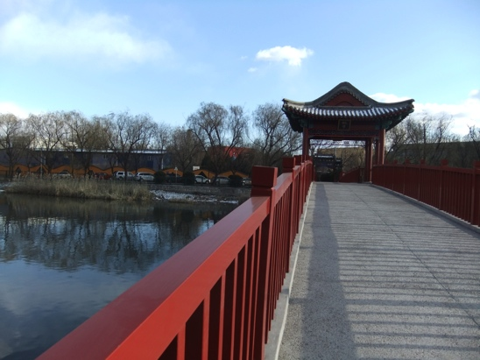
Case study approach
nine IB schools reflecting diverse and challenging contexts
nominated and selected for promising practice
3 PYP, MYP, DP
Multi-methods (including
some students taking photos
and showing the researchers
around the school)

Slide 5
The 13 Fs
Cn be viewed as carriers of institutionalisation
But, alone are not enough to legitimize a school

Slide 6
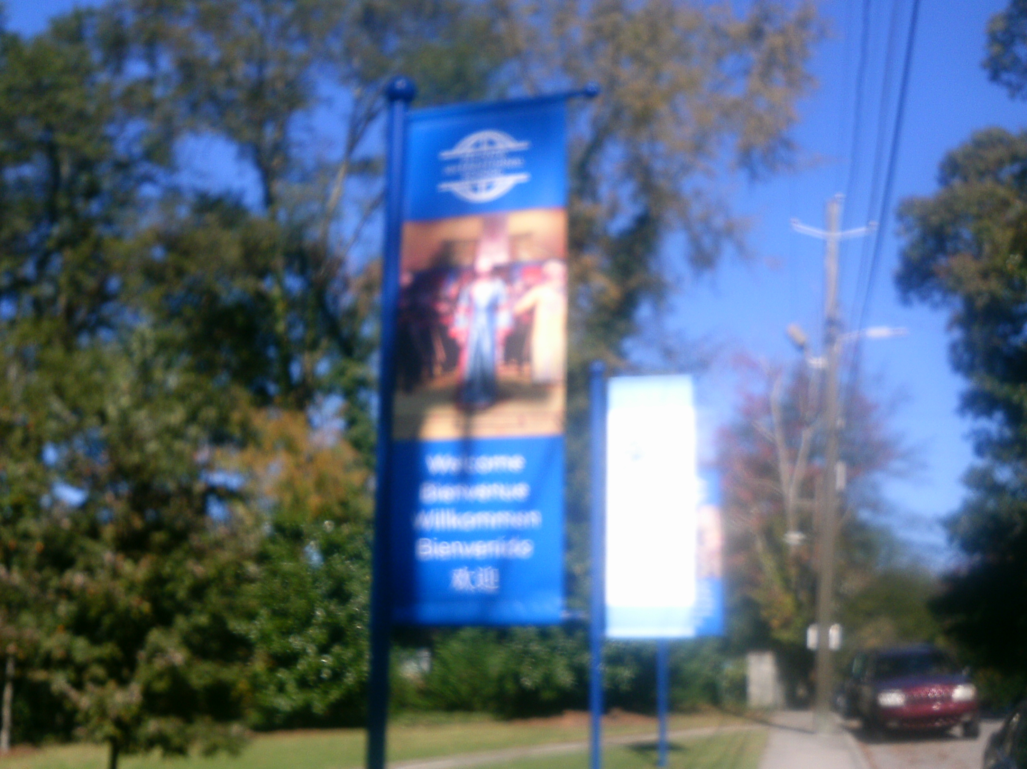

Slide 9
Analytical Framework: The Internationally-Minded School
Carriers of Institutionalisation | The Regulative Pillar | The Normative Pillar | The Cultural-Cognitive Pillar
Symbolic Systems | Rules Laws Policies | Values Expectations Standards Traditions | Categories Typifications Schema Frames
Relational Systems | Governance Systems Power Systems | Regimes Authority Systems | Structural Isomorphism Identities
Activities | Monitoring Sanctioning Disrupting | Roles Tasks Routines & Habits Repertoires of collective action | Predispositions Scripts Interpretations
Artefacts | Objects complying with mandated specifications | Objects meeting conventions and standards e.g. FLAGS | Objects possessing symbolic value

Slide 10
Further reading…
Papers
Bunnell, T; Fertig, M; and James, C. (2017) Establishing the legitimacy of a school’s claim to be ‘International’: The provision of an international curriculum as the institutional primary task, Educational Review.
Bunnell, T; Fertig, M; and James, C. (2016) What is international about International Schools? An Institutional Legitimacy Perspective, Oxford Review of Education.
Articles
Bunnell, T. and Fertig, M. (2016) International Schools as ‘institutions’ and the issue of legitimacy, International Schools Journal 36 (1).
Bunnell, T. (2016) International schools as legitimate institutions, ECIS Global Insights 2.
Bunnell, T. (2016) The Institutional Primary Task of an International School ECIS Global Insights 3.

