Slide 1
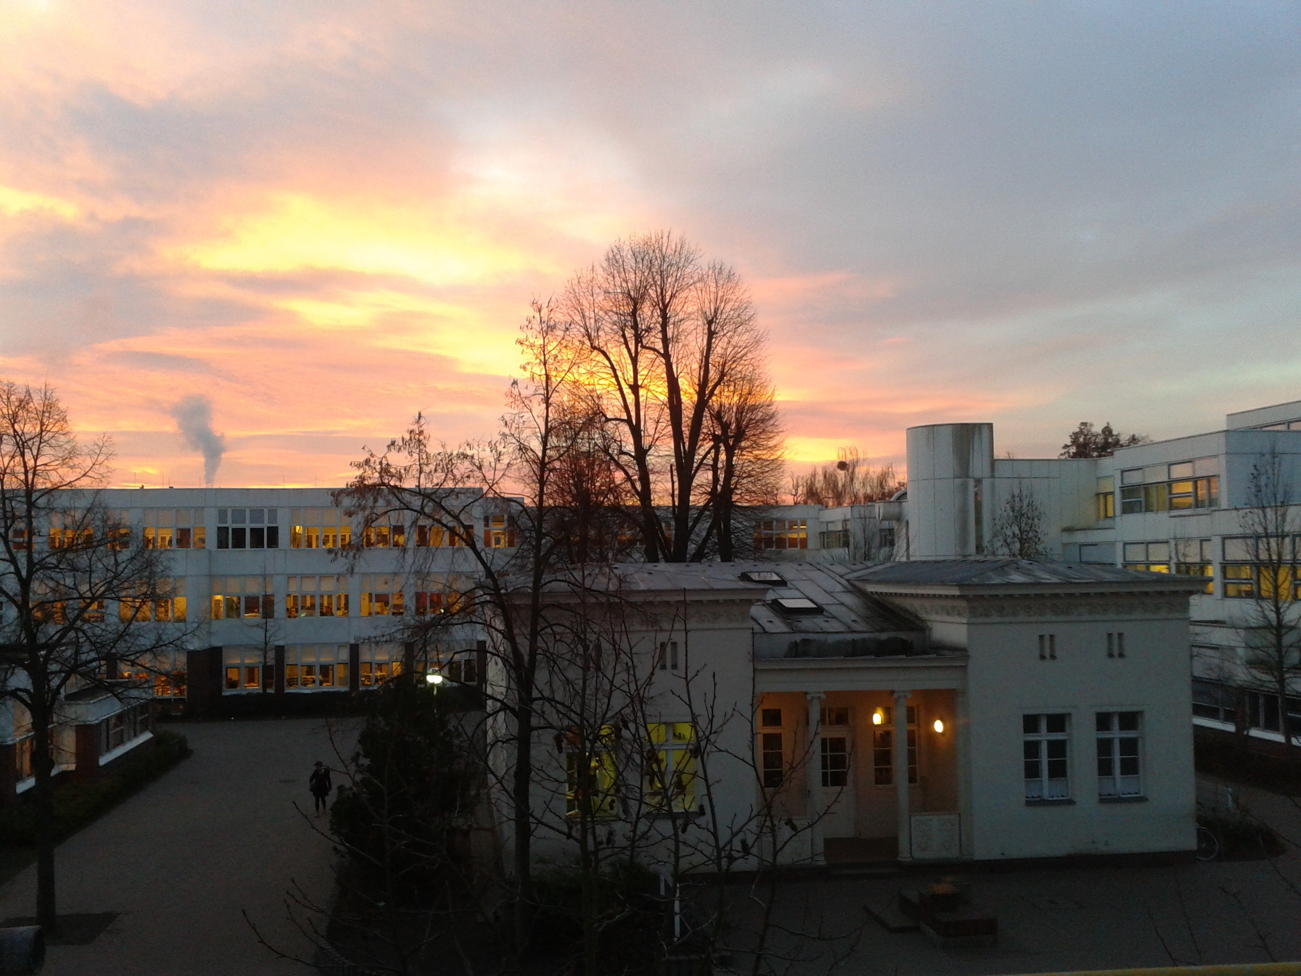
Leadership of a bi-cultural and bilingual Organization
JFKS Berlin as an example for challenges and solutions in international Education

Slide 2
Stakeholders and Ownership
Consistency and change
Staff/Admin/Parents/Students/Governance/ Programs
Promise, expectations, evolution

Slide 3
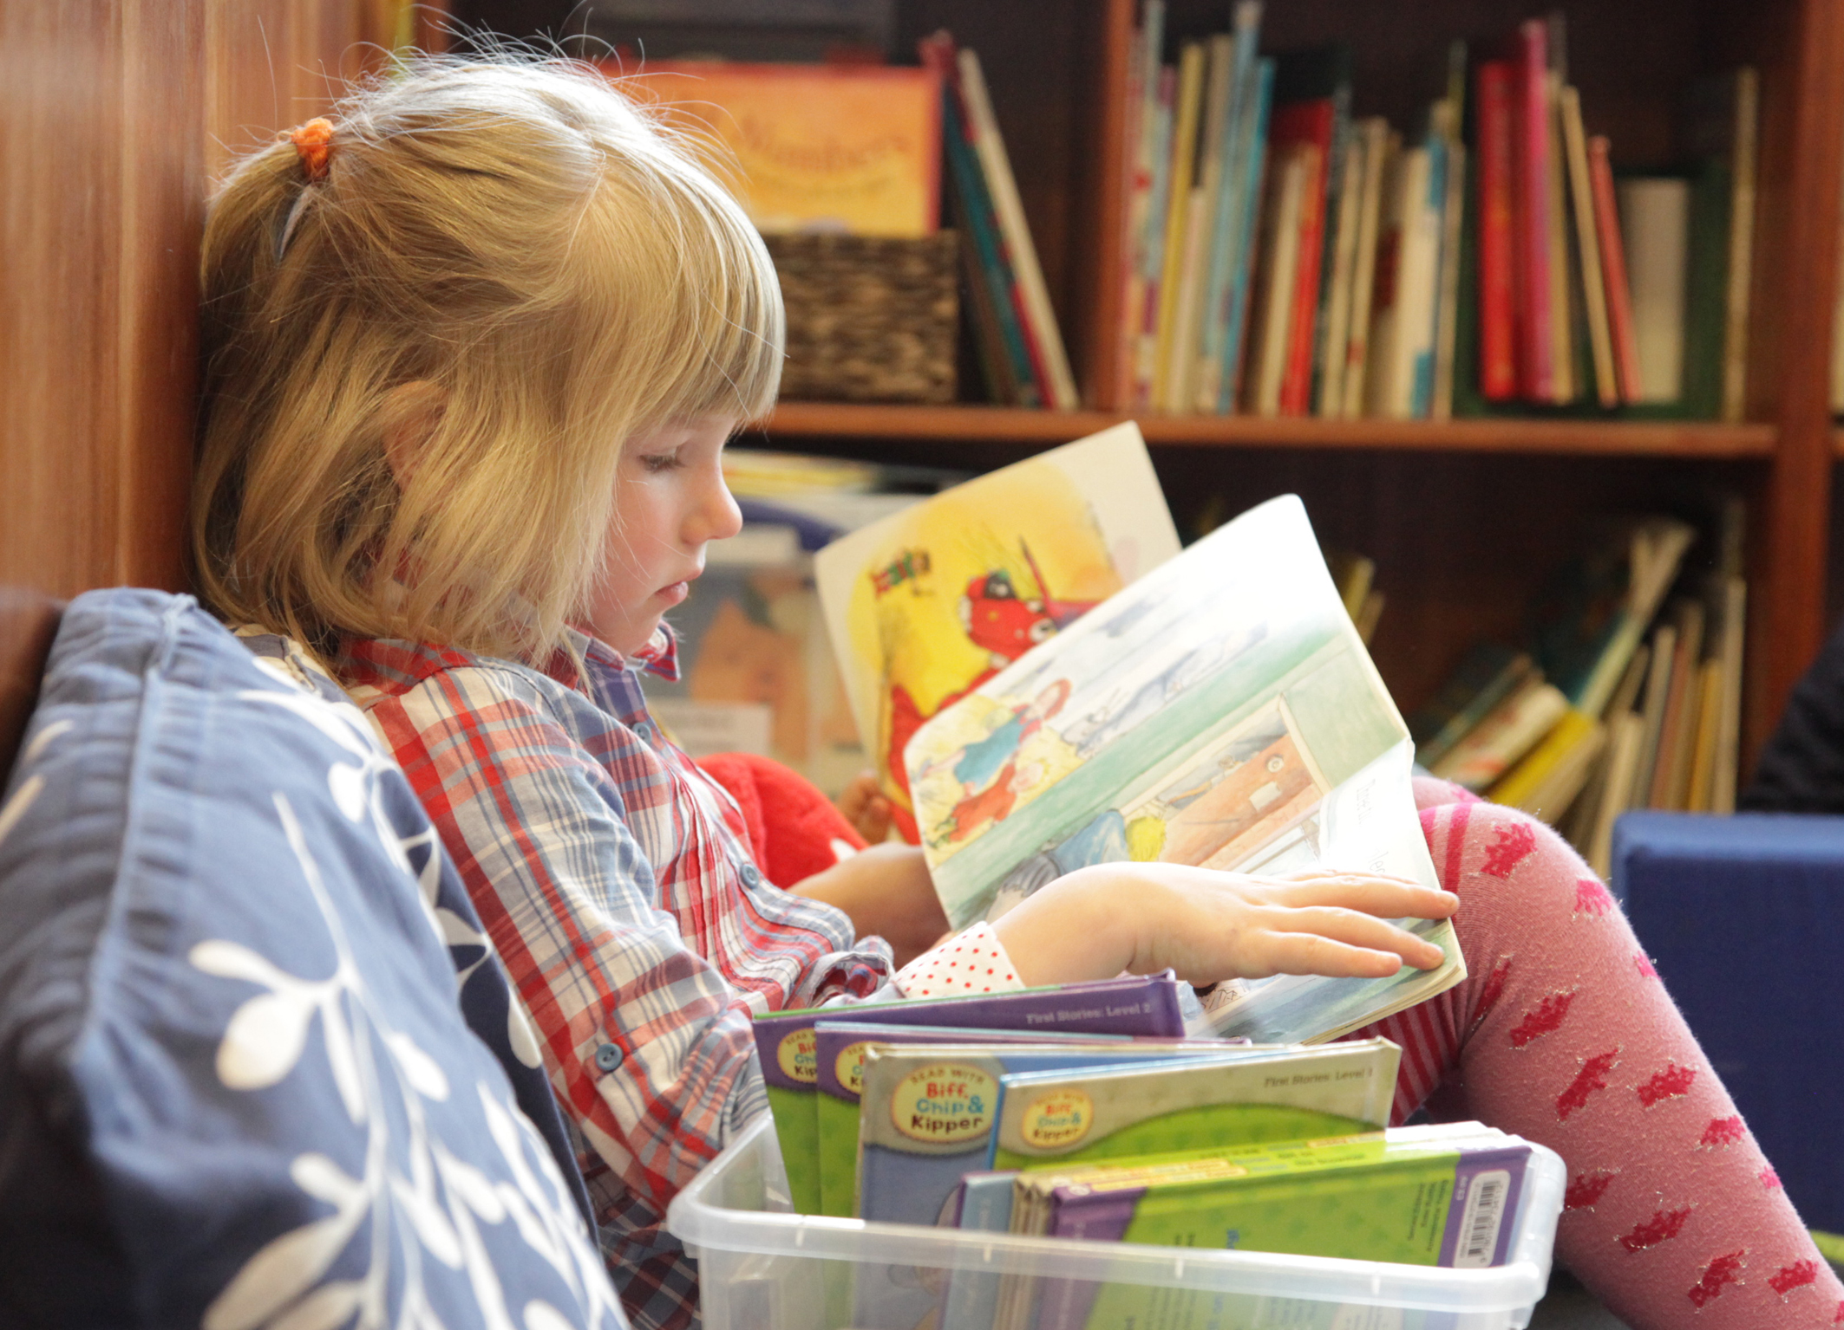
Our new students
Arrive in September 2014
Graduate in June 2027

Slide 4
Schools are always behind…
…yet, we must maintain stability emotionally, ethically, while preparing for technological and societal changes.

Slide 5
Takeaway # 1: Focus on the universal
Mutual respect
Whole child development
Learning how to learn
Democracy
Citizenship
Leadership
Entrepreneurship
In the face of high academic standards

Slide 6
Takeaway # 2: Quality of Teacher is key to success
Quality of Leadership is critical
Recruitment of quality candidates
Open channels for teacher learning and set budget priorities for curriculum and materials
Stewards of mission and vision

Slide 7
Takeaway # 3: Community
A healthy collaboration with the community will provide the stabilizing force to support success in the school.

