Slide 1

Internationalism:
IS IT preparing peaceful and better generations?
Notes:
NOTE:
To change the image on this slide, select the picture and delete it. Then click the Pictures icon in the placeholder to insert your own image.

Slide 2
What is Internationalism?
The ideal or practice of cooperation and understanding between nations.
Internationalism is the ethical belief or scientific approach in which people of different nations are assumed to be equal.

Slide 3
Importance of Internationalism in Education:
To bring the world close into the classroom;
To enhance the knowledge of other world regions & cultures;
To become familiar with international and global issues;
To enhance the skills in working effectively in global or cross-cultural environments, and using information from different sources around the world;
To show respect and concern for other cultures and people;
To reinforce intercultural growth;
To break the limitations between different cultures, reducing conflicts and unacceptance to other people from different nationalities;

Slide 4
Implementation of Internationalism in Education:
Examples :
International Education program: (The IB program)

Slide 5
Overview of the IB Program
Founded in 1968
Offers four programs of international education that develop the intellectual, personal, emotional and social skills needed to live, learn and work in a rapidly globalizing world.

Slide 6
The IB Learner Profile
THINKERS
INQUIRERS
KNOWLEDGABLE
COMMUNICATORS
OOPEN-MINDED
PRINCIPLED
RISK-TAKERS
BALANCED
REFLECTIVE
CARING

Slide 7
Overview of The IB Program
To what extent does applying the IB prepare peaceful and better generations?
What other things can be introduced into international education that can reduce the conflict between people?

Slide 8
YOGA “ The Way to Internationalism”
“If every child in the world would be taught meditation, we would eliminate violence from the world within one generation” - Dalai Lama
"Education is about making the child grow with an uncluttered intelligence. An intelligence that is not identified and entangled in religion, doctrine, or prejudice will naturally lead to ultimate blossoming of the individual." Sadhguru

Slide 9
What is Yoga?
The word “yoga” comes from the word “yuj” which means, “to unite.” Yoga is the union of the individual with the whole of existence, also commonly referred to as “self-realization.”

Slide 10
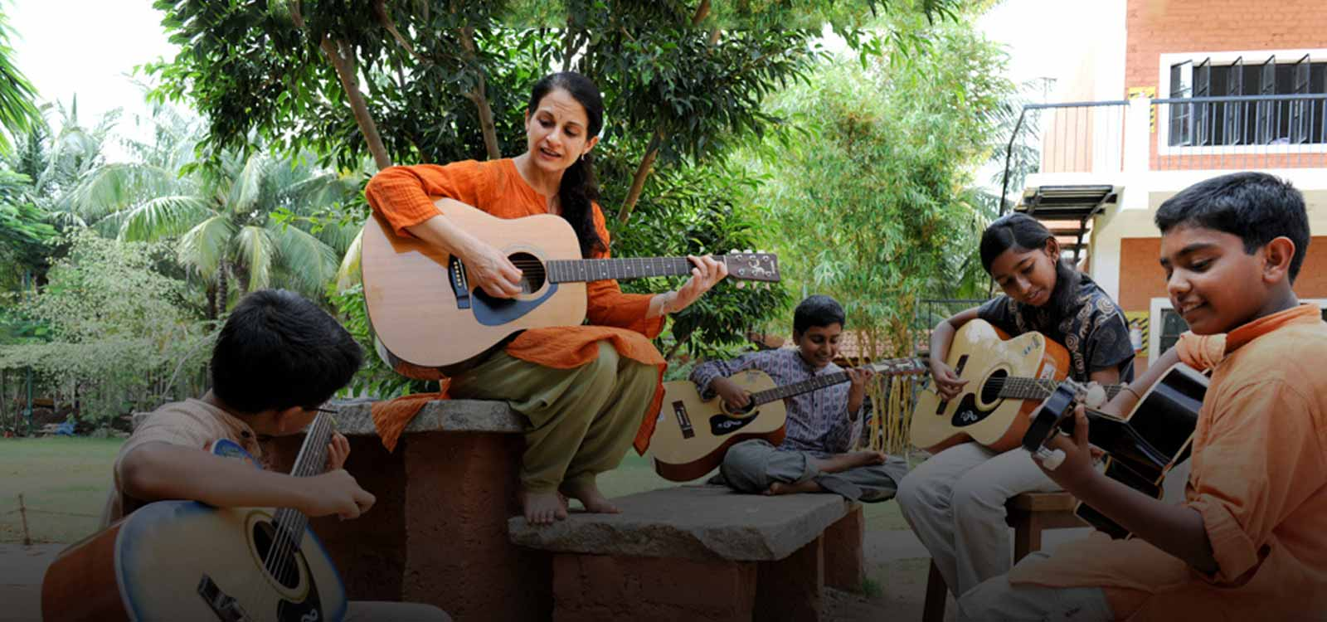
My Observations At The ISHA Yoga Center
People are peaceful, happy and energetic.
No difference between one person and another, we are all humans.
Everyone is willing to volunteer and help in various activities throughout the day.
ISHA Home School Students were: Full of energy, peaceful, happy and enjoying every moment of their school life.

Slide 11
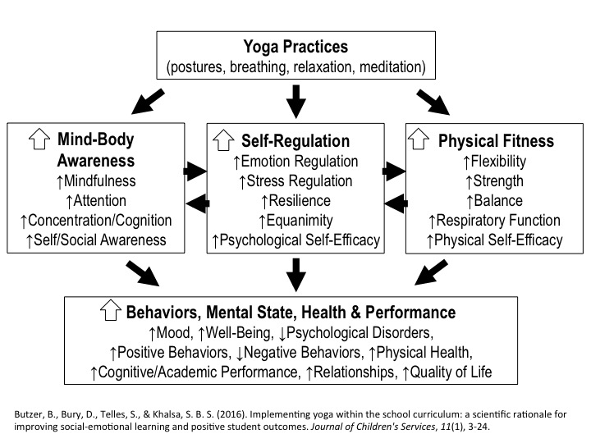
Scientific Evidence of the Potential Benefits of Yoga:

Slide 12
Worldwide Concerns:
In the U.S, there was lots of concerns in relation to the increased cases of bullying, stress levels and violence in schools.
In 1999, two students in Columbine high school Living in Colorado, felt the need to take revenge and take action in a violent manner leaving 15 dead and creating anxiety and sorrow in the hearts of parents and students.
Another incident when a 16-year-old student set himself on fire in the cafeteria of a high school in a Denver suburb on Jan 27, 2014.
Many other incidents, such as committing suicide happened because students were bullied.

Slide 13
More studies that prove the benefits of Yoga:
In Boulder, Colorado, a classical yoga program was offered to students in grades 4 and 5, to check whether Yoga practice is effective against decreasing bullying:
Comparison of pre- and post-questionnaires after the program indicated a decrease by 60% in the student’s own bulling behavior and a 42% decrease in regard to being bullied by others at school.
Other studies have shown that mindfulness education programs improved students’ self-control, attentiveness and respect for other classmates, enhanced the school climate, and improved teachers’ moods.

Slide 14

“If we wish to create lasting peace we must begin with the children.” - Mahatma Gandhi

Slide 15
References
http://www.ibo.org/benefits/learner-profile/
https://www.qaeducation.co.uk/content/value-internationalism-education
http://blog.ishafoundation.org/
https://www.prisoncensorship.info/archive/etext/faq/internat.html
Internationalism. (2009). [video] youtube.
Should Schools Teach Kids to Meditate. (2014). The Atlantic, p.2
Yoga Prevents Bullying in School – Pure Edge, Inc.
YOGA AND ITS INTEGRATION IN MODERN EDUCATION. (1987). Ancient Science of Life.
More information on the benefits of yoga, can be found in the links below:
Meditation Helps College Students Focus Better and Overcome Stress
Integrating yoga and meditation at Duke University Medical school
Isha foundation taught yoga to 100,000 school students
YogaDay Diaries – How Isha-Yoga Transformed Millions of students

