Slide 1

Globalization And Internationalization In Education:
Teachers’ Perspectives On Culture, International Education And International Mindedness
Alliance for International Education
Dr. Rebecca K. Fox
George Mason University, VA, USA
10 October 10 2014
Ecole Mondiale World School
Mumbai, India

Slide 2
Purpose of Our session Today
Share findings from research we have been conducting with in-service teachers enrolled in an advanced master’s degree program
  to further our understanding of how to better provide purposeful professional development that promotes the development of teachers’ understanding of international-mindedness, culture, and international education in their educational practice in U.S. and international classrooms

Slide 3
Our point of departure
Numerous perspectives exist on international education and just as many on international (or global) teacher education (Hayden, Thompson, & Levy, 2007)
When we consider the meaning and significance of engaging with internationalization, we also must keep in mind that teachers play a key, or pivotal, role in how internationalizing our teaching applies in the primary and secondary education setting
Notes:
Changed k-12 to encomas

Slide 4
Importance of this line of research
With the demand for global-minded educators who can prepare students to be world citizens, it is critical to explore teachers’ perspectives of culture, international education, intercultural competence, and international-mindedness
(Duckworth, Walker Levy, & Levy, 2005; Wang, Lin, Spalding, Odell, & Klecka, 2011; Yuen, 2010; Zhao, 2010)
This knowledge will have impact on thoughtful and purposeful curriculum development and on teachers’ ability to work effectively with K-12 learners and colleagues to achieve 21st century

Slide 5
Research TO MEET Changing needs
As educators, we recognize the complex multi-faceted nature of teacher knowledge
  All teachers need to be prepared in thoughtful ways so that they understand the needs of their students and prepare them for effective education in a rapidly changing world demographic
  Teachers and teacher educators should understand that engaging students who come from different cultural, ethnic, language and racial groups is very different from simply transmitting knowledge to them or “being in an international school”
“International” may be determined in multiple ways –
  Our Context→ a U.S.-based program with an international focus designed for educators who are teaching in schools both in the U.S. and/or other countries

Slide 6
Context: Advanced Studies in Teaching and Learning Program [ASTL]
Master’s degree program designed for experienced teachers
  aligned with the propositions of the National Board for Professional Teaching Standards (NBPTS)
  multiple sets of Content Standards, including the IBO
Two program components
  Content area specialization (e.g., International Baccalaureate, Literacy, Early Childhood, Foreign Languages, Math, Science, etc.)
  Education Core
Emphasizes content knowledge, research and inquiry, and connecting theory and practice in the classroom through
  Critical reflection capacity
  Teacher inquiry and research skills
  Expanded knowledge - language and culture, international perspectives

Slide 7
ASTL: purposefully Moving toward internationalization
Previous research (2012-13) findings about teachers’ perspectives regarding language and culture found:
Purposefully selected readings and discussions are essential but the teachers do not automatically connect their new thinking to their “international classrooms”
  The notion of classrooms being international classrooms is new to many U.S. teachers
  Findings indicated that teachers benefited from an explicit discussion of IM
Positive pathways toward new understanding occurred:
    Teachers needed to “see” their thinking (critical reflections)
    Teachers needed to “do” and “challenge” their thinking through experience (action research, case study)

Slide 8
ASTL: Consciously Moving toward internationalization
New study to provide next steps to inform internationalization efforts through research:
  Capture a Pre- and Post- snapshot of teachers’ learning during the program;
  Inform our own program’s development;
  Advance our collective understanding of teachers’ perspectives about internationalization and its incorporation into teaching and curriculum development.
  Develop international approaches while remaining, authentically, thoughtfully, and intentionally, committed to sound critical pedagogy and learner-centered/learner-directed education

Slide 9
Updated program Context
Current inclusion of cohort of IB teachers, both domestic and international, in each sequence of Core courses – provide context for broader discussion in class and across country locations
IB Advanced Certificate in Teaching and Learning
Dialogic approaches toward critical reflection embedded
Conscious addition of international perspectives through readings, discussion, application of knowledge through teacher inquiry and research in each course

Slide 10

Pieces of the Puzzle
International Education
Intercultural
International Mindedness

Slide 11
Literature Calls
‘International education’ has come to include multiple meanings worldwide (Bray 2007; Hayden & Thompson 1995b; Hayden, Levy &Thompson 2007; Marshall 2007; Tate, 2012)
‘International education is a response to an increasingly diverse and globalised world (Horn, Hendel, & Fry 2011)
Calls for teacher professional development that includes building intercultural knowledge and cross cultural capacity (Dooley &Villanueva 2006; Duckworth et al. 2005; Zhao 2010)
Response to globalisation and creates internationally-minded, global citizens, teachers who are mindful and aware of these same sorts of issues are vital (Snowball, 2007)

Slide 12
Research questions
What are these teachers’ perceptions of culture, international education, and international mindedness?
How do these teachers articulate their understanding of intercultural competence?
In what ways do these teachers relate these concepts to their educational practice?

Slide 13
Participants
In-service teachers enrolled in an advanced master’s degree program, engaged in the Core coursework component
Teach in multiple content areas in both U.S. and international settings, experience ranging from 4 – 22 years in PK through high school
Participants
  Total Participants in the current Core sequence = 63
  Ethnicities – Caucasian/White, Asian Pacific/Islander, Latino/Hispanic
  Mostly females, a few males
  Home language (L1) = majority English; other – Chinese, Spanish
  Languages spoken/known = English (all), German, Spanish, Chinese, French
  Subject areas = elementary (most), secondary - FL, history, maths, science

Slide 14
Data Collection
Online Survey
60 questions
  13 Open-ended
  37 Likert Scale (Strongly Agree, Agree, Disagree, Strongly Disagree)
  10 Fill-in or Check all that apply
Demographic (12 questions)
Culture (15 questions)
International Education (10 questions)
International Mindedness (23 questions)
Interviews
Interviews with a purposive sample to follow this year

Slide 15
Findings - overview
Teachers hold varying theoretical understandings of culture, intercultural competence, international education, and international-mindedness
Additionally, some teachers articulated challenges concerning how to model and incorporate these concepts in their educational practice, whereas others provided concrete examples of current practices incorporating international-mindedness and culture.

Slide 16
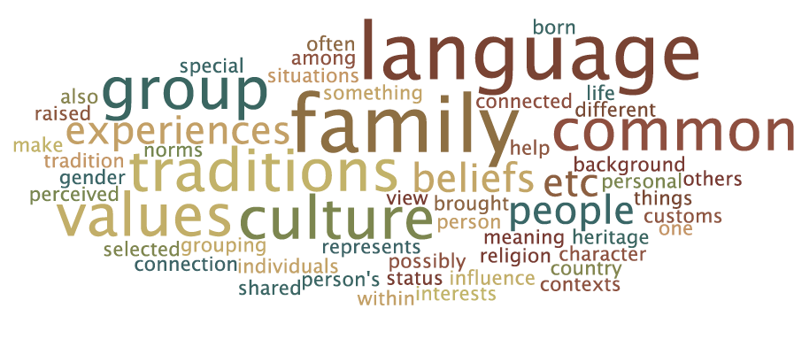
Culture
What is your understanding of the term culture?

Slide 17
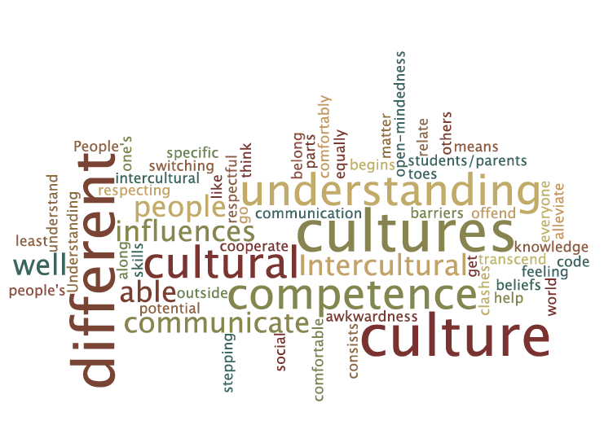
Intercultural competence
In your opinion how would you describe intercultural competence?

Slide 18
Culture and ICC: Overall Comments
Culture: Many responses tended toward the “definition” of culture, rather than delving deeply in to a more sophisticated understanding of culture, while others appeared to hold a deeper feeling
ICC: Understanding and communicating with others
Representative quotes:
“I am part of multiple cultures. Culture is more than simply my race or ethnicity: it also has to do with my religion, my small-town upbringing . . . . Each of these aspects of my identity concerns a grouping of people with similar beliefs or backgrounds. . . Liberal view . . my life experiences have placed me within other cultures, such as a teaching culture”
“How we communicate with other people who have different cultural influences. Understanding other people's cultural influences can help us understand and relate to them”

Slide 19
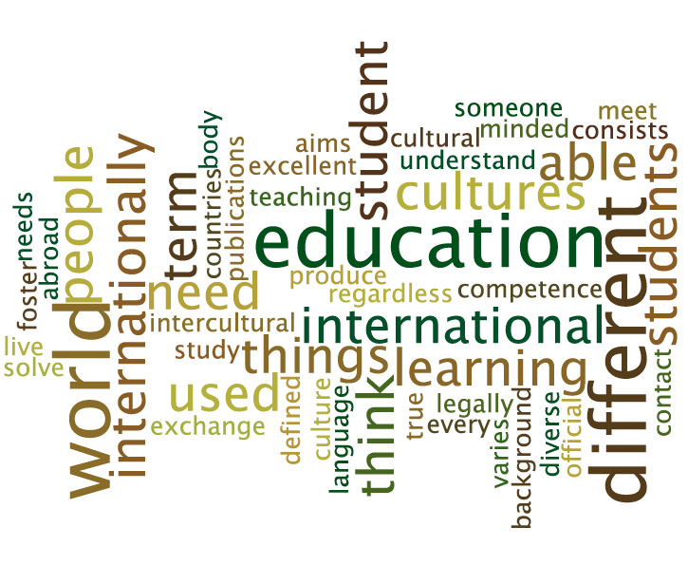
International Education
I define International education as…

Slide 20
International Education –
Overall Comments
Participants generally define IE as:
An education that embraces others and is universal. The purpose is to make a better world and to benefit all. One participant used study abroad.
Representative quotes:
“Teaching students to know and understand other cultures in order for them to be able to work and produce with other cultures”
“International education consists primarily of an internationally minded curriculum, but for a true international experience, I think that the student body should be internationally diverse as well”

Slide 21
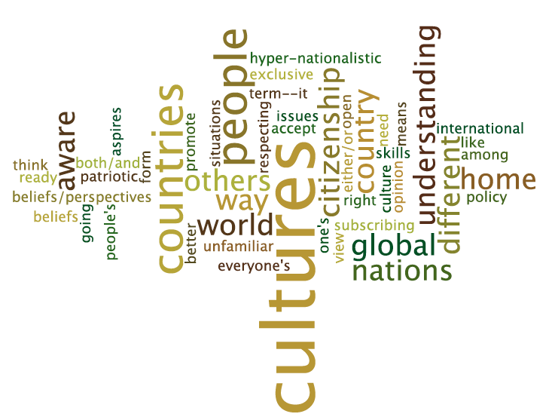
International mindedness
What does international-mindedness meant to you? Explain briefly

Slide 22
IM – Overall comments
In the qualitative responses, the “nouns” stand out versus the verbs (action)
There seems to be a dominant discourse of awareness and acceptance about different things such as beliefs, unfamiliar ways, thinking, of others that are all over the world. It is a state of “being” these things
Participant #9 is unfamiliar with this term, yet takes a good “stab” at it, with his/her response corroborating with views of her peers

Slide 23
Comfort level
20%
30%
30%
70%
50%

Slide 24
Language
20%
20%
20%
70%
60%
10%

Slide 25
Global competence
10%
20%
50%
70%
30%
10%
10%

Slide 26
Snapshot of data
The terms intercultural competence, international education and international mindedness seem to carry similar meanings for the teachers, with an emphasis of understanding more about others and knowing how to interact with them
Most teachers (70%) wished they knew more about international education in their preservice training
All believe that it is important to prepare students to be global citizens, yet one person believe that it is not his/her responsibility as a teacher to do such

Slide 27
Snapshots of all data
The data suggest that there are some teachers who appear hesitant about knowing more about the broader world; some don’t feel a need to connect to the larger world
Most teachers feel its their duties to prepare their students as a global citizen, but feel more “trainings and professional development” are needed
Even though they state having a motivation to learn more about international education, at the same time they appear to want this support to come from universities or PDs from their schools

Slide 28
Conclusions
Although this study remains in progress, its emergent results are providing greater depth to our understanding of teachers’ perspectives on internationalization in education. Results suggest several important areas for our ongoing work as teacher educators
As teachers seek to develop more world knowledge and skills in their students, they must also continue strengthening their own global understanding and intercultural development
Results point to the importance of focused professional development for teachers that provides avenues to scaffold international perspectives and foster intercultural sensitivity

Slide 29
Conclusions
Teachers' knowledge development in multiple areas, such as international mindedness and intercultural competence, needs to begin in pre-service coursework and continue through professional development
AND, what about expanding the knowledge of Teacher Educators? In order to provide professional development promoting international mindedness and the development of inter-cultural competence, teacher educators also need to understand how teachers define these concepts and apply them in their educational practice

Slide 30
Selected references
Bray, M. 2007. “International and comparative education: Boundaries, ambiguities synergies”. In The SAGE Handbook of Research in International Education, edited by Mary Hayden, Jack Levy and Jeff Thompson, 51-56. London: SAGE Publications, Inc.
Dooly, M., and M. Villanueva. 2006. “Internationalisation as a key dimension to teacher education.” European Journal of Teacher Education 29: 223-240. doi:10.1080/02619760600617409
Duckworth, R., Levy, L., and Levy, J. 2005. “Present and future teachers of the world’s children: How internationally-minded are they?” Journal of Research in International Education 4: 279-311. doi: 10.1177/1475240905057808
Hayden, M.C., J. Levy and J. Thompson. 2007. “Introduction”. The SAGE Handbook of Research in International Education, edited by Mary Hayden, Jack Levy, & Jeff Thompson, 1-8. London: SAGE Publications, Inc.

Slide 31
Selected references
Hayden, M.C., and J.J. Thompson. 1995. “Perceptions of international education: a preliminary study.” International Review of Education 41: 389-404. doi:10.1007/BF01103036
Horn, A.S., D.D. Hendel, and G.W. Frey. 2011. “The empirical basis for adopting a civic rationale for internalization.” Higher Education 64: 161-175. doi: 10.1007/s10734.011-9485-0.
Marshall, H. 2007. “The Global education terminology debate: Exploring some of the issues.” In The SAGE Handbook of Research in International Education, edited by Mary Hayden, Jack Levy, & Jeff Thompson, (pp. 38-50). London: SAGE Publications, Inc.
Snowball, L. 2007. "Becoming more internationally-minded: International teacher certification and professional development." In The SAGE Handbook of Research in International Education, edited by Mary Hayden, Jack Levy, & Jeff Thompson, (pp. 247-255). London: SAGE Publications, Inc.

Slide 32
Selected references
Tate, N. 2012. “Challenges and pitfalls facing international education in a post-international world.” Journal of Research in International Education 11: 205-217. doi: 10.1177/1475240912461219.
Wang, E., E. Lin, E. Spalding, S. Odell, and C. Klecka. 2011. “Understanding teacher education in an era of globalization.” Journal of Teacher Education 62: 115-120. doi: 10.1177/0022487110394334
Yuen, C.Y.M. (2010). “Dimension of diversity: Challenges to secondary school teacher with implication for intercultural teacher education.” Teaching and Teacher Education 26: 732-741. doi:10.1016/j.tate.2009.10.009
Zhao, Y. (2010). “Preparing globally competent teachers: A new imperative for teacher education.” Journal of Teacher Education 61: 422-431. doi:10.1177/0022487110375802

Slide 33
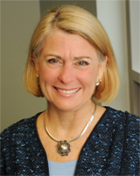
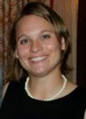
Further discussion
Thank you for your rich input.
Kindly address ongoing thoughts to
Rebecca Fox
rfox@gmu.edu
and Sydney Merz
smerz@gmu.edu

