Slide 1
More than a second language:
Leadership structures and pedagogic strategies – across six countries
AIE Mumbai, October 2014
Notes:
Sue- welcome and structure of session – how and why? Everyone does PIP and PI start

Slide 2
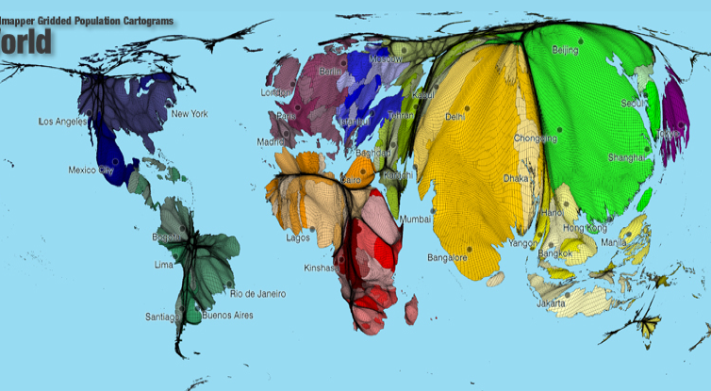
Educational Research
Pursuit of Knowledge and Problem Solving
To help make sense of the world

Slide 3
Intercultural Understanding
The multi-national research sought to explore the role of Additional Language Teachers (ALTs) in IB PYP schools.
Six countries, five academics and six case study schools
It revealed the importance of leadership structures and pedagogic strategies that promote intercultural understandings within additional language teaching (ALT) and additional language learning (ALL)
Notes:
geraldine

Slide 4
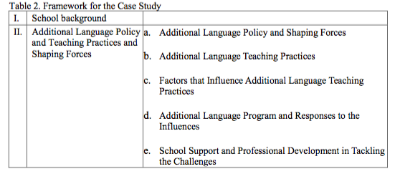
Case Study Overview
Data Collection: Document analysis, interviews, surveys

Slide 5
English instruction German AL
Dual immersion Spanish English.
French German AL
English instruction Cantonese AL
Dual Immersion German & English
AL Spanish
English Instruction Japanese AL
Bilingual Spanish & English.
Case Studies

Slide 6
What impacts intercultural understandings within these settings?
AL Teacher personal context & professional growth
The Profession:
International trends
National Context
Culture, Language
International Baccalaureate
Standards & Practices
School Context
Leadership
Policies
Practices
Notes:
sue

Slide 7
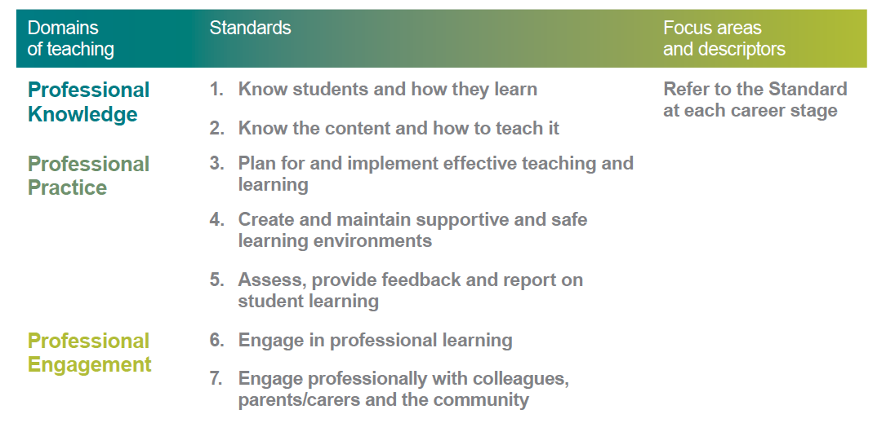
Australian Context
Australian Professional Standards
http://www.teacherstandards.aitsl.edu.au/

Slide 8
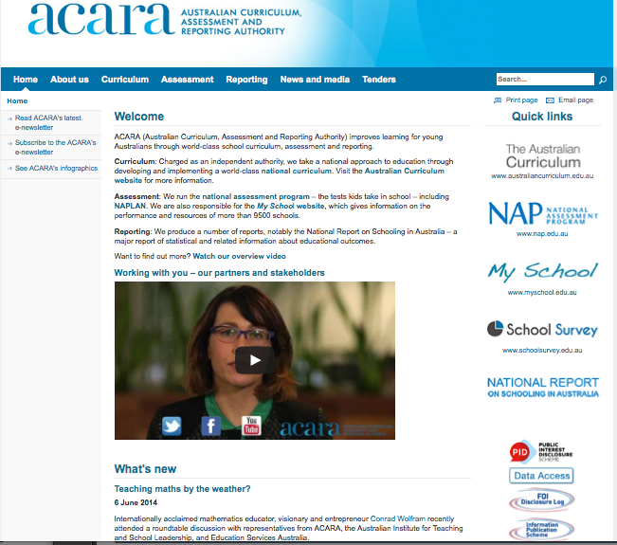
Australian Curriculum
http://www.australiancurriculum.edu.au/

Slide 9
Australian Findings
Principal and PYP Coordinator drove organisational change to support Additional Language Teaching and Learning
Integration of AL throughout school’s curriculum and school community
Intercultural language learning took place in and beyond AL classroom
Integration of language, culture and learning was used to develop understanding of own and additional language and culture

Slide 10
Overall findings
The school leadership support and understanding of additional languages and intercultural understandings determined successful implementation.
The school’s language policy was important in framing language learning and intercultural understandings.
Organisational structures within the school impacted programs.
Teachers and parents from the Asia pacific regions have a greater concern or struggle over the systematic learning of the additional languages
Sociocultural factors within the school cohort affected ALT and ALL at the local level
Appreciation for the culture of the AL impacted ALL
Language Learning involves: learning language, learning through language and learning about language.
Notes:
mel

Slide 11
Beliefs
Teachers and parents continually referred to the IB
learner profile as a tool for developing intercultural understandings. In each setting they reminded the researchers that it is the key to culture and instruction. They taught it and modelled it with the school community.
“The Learner Profile is really just who we are. It is just the language we speak with children. Whether you are a German teacher, English teacher, a custodian, a front office clerk or a principal, it doesn’t matter. It is the language you speak, it is how we are with children” (Principal S6).
My children have opened up my eyes to another culture, we are planning a trip to Japan, it will be our first trip out of our country (Parent S2)
Students become aware that there exists a whole group of people functioning and working in a different culture and language being slightly different to them (Teacher S3)

Slide 12
Discussion & links to research
School leadership at the forefront of successful school
programs and improvement (Dufour & Eaker, 1998; Gillespie, 2010)
Strong leadership from principal and IBPYP coordinator particularly their belief and support of the IB philosophy determines active promotion of the program within the school (Hallinger et al, 2010)
Trust level and value alignment of school leadership influences implementation (Hall et al, 2009)
Developing cultural proficiency in the leadership enhances the school culture (Van Vooren & Lindsay, 2012)
Cultural bubbles that exist in some international schools represent language classrooms - the connections can be contrived and superficial if intercultural understandings are not developed (Katz, 2011; Pearce, 1994; Shawn, 2008)

Slide 13
Conclusion
The study revealed that teaching language cannot be separated from teaching intercultural understandings.
If all teachers are teachers of language then all teachers are teachers of intercultural understandings.
School leadership is fundamental in promoting intercultural understandings within the school community.

Slide 14

Questions …
Dr Susan F Ledger
s.ledger@murdoch.edu.au
http://profiles.murdoch.edu.au/myprofile/susan-ledger/

