Slide 1
Shalini Ghosh

Slide 2
“A metamorphosis of non-believers of international mindedness into believers”, in the Asian context

Slide 3
“ Change”

Slide 4
“ INTERNATIONALISM”
Is it all in the mind?
Shalini Ghosh

Slide 5
WHY CHANGE TOOK PLACE?
Shalini Ghosh

Slide 6
According to Lawton (1989), the curriculum is a ‘selection of the culture of a society’.
“We went to school to be educated, to acquire the knowledge and skills which would be needed when we embarked on life in the adult world.”(M.Hayden, 2007)

Slide 7
Gutenberg’s Printing Press went into action in Germany, in 1439
“People got introduced to new ideas and were no longer landlocked by narrow notions of individual beliefs. Education or exposure to literature, which was largely interactive process in oral tradition, it was now at the disposal of the individual.” (Samuael Gary)

Slide 8
When the flavours in education became visible
The field of international education emerged at the London Universal exposition in 1851 (Sylvester, 2007)
Columbian Exposition (1893)
In 1901, Rabindranath Tagore, the Indian Nobel Laureate, founded the Visva-Bharati University at Shantiniketan, near Kolkata with the idea that within the next twenty years it would evolve into an international school and a world university.
1968, the Japanese government implied for the first time, its wish to request educational improvement from international sources

Slide 9




Industrialisation set roots
Technology made it easier to move
Barriers and Divides were more in the mind
People shed apprehensions of leaving home and setting up ‘home’ away from home
Sending children out for more modern and learner centric education
Need for Education which is not so “Foreign”
WHY CHANGE TOOK PLACE?

Slide 10

Where the 21st century learner should be a lifelong learner;
an individual who is adaptable to the working styles, interpersonal relationships and the soft professional tools needed at the time.
Educational institutions need to prepare this kind of an individual.
..A Small place

Slide 11
WHAT KIND OF CHANGE TOOK PLACE?
Shalini Ghosh

Slide 12
Activity

Slide 13
Possible Meanings
‘Developmental education’- the focus is primarily promotion of awareness of the development issues of a school
‘Comparative education’- using the focus of a country’s philosophy and practice for another country
‘Global education’- amalgamation of educational deliberations that go beyond just the national aspects in the national system

Slide 14
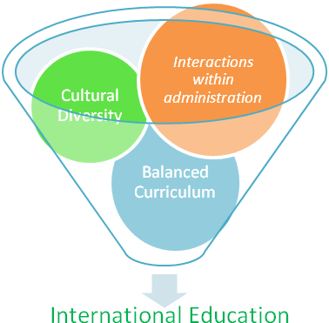
International Education
School Philosophy
Cultural Composition
Instructional curriculum perspective
Governance and administrative practices
Needs believers
Fig 1:
Interpretation of Thompson’s Tripartite Model
Fig. 2:
Interpretation of International Schools Association Model

Slide 15
WHAT KIND OF CHANGE TOOK PLACE?
‘education for international-mindedness’ (Hill, 2007)
contain course content that provides an international perspective;
recognize that the world is increasingly interdependent;
provide activities that bring students into contact with people of other cultures;
create a context for world peace by providing opportunities for many cultures to learn together in mutual understanding and respect.

Slide 16

Emerging School Groups
European Schools, which are obviously Eurocentric;
the English Schools Foundation specialized to deliver the British style curriculum in Hong Kong;
Yew Chung International Schools, based largely in Hong Kong and China, operating on co-teaching systems, with one Chinese and one westerner in the room teaching in dual languages
The Dutch school and the Japanese schools found outside the respective countries aim more specifically towards providing education to their own children off shores.

Slide 17
Emerging School Groups
IBDP, International School of Geneva (1962)
Pedagogical- emphasis on critical thinking
Idealistic- promote intercultural understanding & perspective
Pragmatic - a diploma recognised for higher education around the world

Slide 18
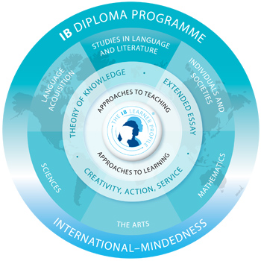
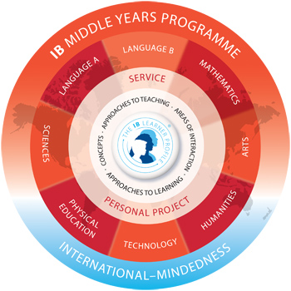
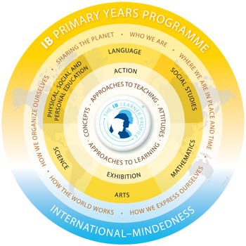
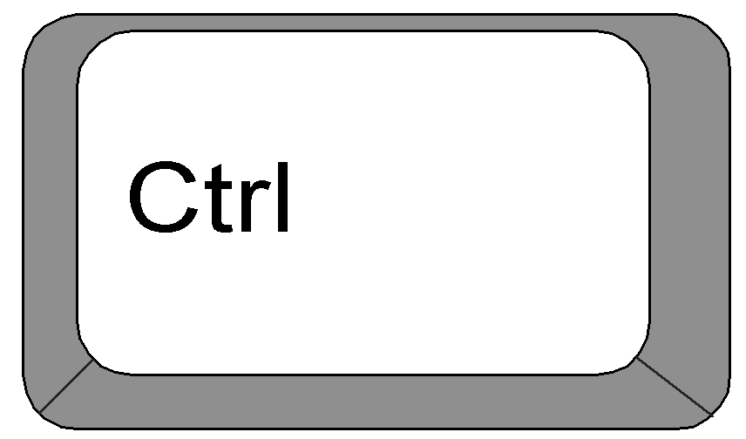
IB Programmes- a continuum
Philosophy
Organisation
+
+
Formal Curriculum
Informal Curriculum
Interaction with external community
+
+
=
International mindedness Nurtured

Slide 19
So what is the problem then?

Slide 20
- Stocktaking on Stakeholders
Who all does the change affect and How?

Slide 21
Students: to develop the whole person
It nurtures the intellectual, emotional, social, physical, creative, aesthetic, and spiritual potentials
concerned with life experience, not with narrowly defined basic skills.
is making meaning of and a quest for understanding the world, which goes beyond far beyond the limited horizons of curricula, textbooks and standardized exams.

Slide 22
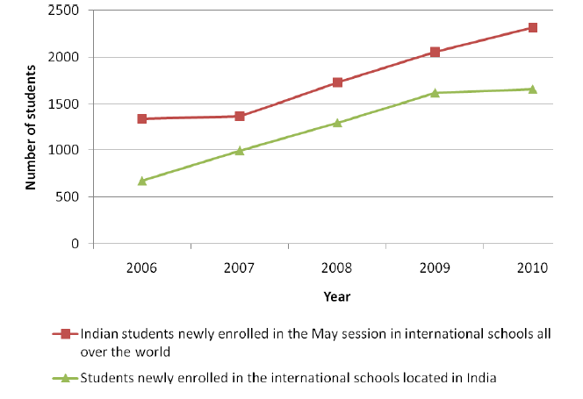
The trend change in educational systems

Slide 23
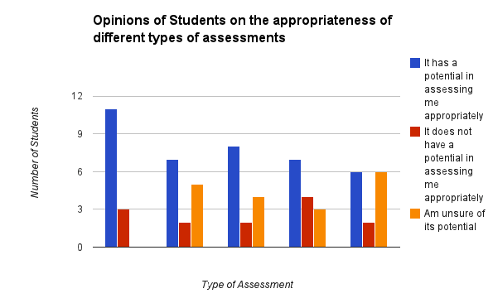
Tests
Designing Labs
Processing data
Essays & ppts
Semester/ year end exams
There are non- believers in the programme!

Slide 24
Parents: roles that they play
the parent body consists mainly of well-educated, professional people who value education and have high expectation of their children and hence of their child’s school
since there is a lack of clarity on what ‘International-mindedness’ means (Comments like: “Why does the school need to follow the National anthem every alternate day, if they are international”, says as expat parent and on the other hand, “Why don’t we celebrate all our festivals in the classroom? ” says a native parent.)
Notes:
degrees by which they can affect the school they already chose for their child includes a great deal of complexity in the process.

Slide 25
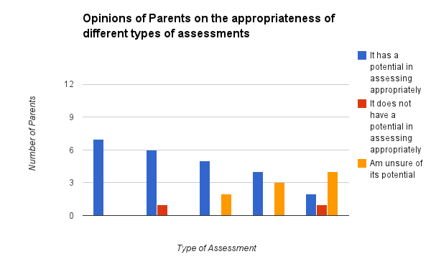
There are non- believers in the programme!
Tests
Designing Labs
Processing data
Essays & ppts
Semester/ year end exams
To keep the parents happy, does the school confuse the student?

Slide 26
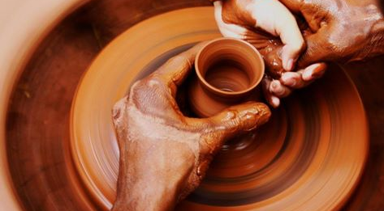

Slide 27
Teachers: imparting smooth philosophy
are the protectors with the learner at the centre
Go through continuous professional development to acquire the best skills to empower her to provide best delivery.
Needs to have a readiness to change every now and then and spend that extra time. (“I have been teaching for ages and getting results”)

Slide 28
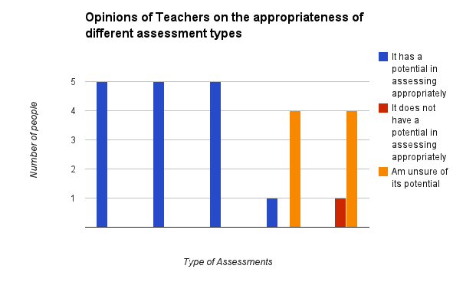
Tests
Designing Labs
Processing data
Essays & ppts
Semester/year end exams
There are non- believers in the programme!

Slide 29
Trustees/ Managements/ Universities:
One of the biggest risk takers amongst the huge family are sure the trustees who set up the school.
The school management must strive hard to make that risk worthwhile.*
From the other side this can happen only if universities support.

Slide 30
“The MYP values both process and content, allowing us to focus on personal and academic development so growing students into confident and caring members of the community”, says R Matthews, director of IB, Havelock Academy, Grimsby, 2010.

Slide 31
-As more and more universities start to recognize the programmes there is a new found confidence in the ones who deliver and the ones who receive.
-a clear indication that we need more believers.

Slide 32
What can be done to retain the change?
Shifting mindsets of those who mind…

Slide 33
Possible solutions- deep seated internationalism
Instructional learning
Practice experiential learning
Adaptation: Acknowledging successful curricula as part of existing;
Integration: Using best practices from a range of successful curricula;
Creation: creating a programme from first principles
Strategies which turn the learners dependent on the educators and make them egocentric

Slide 34
A lot is in the mindset if one does wish to aspire to take new philosophies, such as “International mindedness” on board.
Since there is an ambiguity on what is the ideal amount one should change, we choose sometimes not to.
In the process we turn “Non believers”.

Slide 35

“Eggs are friends, not food” !
The Egg model….

Slide 36

Ones who deliver
Learner at the centre (MYP)
Ones who design (IB)
Receivers in the community-
(Parents-SMTs- Universities)

Slide 37

“Eggs are friends, not food” !
The Egg model….

Slide 38
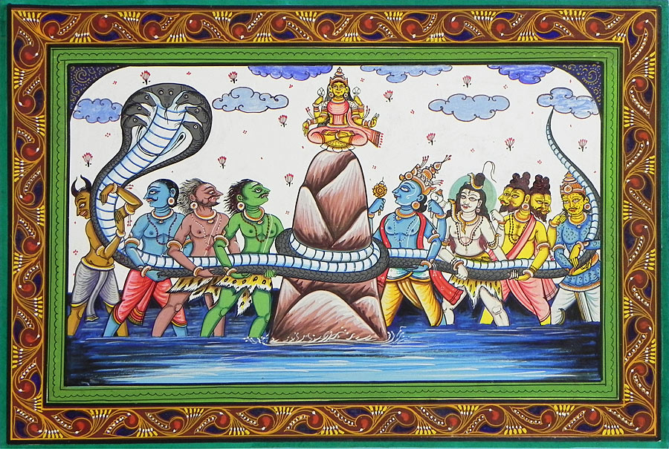
“ SAGARMANTHAN?”
“ –or Just a TUG of WAR?”

