Slide 1
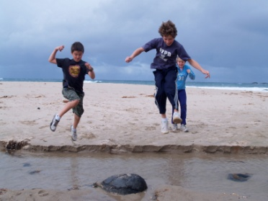
Building Powerful, Inclusive Communities
our goal of 21st Century Learning
Fiona Gordon, Head of Teaching and Learning
Meredith Lawson, Head of Middle School
Sandra Tiepermann, Head of Geography

Slide 2
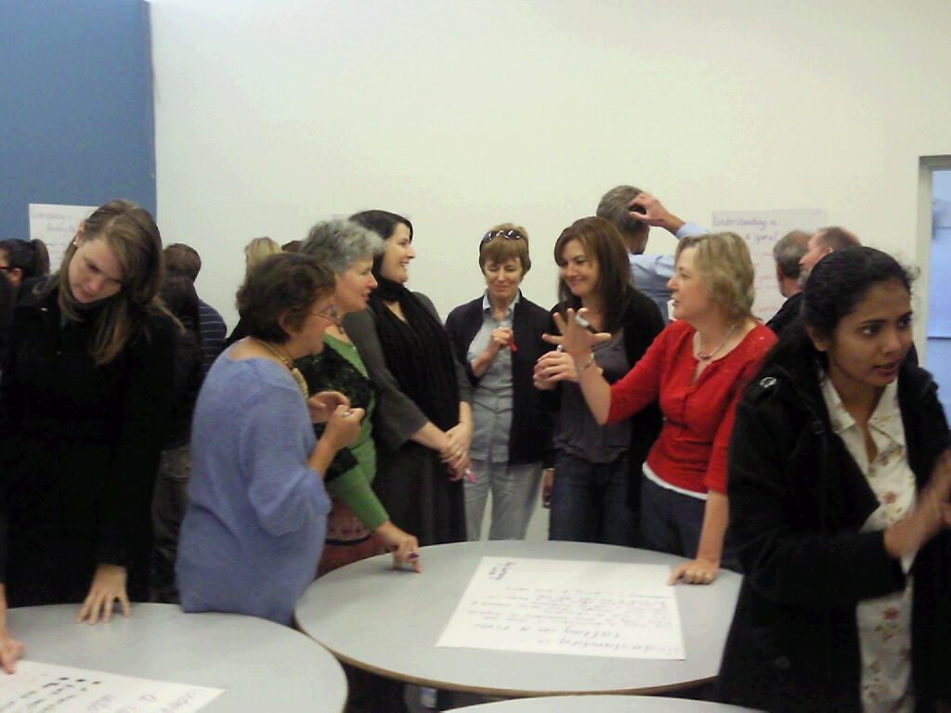
At Huntingtower in Melbourne, Australia we “Magnify the Good” for our 586 K -12 students

Slide 3
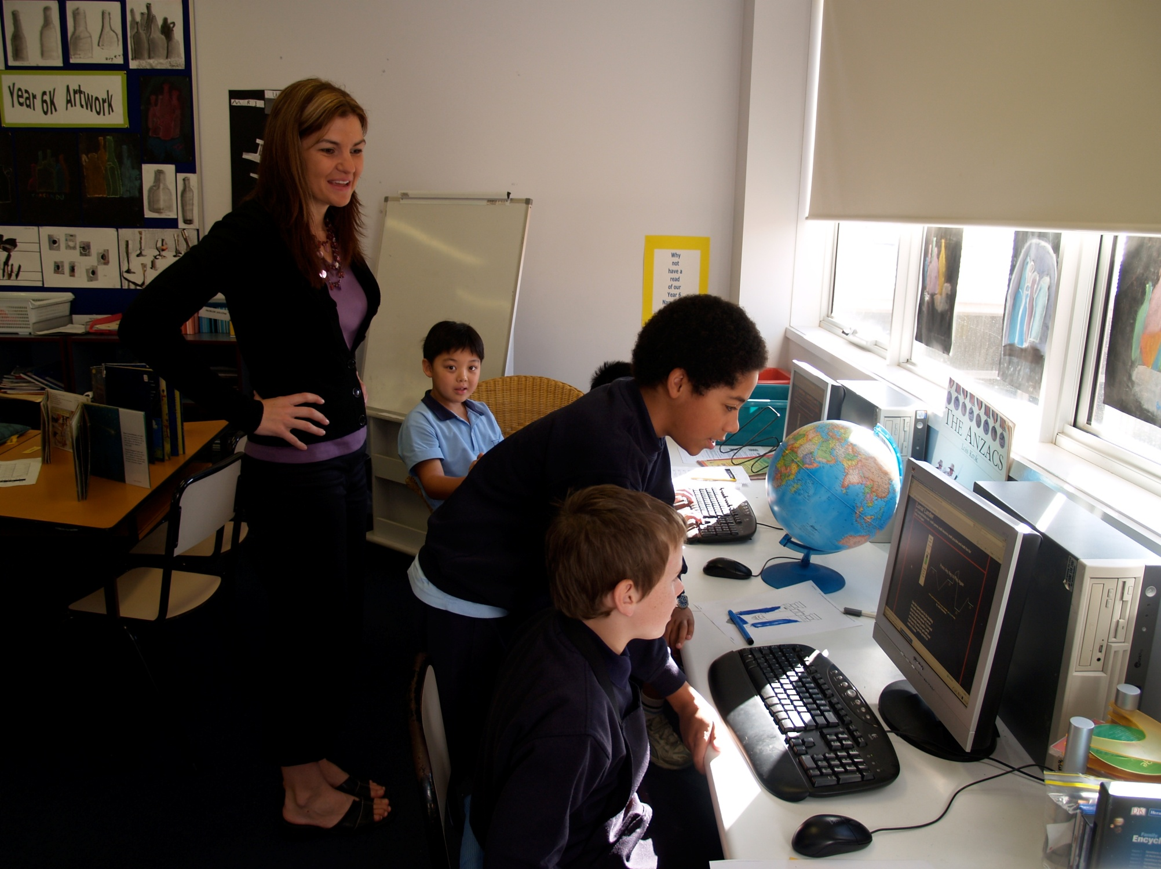
From textbook learning to understanding
In 2005 2 teams TfU1, in 2010 90% teachers use TfU.

Slide 4
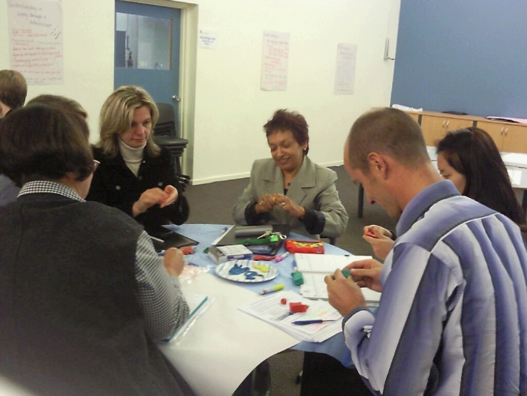
We support teachers as reflective practitioners
Our change initiative to achieve 21st century learning is centred on:
Promoting purposeful conversations
Sustaining the use of the TfU Framework
Giving permission for innovation

Slide 5
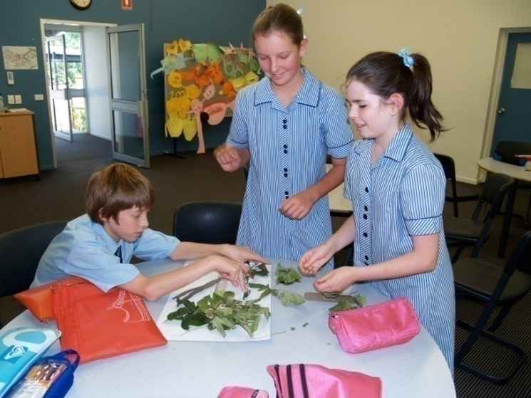
Using The TfU Framework
Generative Topics
Performances of Understanding
Understanding Goals
Ongoing Assessment

Slide 6
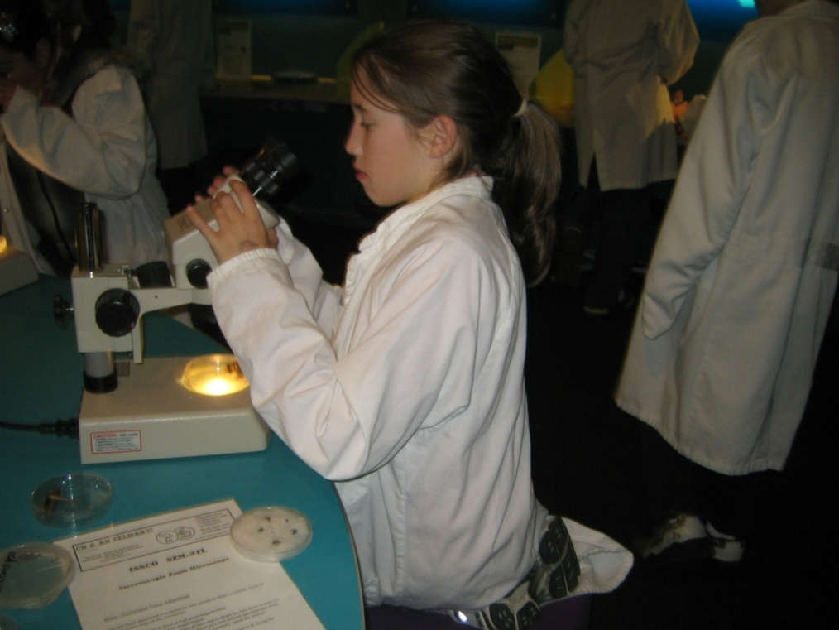
Enriching our Classrooms
Students have a clearer picture of what we expect as Understanding Goals are shared and linked to their Performances of Understanding

Slide 7
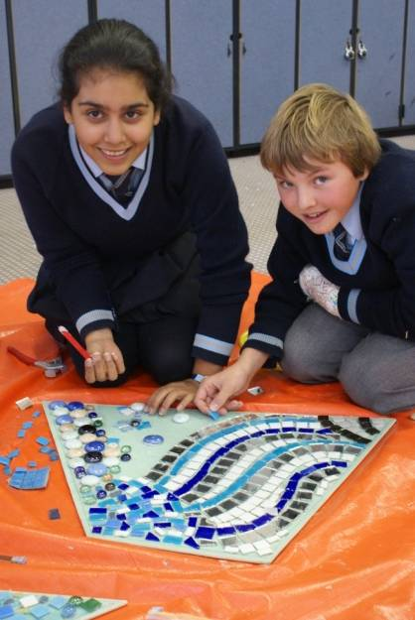
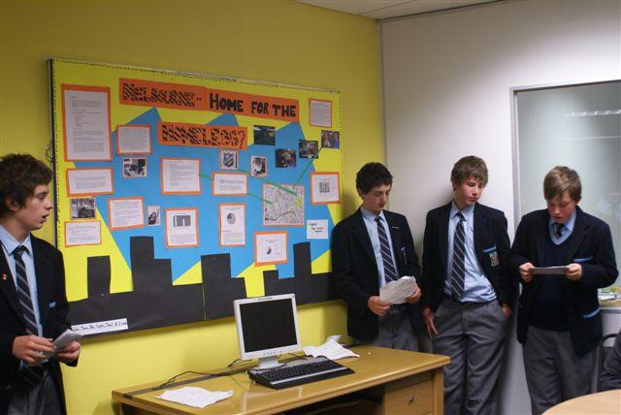
Integrated Studies
uses themes so curriculum areas can merge
uses experiential learning

Slide 8
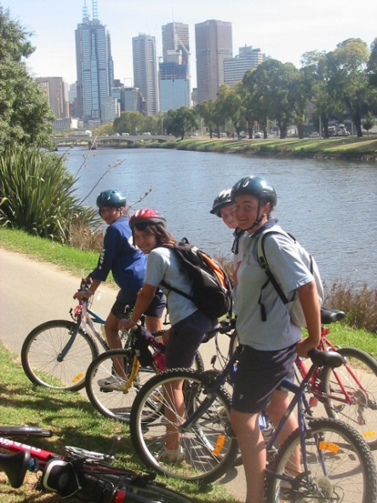
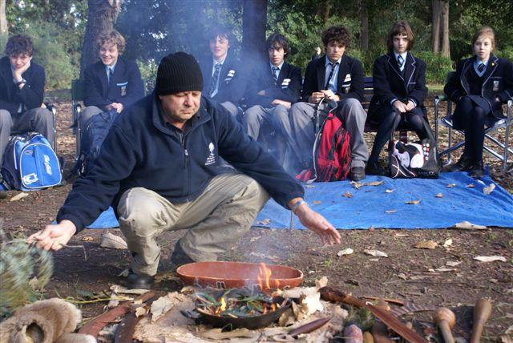
Integrated Studies
is a way of encouraging young people to develop a broader understanding of themselves and their world.

Slide 9
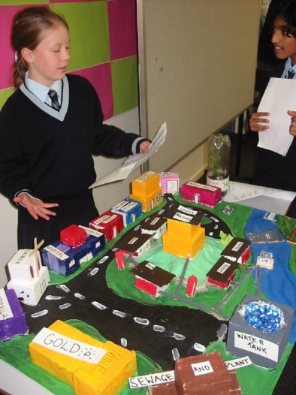
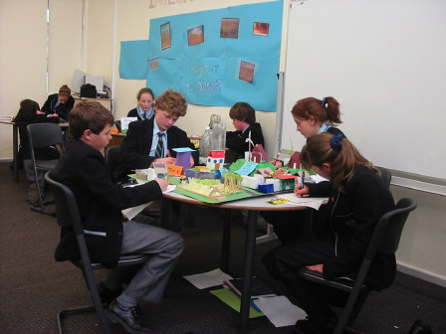
Integrated Studies
is more authentic because it parallels real-world tasks
enables a collaborative process of knowledge construction

Slide 10
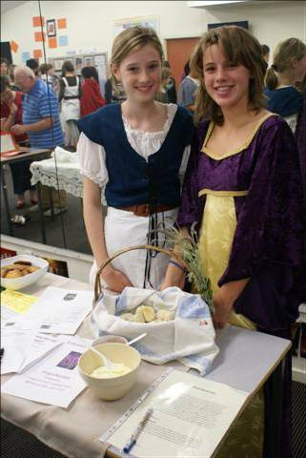
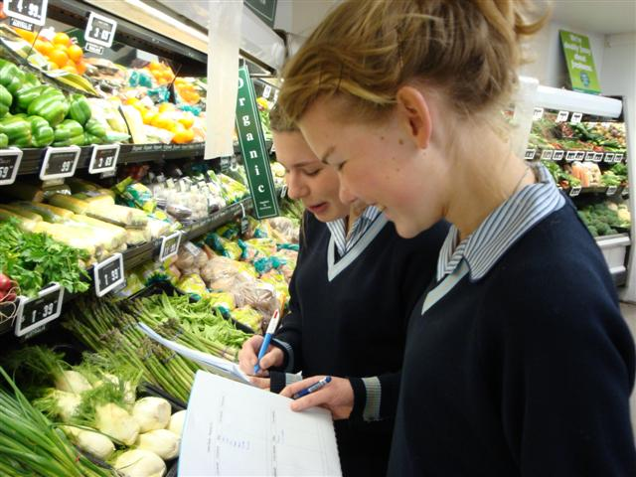
Integrated Studies
promotes divergent thinking
teaches life skills: lifelong learning, effective communication, project management and responsible citizenship.

Slide 11
Integrated Studies
Uses the MS Compass as a planning tool
..\Middle School Organisation\Documentation\compass 2009.pdf

Slide 12
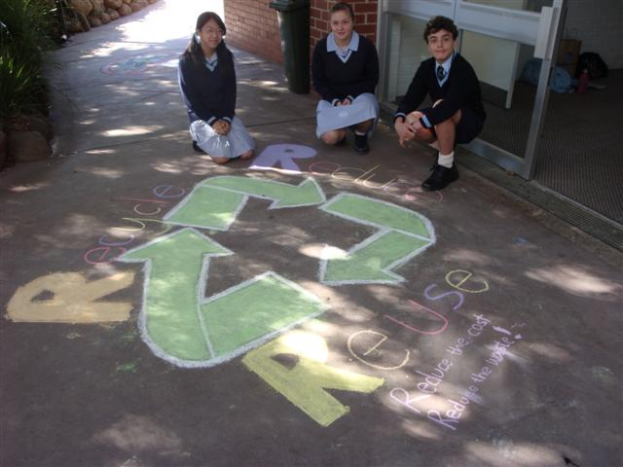
Saving Planet Earth:
Social Consciousness and Action
Understanding Goals
How do we impact the planet?
How does my community contribute to a sustainable planet?
How do I convince people of my ideas?
How do I determine if things are right or wrong?

Slide 13
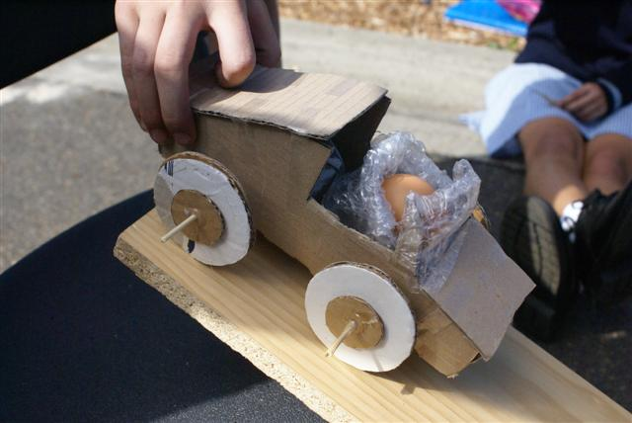
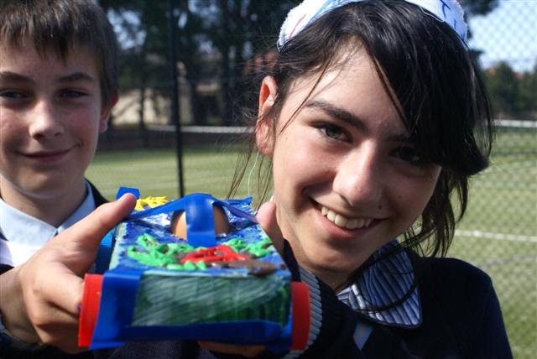
Saving Planet Earth
Nude food - packaging
Trash carts – recycling materials

Slide 14
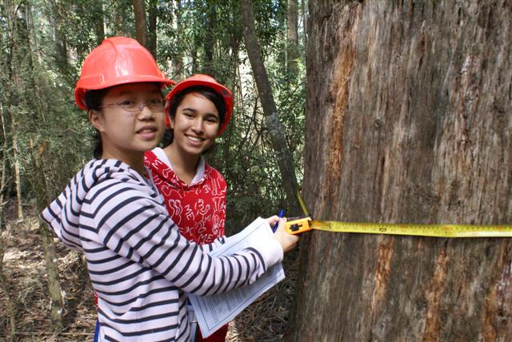
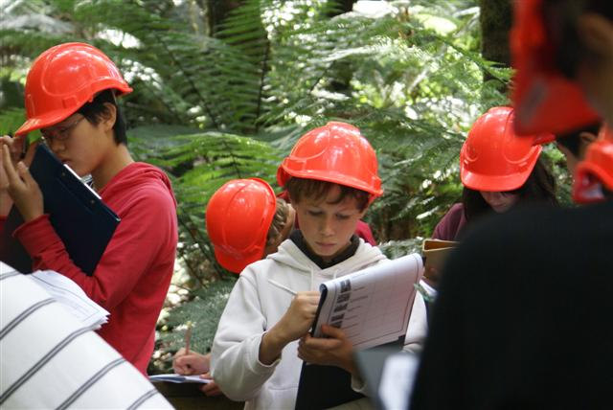
Saving Planet Earth
Toolangi Forest visit – unique rainforest environment and forest management

Slide 15
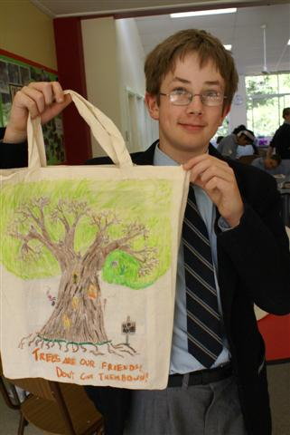
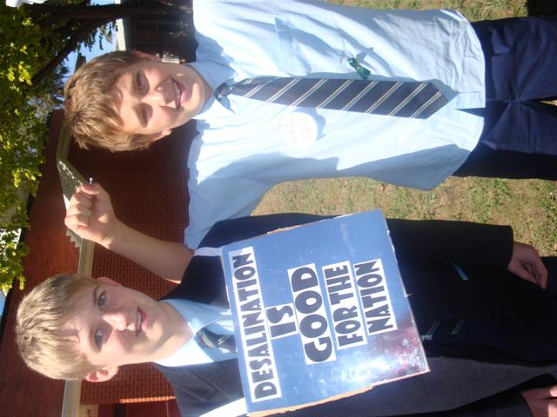
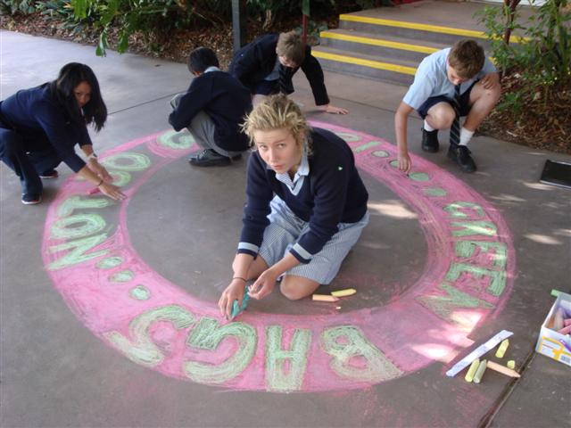
Saving Planet Earth
Campaign a local environmental issue
  Create sidewalk chalk art
  Decorate re-useable bags

Slide 16
Saving Planet Earth
Example of a protest topic:
Solar energy
  How does solar energy work?
  How does it help or hinder global warming?
  How can we use solar energy in our everyday lives? Give examples
  What is the cost of installing solar panels? Why is the installation government funded?
  What are the benefits/disadvantages of solar energy?

Slide 17
Saving Planet Earth
Shopping bags
  Are the ‘green’ shopping bags better than plastic? What are they made of?
  What other options are available now?
  Have shopping bags always been an issue and why?
  Who/what is affected by the production and disposal of plastic bags?
  What is an alternative solution to plastic bags and or ‘green’ bags? What is the ultimate ‘eco’ bag?

Slide 18
World Religions:
Social consciousness and action
Understanding Goals
What are the differences and similarities between the major religions of the world?
Do religions make responsible choices for the greater good of society?
What is your role in creating a just world?

Slide 19
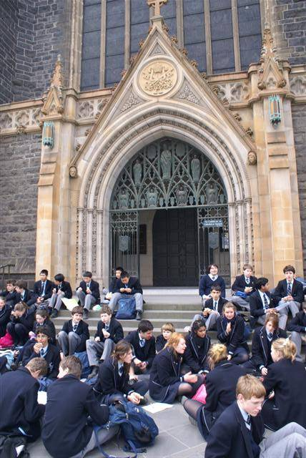
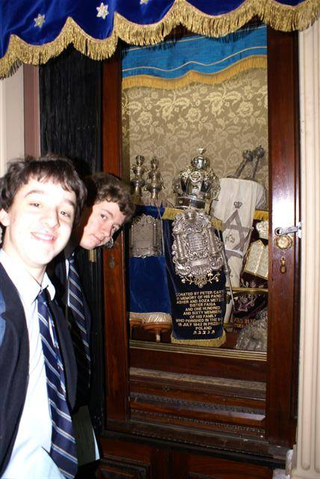
World Religions
A presentation by representatives of the Jewish, Christian and Muslim Association of Australia.
Visits to a cathedral, temple and synagogue.

Slide 20
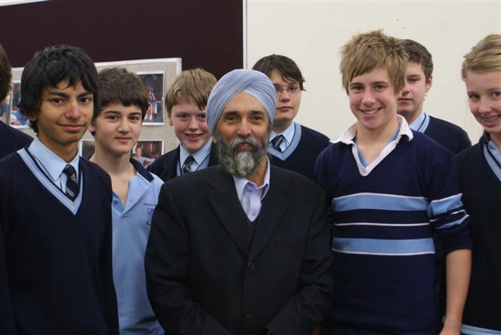
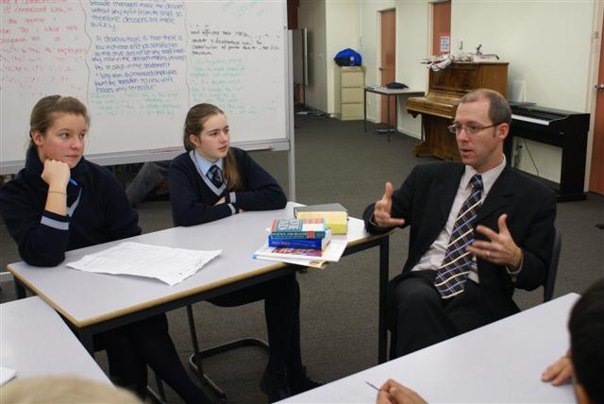
World Religions
Focus group discussions with teenagers from other religious schools
Interviewing representatives of various faiths

Slide 21
World Religions
Creating a media presentation on ‘A week in the life’ of a follower of a religion.
Debating topics such as ‘Although based on compassion, religions support conflict’ and ‘Religions make choices for the greater good of society’.

Slide 22
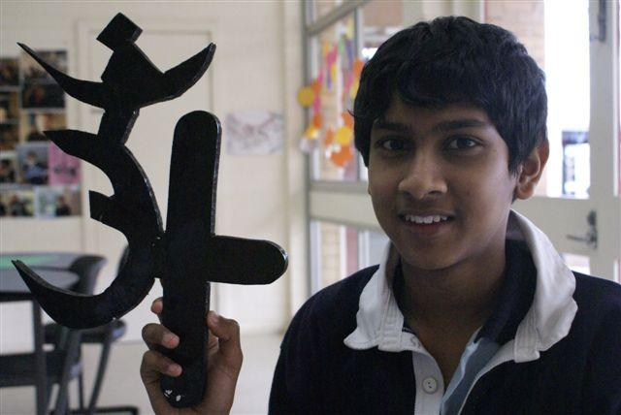
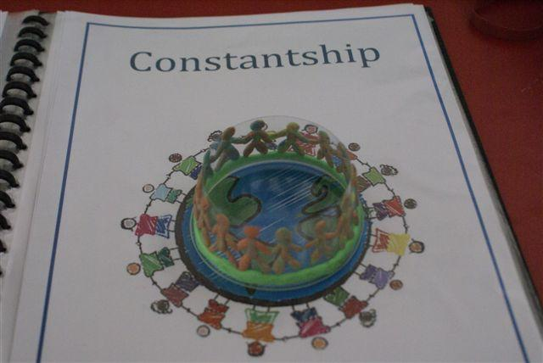
World Religions
As a culminating activity, the students create a 3D representation of a religion of their creation. (They choose aspects of different religions that they can identify with and justify the reasons for their choices)

Slide 23
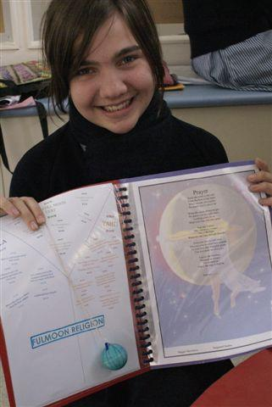
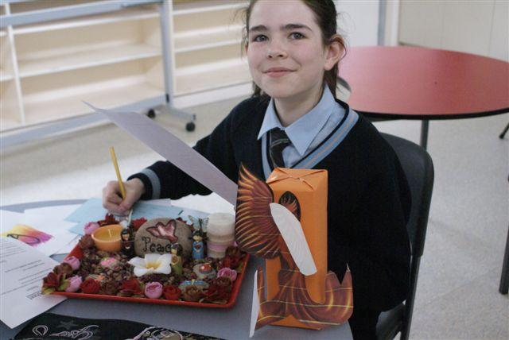
World Religions

